Slide 1
30
STAT
second
(the closest answer wins)
Out of a world population of 7 Billion how many people are Muslims?
Answer: 1.619 Billion

Slide 2
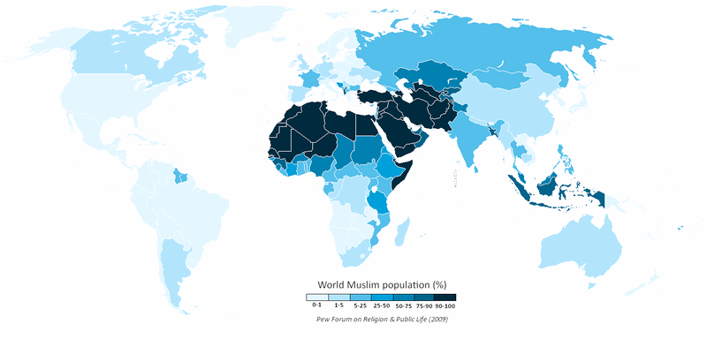
Muslims in Middle East and Northern Africa
321 million Muslims
91% of the overall population

Slide 3
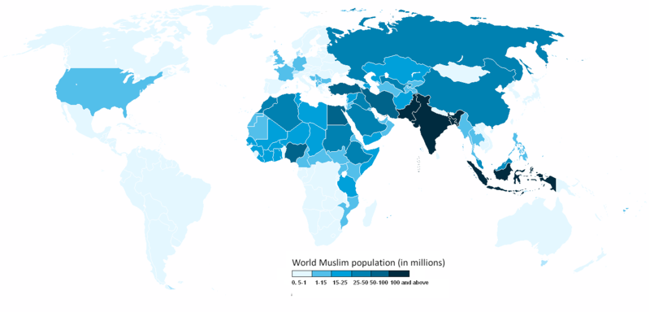
1 Billion in South & Southeast Asia
Islam by Country

Slide 4
Muslims Around the World
Complete the following:
1. Most of the world’s Muslims are not _______________________________________.
2. Most of the world’s Muslims live in _______________________________________.
3. Those who live in the Middle East are more likely to be ______________________.
Arabic or living in the Middle East
in South and Southeast Asia
Arabic and Muslim

Slide 5
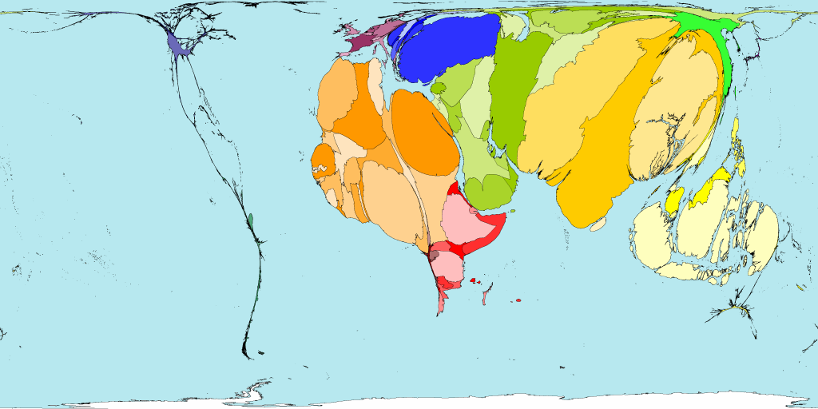
Muslims

Slide 6
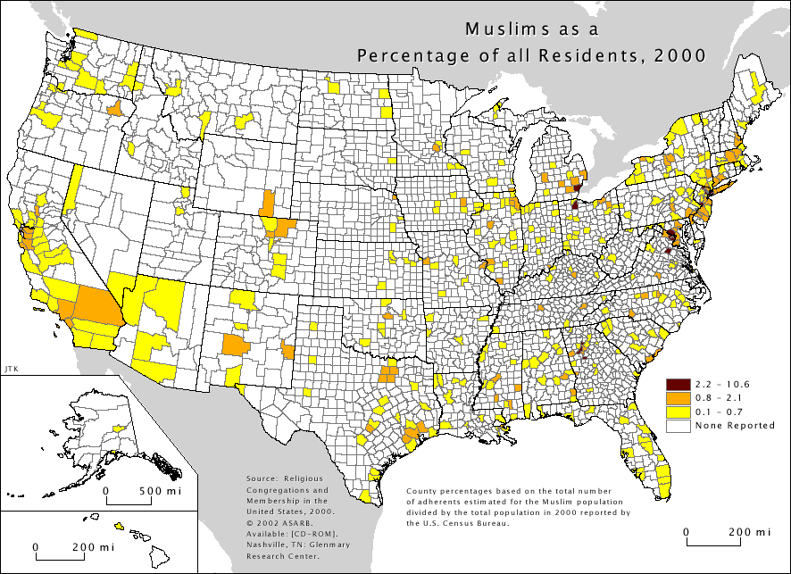

Slide 7
30
STAT
second
(the closest answer wins)
What % of the white Tennesseans live below the poverty line?
Answer: 18%

Slide 8
30
STAT
second
(the closest answer wins)
What % of the African-American Tennesseans live below the poverty line?
Answer: 37%

Slide 9
30
STAT
second
(the closest answer wins)
What % of the Hispanic Tennesseans live below the poverty line?
Answer: 35%

Slide 10
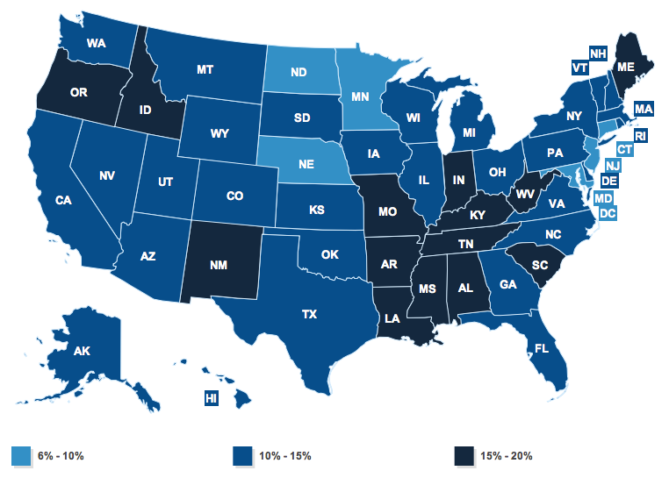
Whites in Poverty

Slide 11
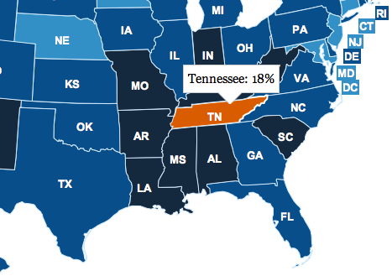

Slide 12
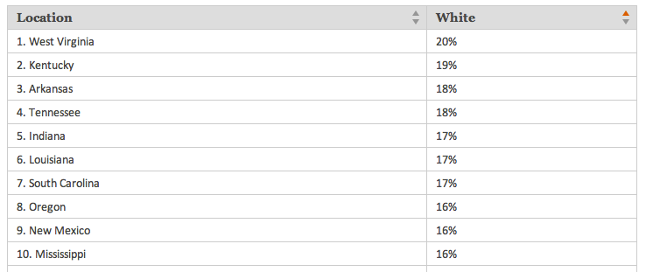

Slide 13
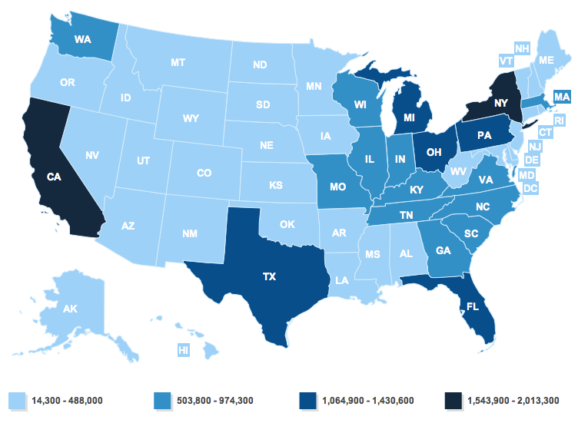
Whites in Poverty

Slide 14
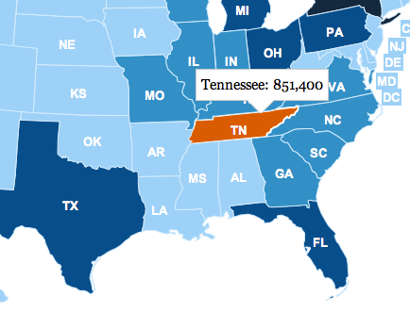

Slide 15
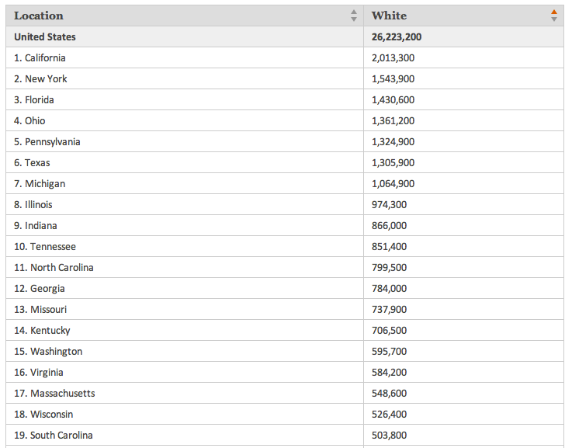

Slide 16
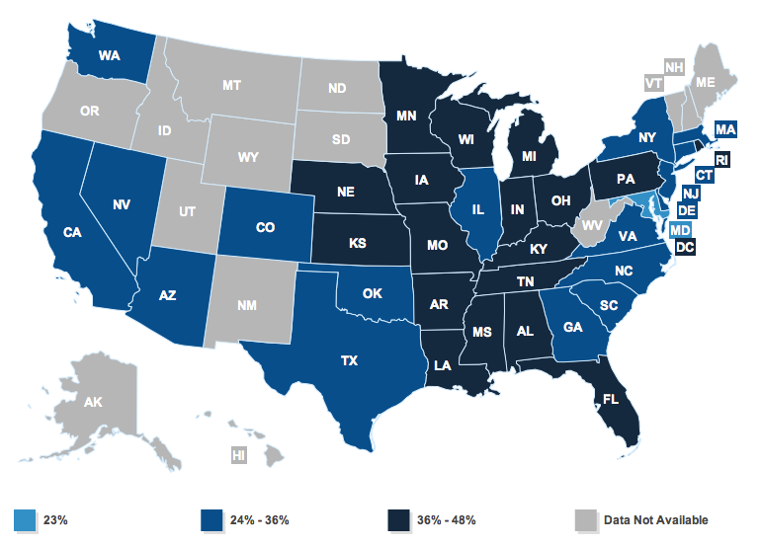
African-Americans in Poverty

Slide 17
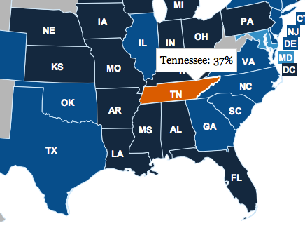

Slide 18
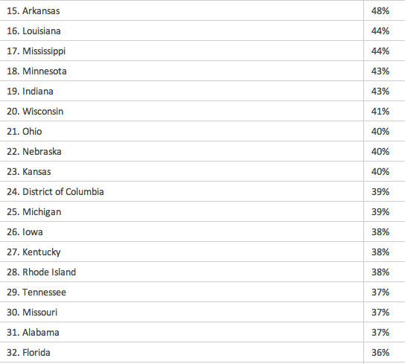

Slide 19
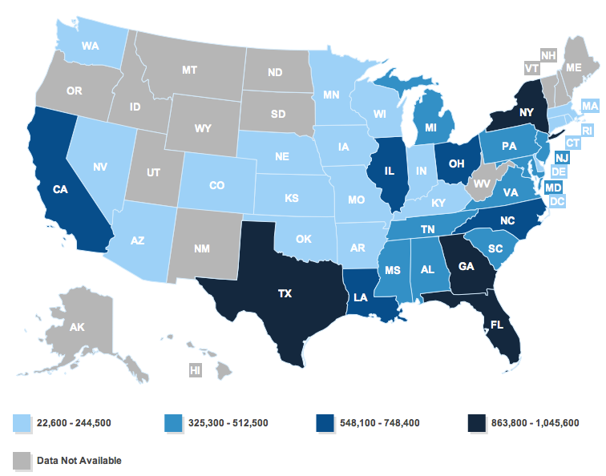
African-Americans in Poverty

Slide 20
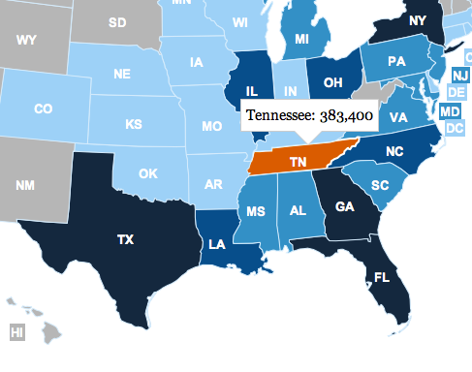

Slide 21
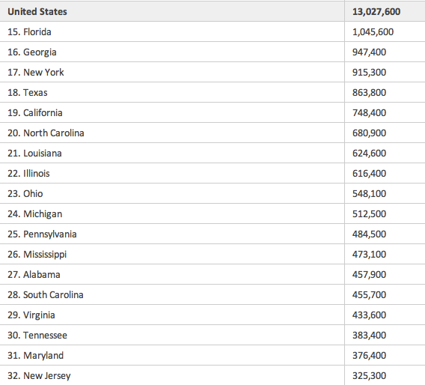

Slide 22
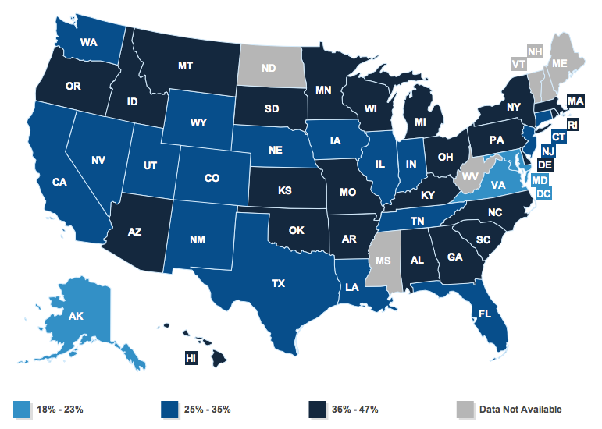
Hispanics in Poverty

Slide 23
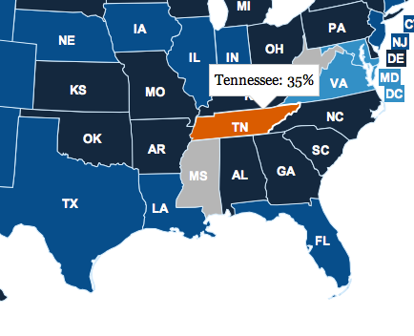

Slide 24
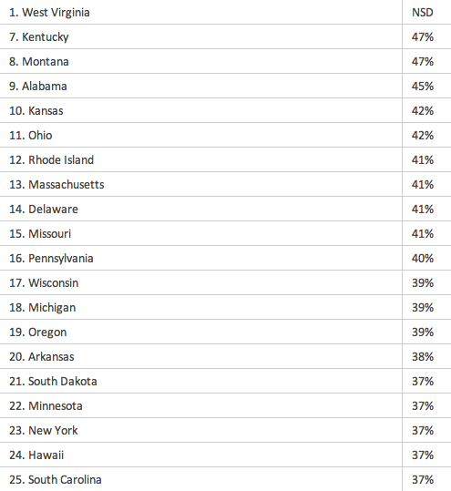

Slide 25
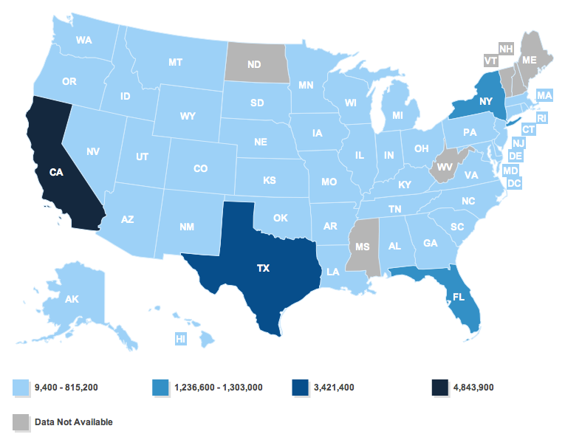
Hispanics in Poverty

Slide 26
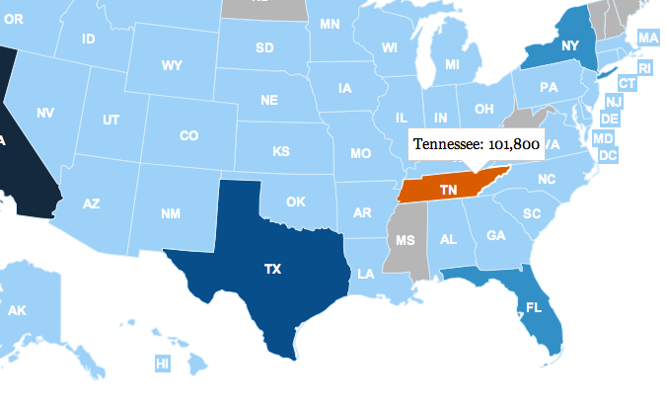

Slide 27
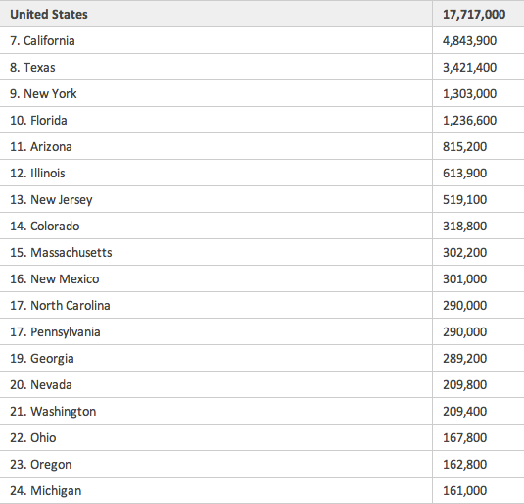

Slide 28
The official poverty thresholds are based off of what Americans spent on food in 1963 – according to the Census Bureau, a household making less than three times what the "minimum food diet" in 1963 cost is below the poverty threshold.

Slide 29
30
STAT
second
(the closest answer wins)
What percentage of Americans oppose same-sex marriage?
Answer: 46%

Slide 30
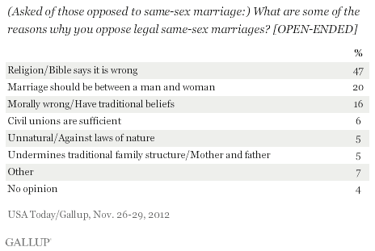

Slide 31
Americans who oppose the legalization of same-sex marriage, 46% of the adult population, are most likely to explain their position on the basis of religious beliefs and/or interpretation of biblical passages dealing with same-sex relations.

Slide 32
30
STAT
second
(the closest answer wins)
What percentage of Tennesseans oppose of same-sex marriage?
Answer: 46%

Slide 33
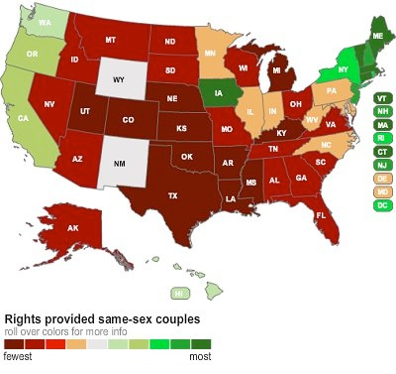

Slide 34
30
STAT
second
(the closest answer wins)
What is the average price in the United States for Heart Bypass surgery?
Answer: $34,358

Slide 35
30
STAT
second
(the closest answer wins)
What % of Americans have a Bachelor’s degree?
Answer: 30.94%

Slide 36
30
STAT
second
(the closest answer wins)
What % of Americans have either a Master’s degree and/or a Doctorate degree ?
Answer: 11.12%

Slide 37
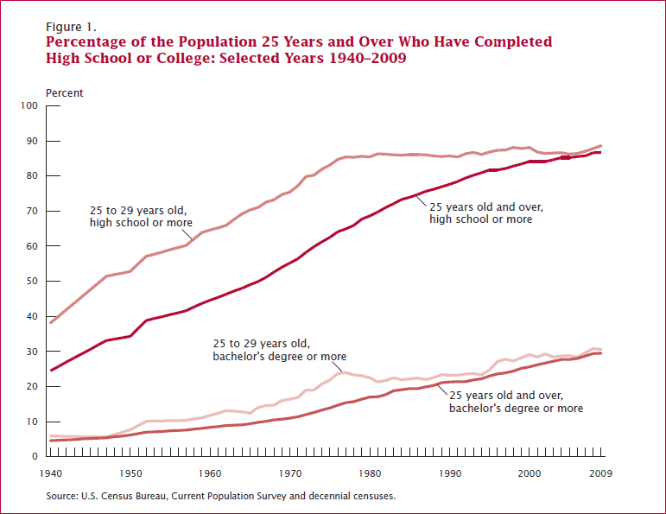

Slide 38
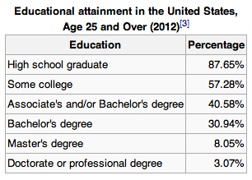

Slide 39
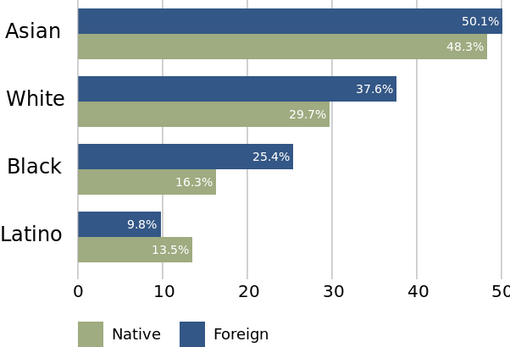

Slide 40
30
STAT
second
(the closest answer wins)
How many illegal immigrants are estimated to live in the United States? (2012)
Answer: 11.7 million

Slide 41
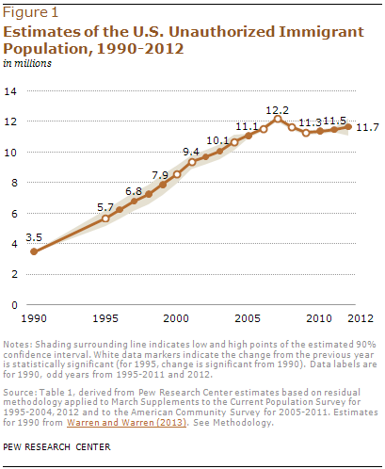

Slide 42
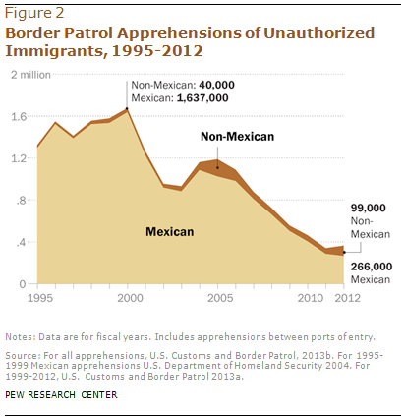

Slide 43
30
STAT
second
(the closest answer wins)
What percentage of California’s population is estimated to be in the country illegal? (2013)
Answer: 7%

Slide 44
30
STAT
second
(the closest answer wins)
In Los Angeles ____ in 10 resident(s) is an illegal immigrant.
Answer: 1

Slide 45
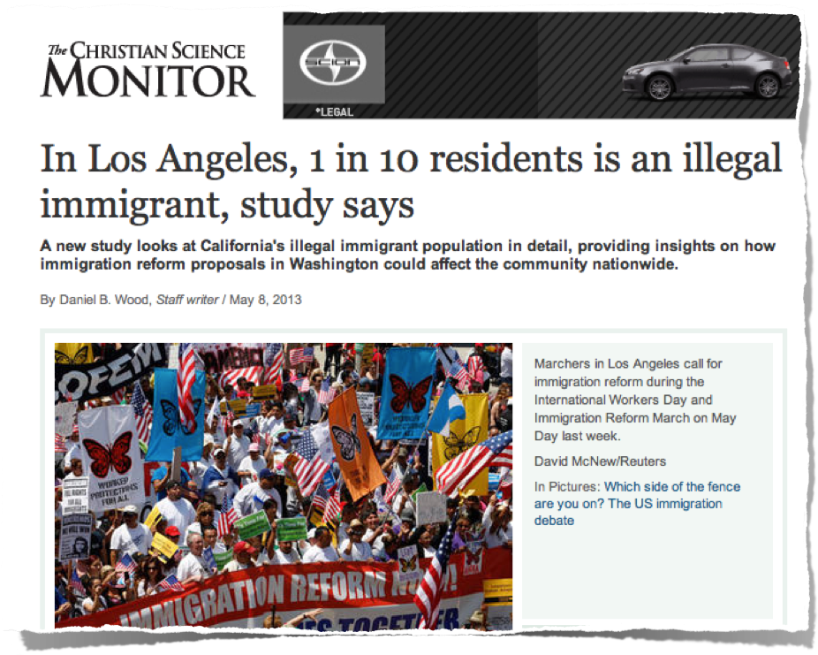

Slide 46
30
STAT
second
(the closest answer wins)
Of the 41.7 million foreign-born population in the USA in 2013 what percentage are illegal?
Answer: 28%

Slide 47
30
STAT
second
(the closest answer wins)
What % of the U.A.E.’s population is foreign born?
Answer: 83.7%

Slide 48
United Arab Emirates > Immigrants: 7.8 million > Pct of population: 83.7% > GDP (PPP) per capita 2012: $49,012 > Gov’t immigration goals: Decrease
A stunning 83.7% of UAE residents are international migrants the most of any country in the world, excluding only Vatican City. Between 2010 and 2013, the emirates let in more than 4.5 million migrant workers, more than any other nation in the world. The UAE is able to attract workers to come there because the country is extremely wealthy, with an economy driven by oil and finance. As of 2012, the nation’s per capita GDP exceeded $49,000, on-par with that of the U.S. But despite the nation’s appeal for immigrants, the UAE’s government as of 2011 considered immigration to be too high. Additionally, the country has been criticized for the poor living and working conditions faced by many migrant workers.

Slide 49
30
STAT
second
(the closest answer wins)
What % of the Canada’s population is foreign born?
Answer: 20.7%

Slide 50
Canada > Immigrants: 7.3 million > Pct of population: 20.7% > GDP (PPP) per capita 2012: $42,734 > Gov’t immigration goals: Maintain
Currently, 7.3 million immigrants live in Canada, equivalent to more than 20% of the nation’s total population. As 2011, the Canadian government was one of the few to propose policies that would increase the level of immigration for the purpose of family unification. The level of immigration, more generally, was considered satisfactory in the same year, according to the U.N. In spite of Canada’s exceptionally liberal immigration policies, there has been concern recently over whether Canada’s immigrants are successfully integrating into society. To avoid the potential social tension that could arise from a growing economic difference between immigrants and locals, the Canadian government has restructured its screening process to emphasize factors such as job skills and language fluency.

Slide 51
30
STAT
second
(the closest answer wins)
What % of the Americans live below the poverty line?
Answer: 15%

Slide 52
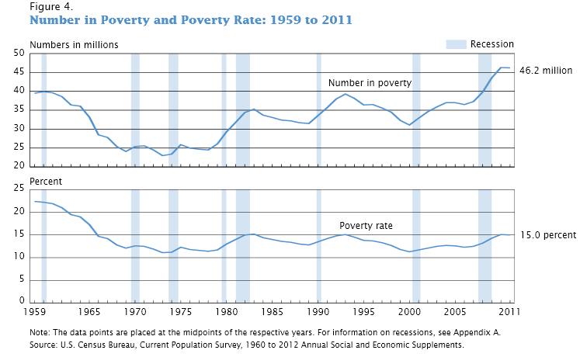

Slide 53
30
STAT
second
(the closest answer wins)
The poverty rate for a family of 1 in the USA is $11,490. What is the poverty rate for someone who lives in Alaska?
Answer: $14,350

Slide 54
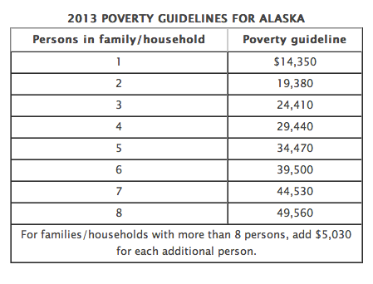

Slide 55
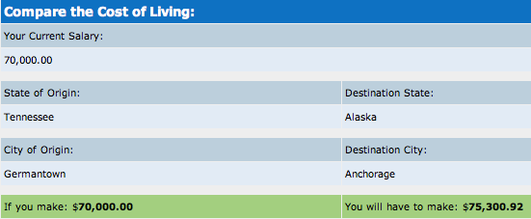

Slide 56
30
STAT
second
(the closest answer wins)
In 2010 women were ___% more likely to be poor than men.?
Answer: 29%

Slide 59
30
STAT
second
(the closest answer wins)
What % of minimum wage workers are 25 years old and over?
Answer: 49%

Slide 60
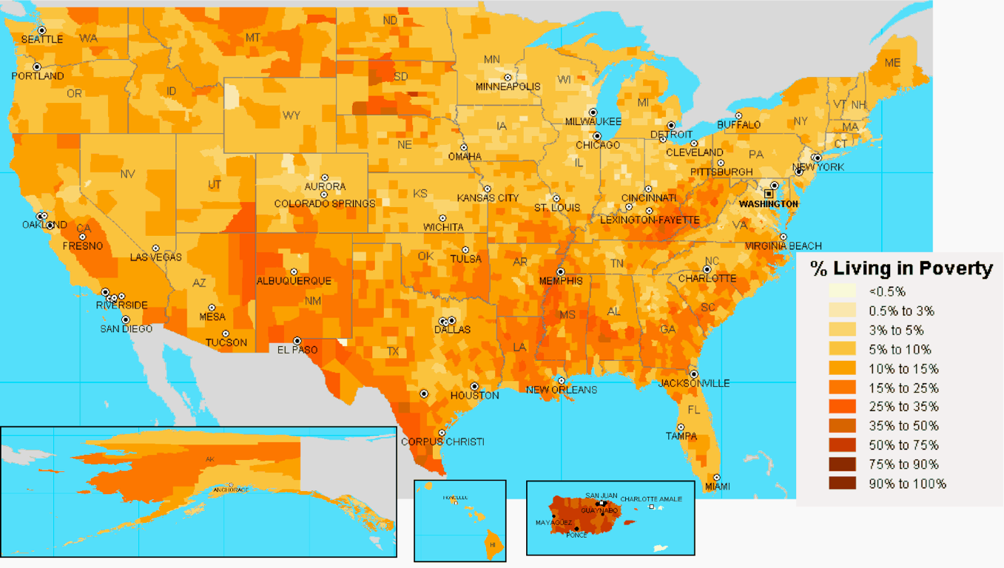

Slide 61
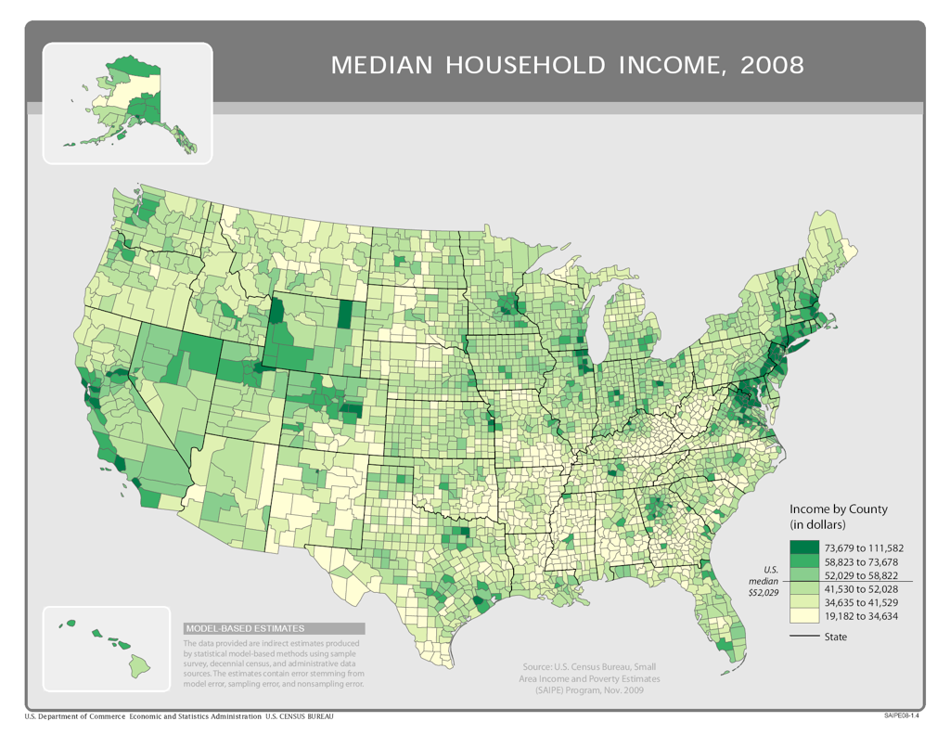

Slide 62
30
STAT
second
(the closest answer wins)
What is minimum wage in Oregon, the second highest in the nation?
Answer: $9.10

Slide 63
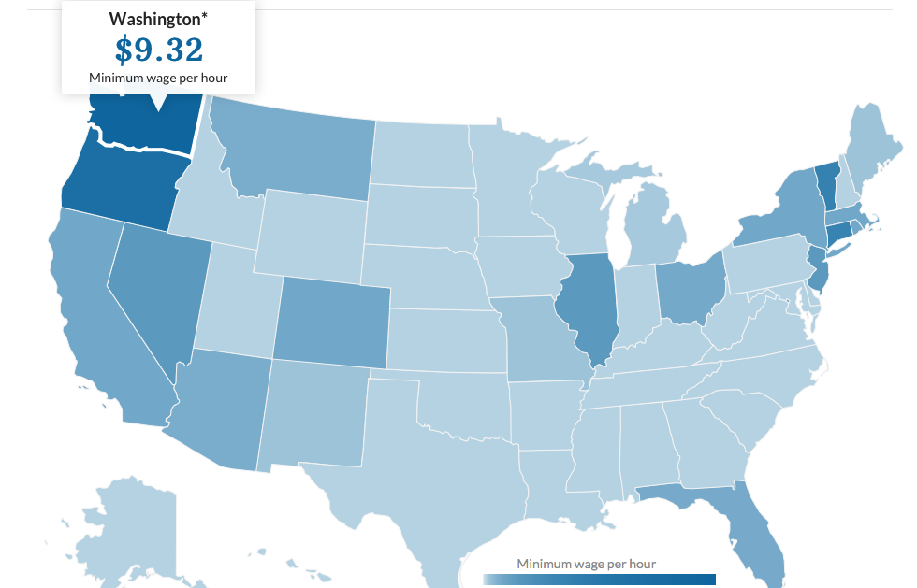

Slide 64
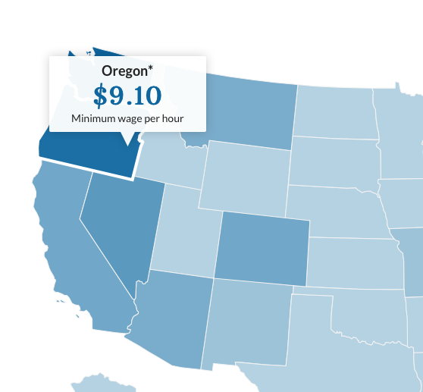

Slide 65
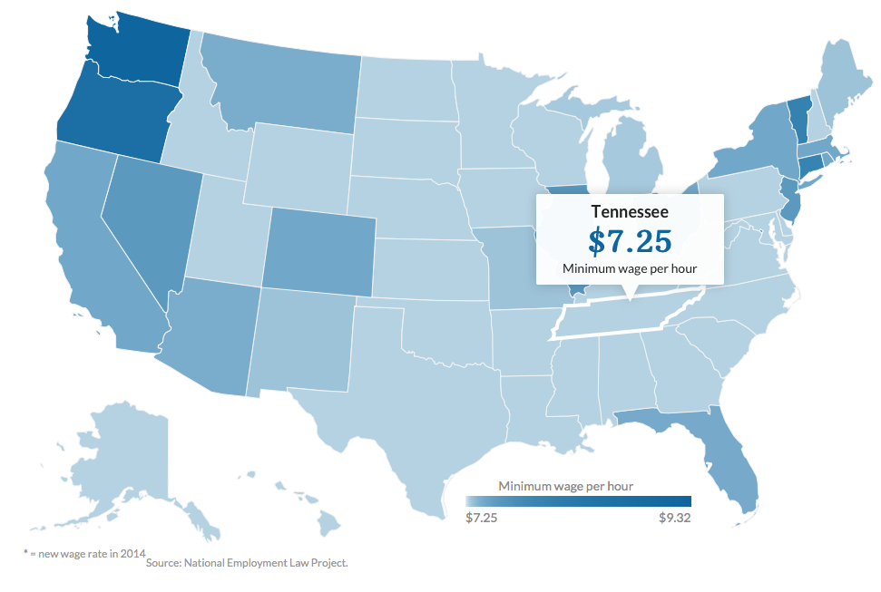

Slide 66
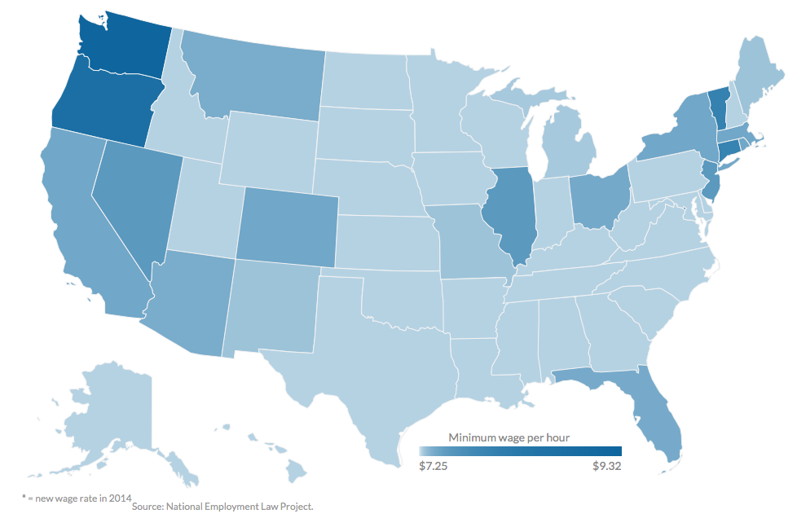

Slide 67
30
STAT
second
(the closest answer wins)
What percentage of all hourly workers make minimum wage or less?
Answer: 4.7%

Slide 68
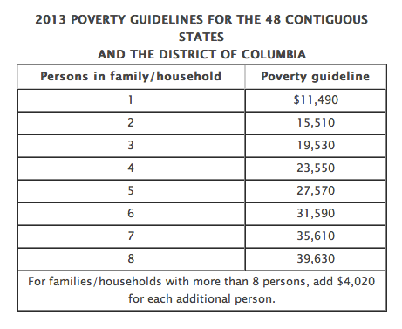
Poverty Threshold: Age and Family Size

Slide 69
30
STAT
second
(the closest answer wins)
What percentage of all hourly workers make minimum wage or less?
Answer: 4.7%

Slide 70
30
STAT
second
(the closest answer wins)
In 2012, 75.3 million workers in the U.S. age 16 and over were paid hourly rates, representing ____ % of all wage and salary workers.
Answer: 59%

Slide 71
Does raising the minimum wage cause food prices to go up?
Do the workers in both of these McDonalds make the same hour wage? McDonalds would not respond to the Washington Post’s inquiry.

Slide 72
30
STAT
second
(the closest answer wins)
What percentage of U.S. households earn more than 100,000 ?
Answer: 17%

Slide 73
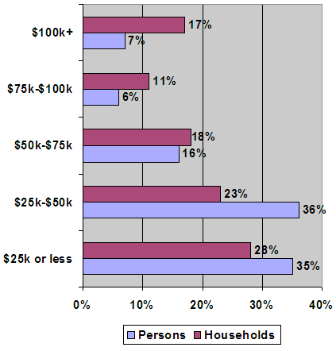
????????????????????????
What % of households in America are in each income category?
Write out your best guess for each...
????????????????????????
????????????????????????
????????????????????????
????????????????????????

Slide 74
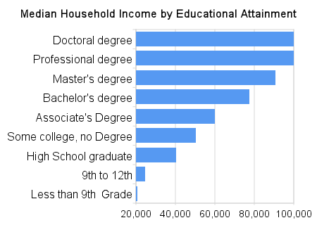

Slide 75
30
STAT
second
(the closest answer wins)
What percentage all high school students play high school sports ?
Answer: 55.5%

Slide 76
