Slide 1
30 SECOND STATS... (the closest answer wins)
Out of a world population of over 7 billion how many people are Muslim?
Answer: 1.619 Billion

Slide 2
30 SECOND STATS... (the closest answer wins)
40% of California’s population is White, non-Hispanic
What % of California’s population is Hispanic?
Answer: 38%

Slide 3
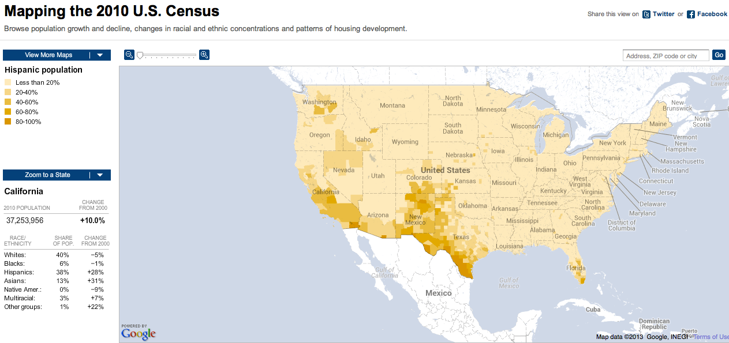
http://projects.nytimes.com/census/2010/map

Slide 4
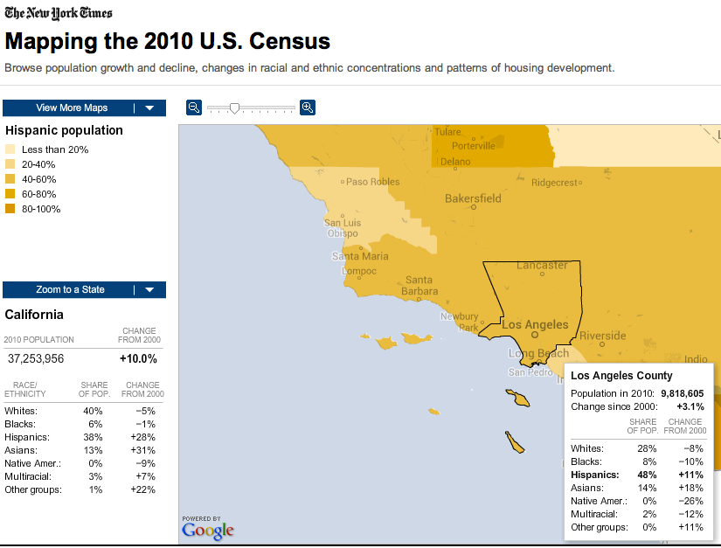

Slide 5
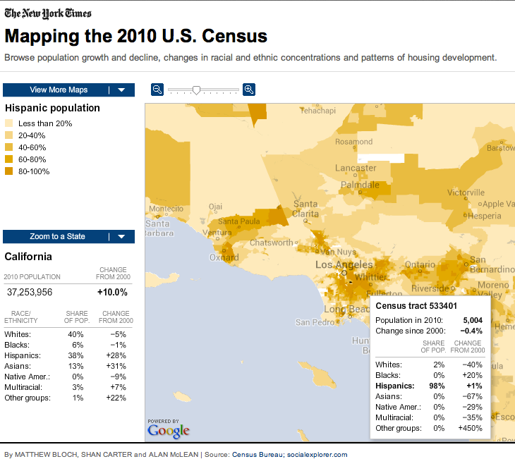

Slide 6
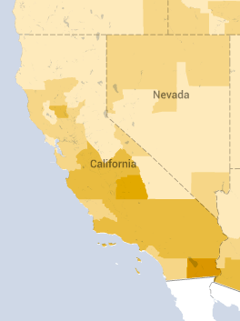
Hispanic Population in
Los Angeles, CA at different scales...

Slide 7
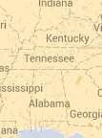
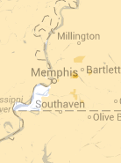
Hispanic Population in
Memphis, Tennessee at different scales...

Slide 8
30 SECOND STATS... (the closest answer wins)
What % of the world’s population are native speakers of Mandarin?
Answer: 14.4%

Slide 9
30 SECOND STATS... (the closest answer wins)
What percentage of the world’s population live in electoral democracies?
Answer: 58%

Slide 10
30 SECOND STATS... (the closest answer wins)
What percentage of the USA’s population are farmers/ ranch families?
Answer: 2%

Slide 11
30 SECOND STATS... (the closest answer wins)
In 2010 what percentage of the world’s population lived outside their country of origin?
Answer: 3%

Slide 12
30 SECOND STATS... (the closest answer wins)
In 2012 what percentage of the world lived in urban areas?
Answer: 51%

Slide 13
30 SECOND STATS... (the closest answer wins)
In 2012 what percentage of the India lived in urban areas?
Answer: 31%

Slide 14
30 SECOND STATS... (the closest answer wins)
In 2010 what % of people living in Reading, PA lived in Poverty?
Answer: 41.3%
COUNTDOWN
Time
30
29
28
27
26
25
24
23
22
21
20
19
18
17
16
15
14
13
12
11
10
09
08
07
06
05
04
03
02
01

Slide 17
30 SECOND STATS... (the closest answer wins)
What percentage of the United States’ GDP goes to foreign aid for other countries?
Answer: 0.2%
COUNTDOWN
Time
30
29
28
27
26
25
24
23
22
21
20
19
18
17
16
15
14
13
12
11
10
09
08
07
06
05
04
03
02
01

Slide 18
30 SECOND STATS... (the closest answer wins)
Sweden gives more per capita for foreign aid than any other country. What % of its GDP does it give?
Answer: 1.02%
COUNTDOWN
Time
30
29
28
27
26
25
24
23
22
21
20
19
18
17
16
15
14
13
12
11
10
09
08
07
06
05
04
03
02
01

Slide 19
30 SECOND STATS... (the closest answer wins)
What is the life expectancy for the most developed countries in the world?
Answer: 78
COUNTDOWN
Time
30
29
28
27
26
25
24
23
22
21
20
19
18
17
16
15
14
13
12
11
10
09
08
07
06
05
04
03
02
01

Slide 20
30 SECOND STATS... (the closest answer wins)
What is the life expectancy for the least developed countries in the world?
Answer: 59
COUNTDOWN
Time
30
29
28
27
26
25
24
23
22
21
20
19
18
17
16
15
14
13
12
11
10
09
08
07
06
05
04
03
02
01

Slide 21
30 SECOND STATS... (the closest answer wins)
On average how many births are there per minute in developing countries?
Answer: 241
COUNTDOWN
Time
30
29
28
27
26
25
24
23
22
21
20
19
18
17
16
15
14
13
12
11
10
09
08
07
06
05
04
03
02
01

Slide 22
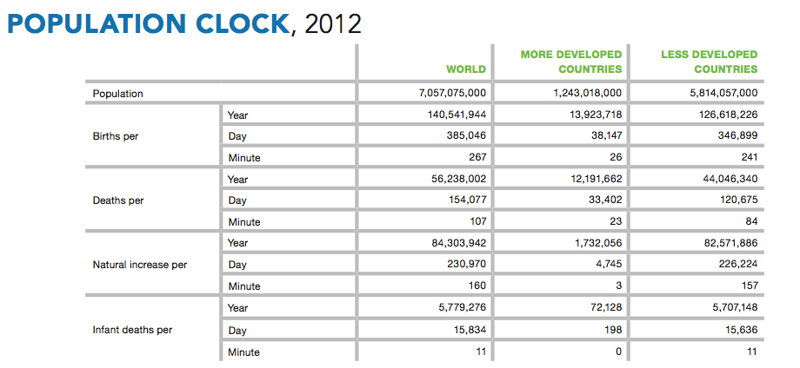
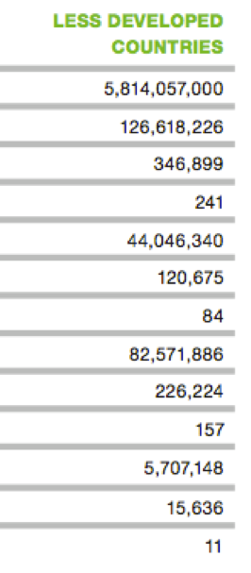

Slide 23
30 SECONDS STATS... (the closest without going over)
The United States relied on net imports for about _____% of the petroleum that we consumed in 2011.
Answer: 45%
COUNTDOWN
Time
30
29
28
27
26
25
24
23
22
21
20
19
18
17
16
15
14
13
12
11
10
09
08
07
06
05
04
03
02
01

Slide 24
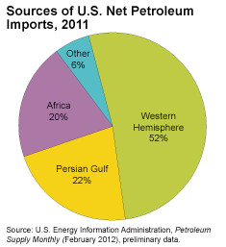
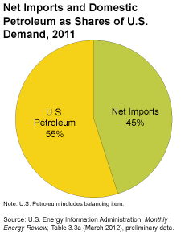
How dependent are we on foreign oil?
The United States relied on net imports (imports minus exports) for about 45% of the petroleum (crude oil and petroleum products) that we consumed in 2011. Just over half of these imports came from the Western Hemisphere. Our dependence on foreign petroleum has declined since peaking in 2005.

Slide 25
Top Sources of Net Crude Oil and Petroleum Product Imports:
Canada (29%)
Saudi Arabia (14%)
Venezuela (11%)
Nigeria (10%)
Mexico (8%)
It is usually impossible to tell whether the petroleum products you use came from domestic or imported sources of oil once they are refined.

Slide 26
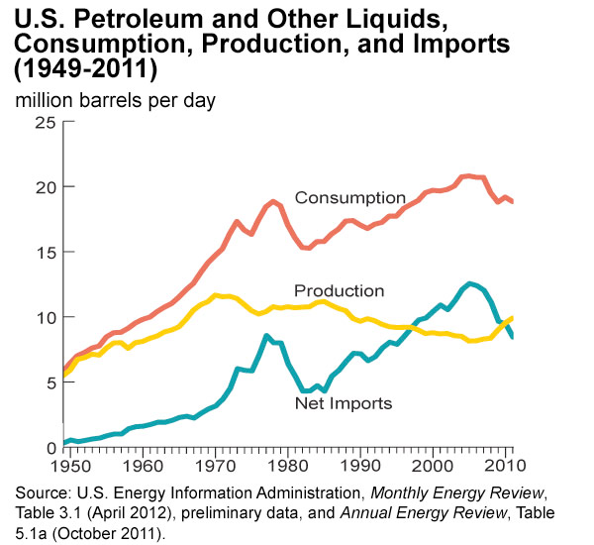

Slide 27
30 SECONDS STATS... (write letter and state abbreviation for answer)
Which US state produces the most coal?
A. Kentucky (KY)
B. Pennsylvania (PA)
C. West Virginia (WV)
D. Wyoming (WY)
Answer: D. Wyoming
COUNTDOWN
Time
30
29
28
27
26
25
24
23
22
21
20
19
18
17
16
15
14
13
12
11
10
09
08
07
06
05
04
03
02
01

Slide 28
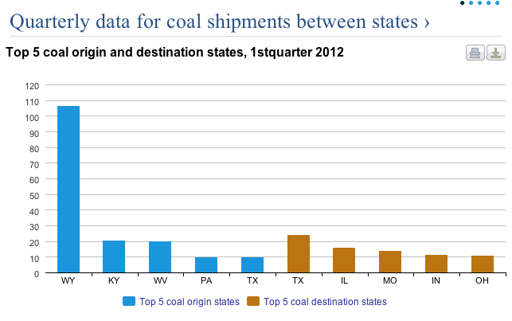

Slide 29
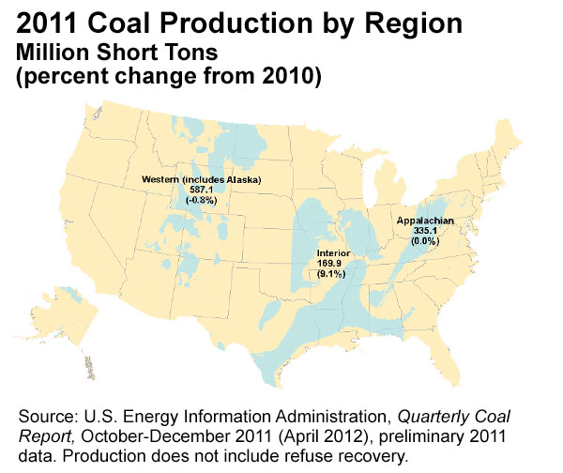

Slide 30
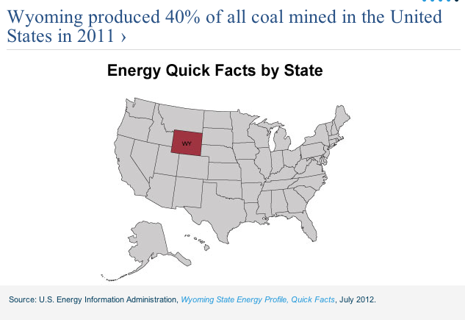

Slide 31
30 SECONDS STATS... (closest to the answer)
What % of U.S. electricity generation is from coal?
Answer: 42%
COUNTDOWN
Time
30
29
28
27
26
25
24
23
22
21
20
19
18
17
16
15
14
13
12
11
10
09
08
07
06
05
04
03
02
01

Slide 32
30 SECONDS STATS... (the closest without going over)
What % of U.S. electricity generation is from renewable?
Answer: 13%
COUNTDOWN
Time
30
29
28
27
26
25
24
23
22
21
20
19
18
17
16
15
14
13
12
11
10
09
08
07
06
05
04
03
02
01

Slide 34
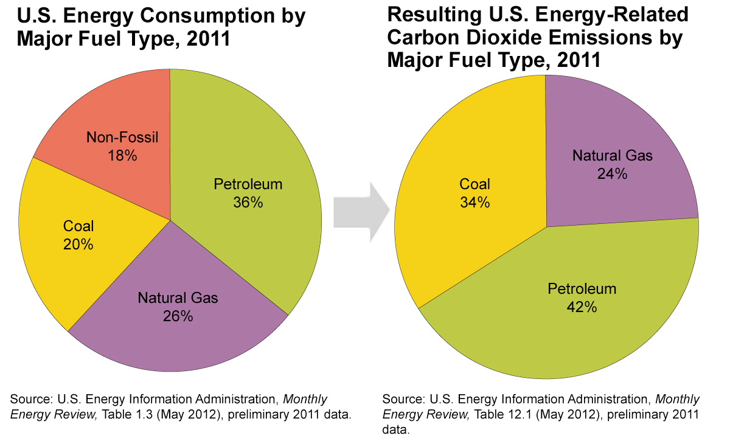

Slide 35
30 SECONDS STATS... (the closest to the answer wins)
What % of the world coal reserves are found in the U.S.?
Answer: 22.6%
COUNTDOWN
Time
30
29
28
27
26
25
24
23
22
21
20
19
18
17
16
15
14
13
12
11
10
09
08
07
06
05
04
03
02
01

Slide 36
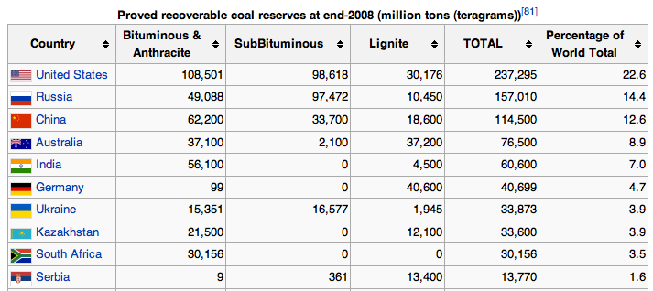

Slide 37
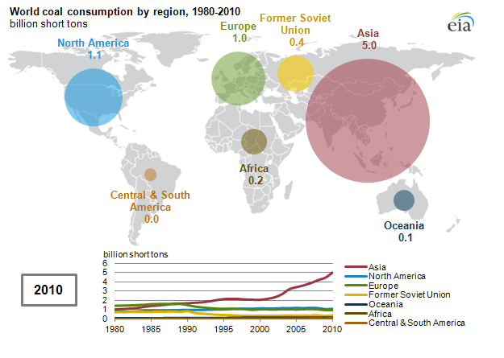

Slide 38
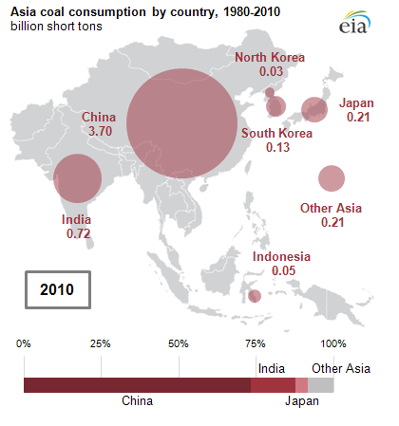

Slide 39
30 SECONDS STATS... (the closest to the answer wins)
What % of the world oil reserves are found in the Middle East?
Answer: 64.5%
COUNTDOWN
Time
30
29
28
27
26
25
24
23
22
21
20
19
18
17
16
15
14
13
12
11
10
09
08
07
06
05
04
03
02
01

Slide 40
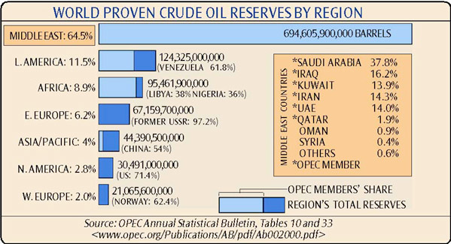

Slide 41
30 SECONDS STATS... (the closest to the answer wins)
What % of Americans would favor lowering the drinking age to 18?
(2007)
Answer: 22%
COUNTDOWN
Time
30
29
28
27
26
25
24
23
22
21
20
19
18
17
16
15
14
13
12
11
10
09
08
07
06
05
04
03
02
01

Slide 42
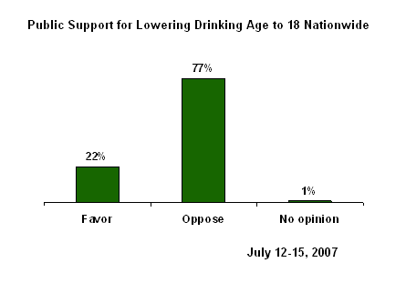

Slide 43
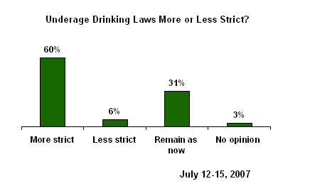

Slide 44
