Slide 1
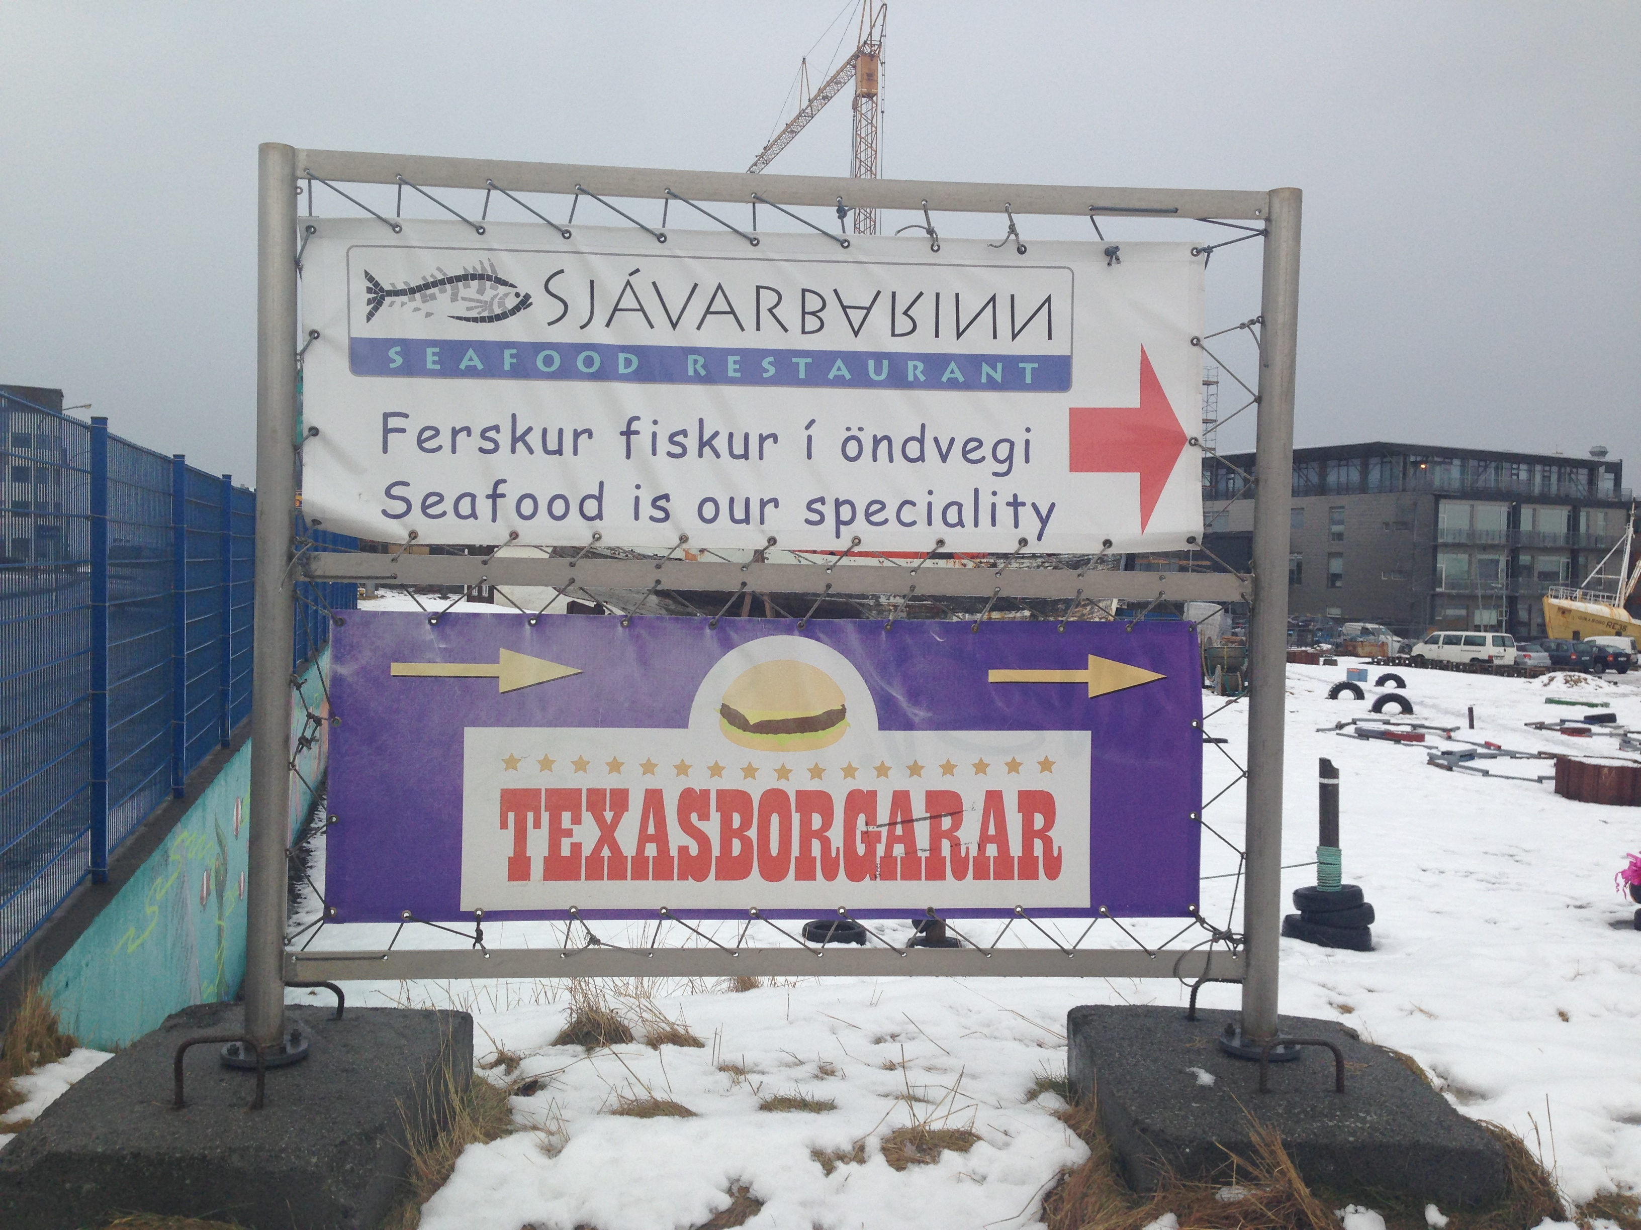
Thinking Geographically

Slide 2
Place in order the countries from largest in AREA to smallest.
Country | Order
Cuba
United Kingdom
India
Chile
Iran
5
4
1
3
2

Slide 3
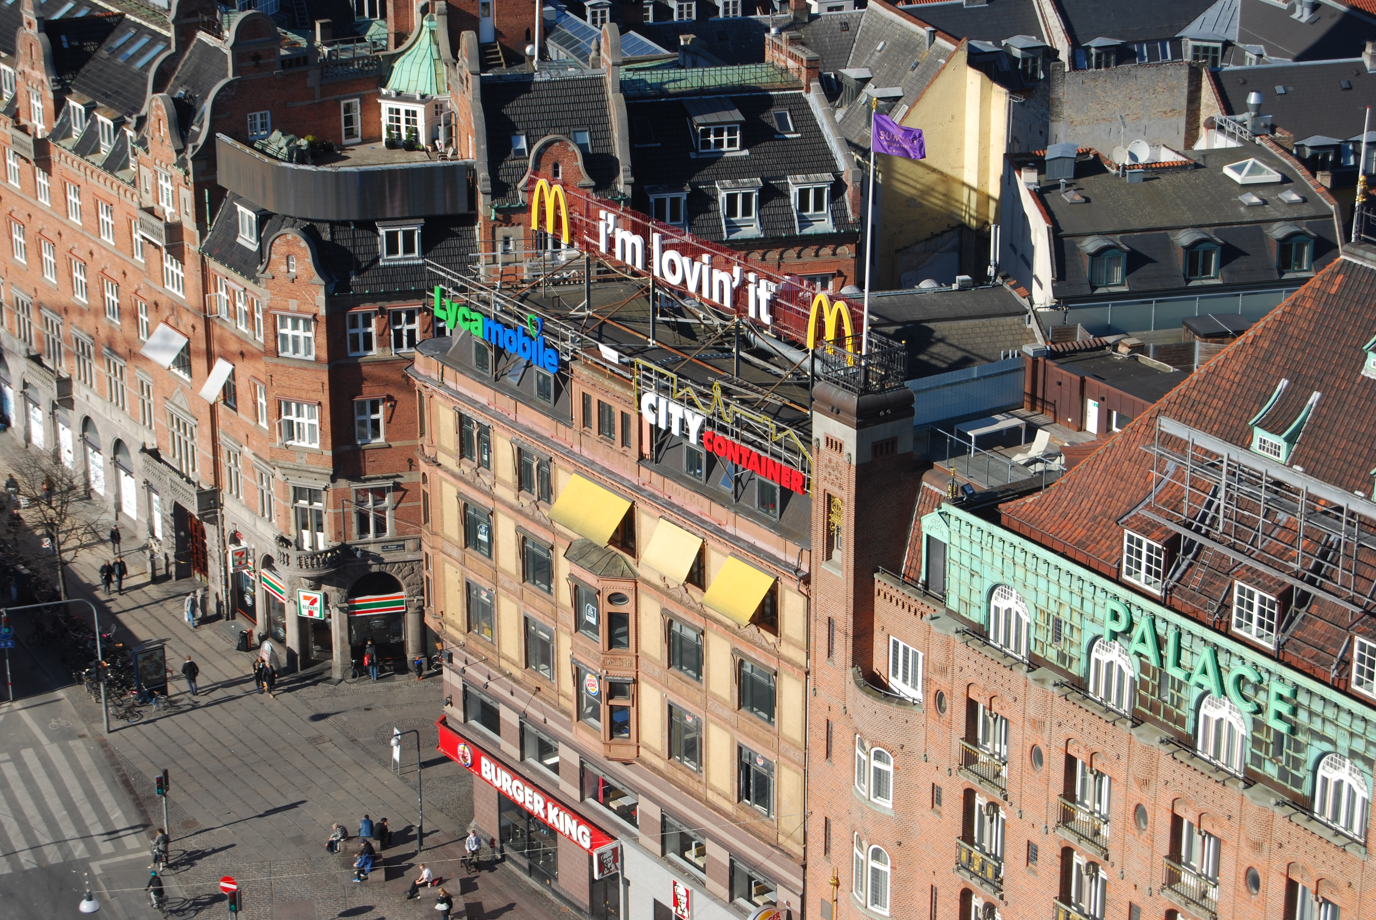
Which countries have the most McDonald’s?

Slide 4
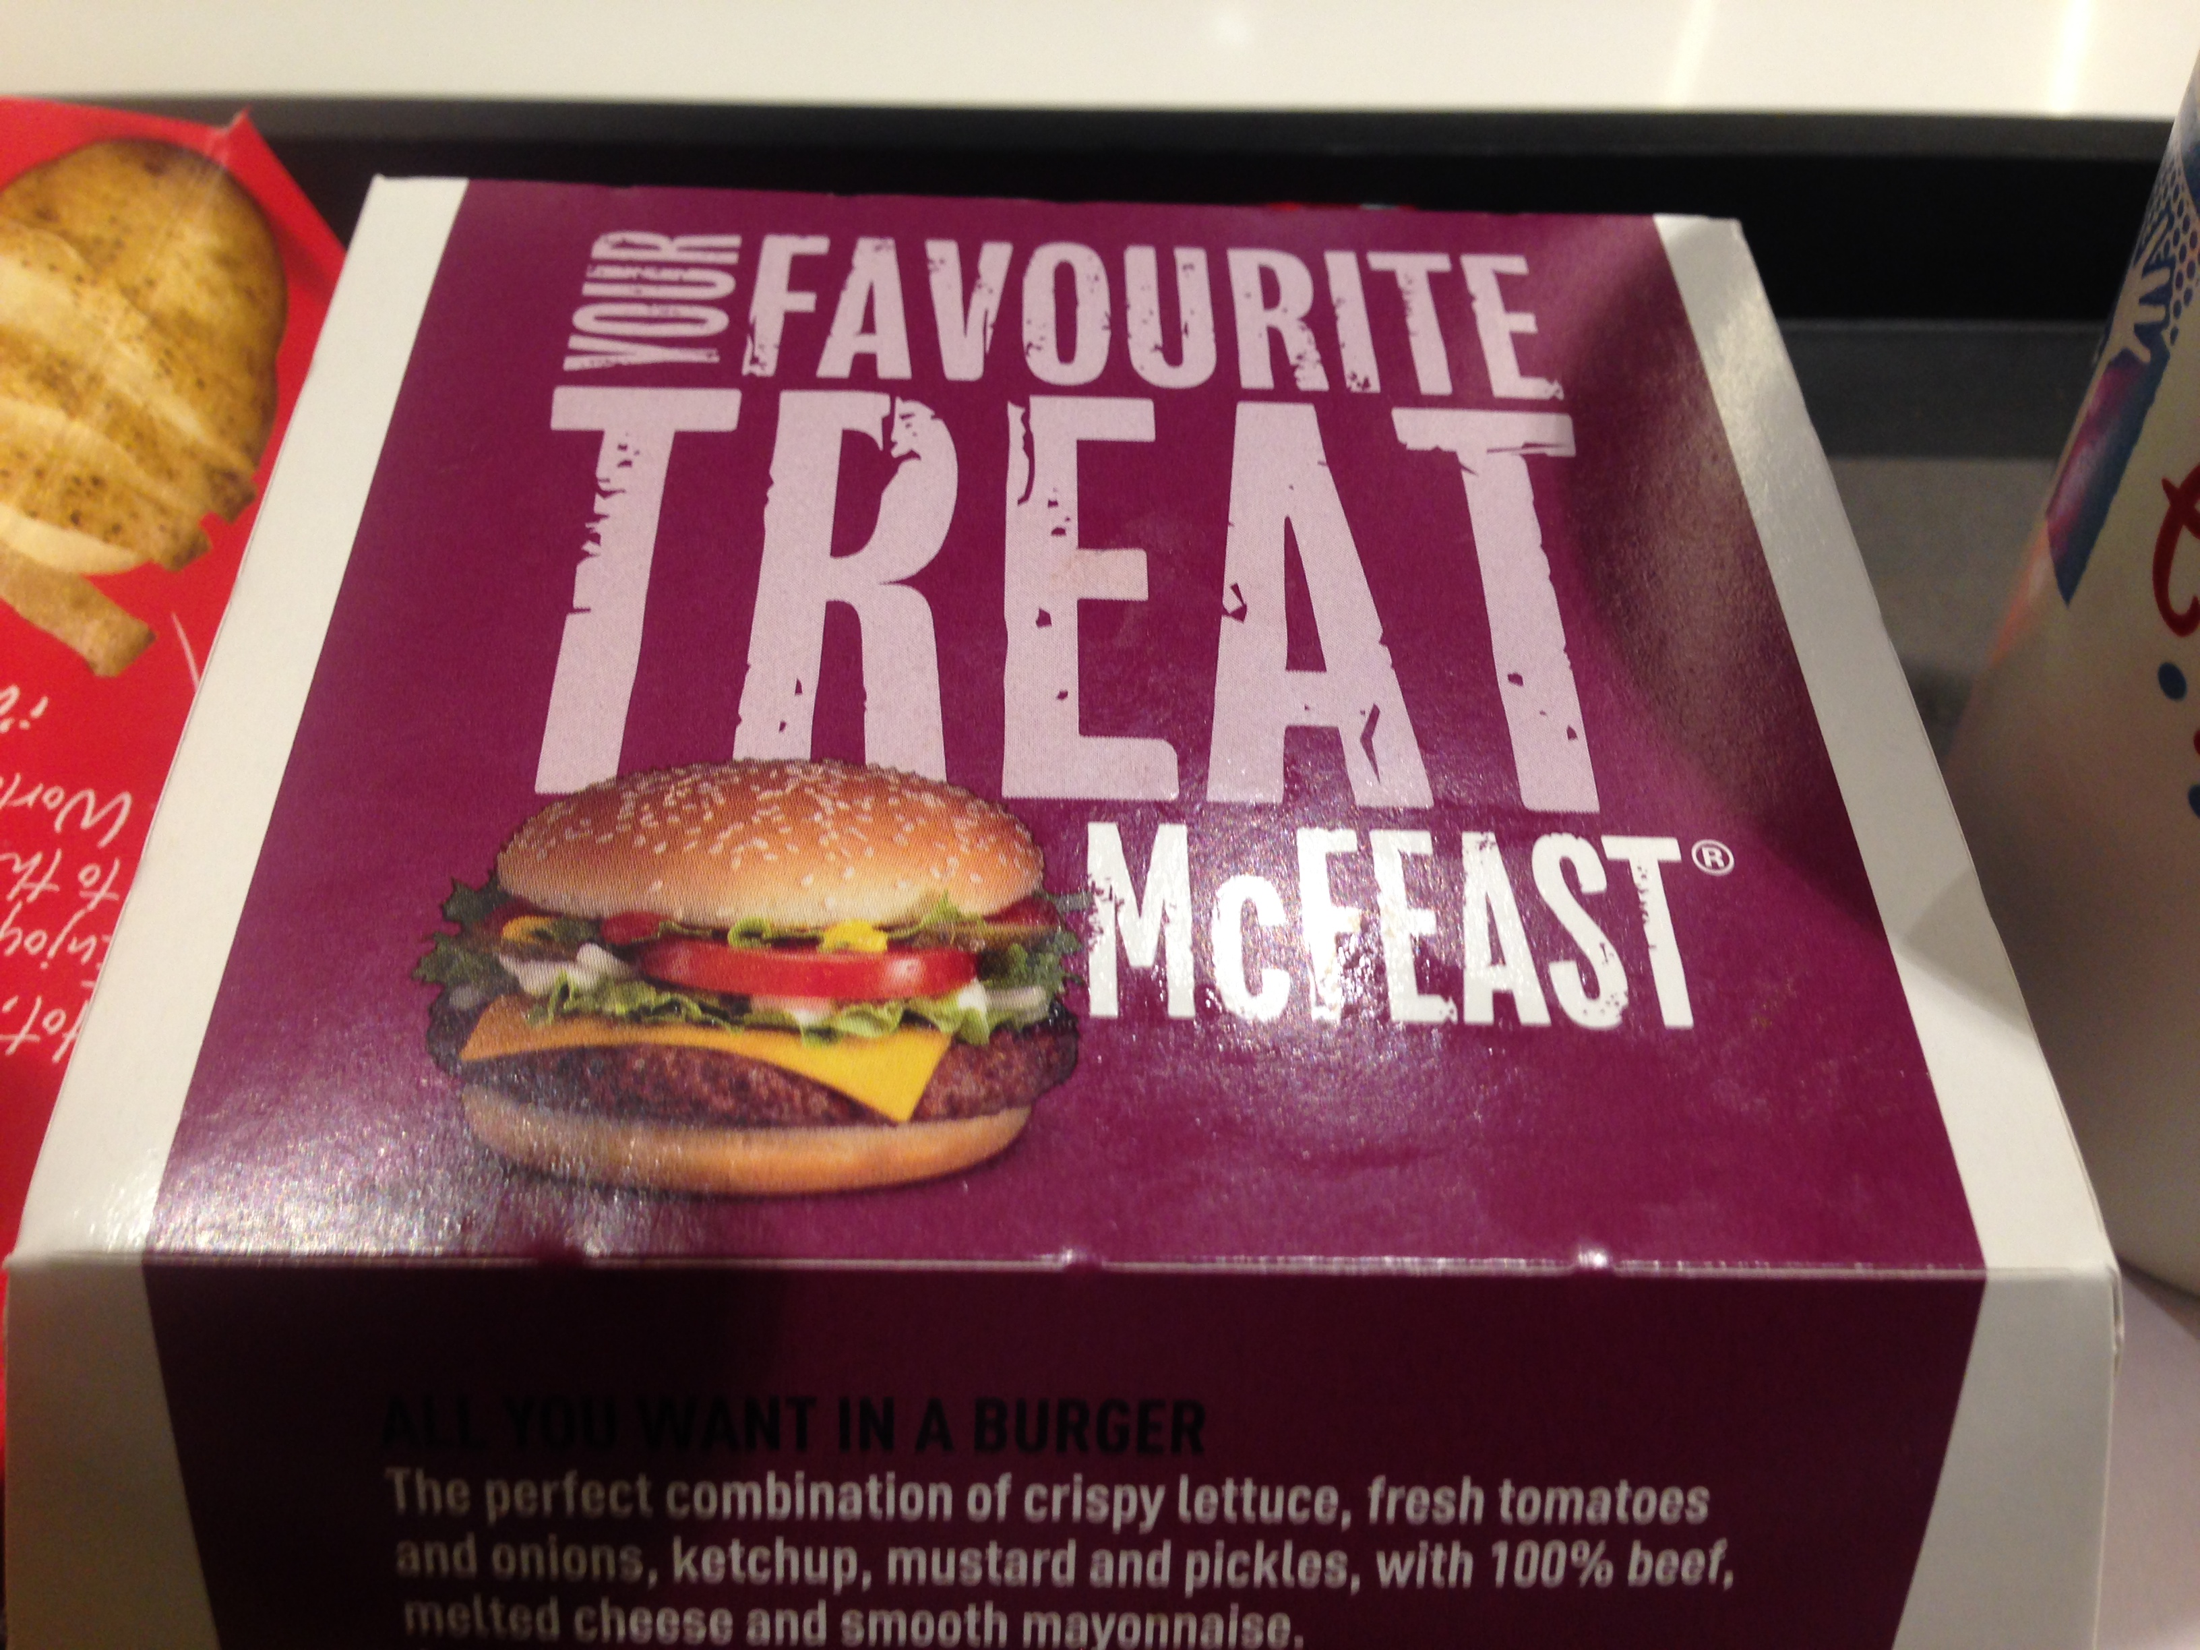

Slide 5
Place in order from the country with the most McDonald’s to the one with the least.
Country | Order restaurants
France
Japan
Pakistan
Austria
Bahamas
2- 1,258
1- 3,096
4- 27
3- 184
5- 3

Slide 6
Place in order from the country with the most McDonald’s to the one with the least.
Country | Order restaurants
Ukraine
Hong Kong
Iraq
Qatar
Iceland
2- 76
1- 237
4- 1
3- 25
5- 0

Slide 7
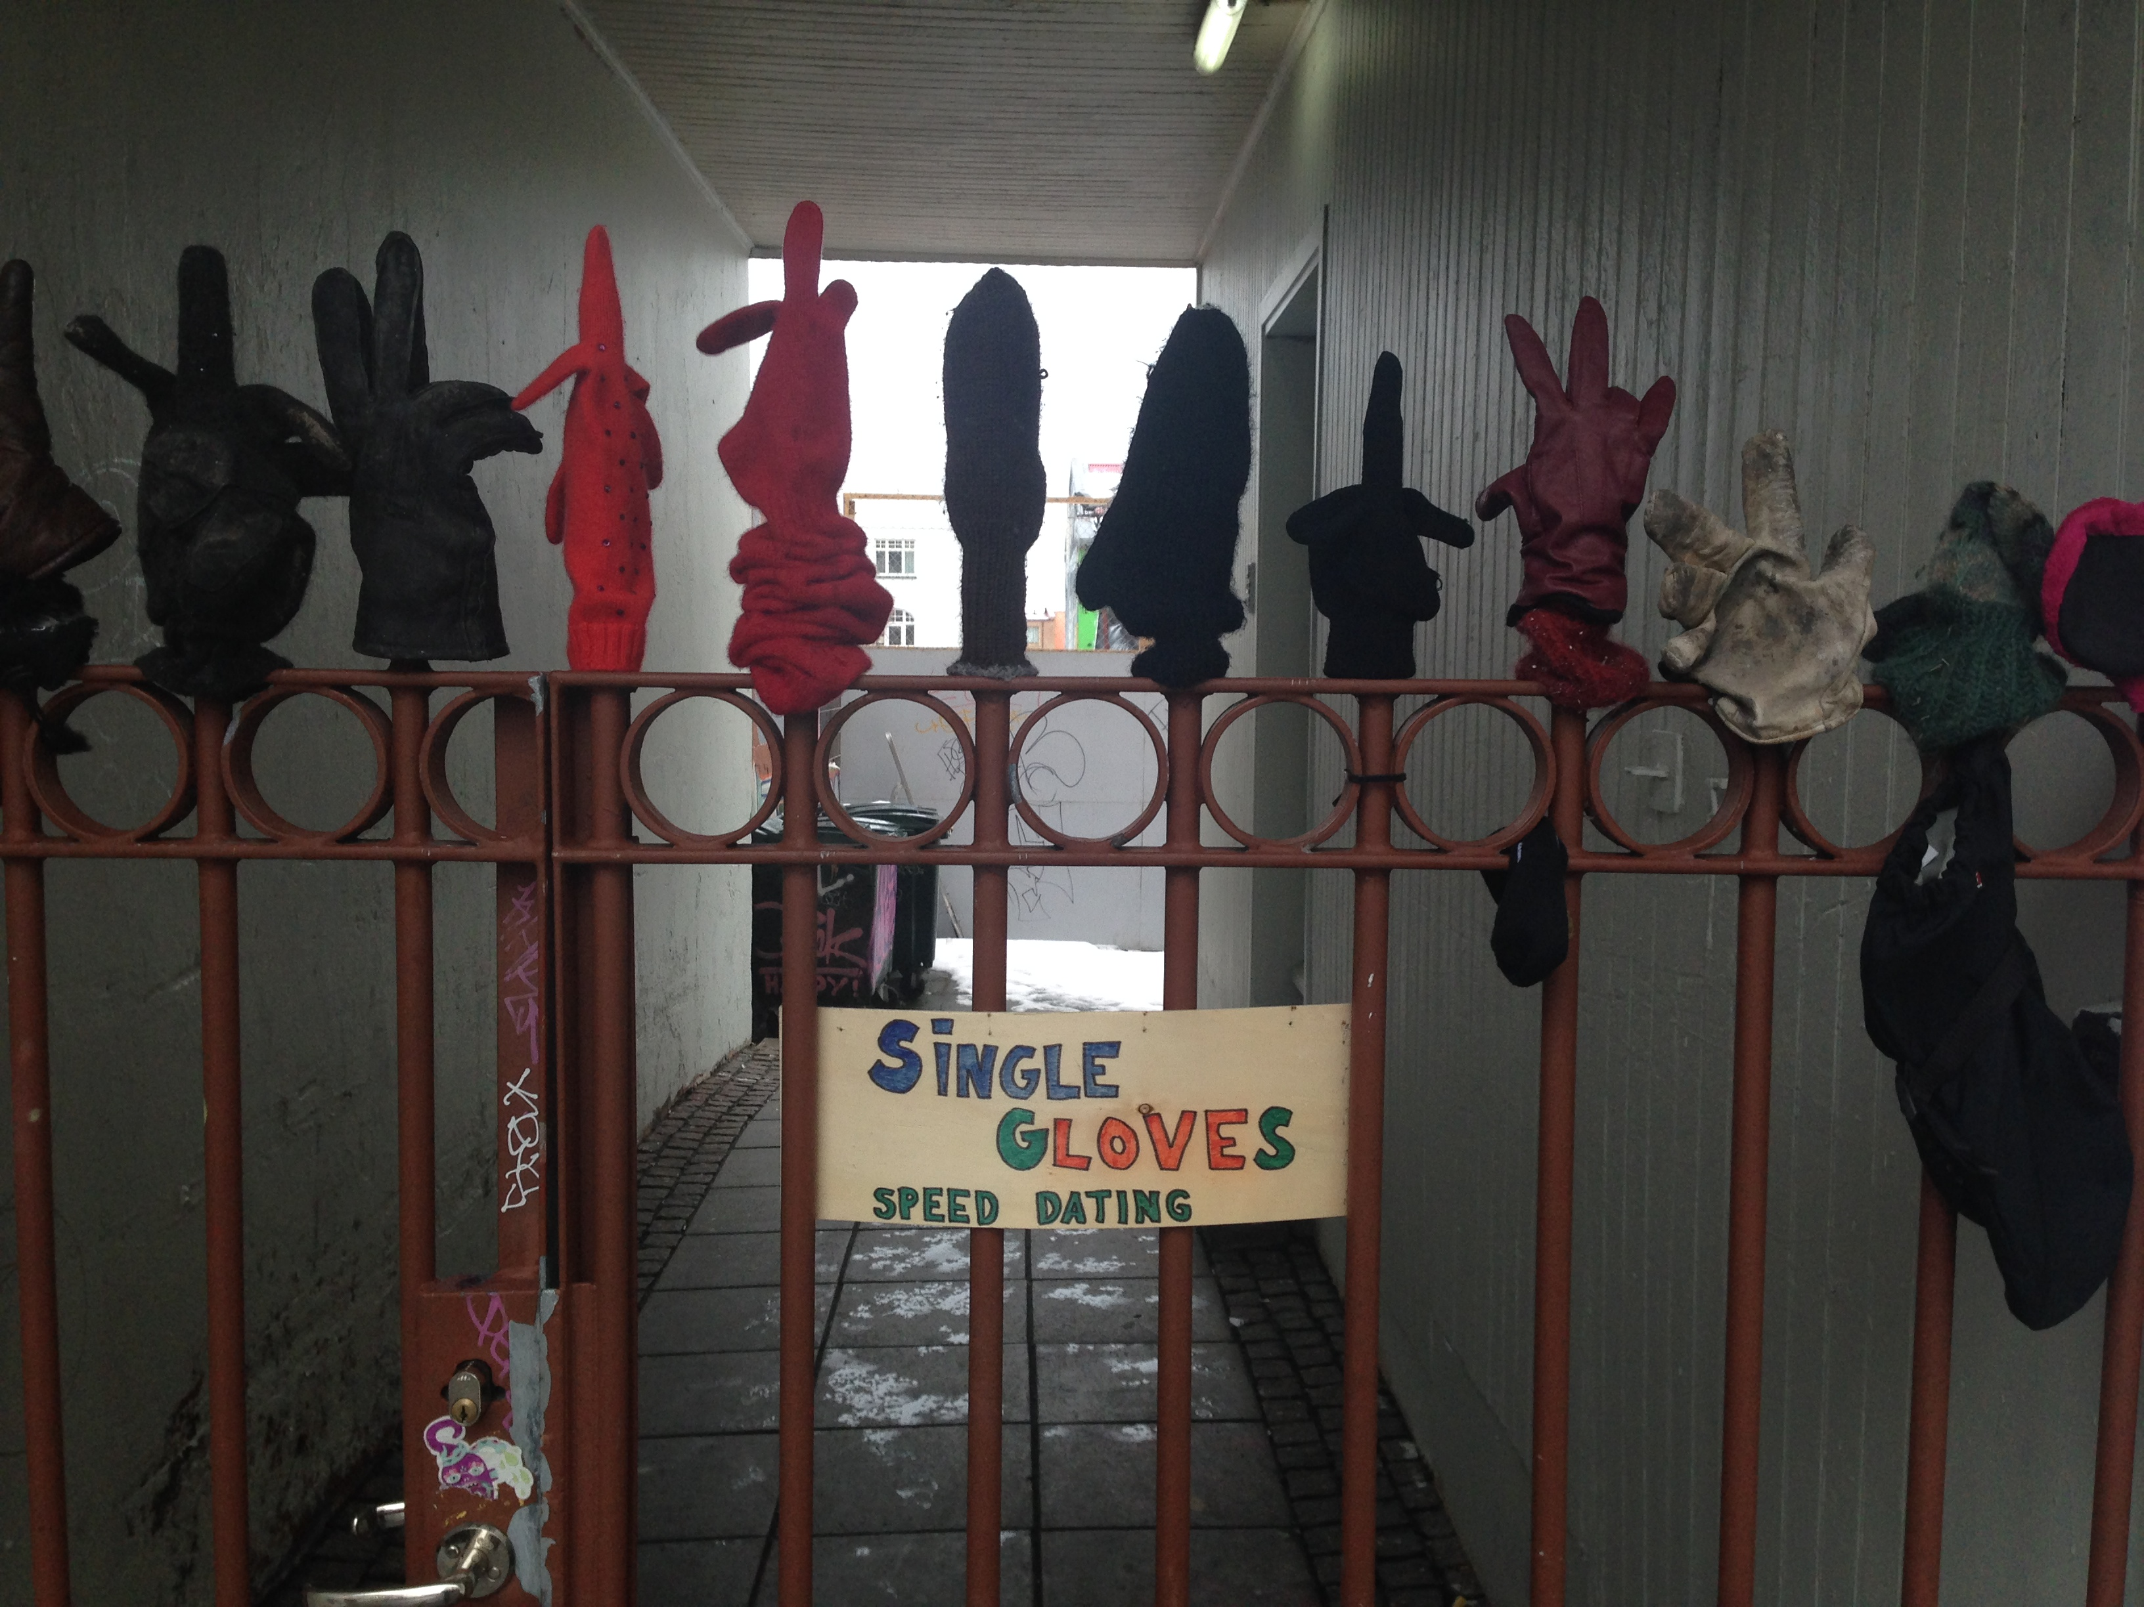
Population and Migration

Slide 8
Place the countries in order from the highest in population to the lowest.
Country | Order people
Bangladesh
United States of America
Egypt
Japan
Australia
2- 152 million
1- 317 million
4- 86 million
3- 127 million
5- 23 million

Slide 9
Place the countries in order from the highest in physiological density to the lowest.
Country | Order pop per km²
Bangladesh
United States of America
Egypt
Japan
Australia
3- 1,946
4- 178
1- 2,924
2- 2,668
5- 43

Slide 10
Place the countries in order from the highest in physiological density to the lowest.
Country | Order pop per km²
Qatar
Netherlands
Singapore
New Zealand
India
2- 4,600
3- 2,205
1- 441,000
5- 272
4- 753

Slide 11
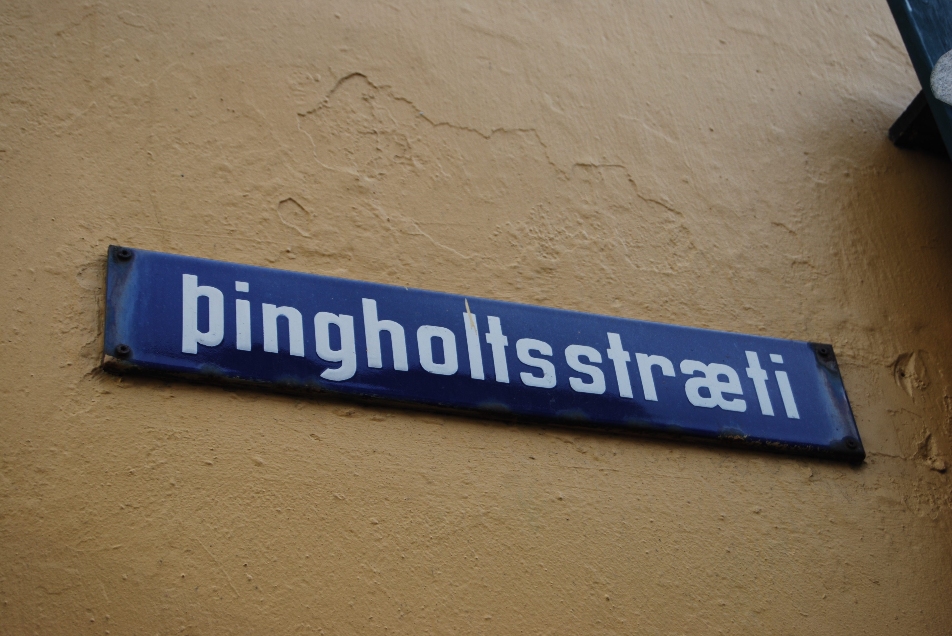
Culture

Slide 12
Place in order the Native speakers in the world from most to least.
Country | Order
English
Mandarin
Hindi
Arabic
Spanish
3
1
4
5
2

Slide 13
Place in order the Native speakers in the world from most to least.
Country | Order
Japanese
Portuguese
Russian
Punjabi
Bengali
4
1
3
5
2

Slide 14
Place in order the Native speakers in the world from most to least.
Country | Order
Romanian
Portuguese
Hausa
German
Persian
2
5
4
1
3

Slide 15
Place in order the total number of speakers in the world from most to least.
Country | Order
Spanish
Hindi
Mandarin
Arabic
English
3
4
1
5
2

Slide 16
Place in order the total number of speakers in the world from most to least.
Country | Order
Indonesian
Russian
Turkish
French
Korean
2
1
4
3
5

Slide 17
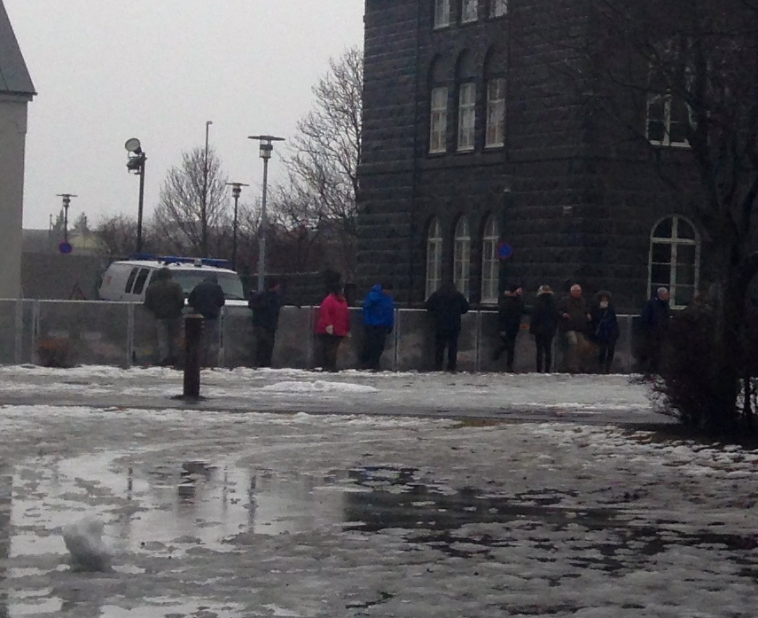
Political

Slide 18
Place in order the most to the least democratic country.
Country | Order
Canada
Iran
China
Turkey
India
1
5
4
3
2

Slide 19
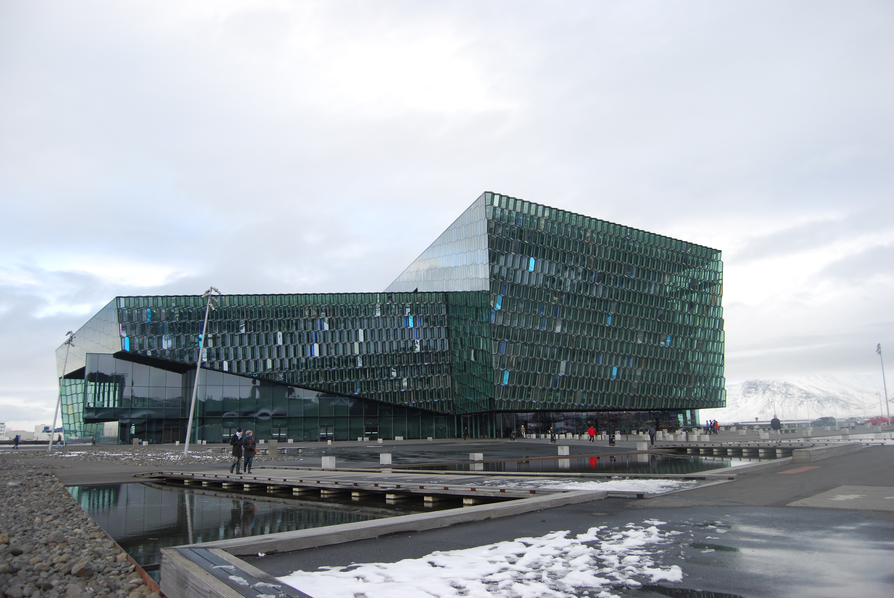
Development

Slide 20
Place in order the countries from highest to the lowest HDI.
Country | Order
Nepal
Honduras
Ireland
Saudi Arabia
Italy
5
4
1
3
2

Slide 21
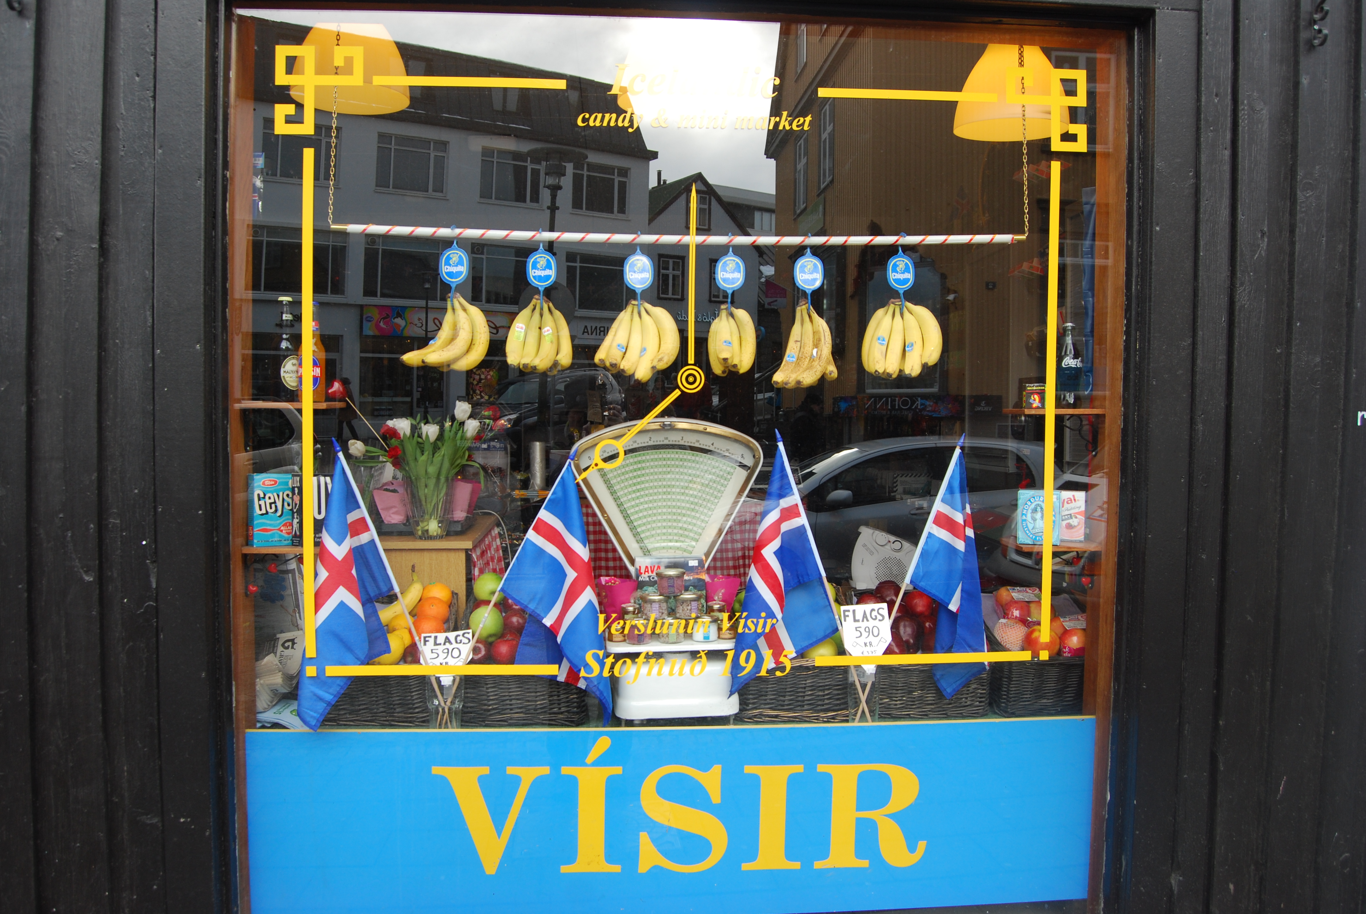
Agriculture

Slide 22
Place in order the cash crops in the United States from most $ to least.
Country | Order
tobacco
cotton
corn
wheat
soybeans
5
4
1
3
2

Slide 23
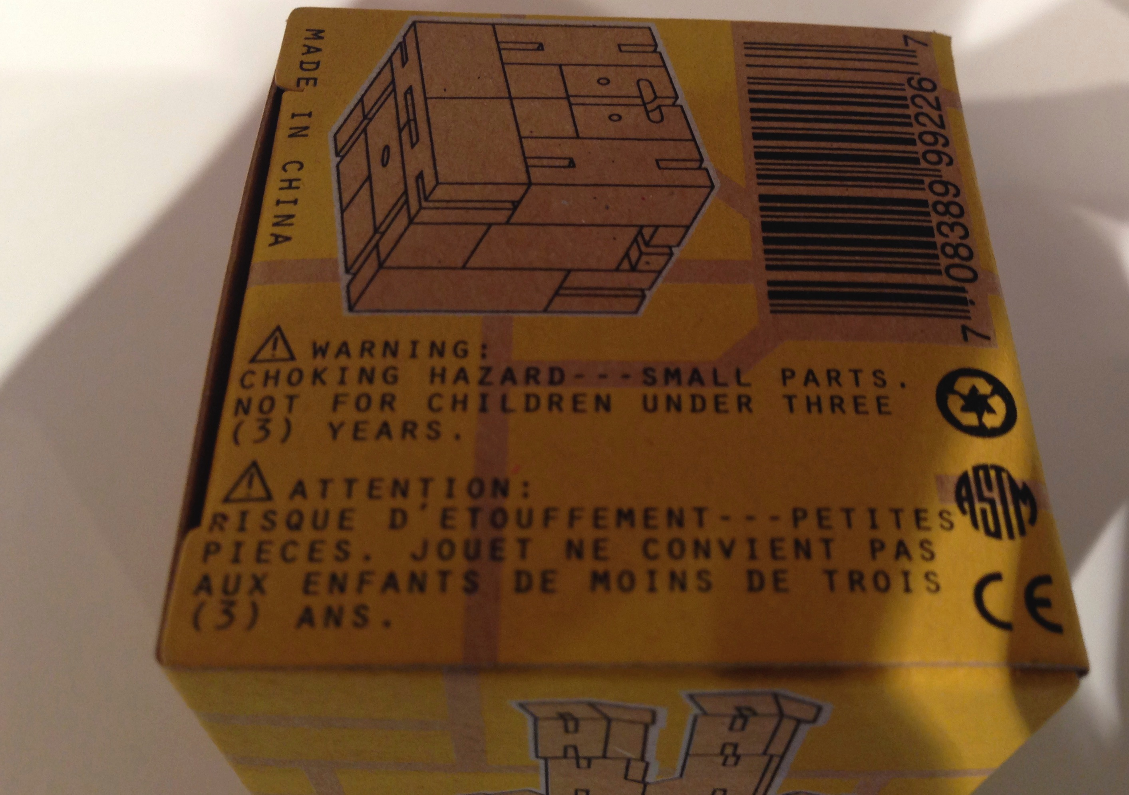
Industry and Services

Slide 24
Place in order the countries with the highest to the lowest GDP per capita.
Country | Order
China
India
Germany
Poland
Spain
4
5
1
3
2

Slide 25
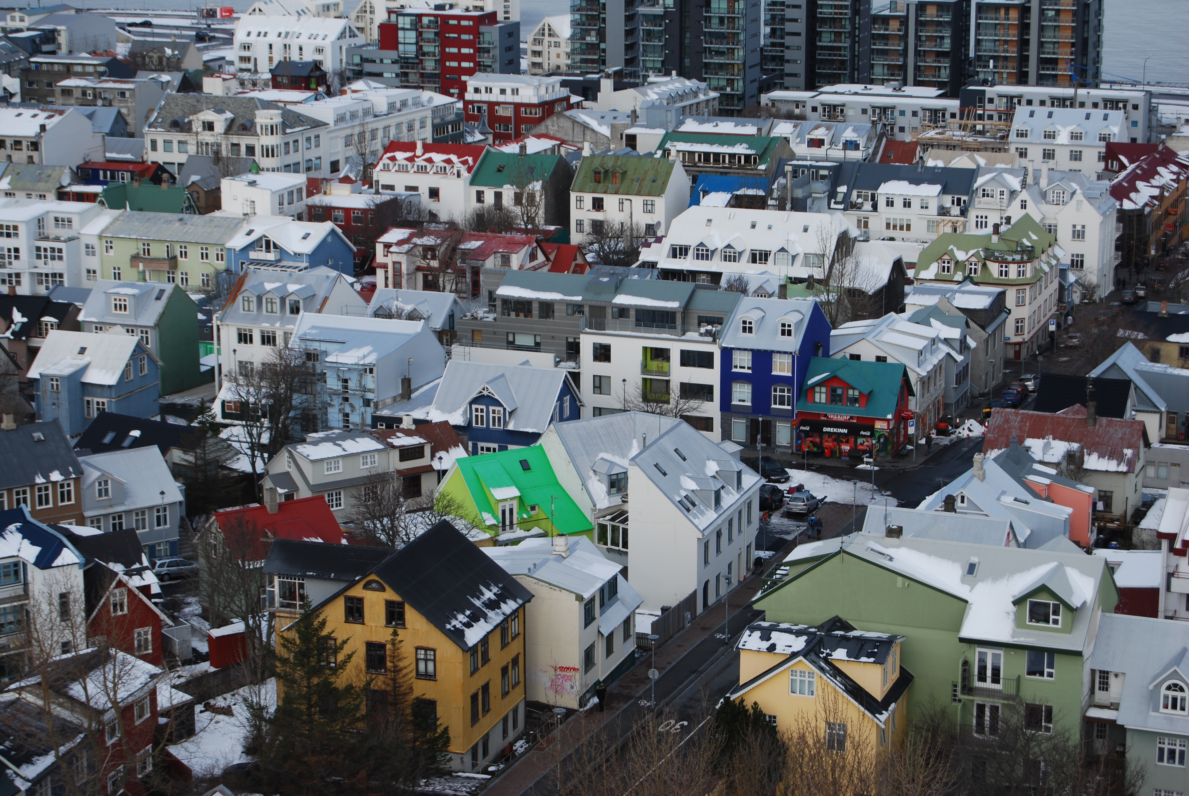
Urban

Slide 26
Place in order from the largest to the smallest world cities by metropolitan area.
Country | Order
Los Angeles
Cairo
Mumbai
Tokyo
Mexico City
4
5
3
1
2

