Slide 1
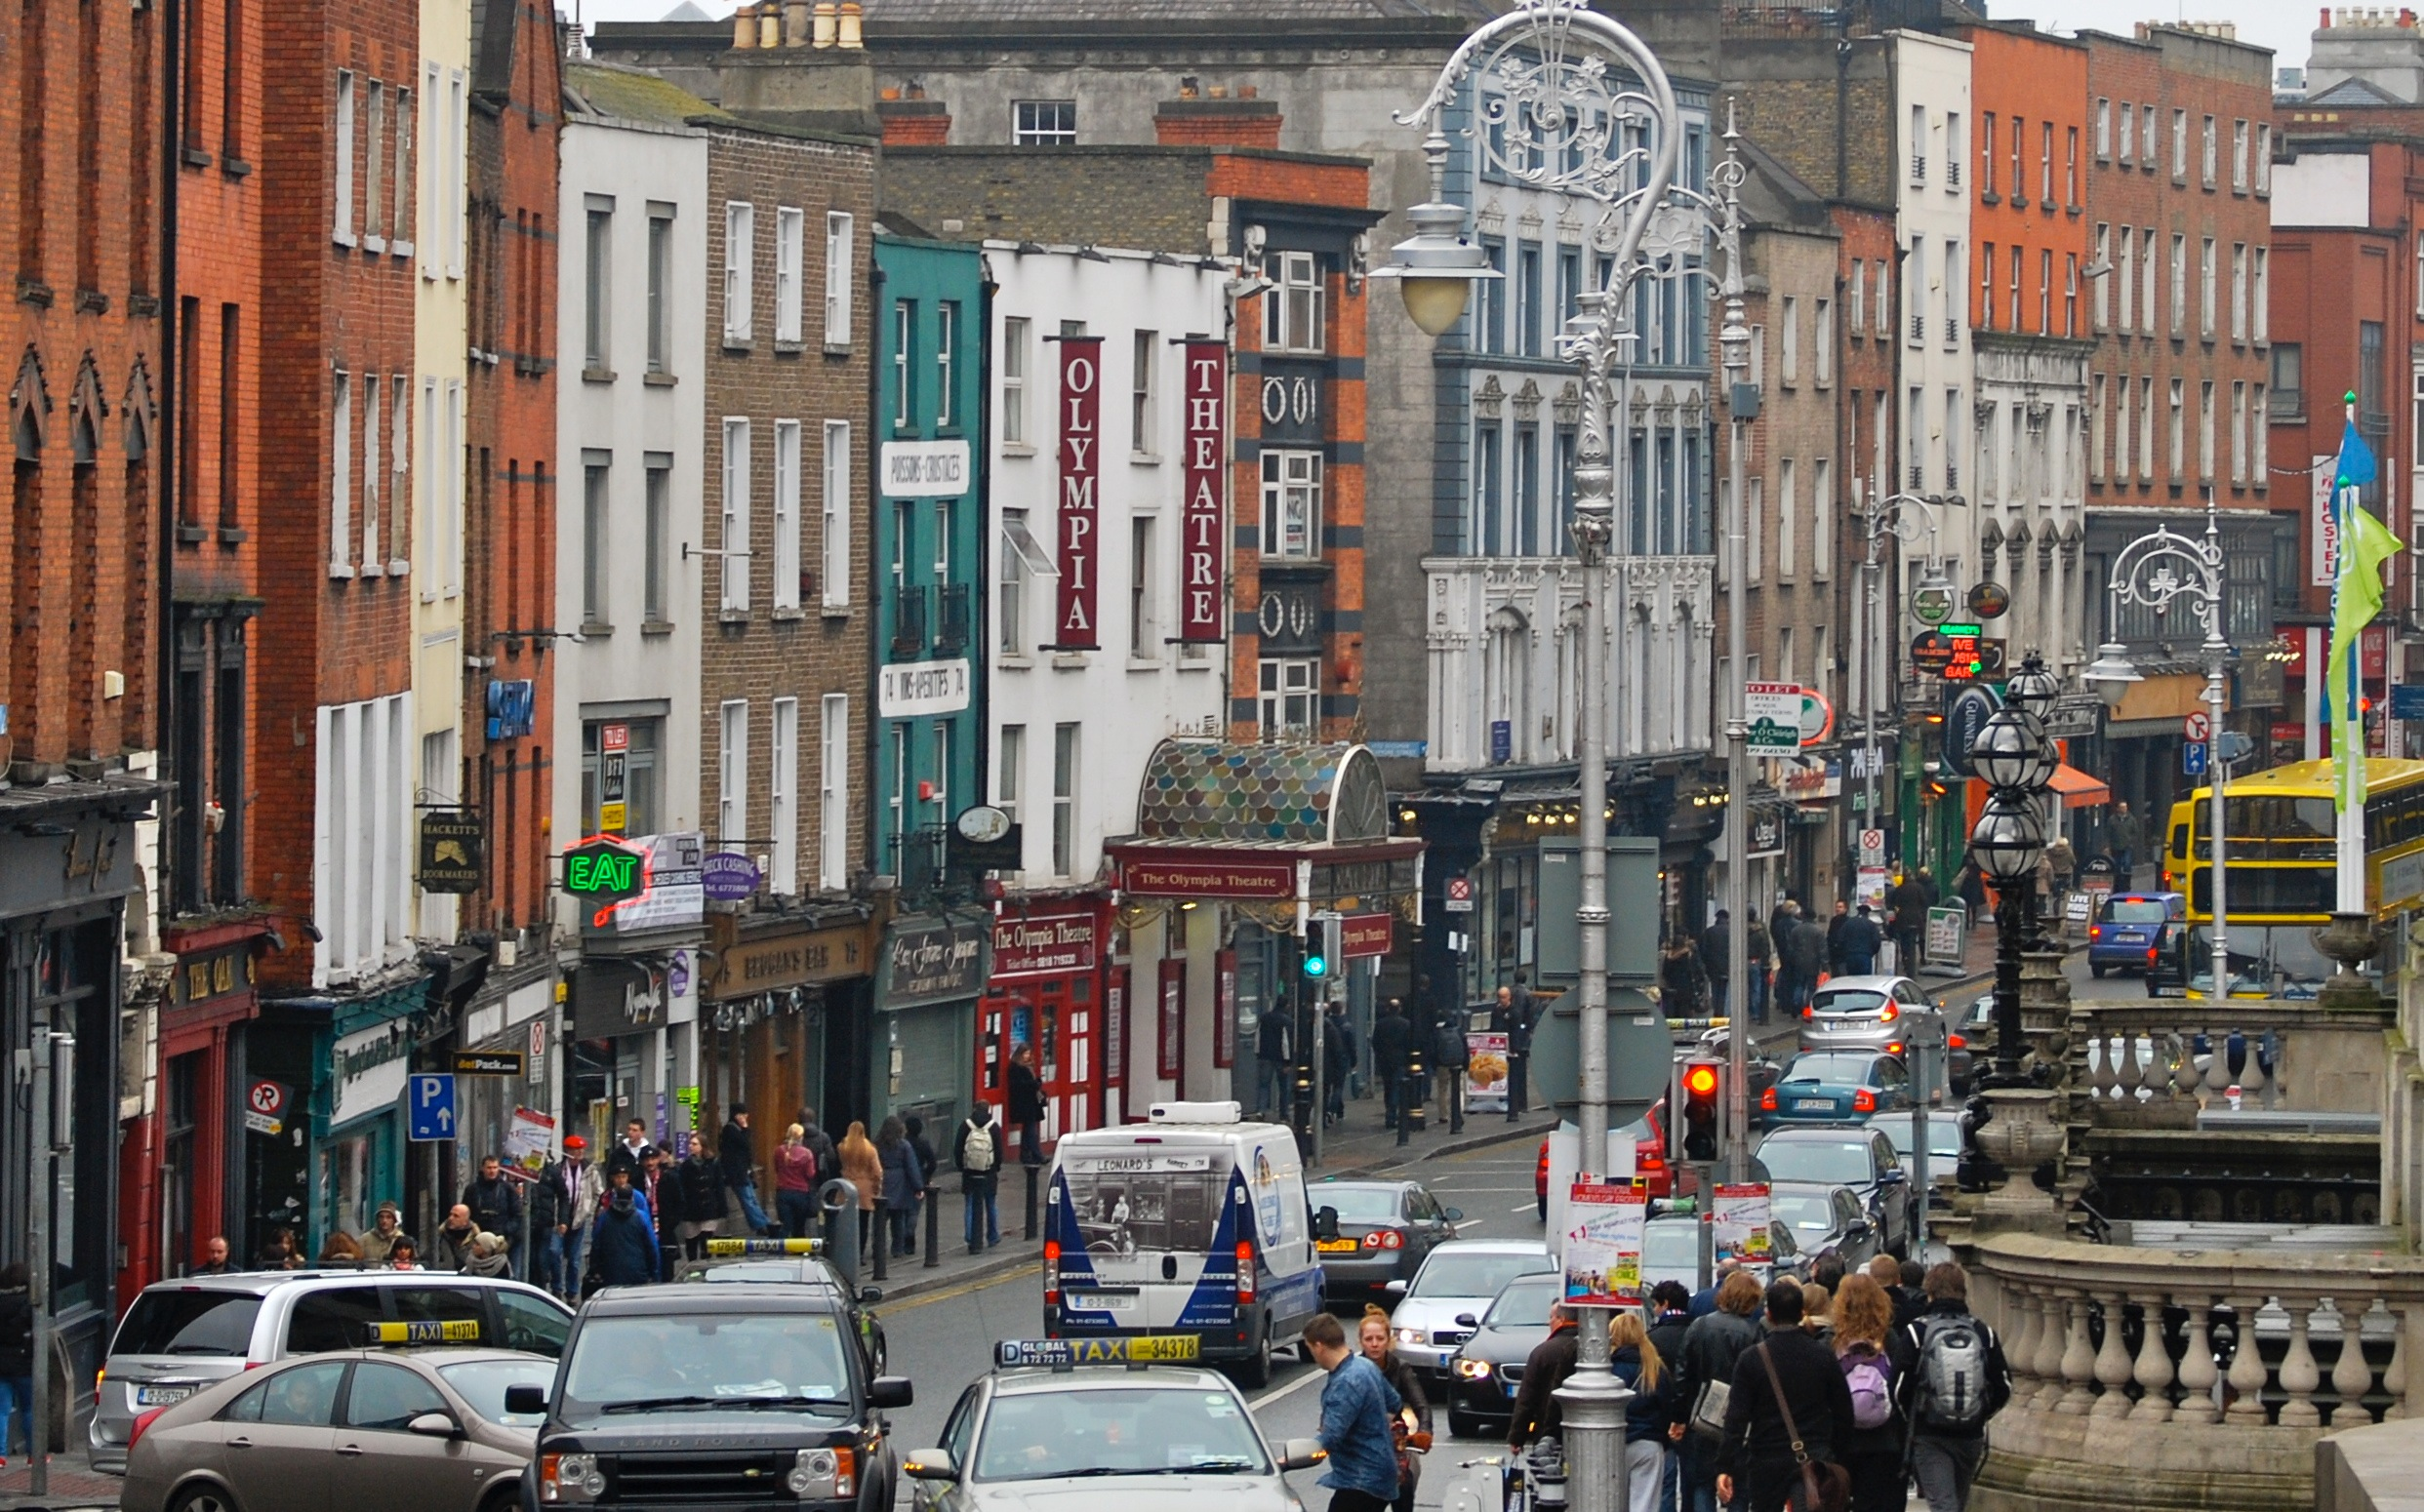
Thinking Geographically

Slide 2
Place in order from the largest to the smallest countries by area.
Country | Order
India
Brazil
Mexico
United States
Canada
4
3
5
2
1

Slide 3
Place in order from the largest to the smallest countries by area.
Country | Order
Poland
North Korea
South Africa
Ukraine
Denmark
3
4
1
2
5

Slide 4
McDonald’s
Total Number
Over 1,000
400 - 999
200 - 399
150 - 199
100 - 149
50 - 99
5 - 49
Less Than 5

Slide 5
A- # McDonalds
Poland
Malaysia
South Korea
India
Netherlands
Total Number
B- # McDonalds
Austria
New Zealand
Switzerland
Israel
South Africa
Total Number
C- # McDonalds
Bahamas
Fiji
Suriname
Brunei
Cuba
Total Number
D- # McDonalds
Morocco
Qatar
Serbia
Cyprus
Luxembourg
Total Number
Number of McDonalds
E- # McDonalds
Australia
Brazil
Mexico
Italy
Spain
Total Number
F- # McDonalds
Venezuela
Singapore
Portugal
Saudi Arabia
Indonesia
Total Number
G- # McDonalds
Japan
China
Germany
Canada
France
Total Number
H- # McDonalds
Czech Republic
Denmark
Finland
Ukraine
Panama
Total Number

Slide 6
G
Japan
China
Germany
Canada
France
Total Number | Over 1,000
E
Australia
Brazil
Mexico
Italy
Spain
Total Number | 400-999
A
Poland
Malaysia
South Korea
India
Netherlands
Total Number | 200-399
B
Austria
New Zealand
Switzerland
Israel
South Africa
Total Number | 150-199
Number of McDonalds
F
Venezuela
Singapore
Portugal
Saudi Arabia
Indonesia
Total Number | 100-149
H
Czech Republic
Denmark
Finland
Ukraine
Panama
Total Number | 50-99
D
Morocco
Qatar
Serbia
Cyprus
Luxembourg
Total Number | 5-49
C
Bahamas
Fiji
Suriname
Brunei
Cuba
Total Number | Less Than 5

Slide 7
Place in order the countries with the highest population density to the lowest.
Country | Order
Netherlands
Vietnam
Singapore
Spain
Bangladesh
3
4
1
5
2

Slide 8
Population & Migration

Slide 9
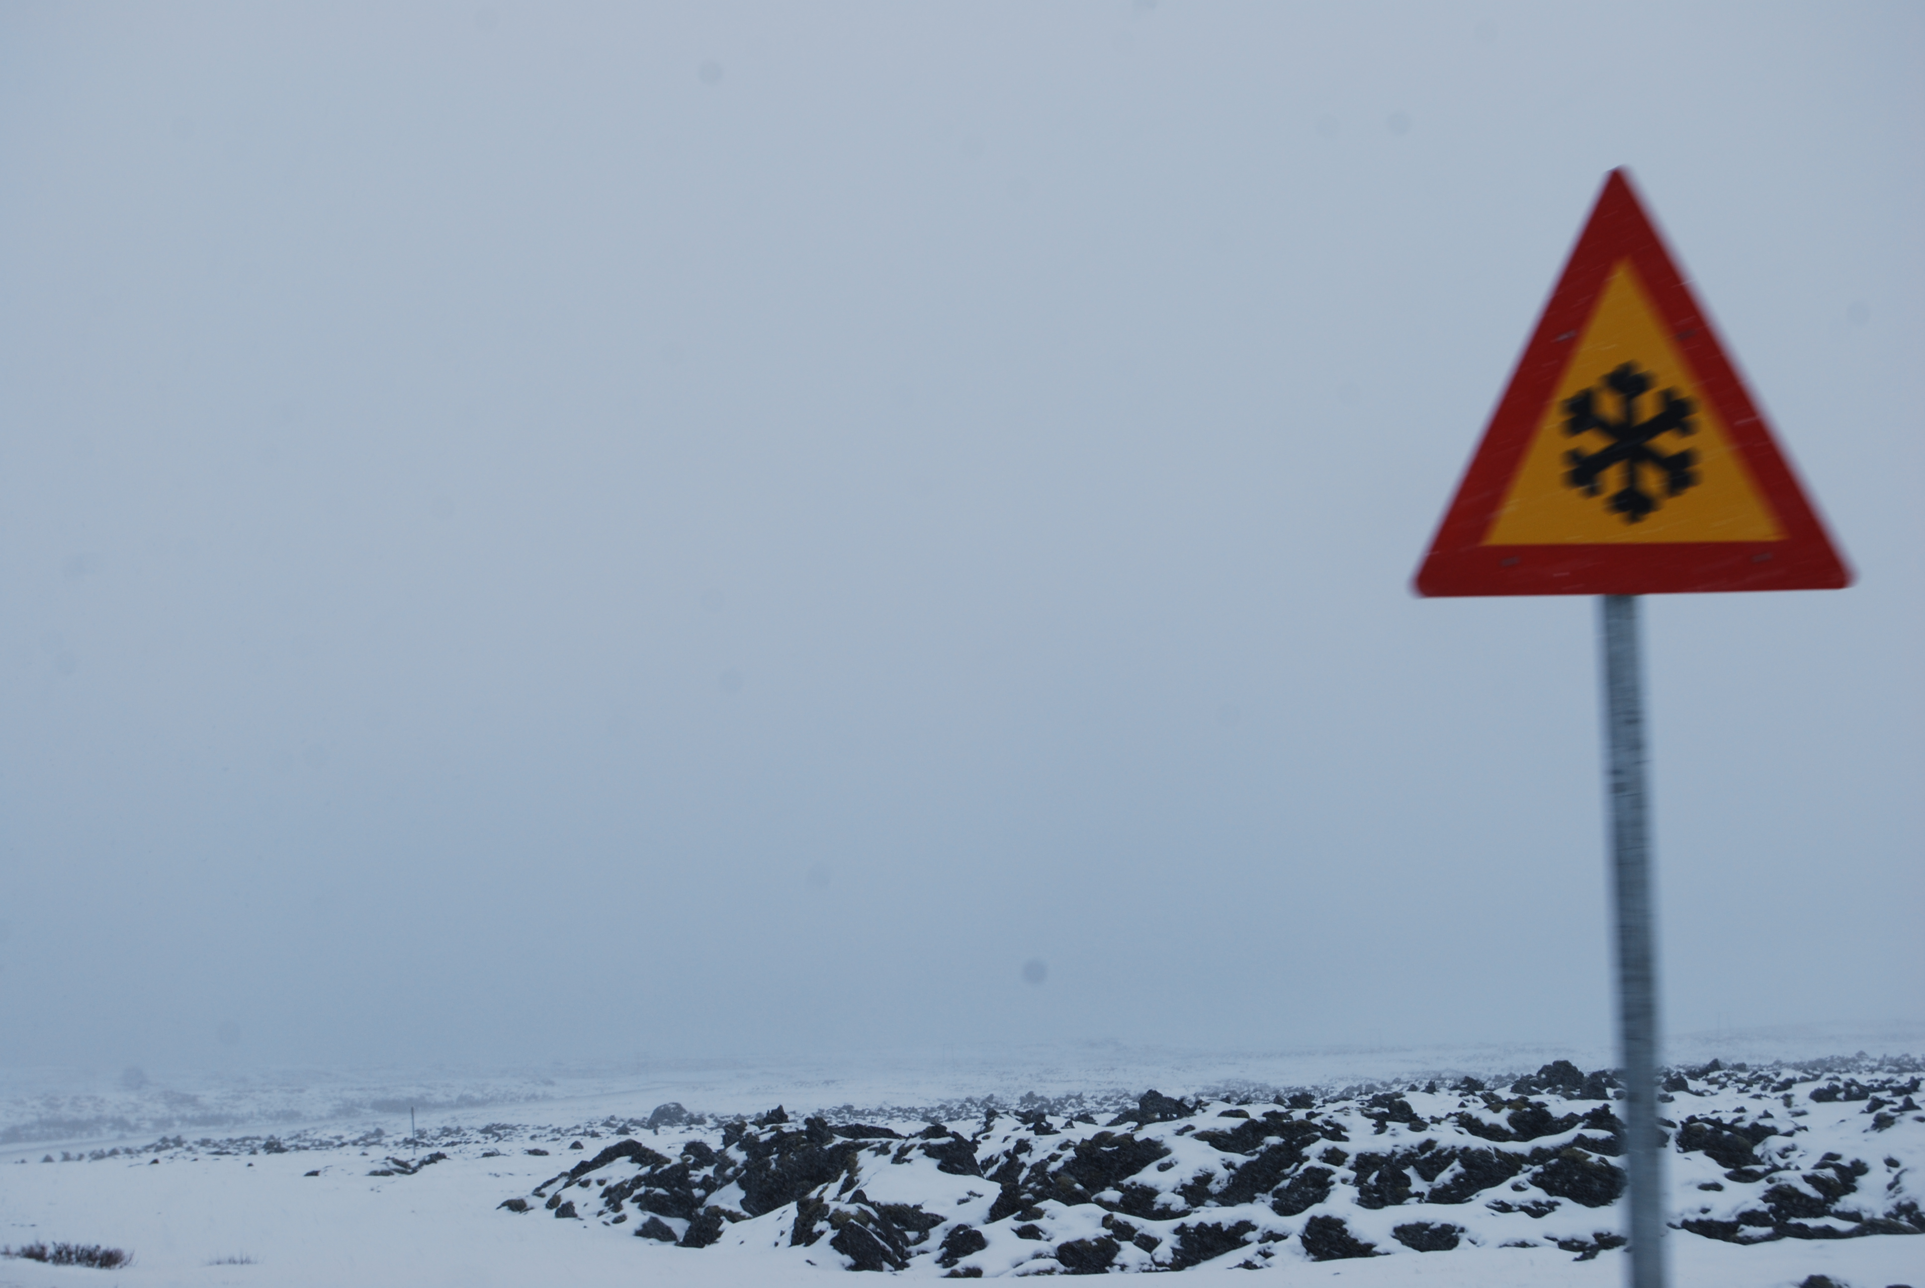
Physiological Density
10,000+
5,000-9,999
3,000-4,999
1,000-2,999
600-999
300-599
100-299
Less Than 100

Slide 10
A
Austria
Panama
Iraq
Greece
Sweden
Total Number
B
China
Pakistan
Peru
India
Germany
Total Number
C
Maldives
Guam
U.A.E.
Qatar
The Bahamas
Total Number
D
Martinique
Cayman Islands
Saint Lucia
Iceland
Malta
Total Number
Physiological Density
E
Japan
Netherlands
Switzerland
Vietnam
Indonesia
Total Number
F
Niger
Canada
Niue
Kazakhstan
Australia
Total Number
G
Spain
Denmark
Mongolia
Argentina
Russia
Total Number
H
Singapore
Bahrain
Kuwait
Oman
U.S. Virgin Islands
Total Number

Slide 11
H
Singapore
Bahrain
Kuwait
Oman
U.S. Virgin Islands
Total Number | 10,000+
C
Maldives
Guam
U.A.E.
Qatar
The Bahamas
Total Number | 5,000-9,999
D
Martinique
Cayman Islands
Saint Lucia
Iceland
Malta
Total Number | 3,000-4,999
E
Japan
Netherlands
Switzerland
Vietnam
Indonesia
Total Number | 1,000-2,999
Physiological Density
B
China
Pakistan
Peru
India
Germany
Total Number | 600-999
A
Austria
Panama
Iraq
Greece
Sweden
Total Number | 300-599
G
Spain
Denmark
Mongolia
Argentina
Russia
Total Number | 100-299
F
Niger
Canada
Niue
Kazakhstan
Australia
Total Number | Less Than 100

Slide 12
Place the countries in order from highest to lowest the number of immigrants entering the USA in 2013.
Country | Order
India
Meixco
China
Dominican Republic
Philippines
3
1
2
5
4

Slide 13
A- % Foreign-Born
China
Indonesia
Vietnam
Cuba
Lesotho
Total Number
B- % Foreign-Born
Holy See
U.A.E.
Qatar
American Samoa
Total Number
C- % Foreign-Born
Monaco
Kuwait
Andorra
Qatar
U.S. Virgin Islands
Total Number
D- % Foreign-Born
Ethiopia
Nicaragua
Mongolia
Haiti
Morocco
Total Number
Percentage Population Foreign-Born
E- % Foreign-Born
Denmark
Italy
Costa Rica
Russia
Finland
Total Number
F- % Foreign-Born
Luxembourg
Singapore
Hong Kong
Saudi Arabia
Oman
Total Number
G- % Foreign-Born
Lithuania
South Africa
Czech Republic
Nepal
Japan
Total Number
H- % Foreign-Born
Switzerland
Australia
Israel
Canada
United States
Total Number

Slide 14
B
Holy See
U.A.E.
Qatar
American Samoa
Total Number | Over 70%
C
Monaco
Kuwait
Andorra
Qatar
U.S. Virgin Islands
Total Number | 50-69.9%
F
Luxembourg
Singapore
Hong Kong
Saudi Arabia
Oman
Total Number | 30-49.9%
H
Switzerland
Australia
Israel
Canada
United States
Total Number | 10-29.9%
Percentage Population Foreign-Born
E
Denmark
Italy
Costa Rica
Russia
Finland
Total Number | 5-9.9%
G
Lithuania
South Africa
Czech Republic
Nepal
Japan
Total Number | 1-4.9%
D
Ethiopia
Nicaragua
Mongolia
Haiti
Morocco
Total Number | 0.2-0.9%
A
China
Indonesia
Vietnam
Cuba
Lesotho
Total Number | 0.1%

Slide 15
Place in order from the largest number of speakers to the lowest number of speakers of the following languages spoken in the USA.
Country | Order
Hebrew
Vietnamese
Arabic
Hindi
Tagalog
5
2
3
4
1

Slide 17
Culture

Slide 18
A - % English Speakers
Italy
Portugal
Spain
India
Rwanda
Correct Order #
B - % English Speakers
Barbados
Ireland
New Zealand
United Kingdom
Australia
Correct Order #
C - % English Speakers
Belgium
Philippines
Greece
Pakistan
France
Correct Order #
Percentage English Speakers
D - % English Speakers
Sri Lanka
Russia
Mexico
China
Honduras
Correct Order #
E - % English Speakers
United States
The Netherlands
Sweden
Denmark
Canada
Correct Order #
F - % English Speakers
Liberia
Singapore
Austria
Cyprus
Germany
Correct Order #

Slide 19
B
Barbados
Ireland
New Zealand
United Kingdom
Australia
95-100%
E
United States
The Netherlands
Sweden
Denmark
Canada
85-94.9%
F
Liberia
Singapore
Austria
Cyprus
Germany
60-84.9&
Percentage English Speakers
C
Belgium
Philippines
Greece
Pakistan
France
35-59.9%
A
Italy
Portugal
Spain
India
Rwanda
10-34.9%
D
Sri Lanka
Russia
Mexico
China
Honduras
Less Than 10%

Slide 20
Place in order from the most popular to the least popular religion in the United States.
Country | Order
Catholic
Presbyterian
United Methodist
Mennonite
Greek Orthodox
1
3
2
5
4

Slide 21
% Population Islam
Sudan
Correct %
% Population Islam
Malaysia
Correct %
% Population Islam
Morocco
Iran
Iraq
Turkey
Niger
Correct %
% Population Islam
Lebanon
Burkina Faso
Kazakhstan
Chad
Brunei
Correct %
% Population Islam
Nigeria
Guinea Bissau
Bosnia
Correct %
% Population Islam
Sweden
Nepal
Italy
Ireland
U.S.A.
Correct %
% Population Islam
Ghana
India
Bulgaria
Uganda
Russia
Correct %
% Population Islam
Kyrgyzstan
Oman
Kuwait
Indonesia
Albania
Correct %
% Population Islam
Benin
Mozambique
Cyprus
v
% Population Islam
Cote d’Ivoire
Eritrea
Macedonia
Ethiopia
Correct %

Slide 22
Islam Population Per Country (Percent)
100-90%
Morocco
Iran
Iraq
Turkey
Niger
89-80%
Kyrgyzstan
Oman
Kuwait
Indonesia
Albania
79-70%
Sudan
69-60%
Malaysia
59-50%
Lebanon
Burkina Faso
Kazakhstan
Chad
Brunei
49-40%
Nigeria
Guinea Bissau
Bosnia
39-30%
Cote d’Ivoire
Eritrea
Macedonia
Ethiopia
29-20%
Benin
Mozambique
Cyprus
19-10%
Ghana
India
Bulgaria
Uganda
Russia
9-0%
Sweden
Nepal
Italy
Ireland
U.S.A.

Slide 23
Place the following states in order from the states with the highest church attendance to the lowest
Country | Order
Nevada
Nebraska
Florida
Alabama
Minnesota
5
2
4
1
3

Slide 24
% Population Christian
Benin
Madagascar
Correct %
% Population Christian
Greece
Norway
Kenya
Lithuania
Austria
Correct %
% Population Christian
UK
Uruguay
Latvia
New Zealand
Netherlands
Correct %
% Population Christian
Lebanon
Chad
Cote d’Ivoire
Mauritius
Sierra Leone
Correct %
% Population Christian
South Korea
Togo
Estonia
Burkina Faso
Correct %
% Population Christian
Ghana
Canada
Fiji
Belgium
Australia
Correct %
% Population Christian
Romania
Armenia
Colombia
Puerto Rico
Bahamas
Correct %
% Population Christian
U.A.E.
Indonesia
Jordan
China
Israel
Correct %
% Population Christian
Cyprus
Burundi
U.S.A.
Botswana
Germany
Correct %
% Population Christian
Egypt
Singapore
Kyrgyzstan
Kuwait
Hong Kong
Correct %

Slide 25
Christianity Population Per Country (Percent)
100-90%
Romania
Armenia
Colombia
Puerto Rico
Bahamas
89-80%
Greece
Norway
Kenya
Lithuania
Austria
79-70%
Cyprus
Burundi
U.S.A.
Botswana
Germany
69-60%
Ghana
Canada
Fiji
Belgium
Australia
59-50%
UK
Uruguay
Latvia
New Zealand
Netherlands
49-40%
Benin
Madagascar
39-30%
Lebanon
Chad
Cote d’Ivoire
Mauritius
Sierra Leone
29-20%
South Korea
Togo
Estonia
Burkina Faso
19-10%
Egypt
Singapore
Kyrgyzstan
Kuwait
Hong Kong
9-0%
U.A.E.
Indonesia
Jordan
China
Israel

Slide 26
Place in following continents in order from the continents with the highest number of countries to the lowest.
Country | Order
North America
South America
Europe
Africa
Asia
4
5
2
1
3

Slide 27
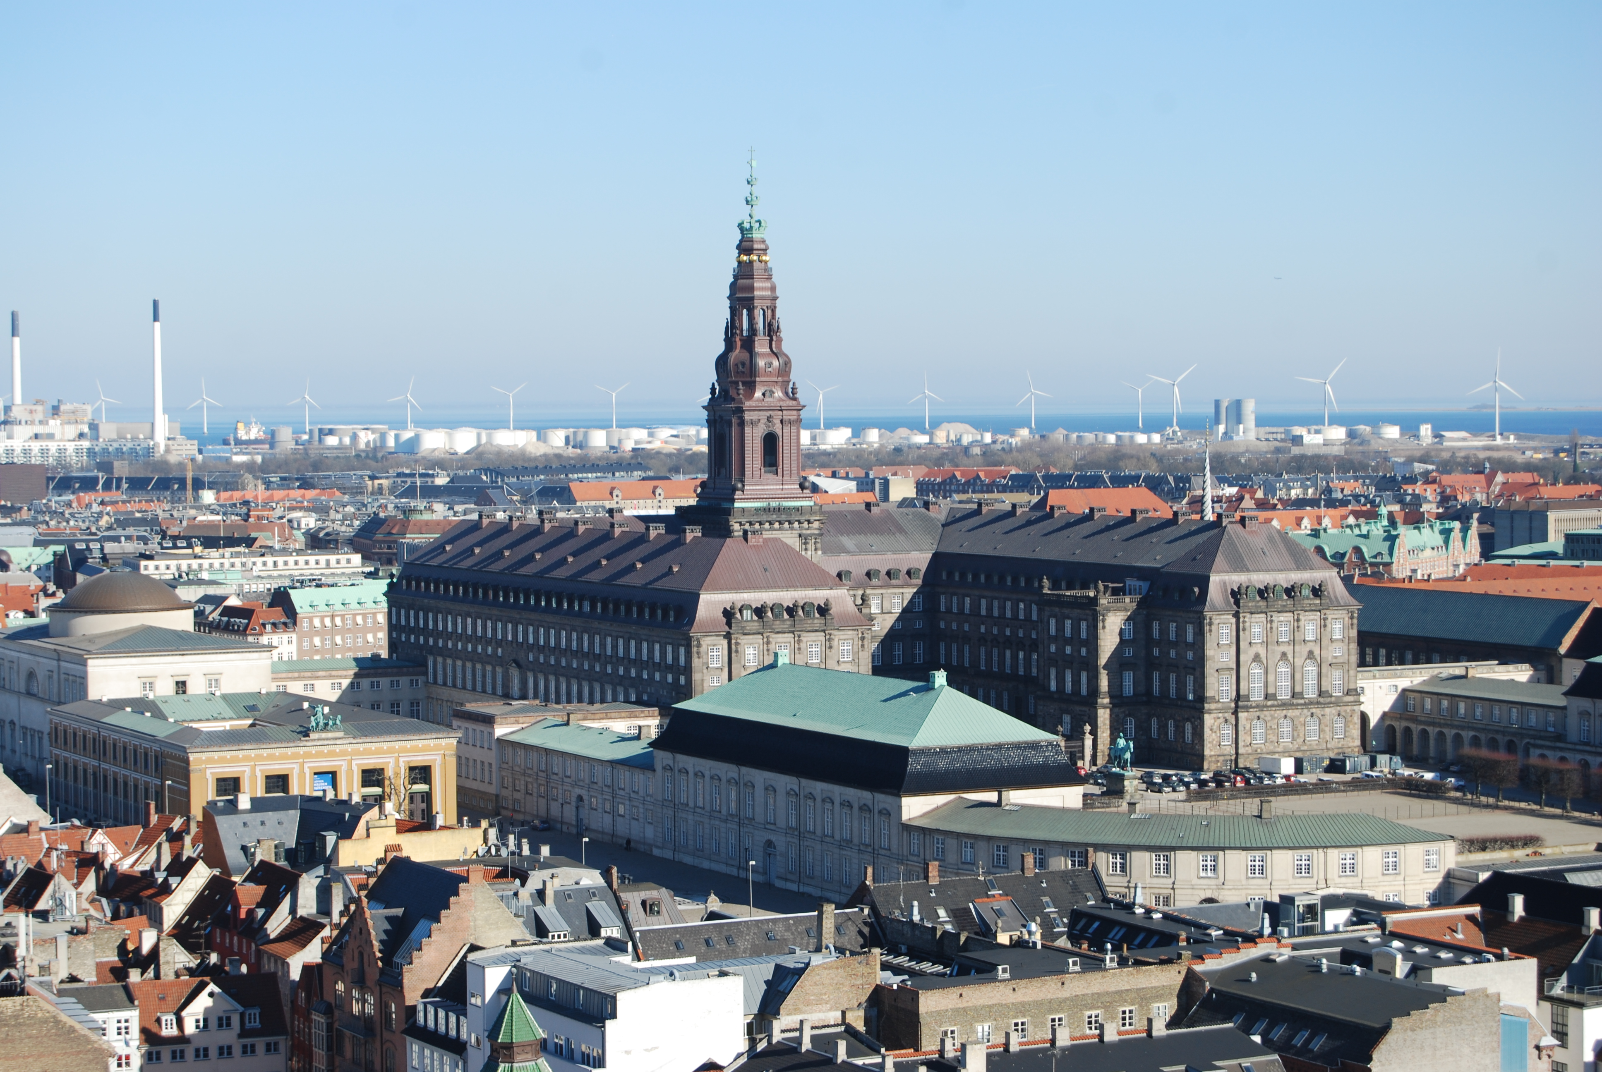
Political

Slide 28
A
Austria
Germany
Ireland
United Kingdom
United States
2014 World Press Freedom Index
B
Italy
Argentina
Japan
Croatia
Panama
2014 World Press Freedom Index
C
Kuwait
Greece
Fiji
Brazil
Algeria
2014 World Press Freedom Index
D
Finland
Netherlands
Norway
Denmark
Iceland
2014 World Press Freedom Index
E
Yemen
Cuba
Sudan
Somalia
Eritrea
2014 World Press Freedom Index
F
Indonesia
Zimbabwe
Ethiopia
Russia
Singapore
2014 World Press Freedom Index

Slide 29
D
Finland
Netherlands
Norway
Denmark
Iceland
1
A
Austria
Germany
Ireland
United Kingdom
United States
2
B
Italy
Argentina
Japan
Croatia
Panama
3
2014 World Press Freedom Index
C
Kuwait
Greece
Fiji
Brazil
Algeria
4
F
Indonesia
Zimbabwe
Ethiopia
Russia
Singapore
5
E
Yemen
Cuba
Sudan
Somalia
Eritrea
6

Slide 30
Place in order countries with the highest percentage of females in their national government (parliament).
Country | Order
Rwanda
New Zealand
China
Finland
United States
1
3
4
2
5

Slide 31
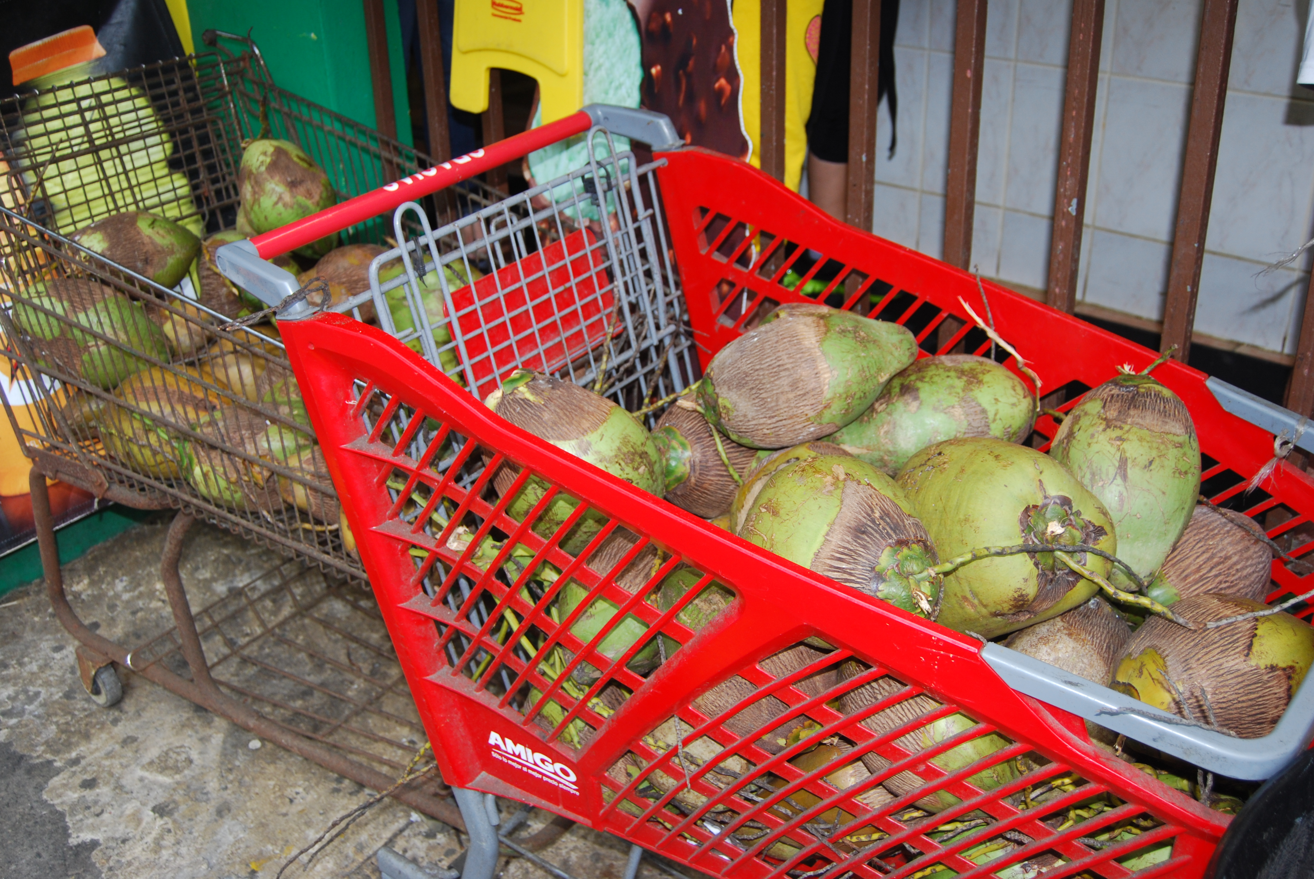
Agriculture & Land Use

Slide 32
A - % Arable Land
Turkey
Spain
United Kingdom
The Netherlands
Vietnam
Correct Order #
B - % Arable Land
Hungary
India
Rwanda
Lithuania
Poland
Correct Order #
C - % Arable Land
Switzerland
Russia
Finland
Canada
Egypt
Correct Order #
Percentage Arable Land
D - % Arable Land
Romania
France
Germany
Nigeria
El Salvador
Correct Order #
E - % Arable Land
United States
Ghana
Ireland
Iraq
South Africa
Correct Order #
F - % Arable Land
Bangladesh
Moldova
Ukraine
Denmark
Correct Order #

Slide 33
F
Bangladesh
Moldova
Ukraine
Denmark
Over 50%
B
Hungary
India
Rwanda
Lithuania
Poland
40-49.9%
D
Romania
France
Germany
Nigeria
El Salvador
30-39.9%
Percentage Arable Land
A
Turkey
Spain
United Kingdom
The Netherlands
Vietnam
20-29.9%
E
United States
Ghana
Ireland
Iraq
South Africa
10-19.9%
C
Switzerland
Russia
Finland
Canada
Egypt
Less Than 10%

Slide 34
Place in order countries with the highest to lowest percentage of their GDP in the Agriculture.
Country | Order
India
France
China
Japan
Denmark
1
4
2
5
3

Slide 35
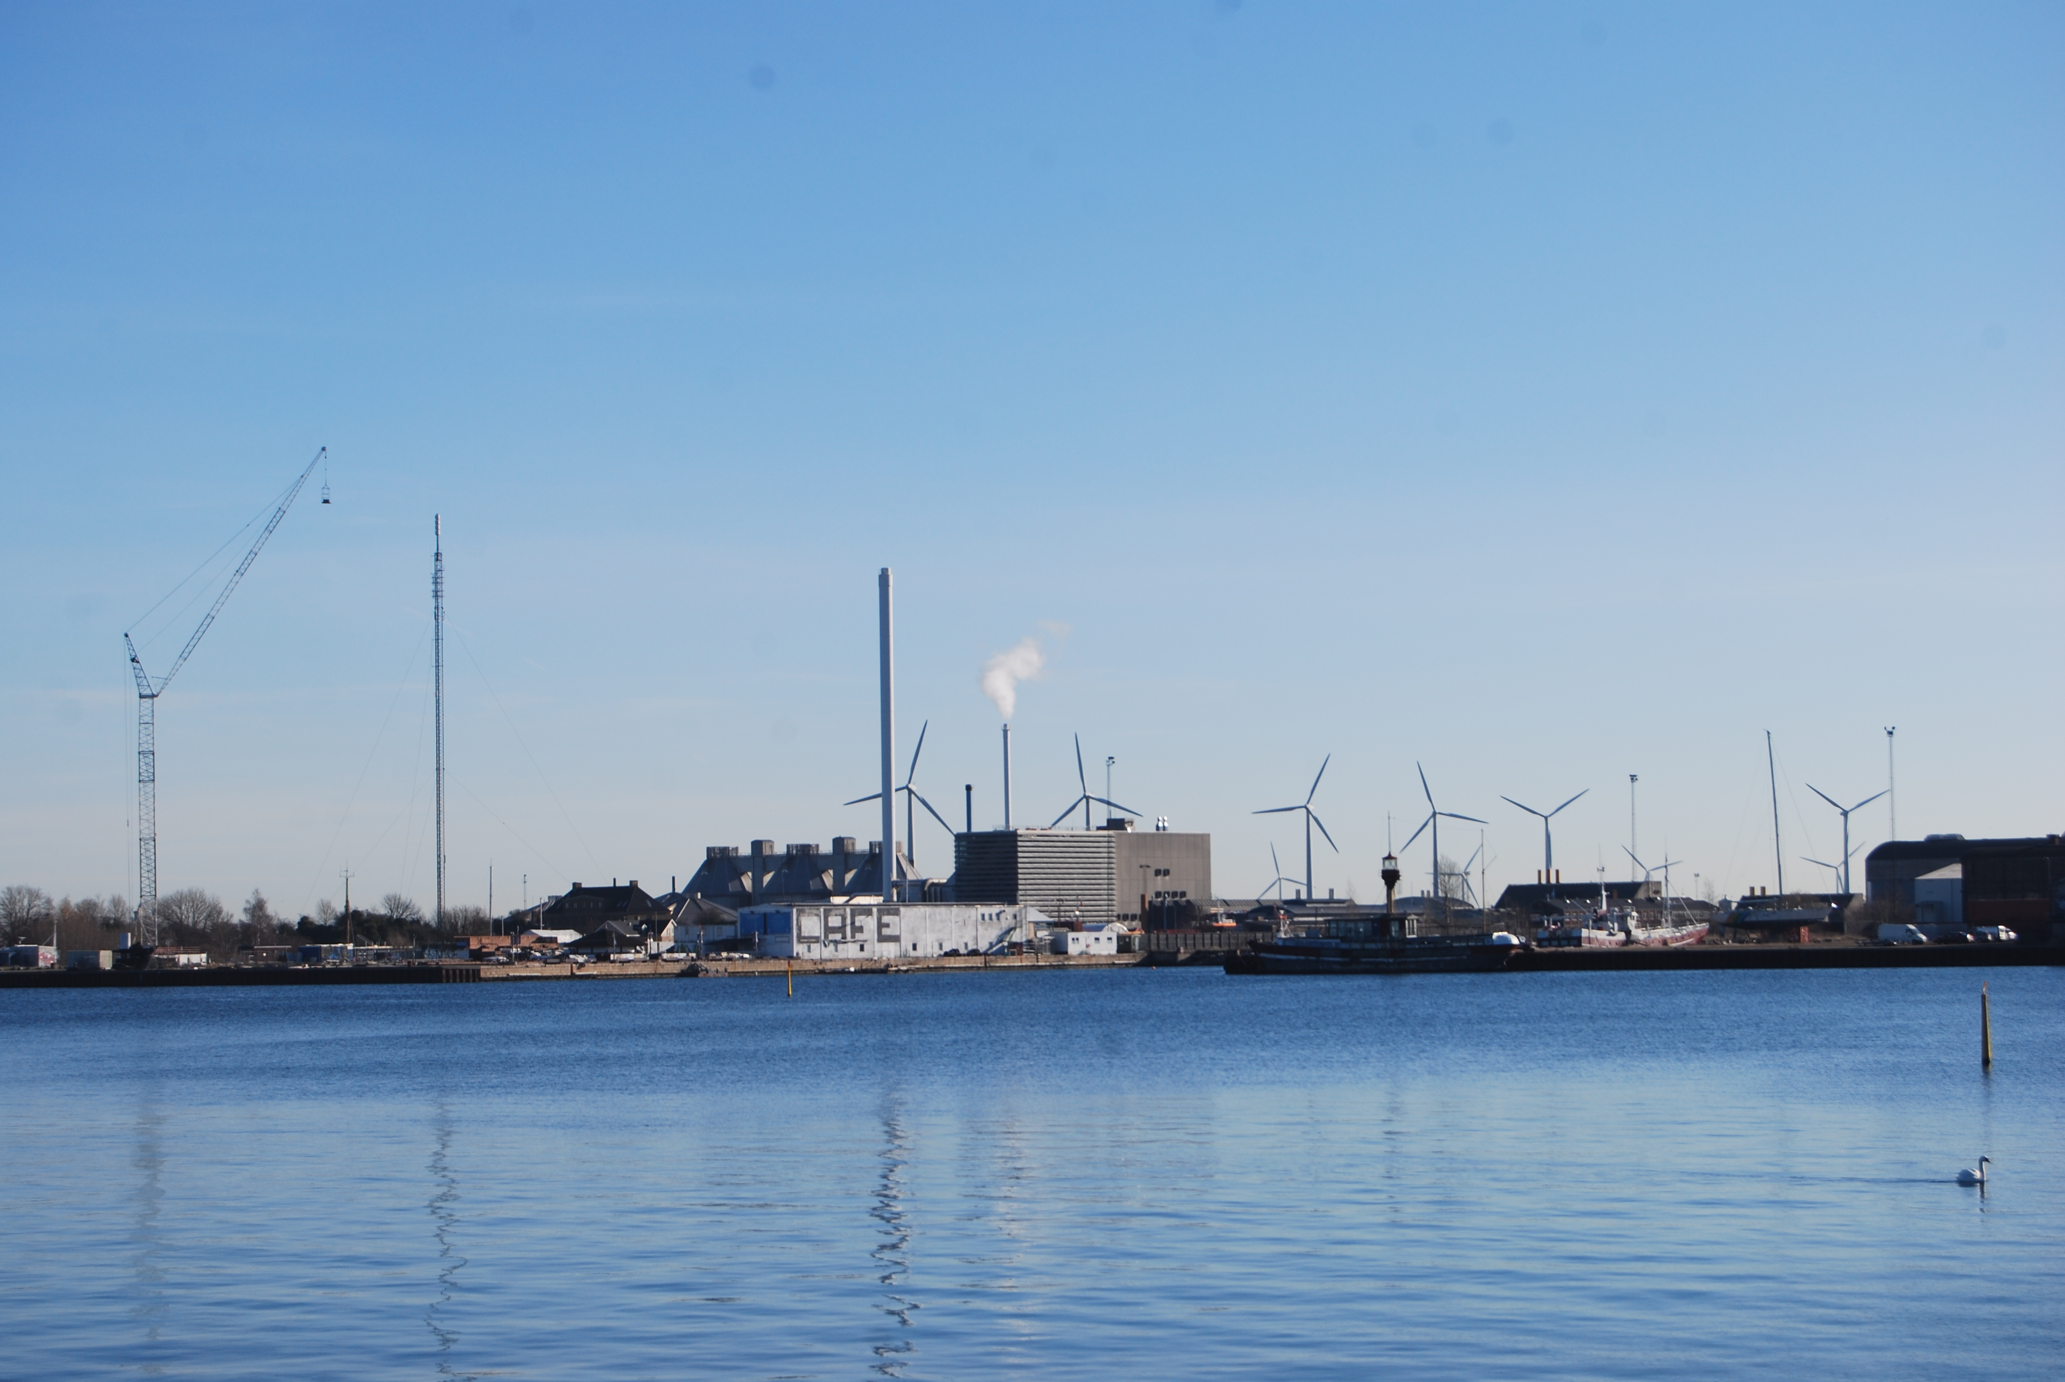
Industry & Development

Slide 36
Place in order countries with the highest to lowest percentage of their GDP in the Service Industry.
Country | Order
France
Russia
China
Spain
Saudi Arabia
1
3
4
2
5

Slide 37
Place in order countries with the highest to lowest percentage of their GDP from Natural Resources.
Country | Order
United Arab Emirates
Russia
Mongolia
Saudi Arabia
India
3
4
2
1
5

Slide 38
Access to Sanitation
Bhutan
Bolivia
Pakistan
Zambia
Zimbabwe
Best Guess
Access to Sanitation
Argentina
Costa Rica
Croatia
Greece
Malaysia
Best Guess
Access to Sanitation
Burkina Faso
Chad
Congo
Guinea
Liberia
Best Guess
Access to Sanitation
Botswana
China
Nauru
Rwanda
Saint Lucia
Best Guess
Access to Sanitation
Brazil
Guatemala
Iraq
Mexico
Moldova
Best Guess
Access to Sanitation
Cambodia
Gabon
India
Namibia
Nepal
Best Guess
Access to Sanitation
Australia
Cyprus
Czech Republic
Finland
Slovenia
Best Guess
Access to Sanitation
Afghanistan
Cote d’Ivoie
Haiti
Kenya
Lesotho
Best Guess
Access to Sanitation
Bangladesh
Micronesia
Mongolia
Nicaragua
Senegal
Best Guess
Access to Sanitation
Colombia
El Salvador
Myanmar
Peru
Philippines
Best Guess

Slide 39
Population With Sustainable Access to Improved Sanitation (Percent)
100%
Australia
Cyprus
Czech Republic
Finland
Slovenia
90%
Argentina
Costa Rica
Croatia
Greece
Malaysia
80%
Brazil
Guatemala
Iraq
Mexico
Moldova
70%
Colombia
El Salvador
Myanmar
Peru
Philippines
60%
Botswana
China
Nauru
Rwanda
Saint Lucia
50%
Bangladesh
Micronesia
Mongolia
Nicaragua
Senegal
40%
Bhutan
Bolivia
Pakistan
Zambia
Zimbabwe
30%
Cambodia
Gabon
India
Namibia
Nepal
20%
Afghanistan
Cote d’Ivoie
Haiti
Kenya
Lesotho
10%
Burkina Faso
Chad
Congo
Guinea
Liberia
Source: http://kff.org/global-indicator/access-to-sanitation/#table

Slide 40
A
Nepal
Botswana
Guyana
Gabon
Indonesia
Correct Order #
B
Congo (DR)
Saudi Arabia
Niger
Afghanistan
Yemen
Correct Order #
C
Mexico
Peru
Algeria
Sri Lanka
Rwanda
Correct Order #
Gender Inequality Index
F
United States
Hungary
Bahrain
Tunisia
Kuwait
Correct Order #
D
Netherlands
Sweden
Denmark
Switzerland
Norway
Correct Order #
E
Czech Republic
Japan
Cyprus
Greece
Poland
Correct Order #

Slide 41
D
Netherlands
Sweden
Denmark
Switzerland
Norway
1
E
Czech Republic
Japan
Cyprus
Greece
Poland
2
F
United States
Hungary
Bahrain
Tunisia
Kuwait
3
Gender Inequality Index
C
Mexico
Peru
Algeria
Sri Lanka
Rwanda
4
A
Nepal
Botswana
Guyana
Gabon
Indonesia
5
B
Congo (DR)
Saudi Arabia
Niger
Afghanistan
Yemen
6

Slide 42
Place in order the countries with the highest to the lowest HDI
Country | Order
Chad
Bhutan
China
Kuwait
Germany
5
4
3
2
1

Slide 43
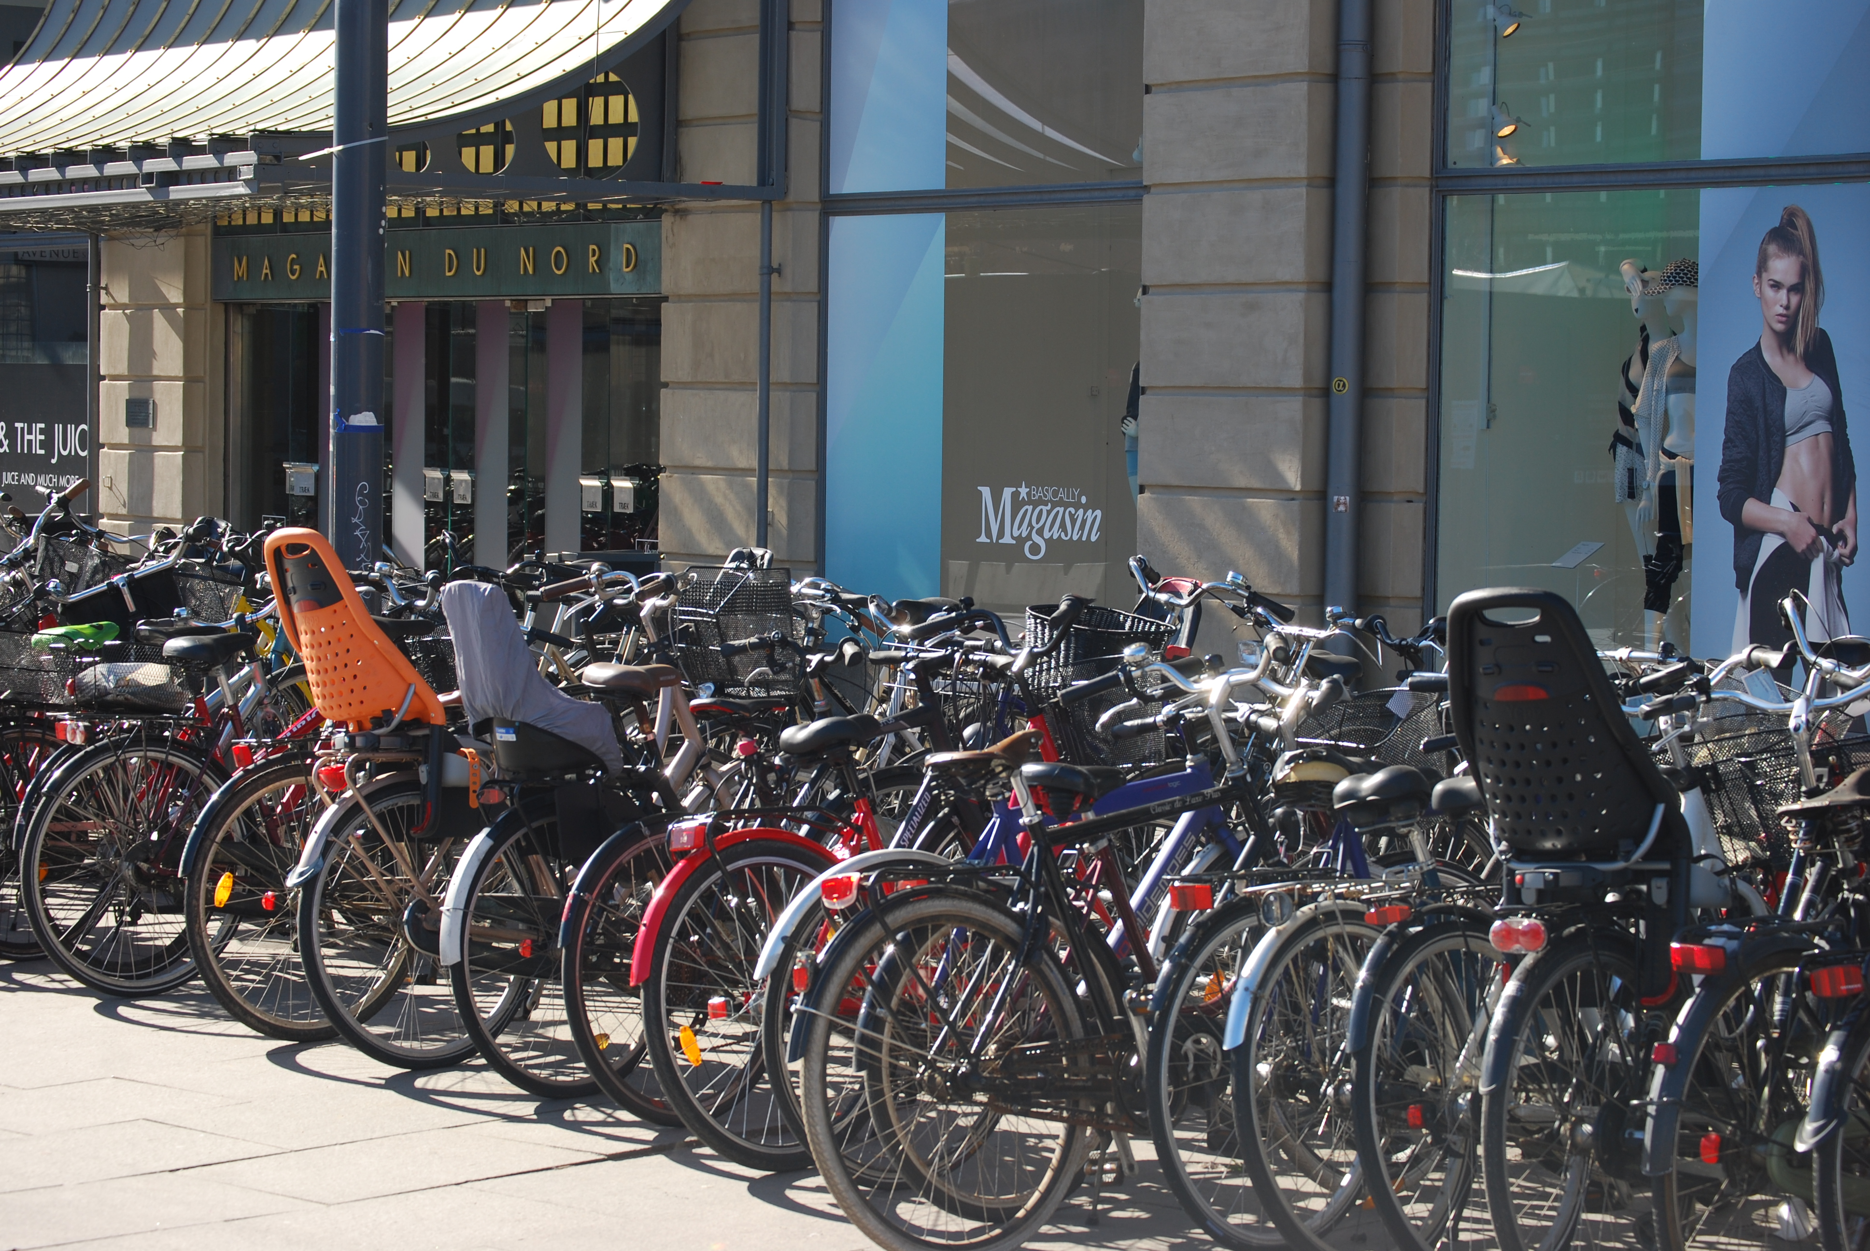
Urbanization

Slide 44
% Urban
Bangladesh
Vanuatu
Kenya
Arghanistan
Chad
A
% Urban
Hungary
Iran
Ukraine
Austria
Tunisia
B
% Urban
Serbia
China
Haiti
Jamaica
Ghana
C
% Urban
Ethiopia
Sri Lanka
Niger
Liechtenstein
Papua New Guinea
D
% Urban
Vatican City
Nauru
Monaco
Macau
Singapore
E
% Urban
Sierra Leone
Somalia
Pakistan
Bhutan
Thailand
F
% Urban
Chile
Denmark
France
Sweden
United States
G
% Urban
Nigeria
Moldova
Barbados
Egypt
Maldives
H
% Urban
Mexico
Spain
Colombia
Belarus
Russia
I
% Urban
Qatar
Belgium
Malta
Iceland
Israel
J

Slide 45
100%
Vatican City
Nauru
Monaco
Macau
Singapore
E
90%
Qatar
Belgium
Malta
Iceland
Israel
J
80%
Chile
Denmark
France
Sweden
United States
G
70%
Mexico
Spain
Colombia
Belarus
Russia
I
60%
Hungary
Iran
Ukraine
Austria
Tunisia
B
Percentage Urban Population
50%
Serbia
China
Haiti
Jamaica
Ghana
C
40%
Nigeria
Moldova
Barbados
Egypt
Maldives
H
30%
Sierra Leone
Somalia
Pakistan
Bhutan
Thailand
F
20%
Bangladesh
Vanuatu
Kenya
Arghanistan
Chad
A
10%
Ethiopia
Sri Lanka
Niger
Liechtenstein
Papua New Guinea
D

Slide 46
Place the cities in order from the largest to the smallest in city population.
Country | Order
New York City
Moscow
Tokyo
London
Mexico City
5
3
1
4
2

