Slide 1
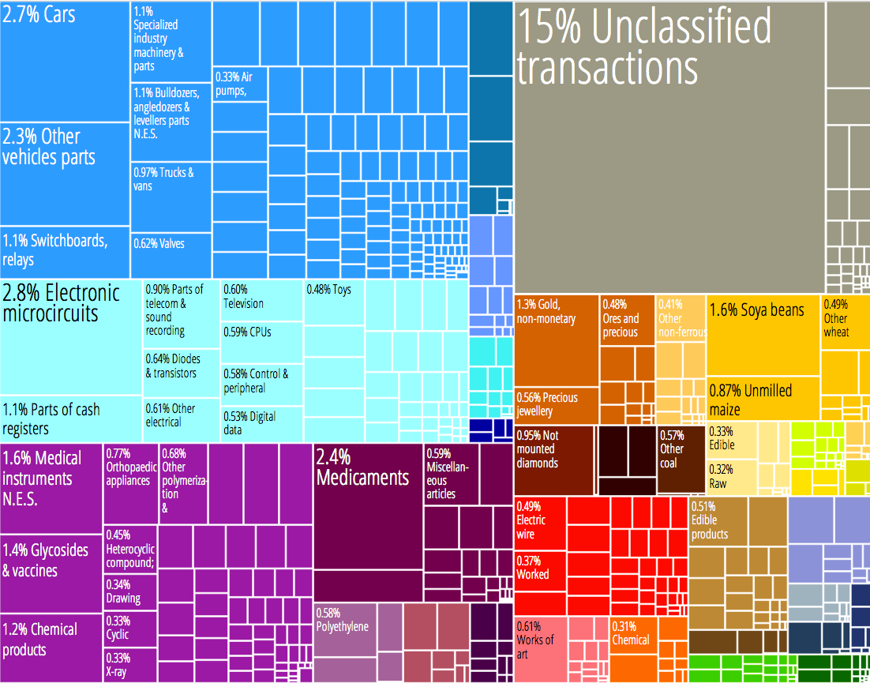
Economic Exports

Slide 2
United States

Slide 3
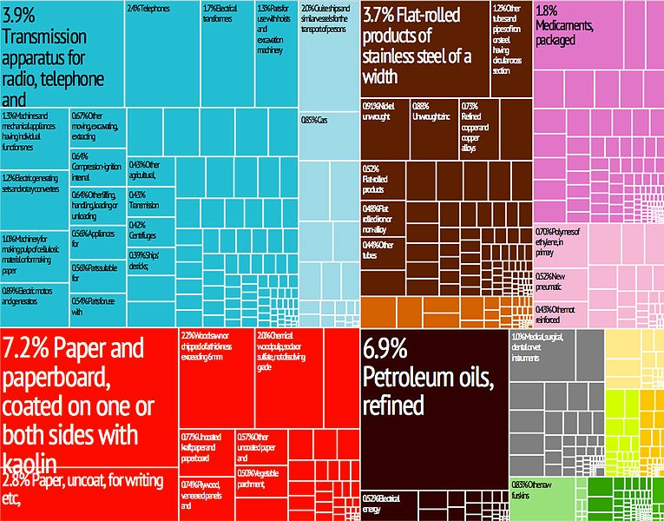
Which country is represented in the graph below?
Albania
Finland
Finland
Italy
Egypt

Slide 4
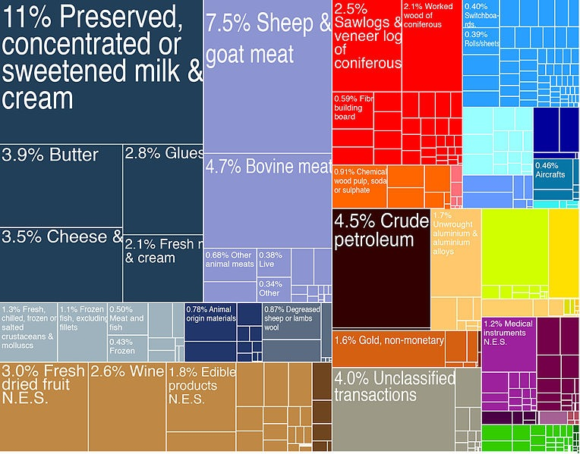
Which country is represented in the graph below?
Singapore
Japan
Fiji
New Zealand
New Zealand

Slide 5
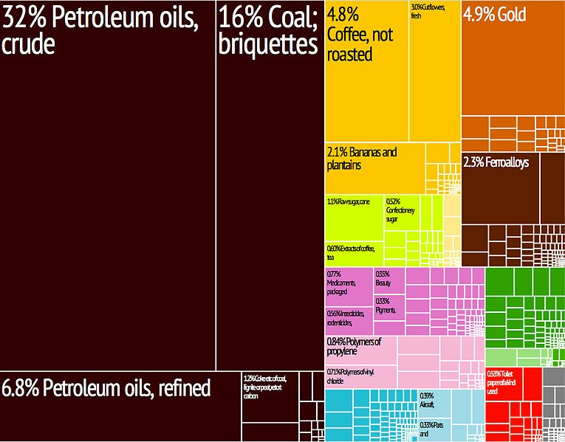
Which country is represented in the graph below?
Colombia
Colombia
Mexico
Canada
Sweden

Slide 6
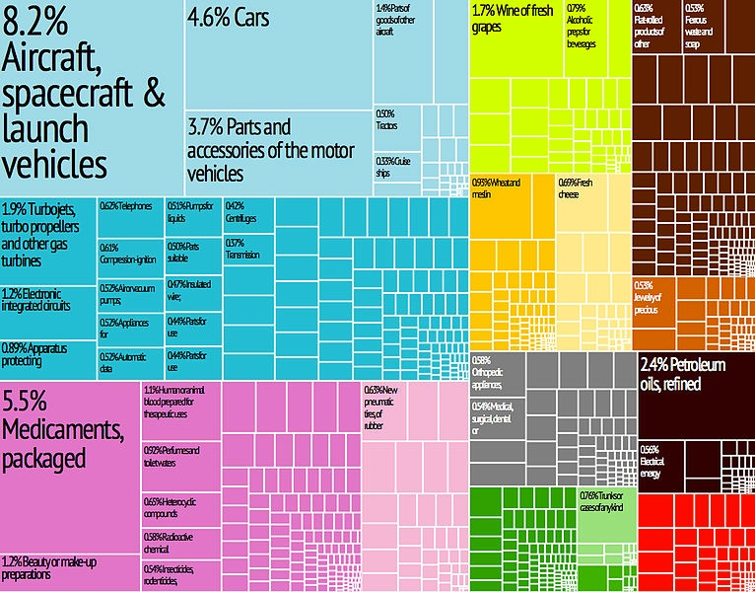
Which country is represented in the graph below?
Russia
Norway
France
France
Cuba

Slide 7
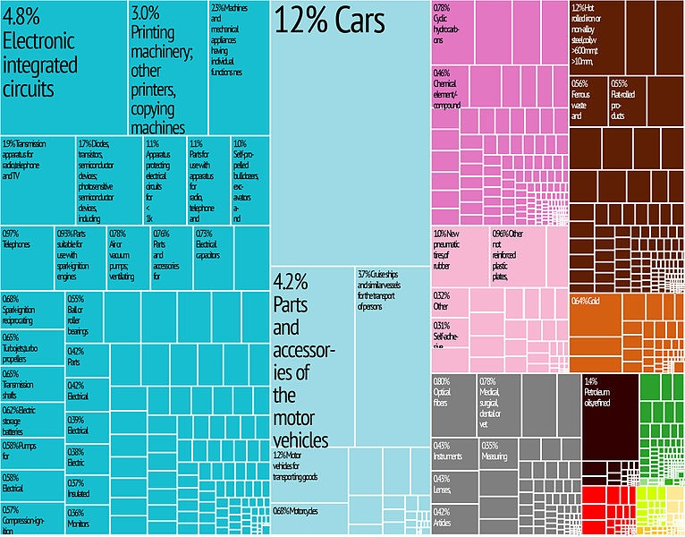
Which country is represented in the graph below?
Japan
Japan
North Korea
Hong Kong
Australia

Slide 8
Which country is represented in the graph below?
Qatar
Qatar
Jordan
Cyprus
Turkey

Slide 9
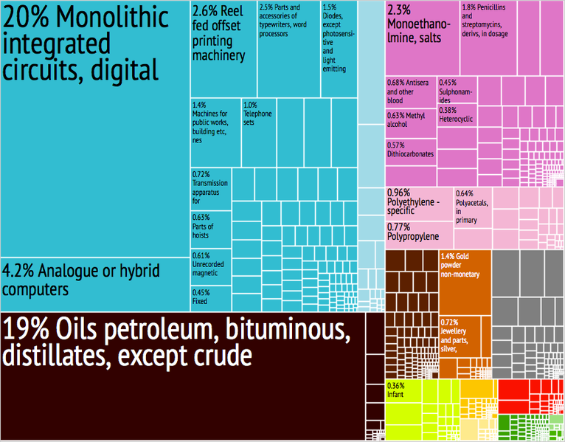
Which country is represented in the graph below?
Bangladesh
Malaysia
Indonesia
Singapore
Singapore

Slide 10
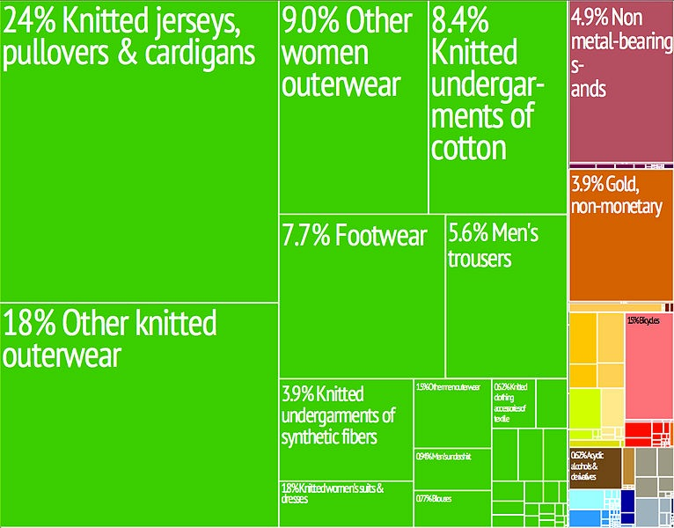
Which country is represented in the graph below?
Cambodia
Cambodia
India
Iraq
Mongolia

Slide 11
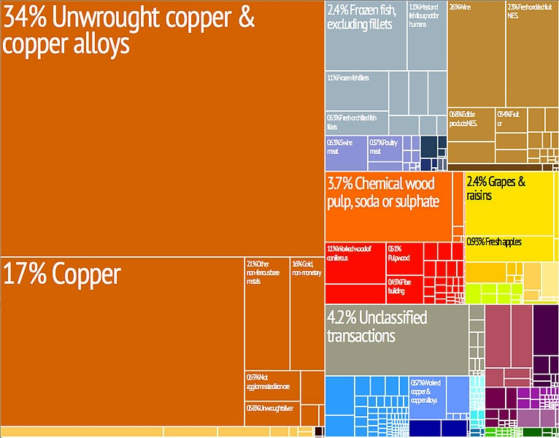
Which country is represented in the graph below?
Peru
Canada
Chile
Chile
Brazil

Slide 12
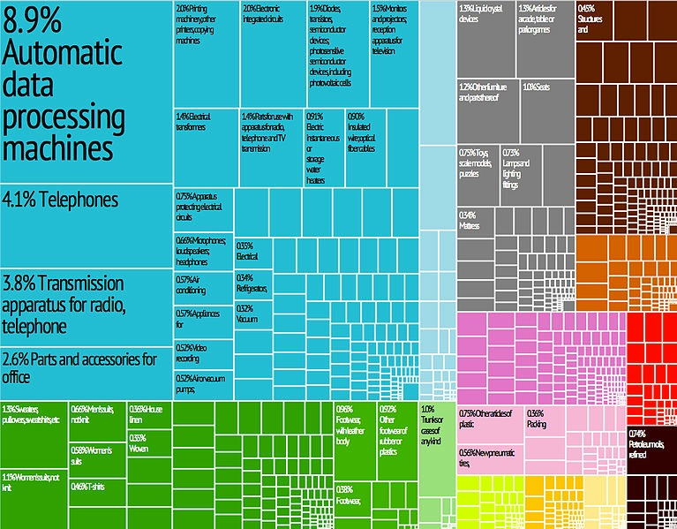
Which country is represented in the graph below?
Portugal
China
China
Pakistan
Russia

Slide 13
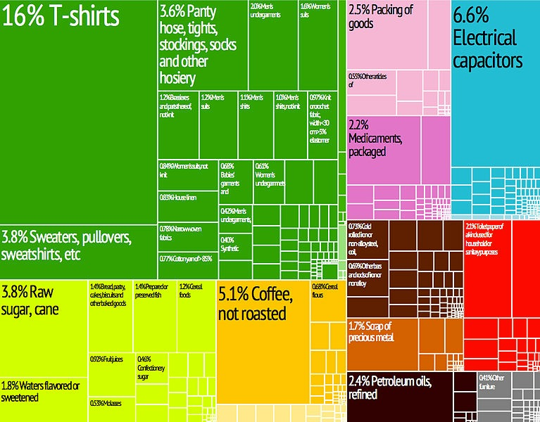
Which country is represented in the graph below?
Costa Rica
Mexico
Bahamas
El Salvador
El Salvador

Slide 14
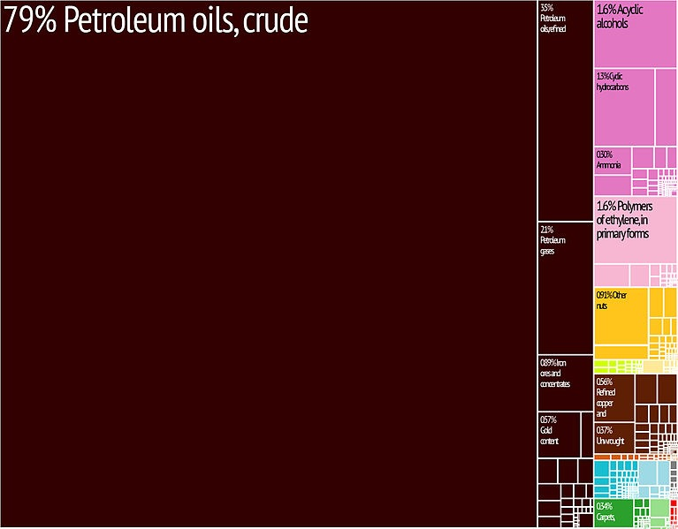
Which country is represented in the graph below?
Ireland
Romania
Iran
Iran
Ukraine

Slide 15
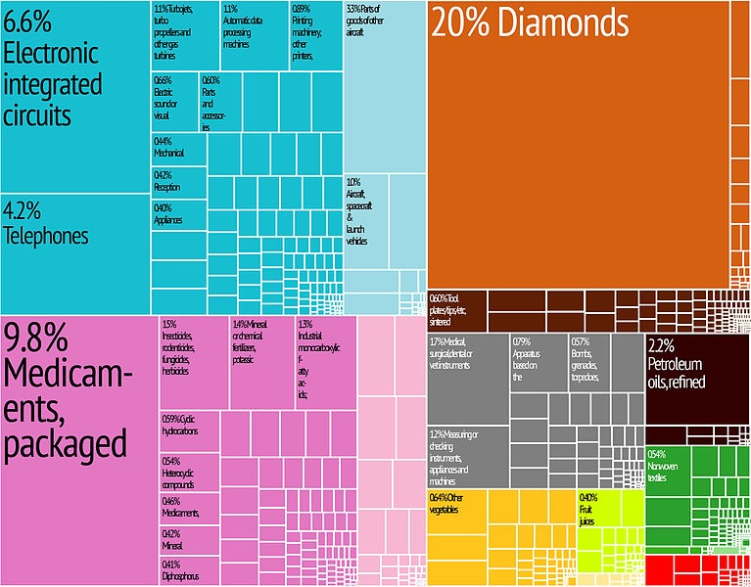
Which country is represented in the graph below?
Kuwait
Israel
Israel
Botswana
India

Slide 16
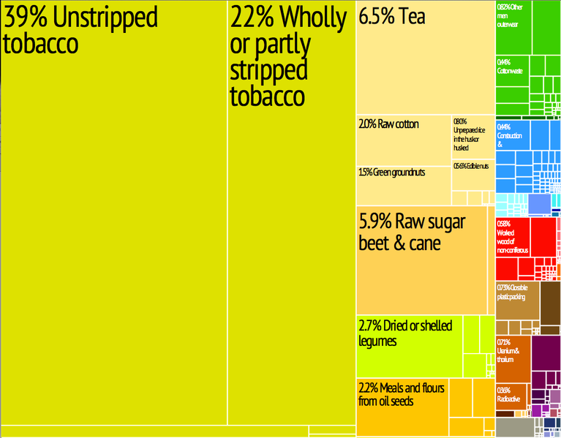
Which country is represented in the graph below?
Malawi
Malawi
South Africa
Sudan
Morocco

Slide 17
Which country is represented in the graph below?
Armenia
Saudi Arabia
Saudi Arabia
Turkey
Jordan

Slide 18
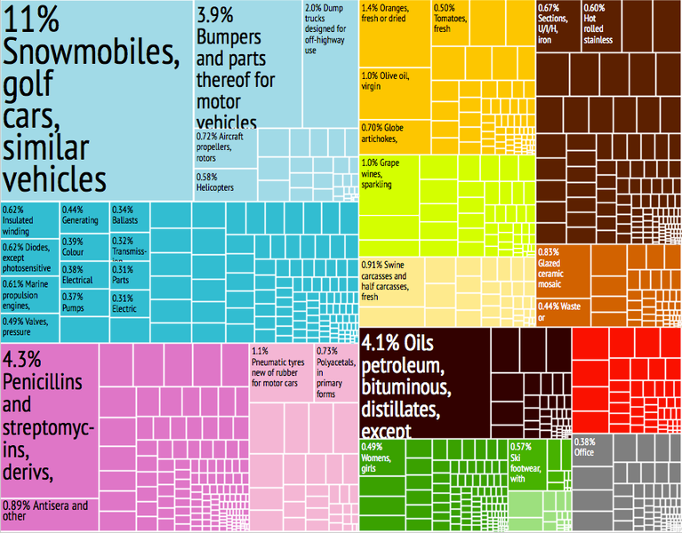
Which country is represented in the graph below?
Spain
Spain
Sweden
Venezuela
Indonesia

Slide 19
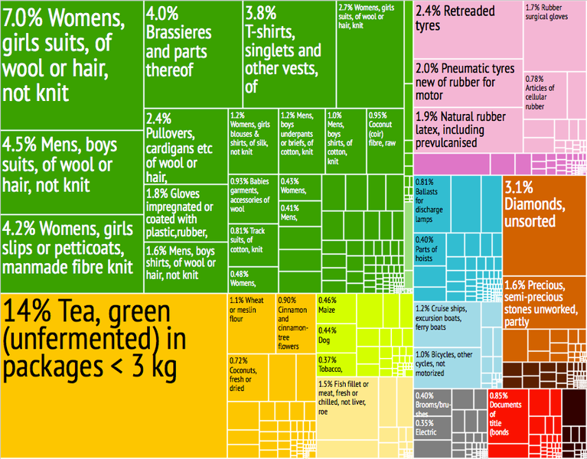
Which country is represented in the graph below?
Bulgaria
Mongolia
Nepal
Sri Lanka
Sri Lanka

Slide 20
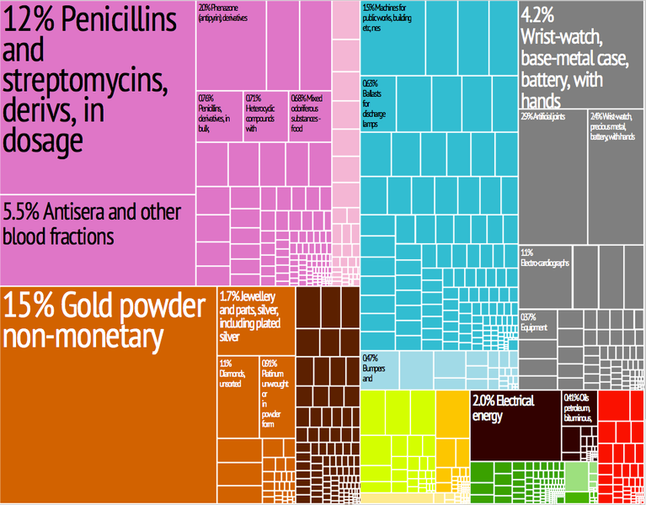
Which country is represented in the graph below?
Kenya
Nigeria
Switzerland
Switzerland
Estonia

Slide 21
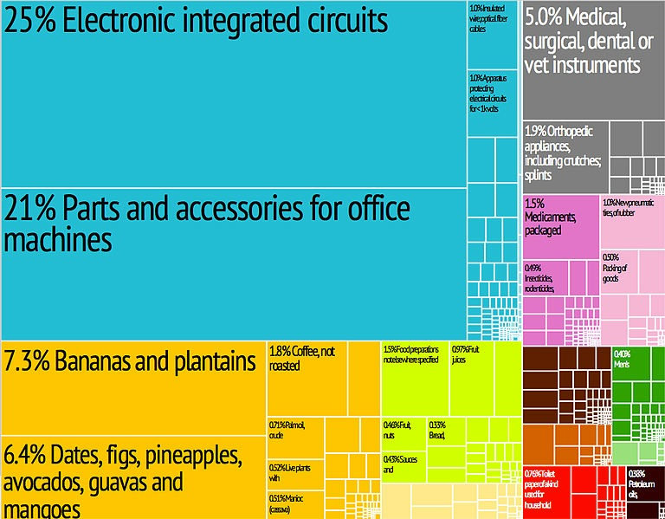
Which country is represented in the graph below?
Belgium
Germany
Costa Rica
Costa Rica
Canada

Slide 22
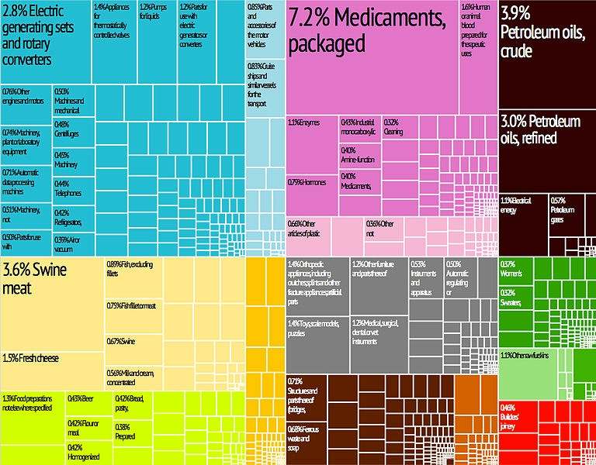
Which country is represented in the graph below?
South Africa
Denmark
Denmark
Singapore
Australia

Slide 23
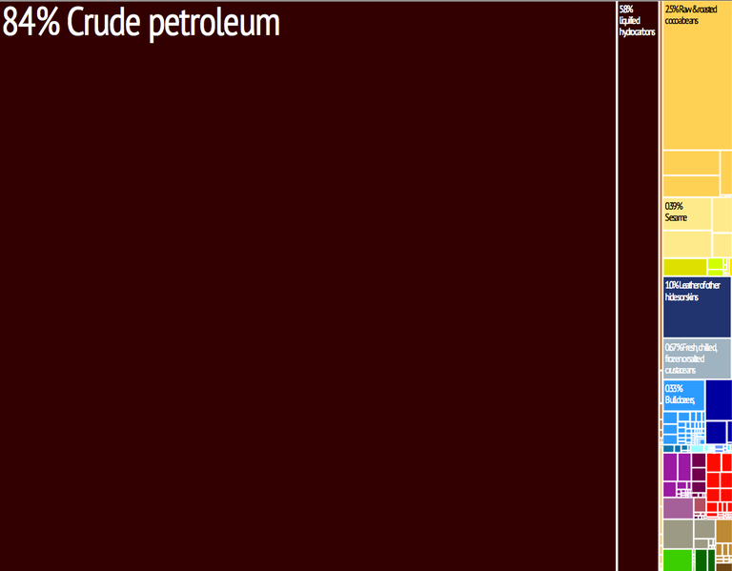
Which country is represented in the graph below?
Tanzania
Kenya
Nigeria
Nigeria
Ghana

Slide 24
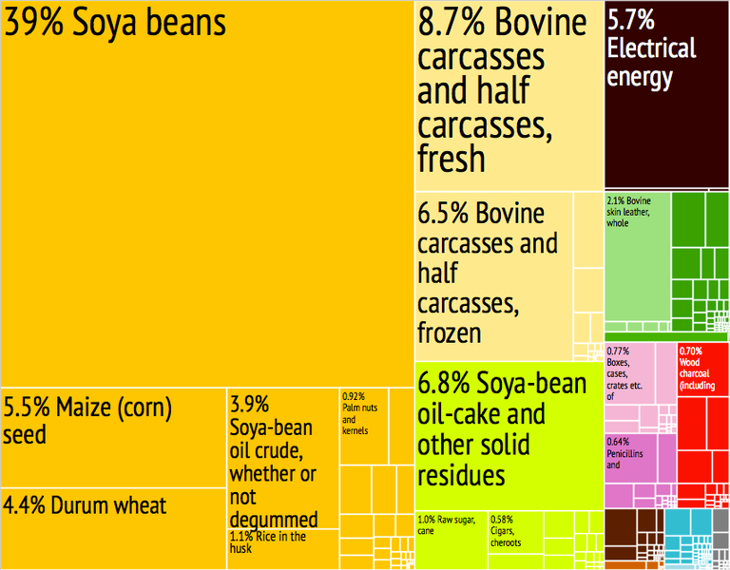
Which country is represented in the graph below?
Paraguay
Paraguay
Brazil
Peru
Panama

Slide 25
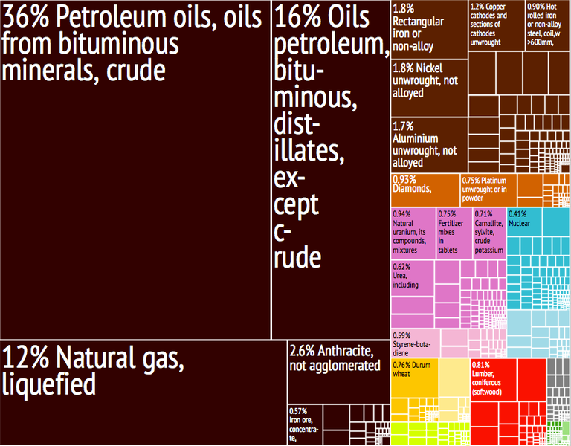
Which country is represented in the graph below?
Brazil
Russia
Russia
China
India

Slide 26
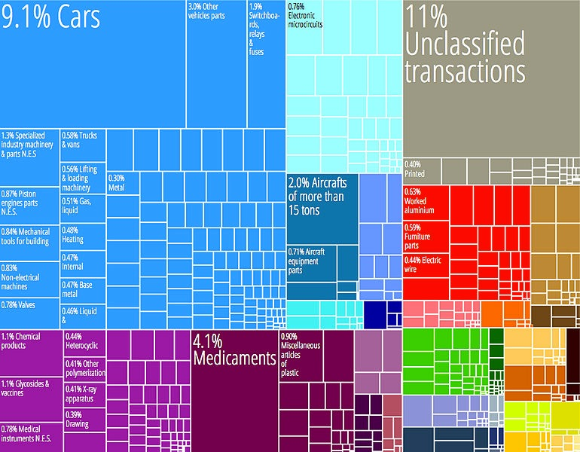
Which country is represented in the graph below?
Vietnam
U.A.E.
Italy
Germany
Germany

Slide 27
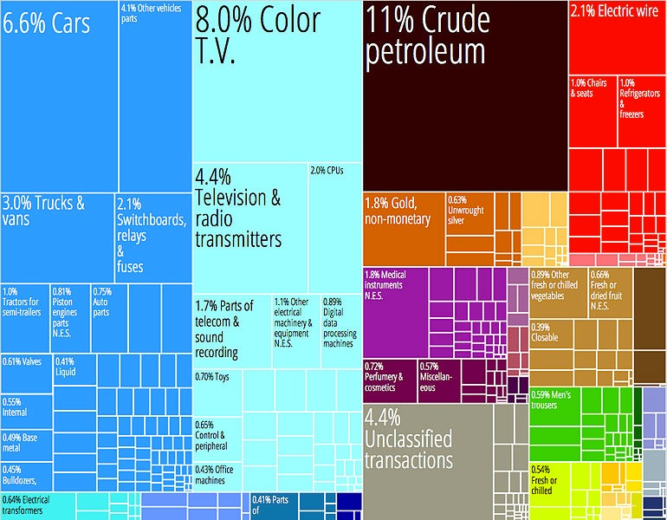
Which country is represented in the graph below?
Mexico
Mexico
Canada
Peru
Argentina

