Slide 1
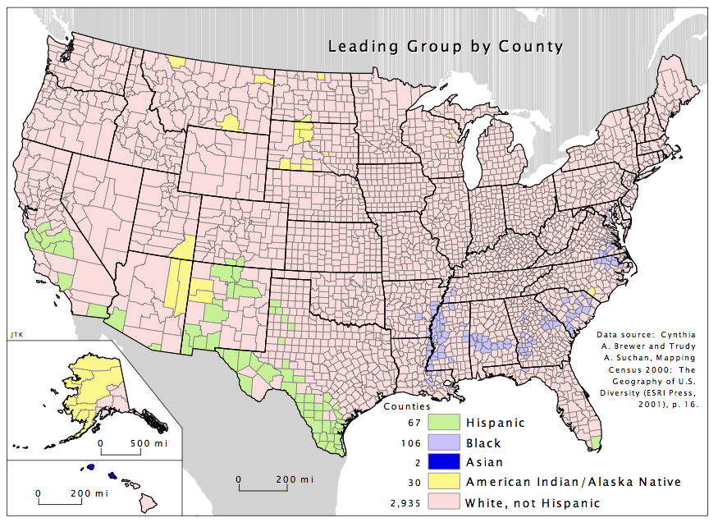
Identify the
Group

Slide 2
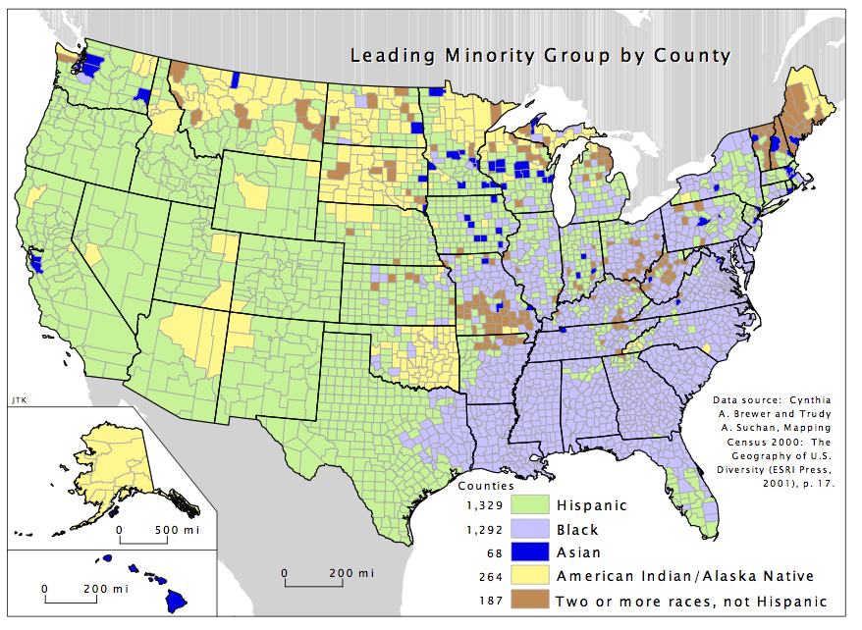
African American
American Indian
Arab
Cajun
Cuban
French
German
Greek
Hispanic
Irish
Italian
Korean
Russian
Scandinavian
Scots-Irish
Bell Ringer Activity

Slide 3
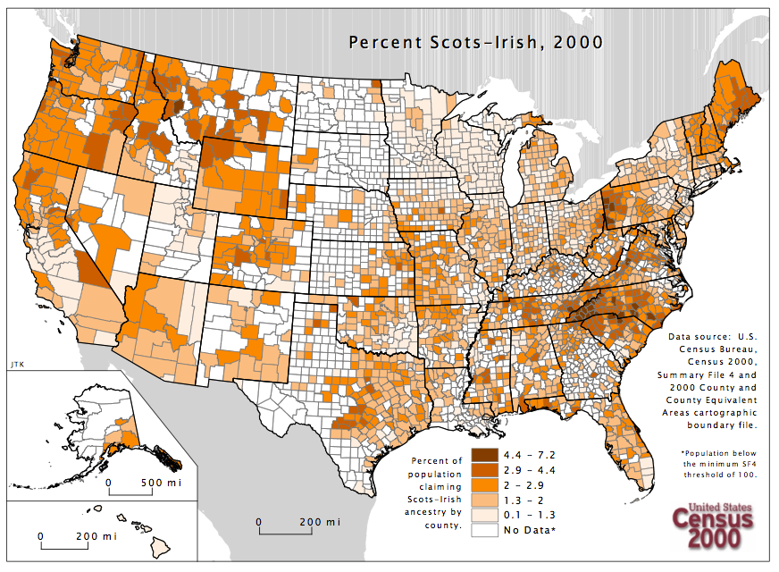
CHOICES
African American
American Indian
Arab
Cajun
Cuban
French
German
Greek
Hispanic
Irish
Italian
Korean
Russian
Scandinavian
Scots-Irish

Slide 4
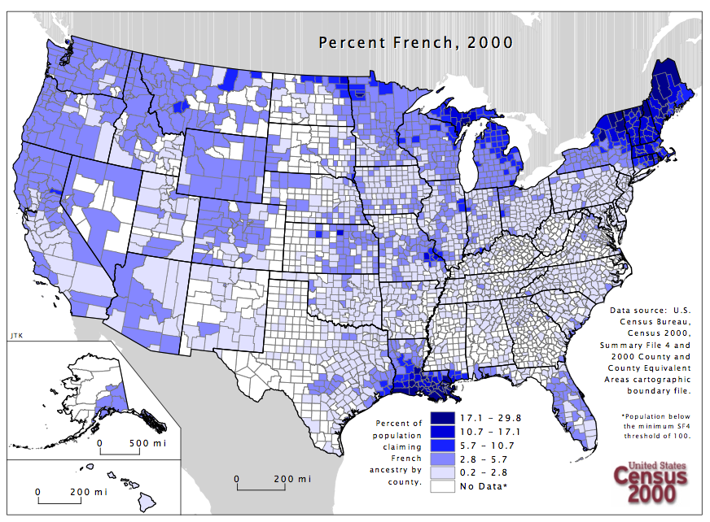
CHOICES
African American
American Indian
Arab
Cajun
Cuban
French
German
Greek
Hispanic
Irish
Italian
Korean
Russian
Scandinavian
Scots-Irish

Slide 5
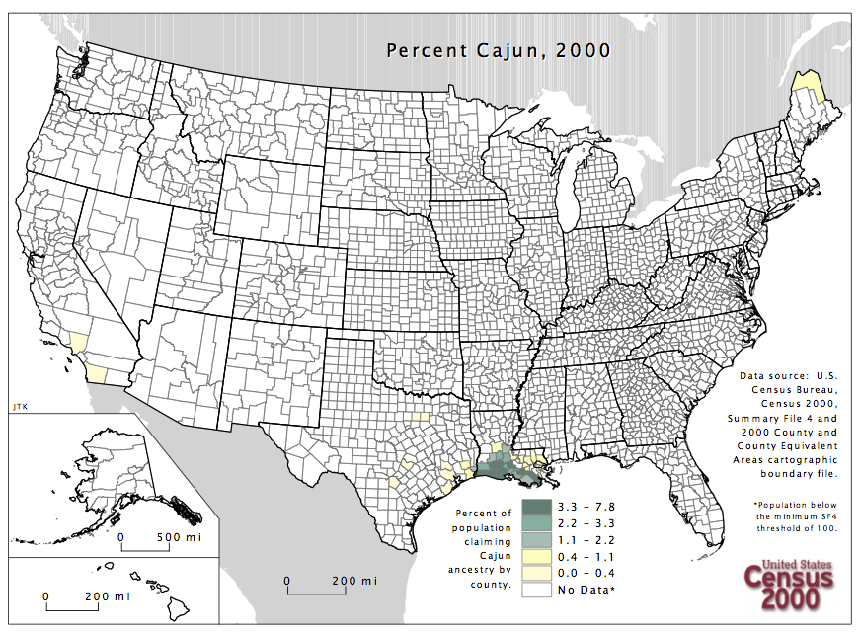
CHOICES
African American
American Indian
Arab
Cajun
Cuban
French
German
Greek
Hispanic
Irish
Italian
Korean
Russian
Scandinavian
Scots-Irish

Slide 6
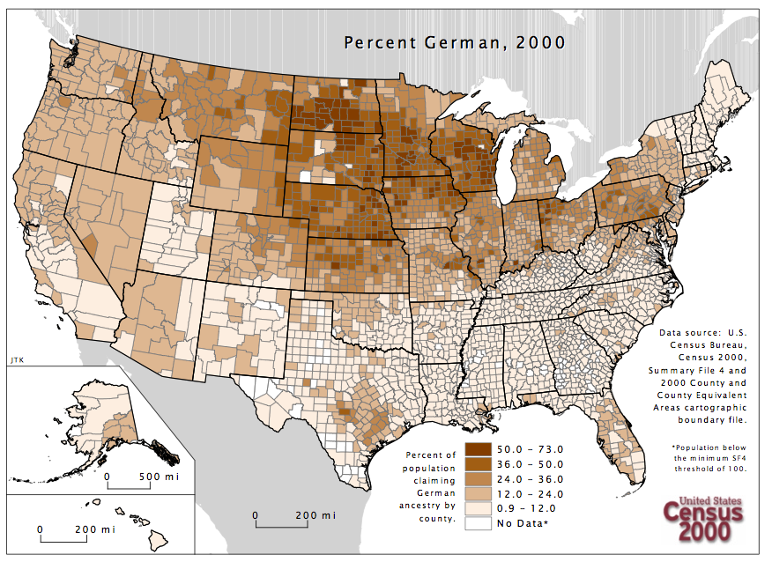
CHOICES
African American
American Indian
Arab
Cajun
Cuban
French
German
Greek
Hispanic
Irish
Italian
Korean
Russian
Scandinavian
Scots-Irish

Slide 7
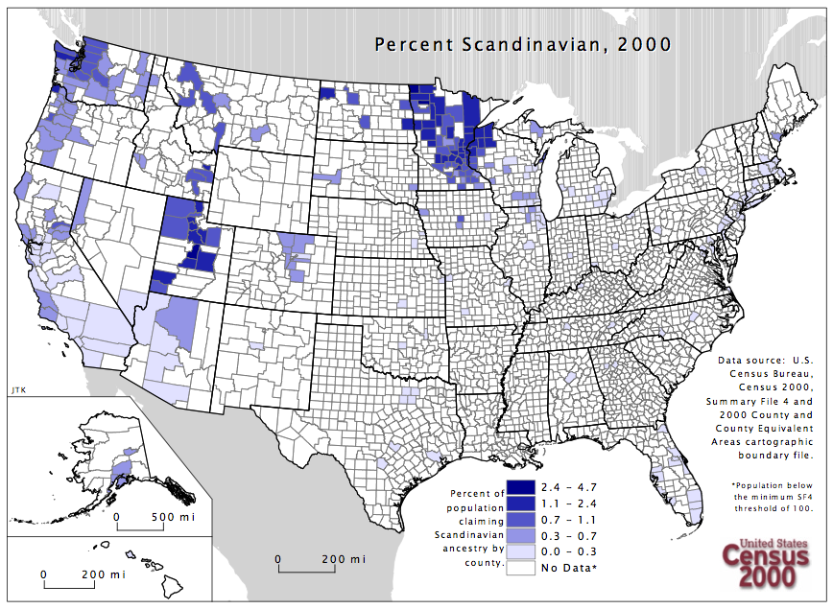
]
CHOICES
African American
American Indian
Arab
Cajun
Cuban
French
German
Greek
Hispanic
Irish
Italian
Korean
Russian
Scandinavian
Scots-Irish

Slide 8
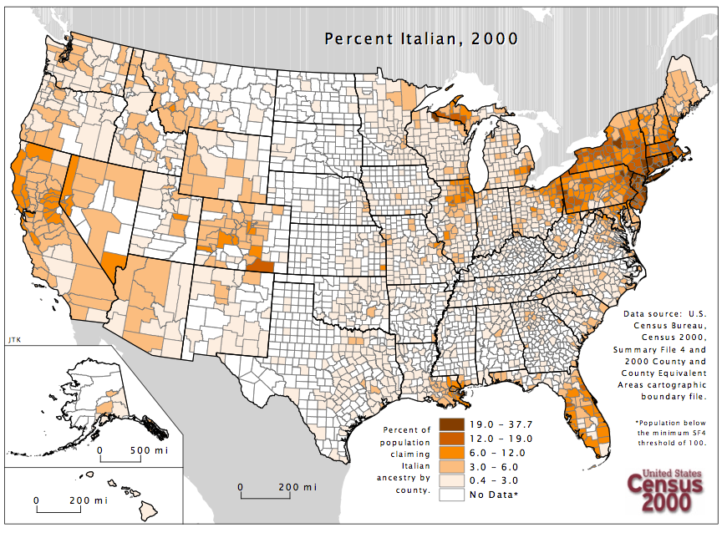
CHOICES
African American
American Indian
Arab
Cajun
Cuban
French
German
Greek
Hispanic
Irish
Italian
Korean
Russian
Scandinavian
Scots-Irish

Slide 9
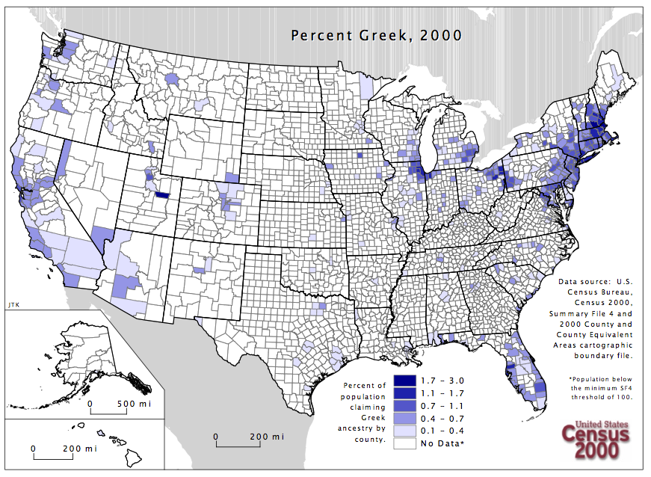
CHOICES
African American
American Indian
Arab
Cajun
Cuban
French
German
Greek
Hispanic
Irish
Italian
Korean
Russian
Scandinavian
Scots-Irish

Slide 10
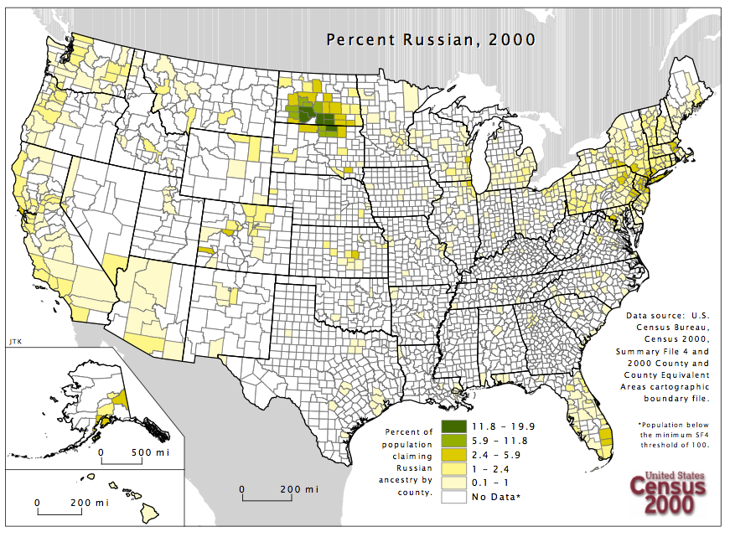
CHOICES
African American
American Indian
Arab
Cajun
Cuban
French
German
Greek
Hispanic
Irish
Italian
Korean
Russian
Scandinavian
Scots-Irish

Slide 11
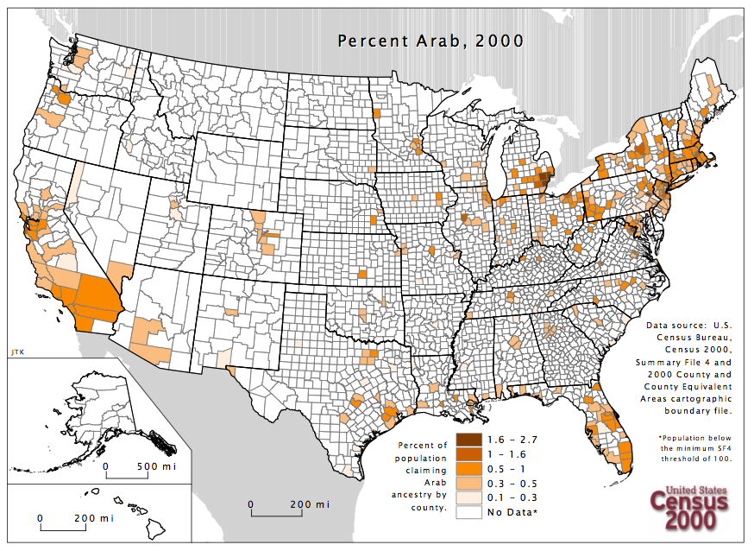
CHOICES
African American
American Indian
Arab
Cajun
Cuban
French
German
Greek
Hispanic
Irish
Italian
Korean
Russian
Scandinavian
Scots-Irish

Slide 12
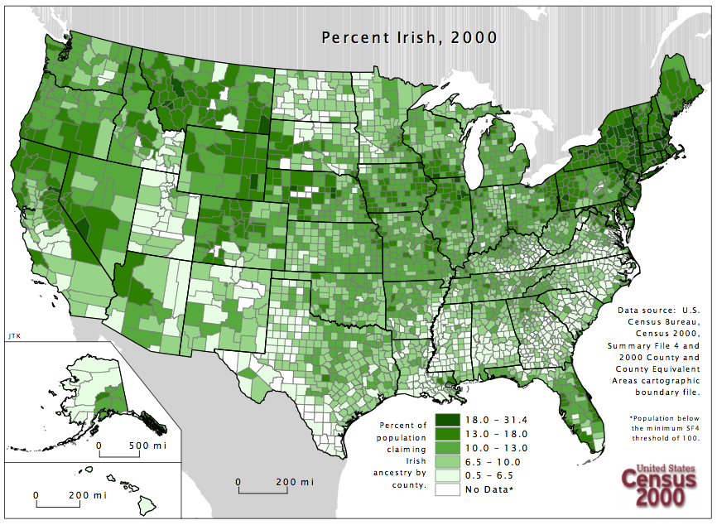
CHOICES
African American
American Indian
Arab
Cajun
Cuban
French
German
Greek
Hispanic
Irish
Italian
Korean
Russian
Scandinavian
Scots-Irish

Slide 13
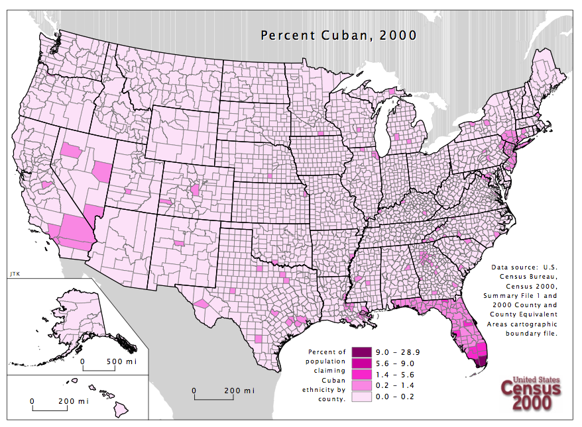
CHOICES
African American
American Indian
Arab
Cajun
Cuban
French
German
Greek
Hispanic
Irish
Italian
Korean
Russian
Scandinavian
Scots-Irish

Slide 14
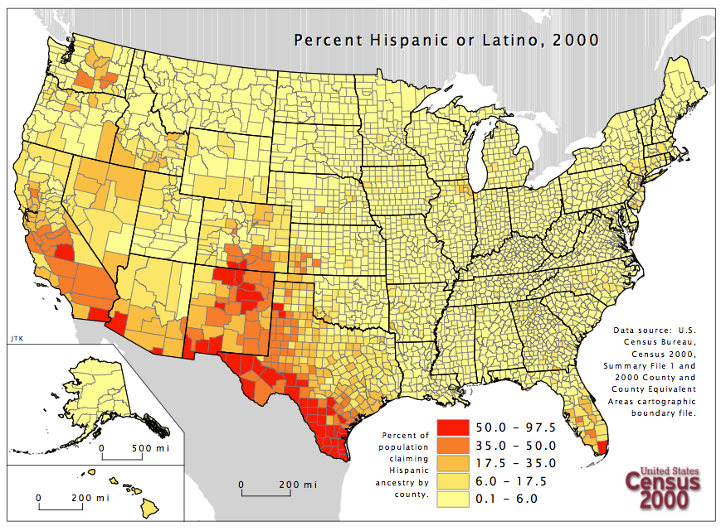
CHOICES
African American
American Indian
Arab
Cajun
Cuban
French
German
Greek
Hispanic
Irish
Italian
Korean
Russian
Scandinavian
Scots-Irish

Slide 15
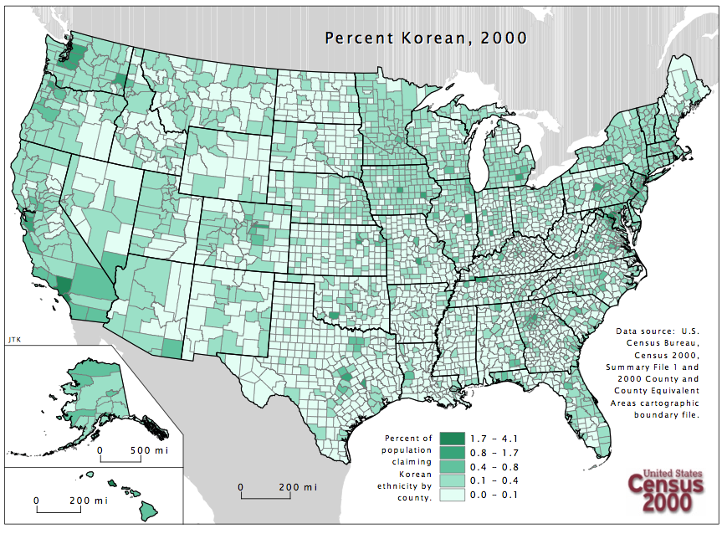
CHOICES
African American
American Indian
Arab
Cajun
Cuban
French
German
Greek
Hispanic
Irish
Italian
Korean
Russian
Scandinavian
Scots-Irish

Slide 16
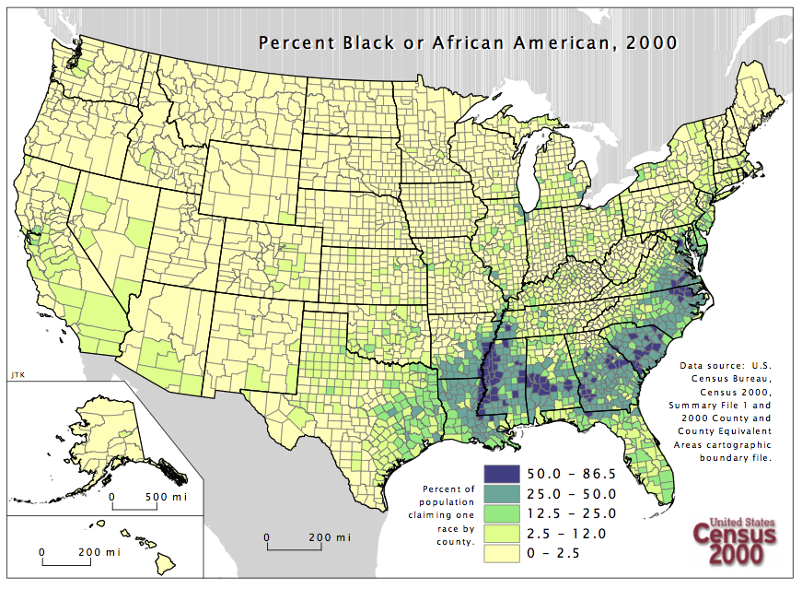
CHOICES
African American
American Indian
Arab
Cajun
Cuban
French
German
Greek
Hispanic
Irish
Italian
Korean
Russian
Scandinavian
Scots-Irish

Slide 17
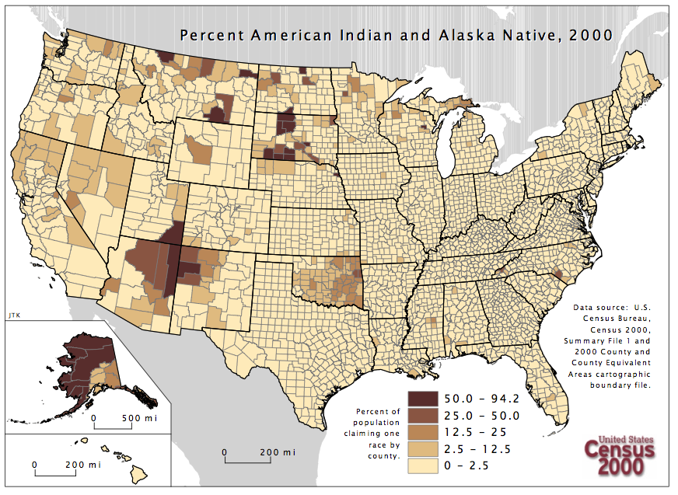
CHOICES
African American
American Indian
Arab
Cajun
Cuban
French
German
Greek
Hispanic
Irish
Italian
Korean
Russian
Scandinavian
Scots-Irish

Slide 18
Ethnic Group
Activity

Slide 19
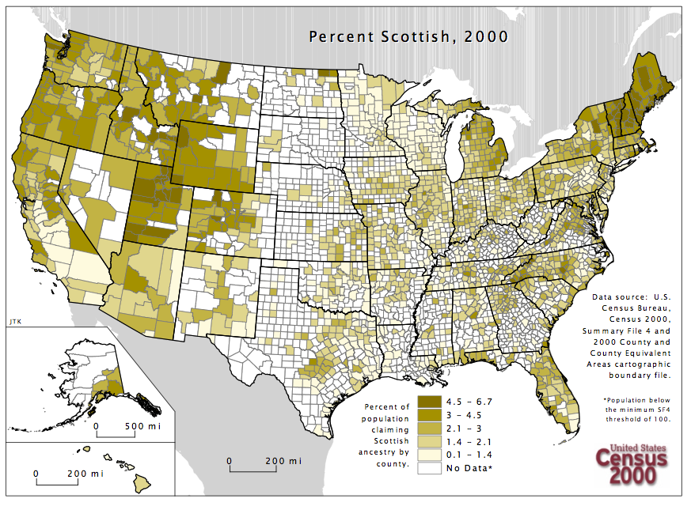
EX

Slide 20
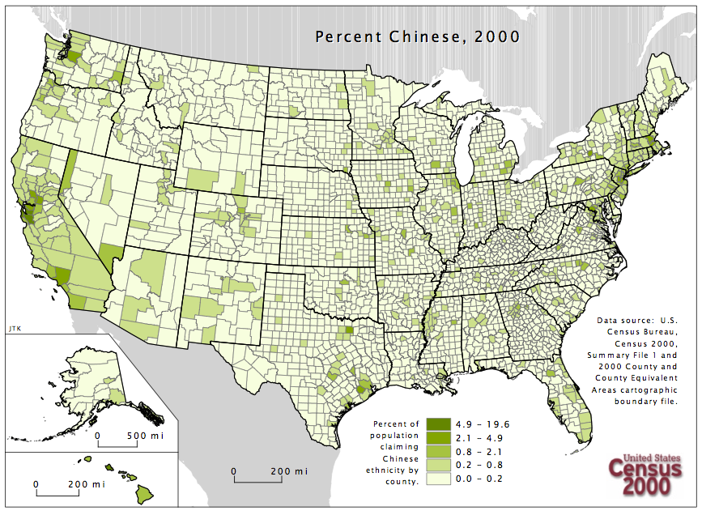
EX

Slide 21
Asian
Czech
Pennsylvania German
Polish
Puerto Rican
Ukraine

Slide 22
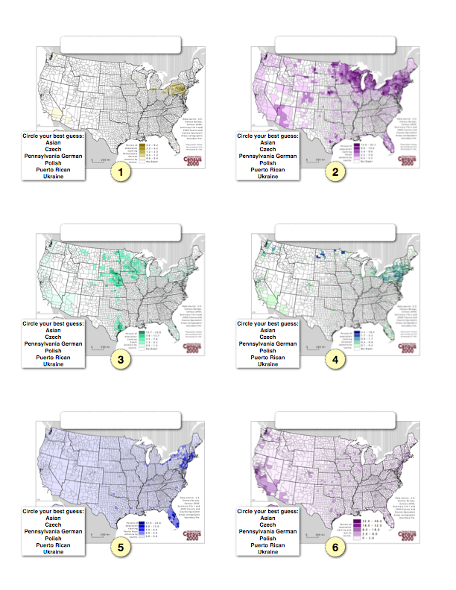

Slide 24
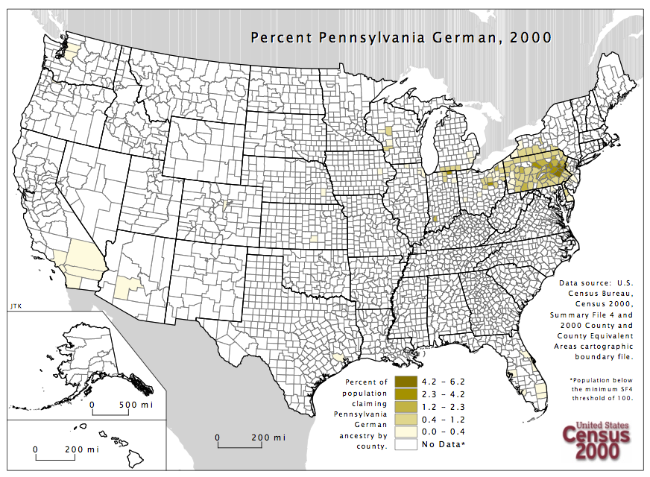
Circle your best guess:
Asian
Czech
Pennsylvania German
Polish
Puerto Rican
Ukraine
1

Slide 25
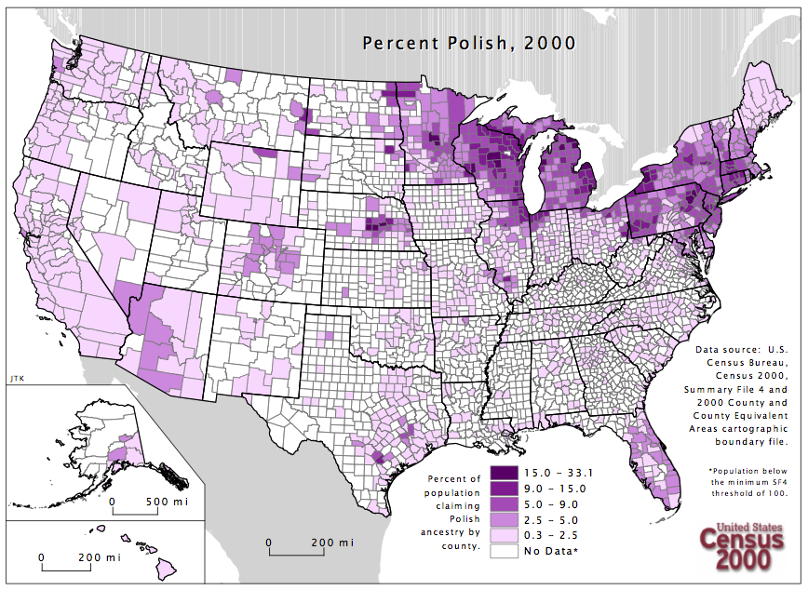
Circle your best guess:
Asian
Czech
Pennsylvania German
Polish
Puerto Rican
Ukraine
2

Slide 26
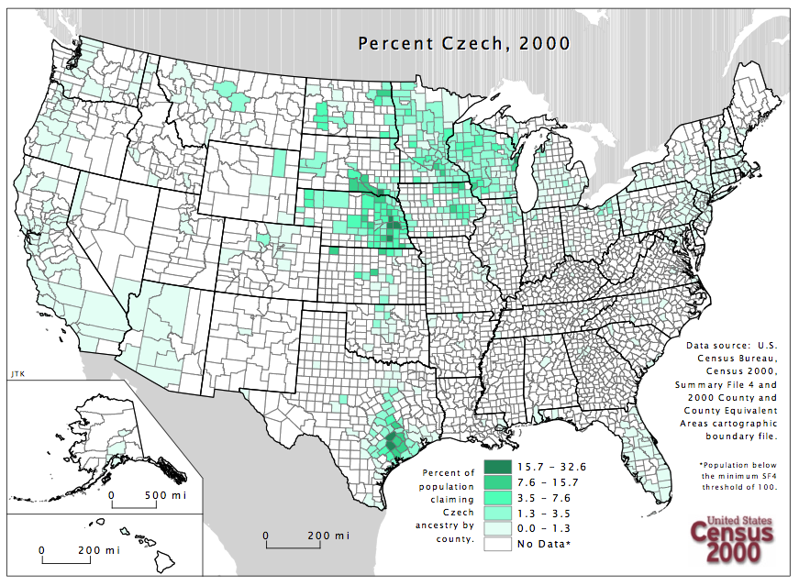
Circle your best guess:
Asian
Czech
Pennsylvania German
Polish
Puerto Rican
Ukraine
3

Slide 27
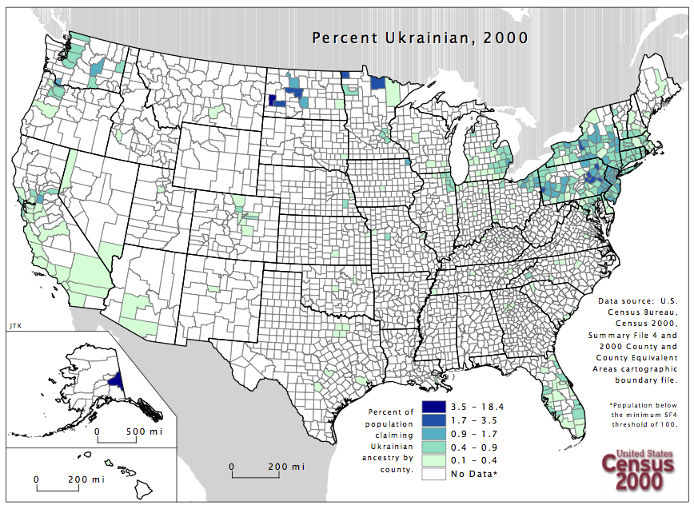
Circle your best guess:
Asian
Czech
Pennsylvania German
Polish
Puerto Rican
Ukraine
4

Slide 28
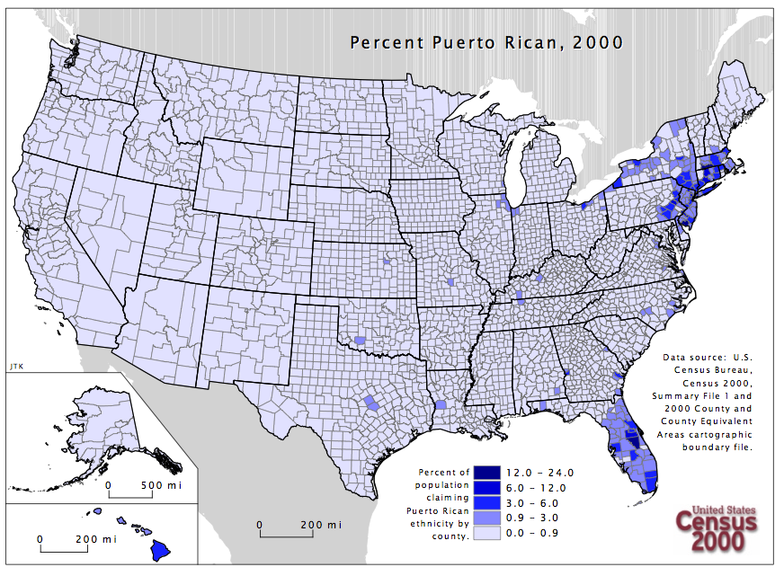
Circle your best guess:
Asian
Czech
Pennsylvania German
Polish
Puerto Rican
Ukraine
5

Slide 29
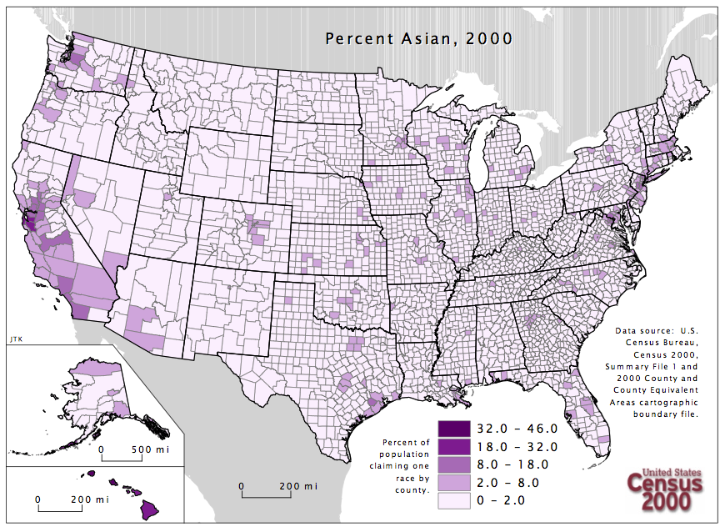
Circle your best guess:
Asian
Czech
Pennsylvania German
Polish
Puerto Rican
Ukraine
6

Slide 30
ANSWERS

Slide 31
Asian
Czech
Pennsylvania German
Polish
Puerto Rican
Ukraine
1

Slide 32
Asian
Czech
Pennsylvania German
Polish
Puerto Rican
Ukraine
2

Slide 33
Asian
Czech
Pennsylvania German
Polish
Puerto Rican
Ukraine
3

Slide 34
Asian
Czech
Pennsylvania German
Polish
Puerto Rican
Ukraine
4

Slide 35
Asian
Czech
Pennsylvania German
Polish
Puerto Rican
Ukraine
5

Slide 36
Asian
Czech
Pennsylvania German
Polish
Puerto Rican
Ukraine
6

Slide 37
Pennsylvania Dutch
Polish
Czech
Ukrainian
Puerto Rican
Asian

