Slide 1
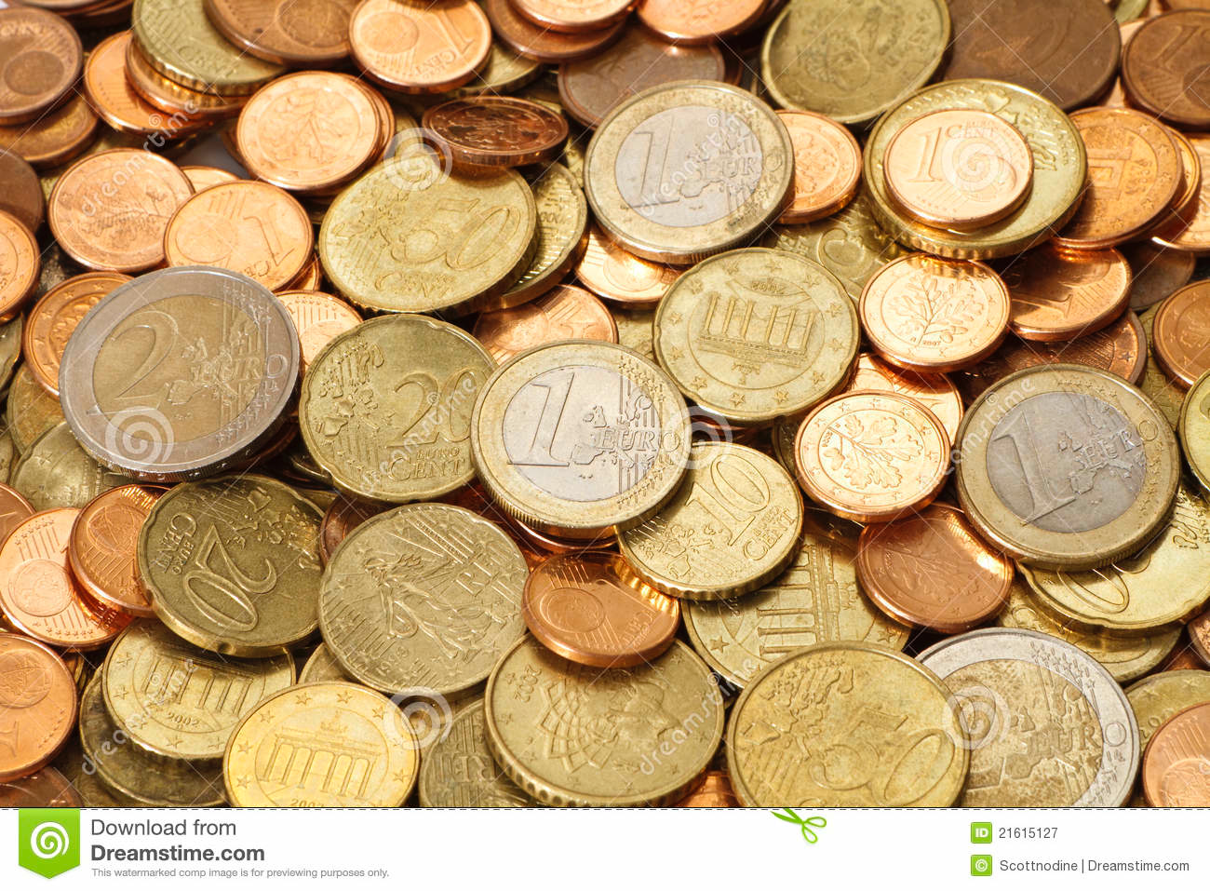
EUROS
Identification
Austria - Belgium - Cyprus - Estonia - Finland - France - Germany - Greece - Ireland - Italy - Latvia
Lithuania - Luxembourg - Malta - Netherlands - Portugal - San Marino - Slovenia - Spain - Vatican City

Slide 2
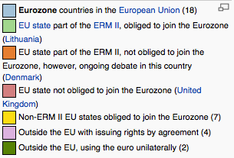
Eurozone in 2014

Slide 3
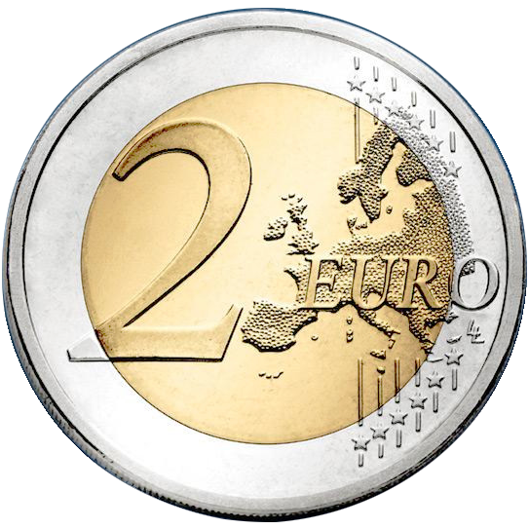
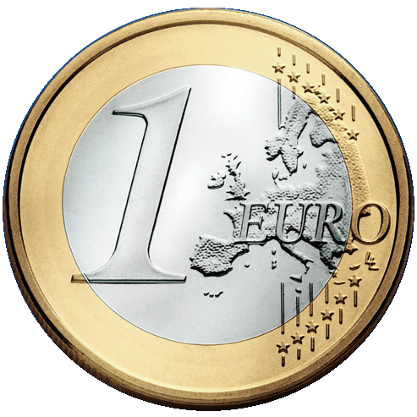
The Euro

Slide 4
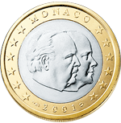
Monaco
EXAMPLE: What is the country?
Austria - Belgium - Cyprus - Estonia - Finland - France - Germany - Greece - Ireland - Italy - Latvia
Lithuania - Luxembourg - Malta - Netherlands - Portugal - San Marino - Slovenia - Spain - Vatican City

Slide 5
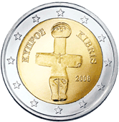
Cyprus
Austria - Belgium - Cyprus - Estonia - Finland - France - Germany - Greece - Ireland - Italy - Latvia
Lithuania - Luxembourg - Malta - Netherlands - Portugal - San Marino - Slovenia - Spain - Vatican City

Slide 6
Ireland
Austria - Belgium - Cyprus - Estonia - Finland - France - Germany - Greece - Ireland - Italy - Latvia
Lithuania - Luxembourg - Malta - Netherlands - Portugal - San Marino - Slovenia - Spain - Vatican City

Slide 7
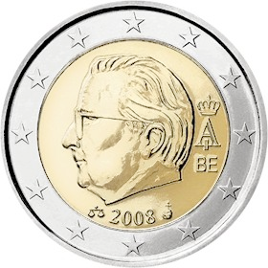
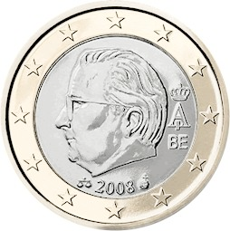
Belgium
Austria - Belgium - Cyprus - Estonia - Finland - France - Germany - Greece - Ireland - Italy - Latvia
Lithuania - Luxembourg - Malta - Netherlands - Portugal - San Marino - Slovenia - Spain - Vatican City

Slide 8
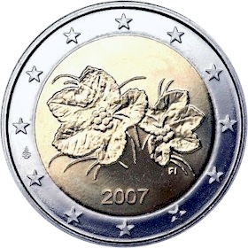
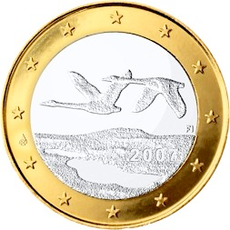
Finland
Austria - Belgium - Cyprus - Estonia - Finland - France - Germany - Greece - Ireland - Italy - Latvia
Lithuania - Luxembourg - Malta - Netherlands - Portugal - San Marino - Slovenia - Spain - Vatican City

Slide 9
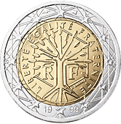
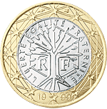
France
Austria - Belgium - Cyprus - Estonia - Finland - France - Germany - Greece - Ireland - Italy - Latvia
Lithuania - Luxembourg - Malta - Netherlands - Portugal - San Marino - Slovenia - Spain - Vatican City

Slide 10
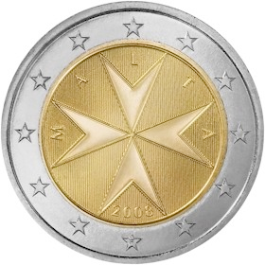
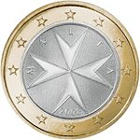
Malta
Austria - Belgium - Cyprus - Estonia - Finland - France - Germany - Greece - Ireland - Italy - Latvia
Lithuania - Luxembourg - Malta - Netherlands - Portugal - San Marino - Slovenia - Spain - Vatican City

Slide 11
Germany
Austria - Belgium - Cyprus - Estonia - Finland - France - Germany - Greece - Ireland - Italy - Latvia
Lithuania - Luxembourg - Malta - Netherlands - Portugal - San Marino - Slovenia - Spain - Vatican City

Slide 12
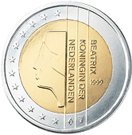
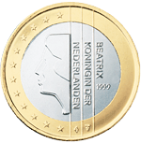
Netherlands
Austria - Belgium - Cyprus - Estonia - Finland - France - Germany - Greece - Ireland - Italy - Latvia
Lithuania - Luxembourg - Malta - Netherlands - Portugal - San Marino - Slovenia - Spain - Vatican City

Slide 13
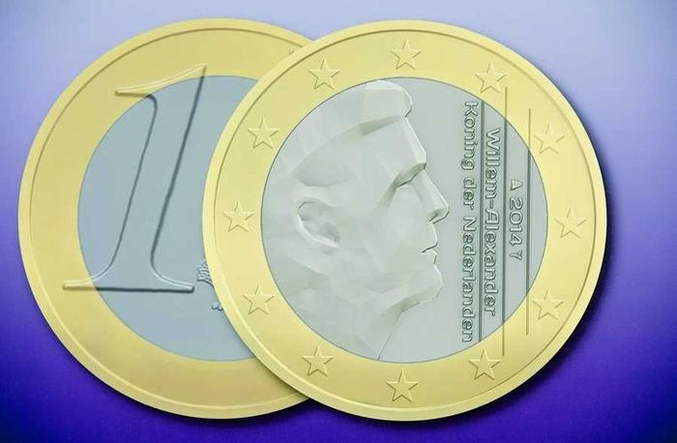

Slide 14
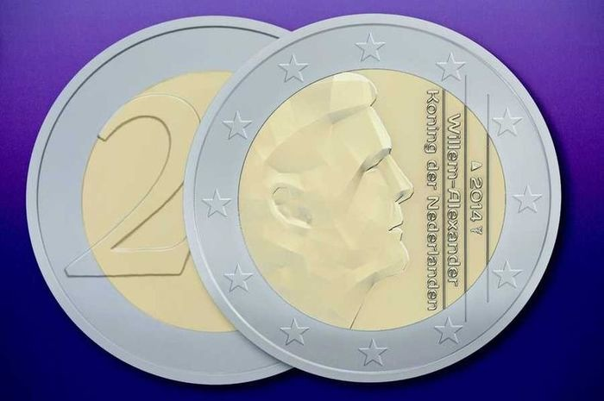

Slide 15
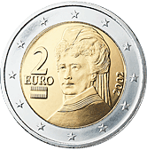
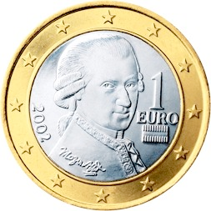
Austria
Austria - Belgium - Cyprus - Estonia - Finland - France - Germany - Greece - Ireland - Italy - Latvia
Lithuania - Luxembourg - Malta - Netherlands - Portugal - San Marino - Slovenia - Spain - Vatican City

Slide 16
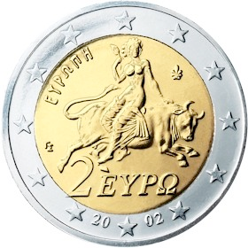
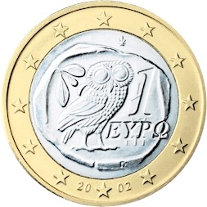
Greece
Austria - Belgium - Cyprus - Estonia - Finland - France - Germany - Greece - Ireland - Italy - Latvia
Lithuania - Luxembourg - Malta - Netherlands - Portugal - San Marino - Slovenia - Spain - Vatican City

Slide 17
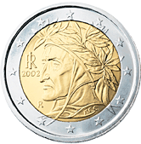
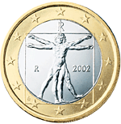
Italy
Austria - Belgium - Cyprus - Estonia - Finland - France - Germany - Greece - Ireland - Italy - Latvia
Lithuania - Luxembourg - Malta - Netherlands - Portugal - San Marino - Slovenia - Spain - Vatican City

Slide 18
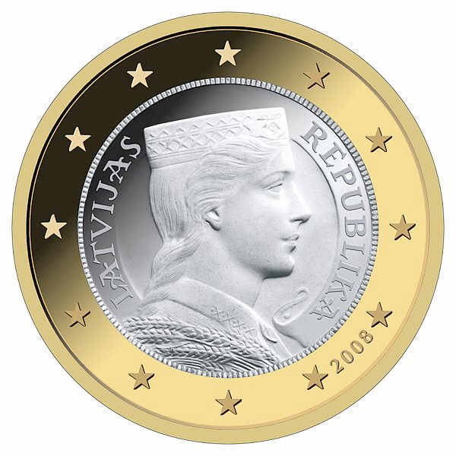
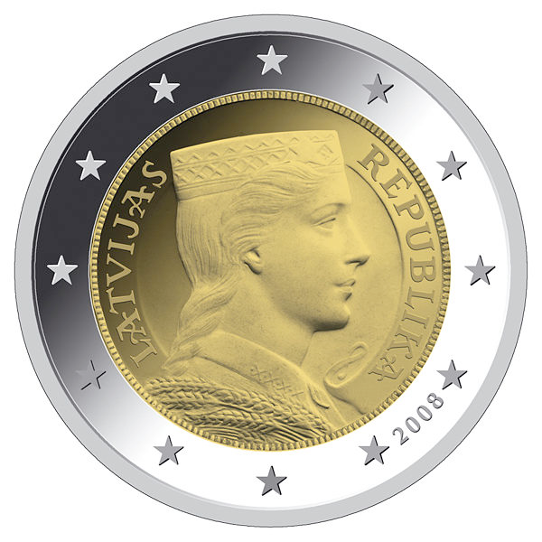
Latvia
Austria - Belgium - Cyprus - Estonia - Finland - France - Germany - Greece - Ireland - Italy - Latvia
Lithuania - Luxembourg - Malta - Netherlands - Portugal - San Marino - Slovenia - Spain - Vatican City

Slide 19
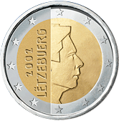
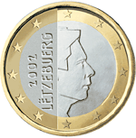
Luxembourg
Austria - Belgium - Cyprus - Estonia - Finland - France - Germany - Greece - Ireland - Italy - Latvia
Lithuania - Luxembourg - Malta - Netherlands - Portugal - San Marino - Slovenia - Spain - Vatican City

Slide 20
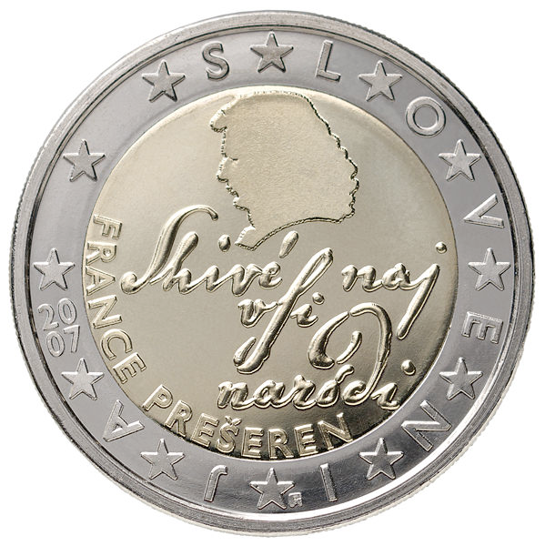
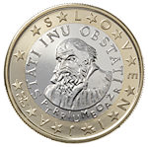
Slovenia
Austria - Belgium - Cyprus - Estonia - Finland - France - Germany - Greece - Ireland - Italy - Latvia
Lithuania - Luxembourg - Malta - Netherlands - Portugal - San Marino - Slovenia - Spain - Vatican City

Slide 21
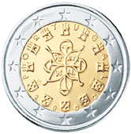
Portugal
Austria - Belgium - Cyprus - Estonia - Finland - France - Germany - Greece - Ireland - Italy - Latvia
Lithuania - Luxembourg - Malta - Netherlands - Portugal - San Marino - Slovenia - Spain - Vatican City

Slide 22
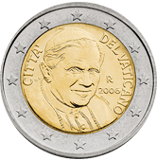
Vatican City
Austria - Belgium - Cyprus - Estonia - Finland - France - Germany - Greece - Ireland - Italy - Latvia
Lithuania - Luxembourg - Malta - Netherlands - Portugal - San Marino - Slovenia - Spain - Vatican City

Slide 23
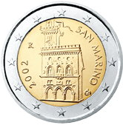
San Marino
Austria - Belgium - Cyprus - Estonia - Finland - France - Germany - Greece - Ireland - Italy - Latvia
Lithuania - Luxembourg - Malta - Netherlands - Portugal - San Marino - Slovenia - Spain - Vatican City

Slide 24
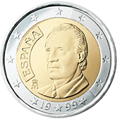
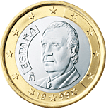
Spain
Austria - Belgium - Cyprus - Estonia - Finland - France - Germany - Greece - Ireland - Italy - Latvia
Lithuania - Luxembourg - Malta - Netherlands - Portugal - San Marino - Slovenia - Spain - Vatican City

Slide 25
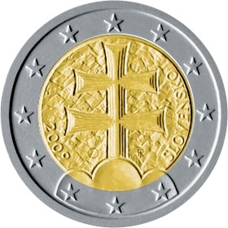
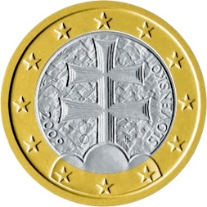
Slovakia
Austria - Belgium - Cyprus - Estonia - Finland - France - Germany - Greece - Ireland - Italy - Latvia
Lithuania - Luxembourg - Malta - Netherlands - Portugal - San Marino - Slovenia - Spain - Vatican City

Slide 26
Estonia
Austria - Belgium - Cyprus - Estonia - Finland - France - Germany - Greece - Ireland - Italy - Latvia
Lithuania - Luxembourg - Malta - Netherlands - Portugal - San Marino - Slovenia - Spain - Vatican City

Slide 27
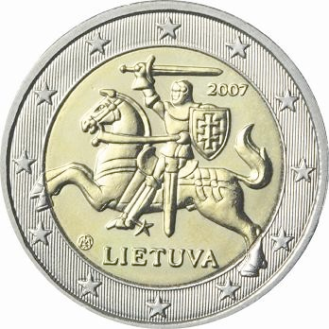
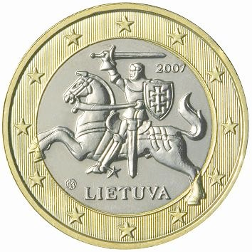
Lithuania
Austria - Belgium - Cyprus - Estonia - Finland - France - Germany - Greece - Ireland - Italy - Latvia
Lithuania - Luxembourg - Malta - Netherlands - Portugal - San Marino - Slovenia - Spain - Vatican City

