Slide 1
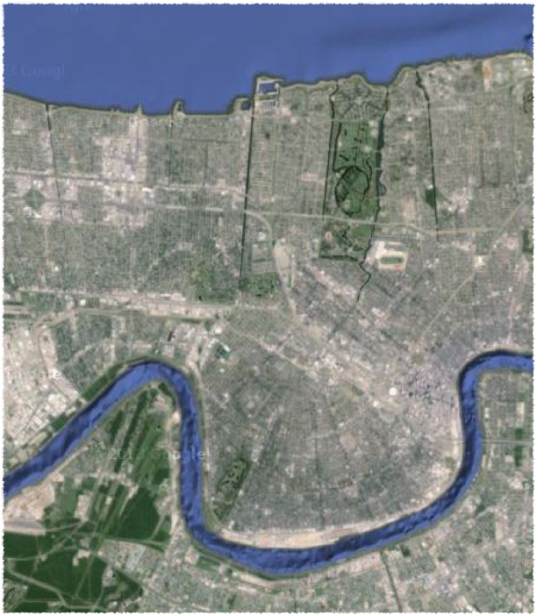
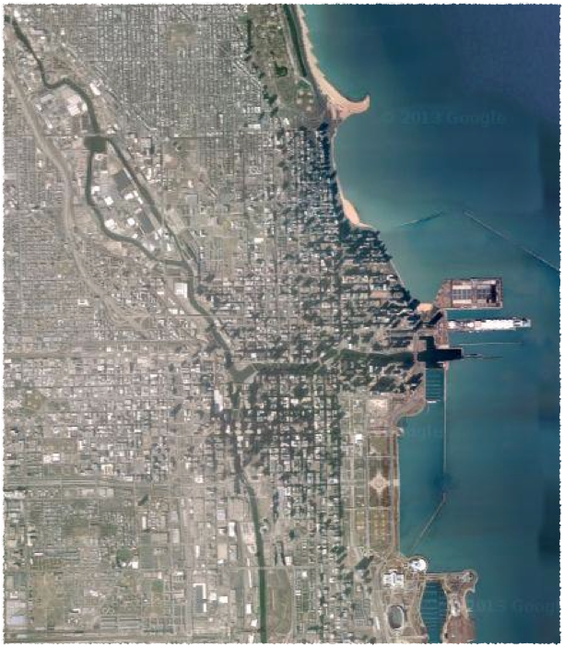
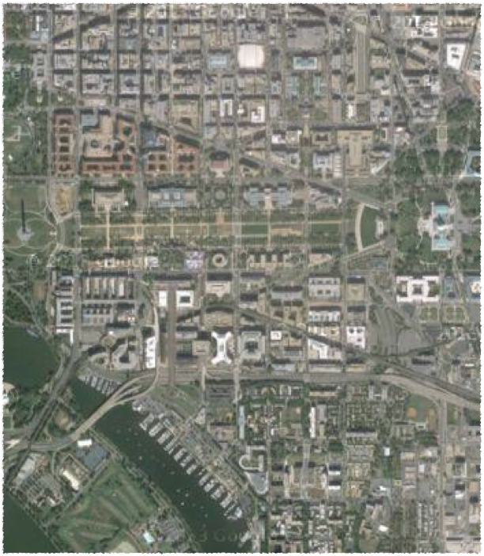
1
2
3
New Orleans
Chicago
Washington, D.C.
Choices: Chicago, New Orleans, or Washington, D.C.

Slide 2
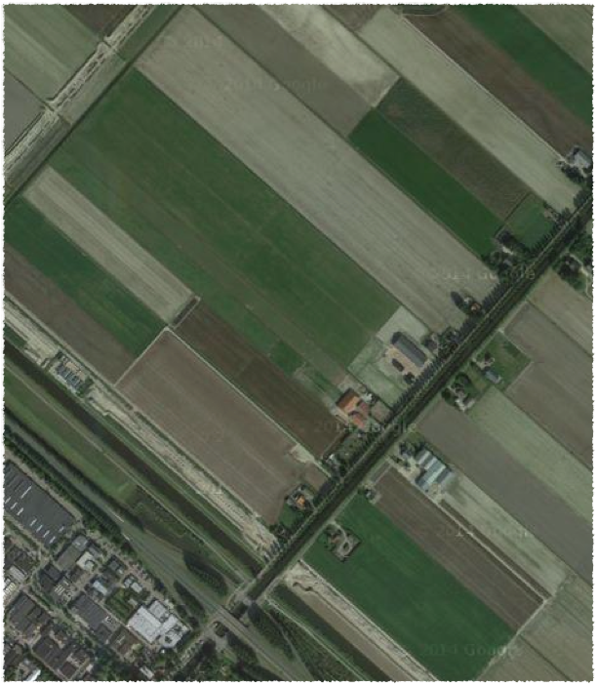
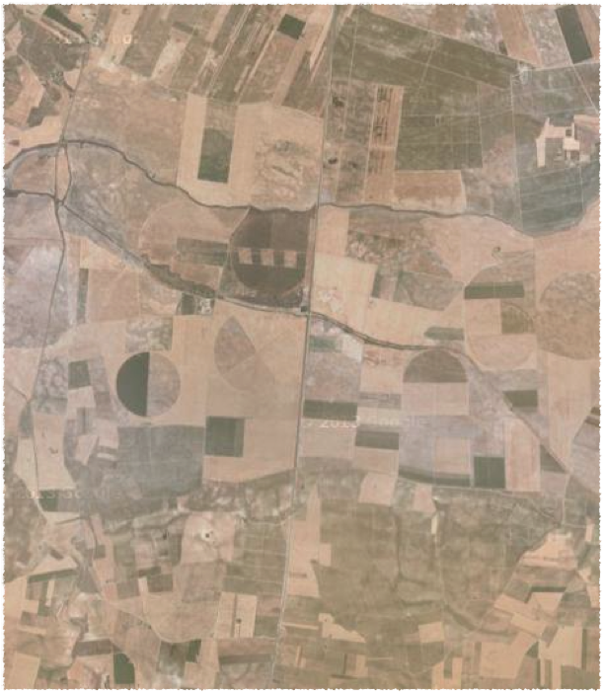
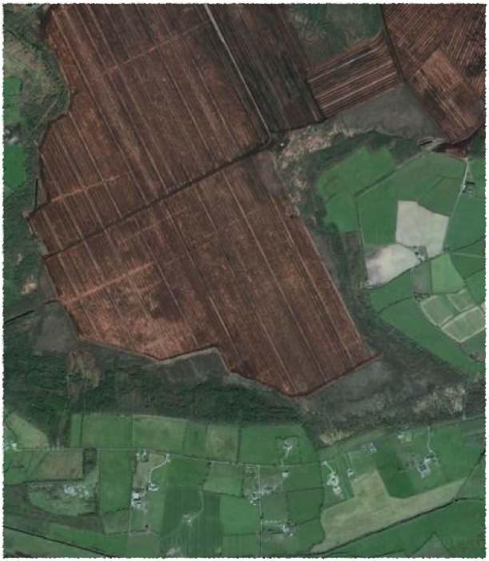
Peat
1
2
3
Netherlands
Spain
Ireland
Choices: Ireland, Netherlands, or Spain

Slide 3
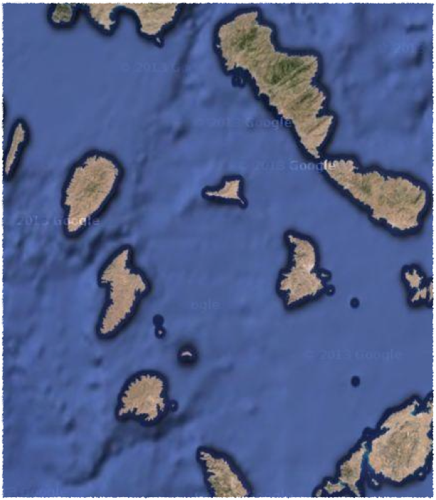
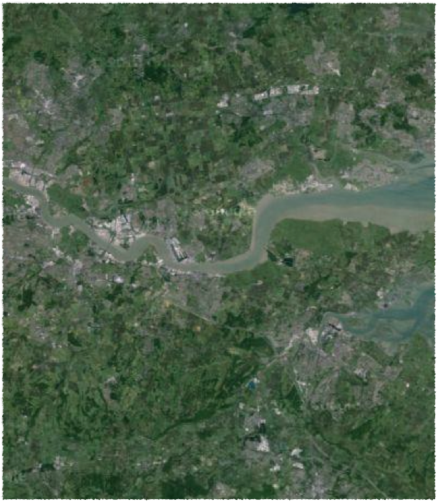
1
2
3
Greece
Iceland
United Kingdom
Choices: Greece, Iceland, or United Kingdom

Slide 4
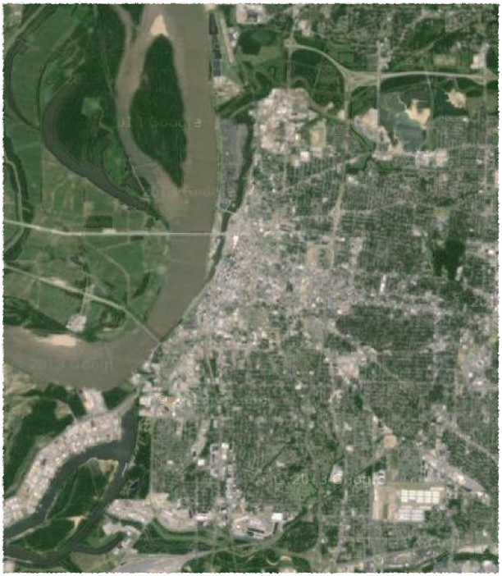
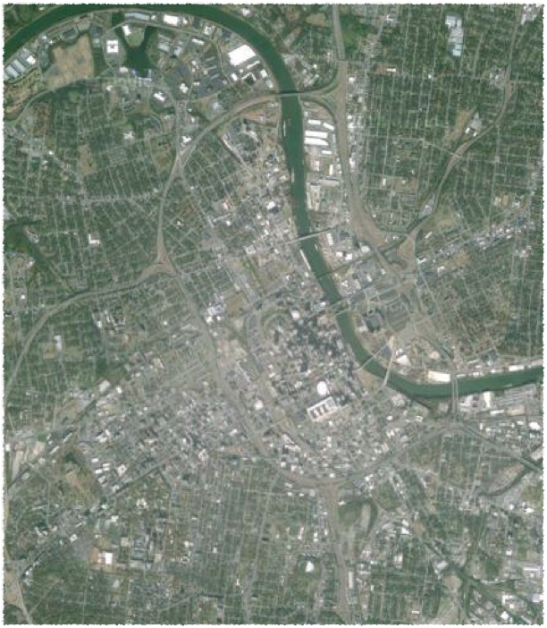
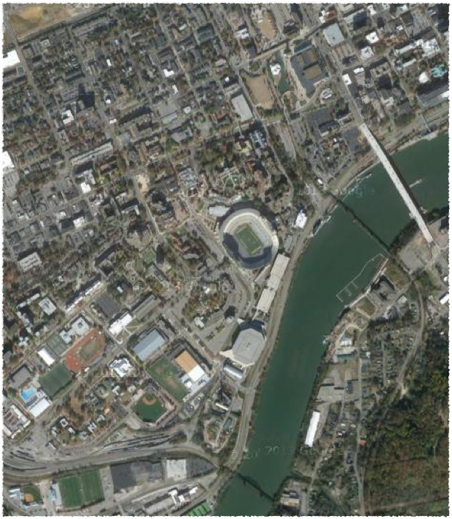
1
2
3
Memphis
Nashville
Knoxville
Choices: Knoxville, Memphis, or Nashville

Slide 5
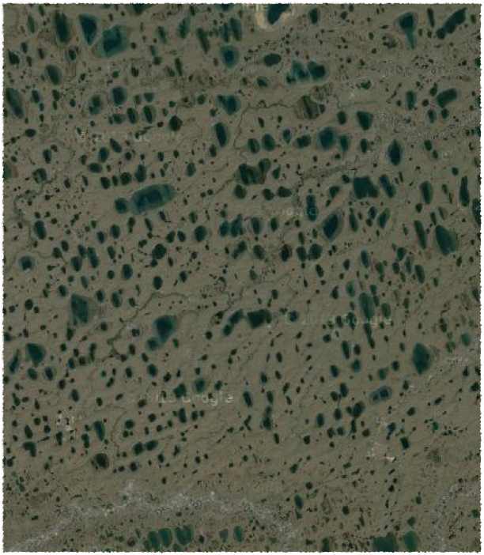
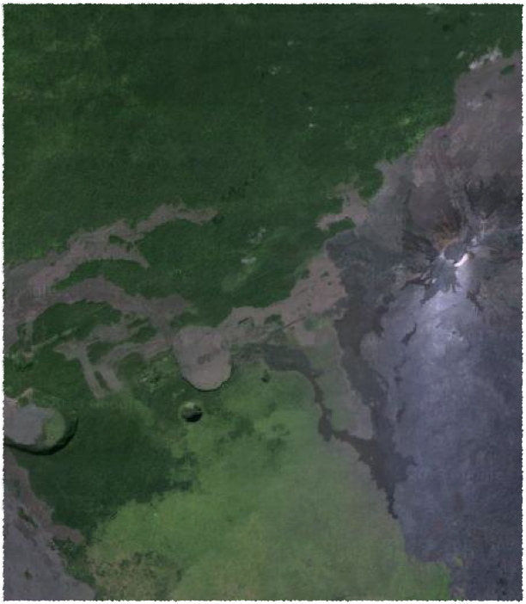
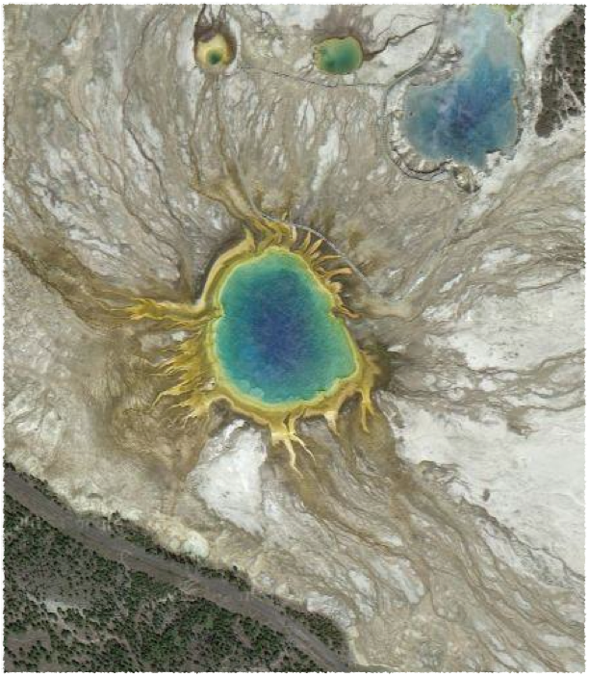
Arctic Plain
Big Island
Yellowstone
1
2
3
Alaska
Hawaii
Wyoming
Choices: Alaska, Hawaii, or Wyoming

Slide 6
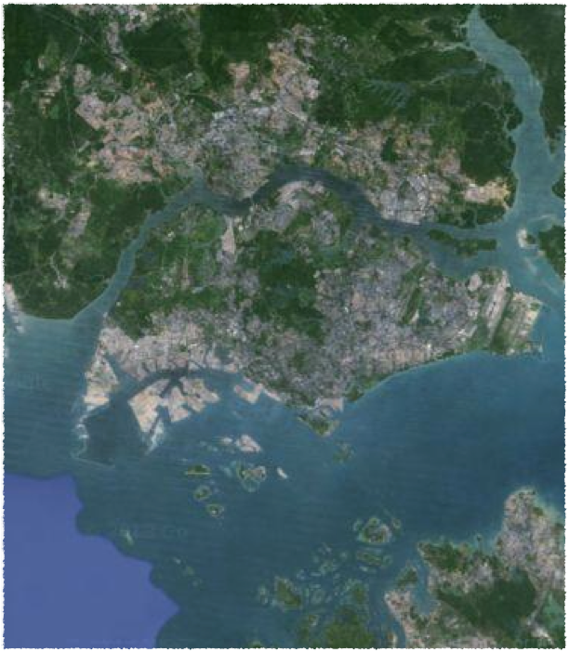
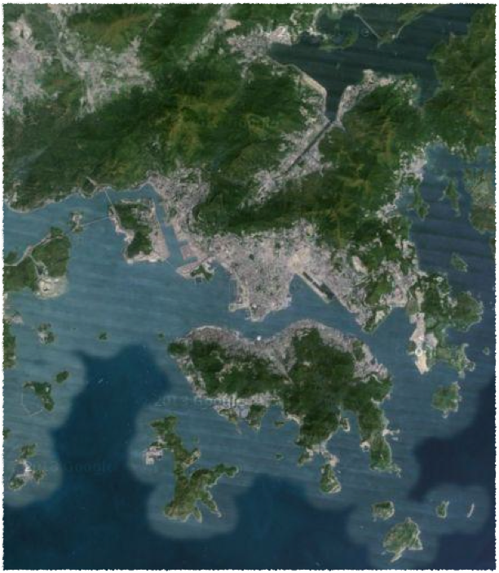
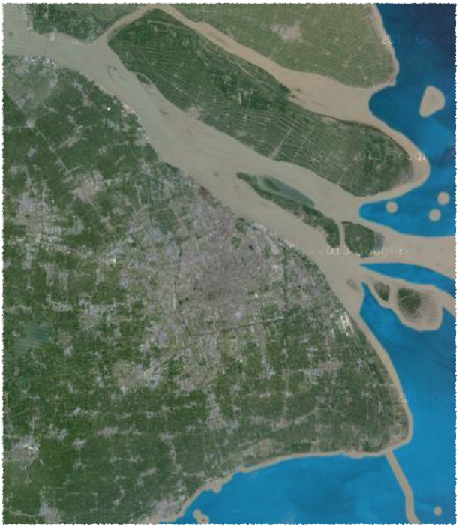
1
2
3
Singapore
Hong Kong
Shanghai
Choices: Hong Kong, Shanghai, or Singapore

Slide 7
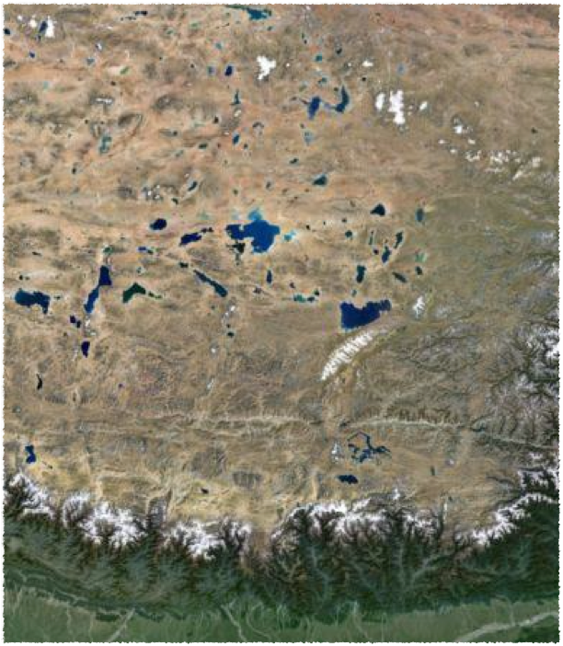
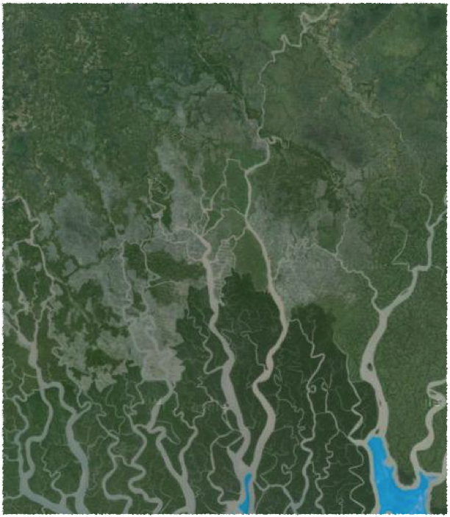
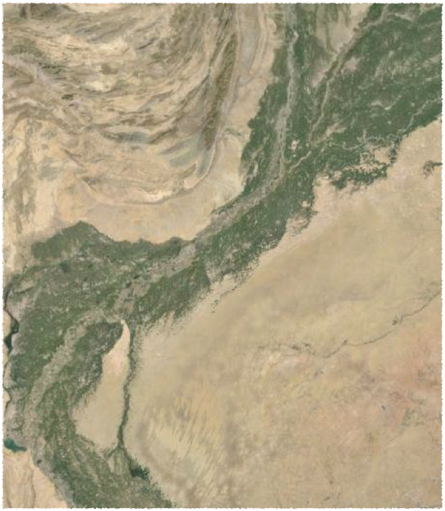
1
2
3
Tibet
Bangladesh
Pakistan
Choices: Bangladesh, Pakistan, or Tibet

Slide 8
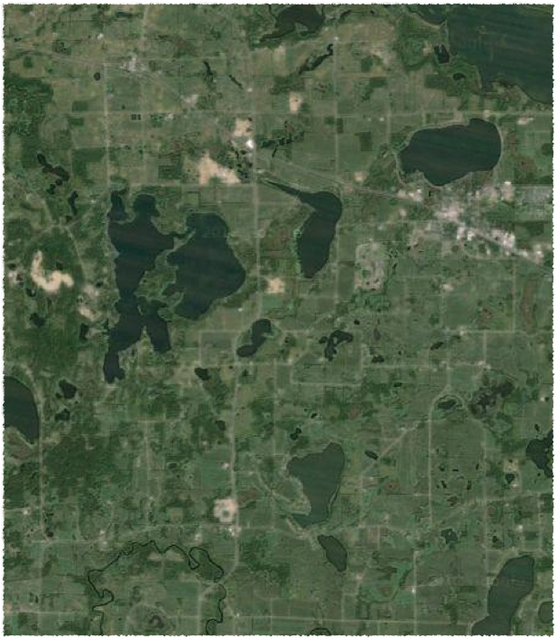
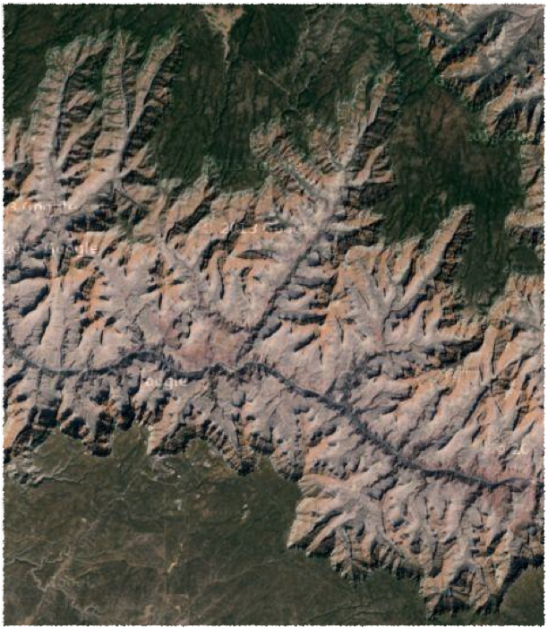
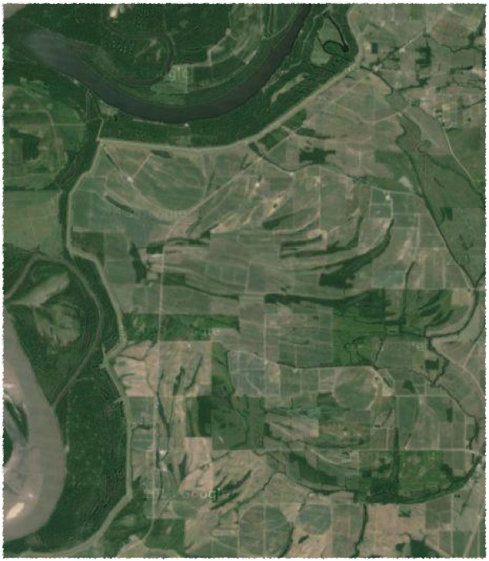
1
2
3
Minnesota
Arizona
Mississippi
Choices: Arizona, Minnesota, or Mississippi

Slide 9
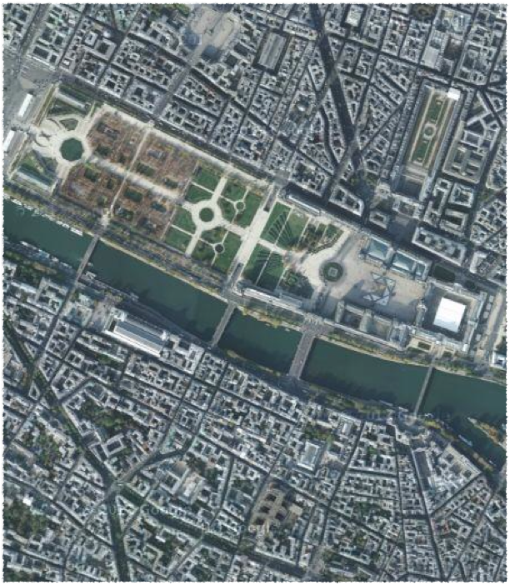
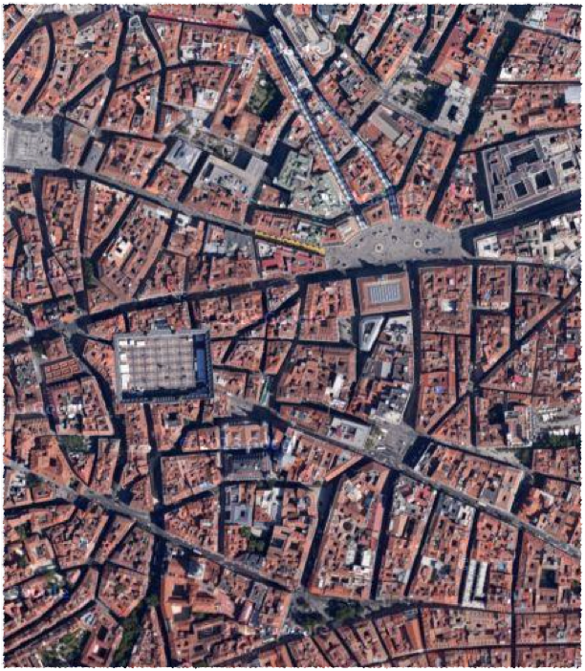
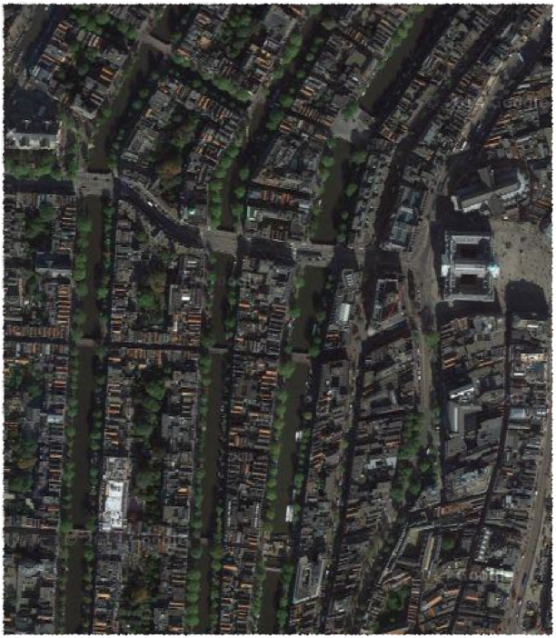
1
2
3
Paris
Madrid
Amsterdam
Choices: Amsterdam, Madrid, or Paris

Slide 10
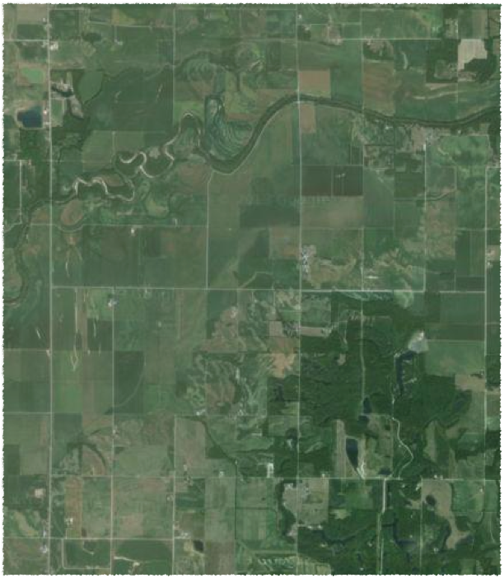
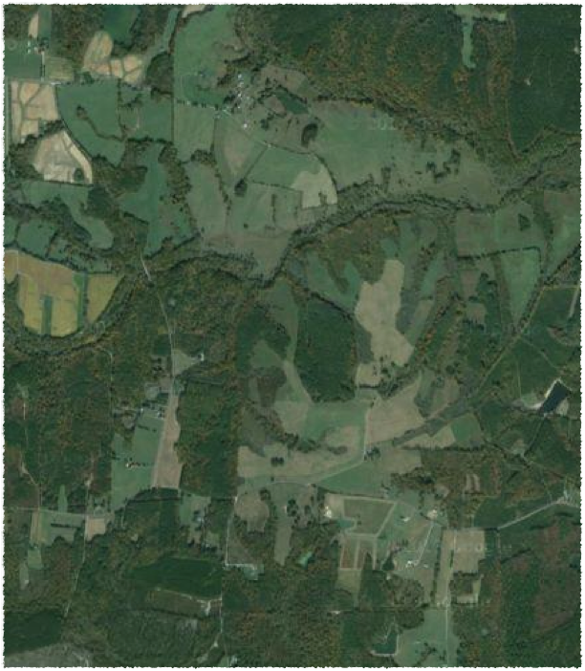
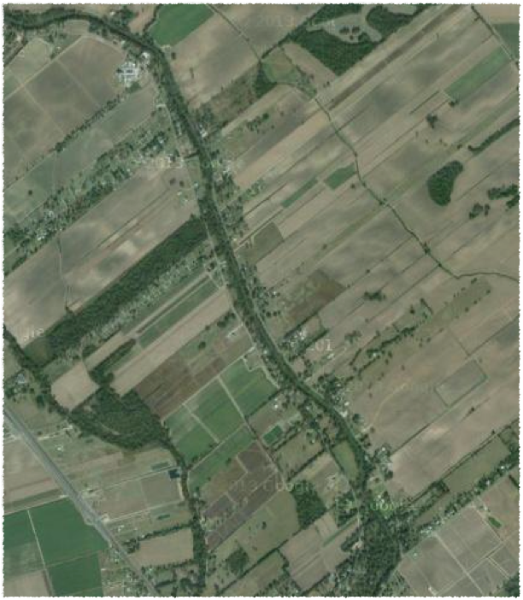
Township
and Range
(U.S.A)
Metes and
Bounds
(English)
Long Lots
(French)
1
2
3
Indiana
Virginia
Louisiana
Choices: Indiana, Louisiana, or Virginia

