Slide 1
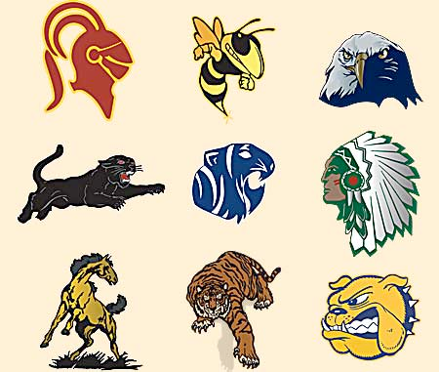
High School
MASCOTS
Activity

Slide 2
TOP 15 MOST POPULAR
TENNESSEE MASCOT NAMES
# Eagles 25 (There are 3 Golden Eagles)
# Tigers 24 (There is 1 Hustlin' Tigers and 1 Purple Tigers)
# Wildcats 20 (There is 1 Golden Wildcats)
# Bulldogs 14
# Warriors 14
# Cougars 12
# Panthers 12
# Lions 12
Patriots 10
Rebels 10
# Indians 9
# Mustangs 8
# Vikings 8
Yellowjackets 8
Hawks 8 (There is 1 Red Hawks)
# Denotes mascot name is in America's Top 15
source: http://www.maxpreps.com/news/uybkd2lSX0yRzeYkvjuDsg/maxpreps-mascot-mondays--tennessee-high-school-mascots.htm

Slide 3
student handout
High School Mascot Activity Name(s):___________________________________________________________________________________________
Directions: Match the state with the correct high school mascot by writing the state abbreviation in the “Answer” column. Write out the name of the state for each Bonus.
1
Mascot | Answers
1. Conchs
2. Razorbacks
3. Skeeters
4. Smoky Bears
Bonus:
2
Mascot | Answers
1. Little Green
2. Slaters
3. Windjammers
4. Witches
Bonus:
3
Mascot | Answers
1. Crabbers
2. Dutchman
3. Redcoats
4. Skippers
Bonus:
4
Mascot | Answers
1. Fighting Scots
2. Grape Pickers
3. Mountaineers
4. Thorobreds
Bonus:
5
Mascot | Answers
1. Cornjerkers
2. Flivvers
3. Little Hawks
4. Sparkplugs
Bonus:
6
Mascot | Answers
1. Elks
2. Haymaker
3. Swathers
4. Tornadoes
Bonus:
7
Mascot | Answers
1. Cheesemakers
2. Kernels
3. Little Gophers
4. Royals
Bonus:
8
Mascot | Answers
1. Dinos
2. Lava Bears
3. Russets
4. Tarantulas
Bonus:
9
Mascot | Answers
1. Breakers
2. Cavemen
3. Glacier Bears
4. Monsters
Bonus:
10
Mascot | Answers
1. Caribs
2. Geckos
3. Menehune
4. Sharks
Bonus:
11
Mascot | Answers
1. Rock-a-Chaw
2. Sauras
3. Scorpion
4. Syrupmakers
Bonus:
12
Mascot | Answers
1. Hot Dogs
2. Papermakers
3. Hillbillies
4. Hi Tides
Bonus:

Slide 4
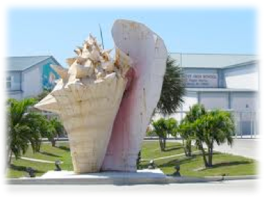
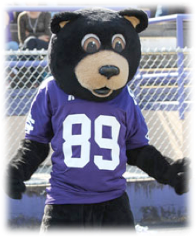
1
2
3
4
1
AR | FL | TN | TX | 1. Conchs | 2. Razorbacks | 3. Skeeters | 4. Smoky Bears

Slide 5
BONUS 2 points

Slide 6
1
2
3
4
2
MA | ME | NH | VT | 1. Little Green | 2. Slaters | 3. Windjammers | 4. Witches

Slide 7
BONUS 2 points

Slide 8
1
2
3
4
3
CT | MD | NY | RI | 1. Crabbers | 2. Dutchman | 3. Redcoats | 4. Skippers

Slide 9
BONUS 2 points

Slide 10
1
2
3
4
4
KY | NC | PA | WV | 1. Fighting Scots | 2. Grape Pickers | 3. Mountaineers | 4. Thorobreds

Slide 11
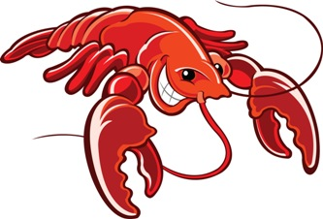
BONUS 2 points

Slide 12
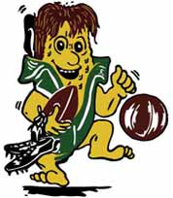
1
2
3
4
5
IA | IL | IN | MI | 1. Cornjerkers | 2. Flivvers | 3. Little Hawks | 4. Sparkplugs

Slide 13
BONUS 2 points

Slide 14
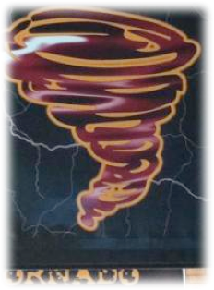
1
2
3
4
6
KS | MT | NE | OK | 1. Elks | 2. Haymaker | 3. Swathers | 4. Tornadoes

Slide 15
BONUS 2 points

Slide 16
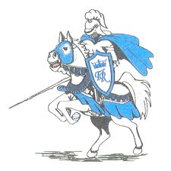
1
2
3
4
7
MN | MO | SD | WI | 1. Cheesemakers | 2. Kernels | 3. Little Gophers | 4. Royals

Slide 17
BONUS 2 points

Slide 18
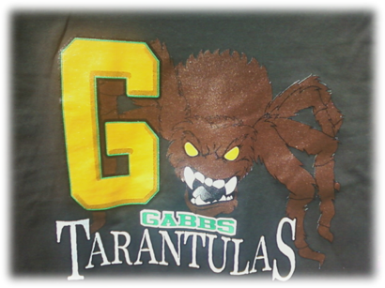
1
2
3
4
8
ID | NV | OR | UT | 1. Dinos | 2. Lava Bears | 3. Russets | 4. Tarantulas

Slide 19
BONUS 2 points

Slide 20
1
2
3
4
9
AK | AZ | CA | NM | 1. Breakers | 2. Cavemen | 3. Glacier Bears | 4. Monsters

Slide 21
BONUS 2 points

Slide 22
1
2
Choices: American Samoa - Guam - Hawaii - Virgin Islands
3
4
10
AS | GU | Hi | VI | 1. Caribs | 2. Geckos | 3. Menehune | 4. Sharks

Slide 23
BONUS 2 points

Slide 24
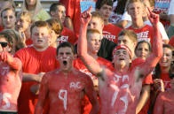
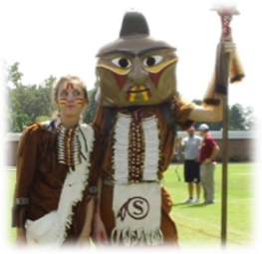
1
2
3
4
11
GA | NC | SC | TX | 1. Rock-a-Chaw | 2. Sauras | 3. Scorpion | 4. Syrupmakers

Slide 25
BONUS 2 points

Slide 26
1
2
3
4
12
FL | IN | NY | WA | 1. Hot Dogs | 2. Papermakers | 3. Hillbillies | 4. Hi Tides

Slide 27
BONUS 2 points

Slide 28
ANSWERS

Slide 29
1
2
FL
AR
3
4
TX
TN
1
AR | FL | TN | TX | 1. Conchs | 2. Razorbacks | 3. Skeeters | 4. Smoky Bears

Slide 30
BONUS 2 points
Georgia
Butler Bulldogs

Slide 31
1
2
NH
VT
3
4
ME
MA
2
MA | ME | NH | VT | 1. Little Green | 2. Slaters | 3. Windjammers | 4. Witches

Slide 32
BONUS 2 points
Delaware
Archmere Academy Auks

Slide 33
1
2
MD
NY
3
4
CT
RI
3
CT | MD | NY | RI | 1. Crabbers | 2. Dutchman | 3. Redcoats | 4. Skippers

Slide 34
BONUS 2 points
New Jersey
Lakewood Piners

Slide 35
1
2
NC
PA
3
4
WV
KY
4
KY | NC | PA | WV | 1. Fighting Scots | 2. Grape Pickers | 3. Mountaineers | 4. Thorobreds

Slide 36
BONUS 2 points
Louisiana
Metairie Park Country Day Cajuns

Slide 37
1
2
IL
MI
3
4
IA
IN
5
IA | IL | IN | MI | 1. Cornjerkers | 2. Flivvers | 3. Little Hawks | 4. Sparkplugs

Slide 38
BONUS 2 points
Ohio
Shenandoah Zeps

Slide 39
1
2
MT
NE
3
4
KS
OK
6
KS | MT | NE | OK | 1. Elks | 2. Haymaker | 3. Swathers | 4. Tornadoes

Slide 40
BONUS 2 points
North Dakota
Oak Grove Lutheran Grovers

Slide 41
1
2
WI
SD
3
4
MN
MO
7
MN | MO | SD | WI | 1. Cheesemakers | 2. Kernels | 3. Little Gophers | 4. Royals

Slide 42
BONUS 2 points
Wyoming
Big Piney Punchers

Slide 43
1
2
UT
OR
3
4
ID
NV
8
ID | NV | OR | UT | 1. Dinos | 2. Lava Bears | 3. Russets | 4. Tarantulas

Slide 44
BONUS 2 points
Washington
Blaine High School Borderites

Slide 45
1
2
CA
NM
3
4
AK
AZ
9
AK | AZ | CA | NM | 1. Breakers | 2. Cavemen | 3. Glacier Bears | 4. Monsters

Slide 46
BONUS 2 points
Colorado
Aspen Skiers

Slide 47
1
2
VI
GU
Choices: American Samoa - Guam - Hawaii - Virgin Islands
3
4
HI
AS
10
AS | GU | Hi | VI | 1. Caribs | 2. Geckos | 3. Menehune | 4. Sharks

Slide 48
BONUS 2 points
Alaska
Dateliners

Slide 49
1
2
SC
NC
3
4
TX
GA
11
GA | NC | SC | TX | 1. Rock-a-Chaw | 2. Sauras | 3. Scorpion | 4. Syrupmakers

Slide 50
BONUS 2 points
Louisiana
Farmerville Farmers

Slide 51
1
2
IN
WA
3
4
NY
FL
12
FL | IN | NY | WA | 1. Hot Dogs | 2. Papermakers | 3. Hillbillies | 4. Hi Tides

Slide 52
BONUS 2 points
Alabama
Gulf Shores Dolphins

Slide 53
ANSWERS

Slide 54
ANSWERS
student handout
High School Mascot Activity Name(s):___________________________________________________________________________________________
Directions: Match the state with the correct high school mascot by writing the state abbreviation in the “Answer” column. Write out the name of the state for each Bonus.
1
Mascot | Answers
1. Conchs | FL
2. Razorbacks | AR
3. Skeeters | TX
4. Smoky Bears | TN
Bonus: GEORGIA
2
Mascot | Answers
1. Little Green | NH
2. Slaters | VT
3. Windjammers | ME
4. Witches | MA
Bonus: DELAWARE
3
Mascot | Answers
1. Crabbers | MD
2. Dutchman | NY
3. Redcoats | CT
4. Skippers | RI
Bonus: NEW JERSEY
4
Mascot | Answers
1. Fighting Scots | NC
2. Grape Pickers | PA
3. Mountaineers | WV
4. Thorobreds | KY
Bonus: LOUISIANA
5
Mascot | Answers
1. Cornjerkers | IL
2. Flivvers | MI
3. Little Hawks | IA
4. Sparkplugs | IN
Bonus: OHIO
6
Mascot | Answers
1. Elks | MT
2. Haymaker | NE
3. Swathers | KS
4. Tornadoes | OK
Bonus: NORTH DAKOTA
7
Mascot | Answers
1. Cheesemakers | WI
2. Kernels | SD
3. Little Gophers | MN
4. Royals | MO
Bonus: WYOMING
8
Mascot | Answers
1. Dinos | UT
2. Lava Bears | OR
3. Russets | ID
4. Tarantulas | NV
Bonus: WASHINGTON
9
Mascot | Answers
1. Breakers | CA
2. Cavemen | NM
3. Glacier Bears | AK
4. Monsters | AZ
Bonus: COLORADO
10
Mascot | Answers
1. Caribs | VI
2. Geckos | GU
3. Menehune | HI
4. Sharks | AS
Bonus: ALASKA
11
Mascot | Answers
1. Rock-a-Chaw | SC
2. Sauras | NC
3. Scorpion | TX
4. Syrupmakers | GA
Bonus: LOUISIANA
12
Mascot | Answers
1. Hot Dogs | IN
2. Papermakers | WA
3. Hillbillies | NY
4. Hi Tides | FL
Bonus: ALABAMA

