Slide 1
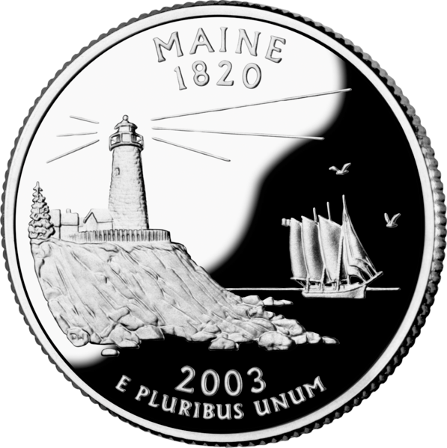
Connecticut | Maine | Maryland | Virginia

Slide 2
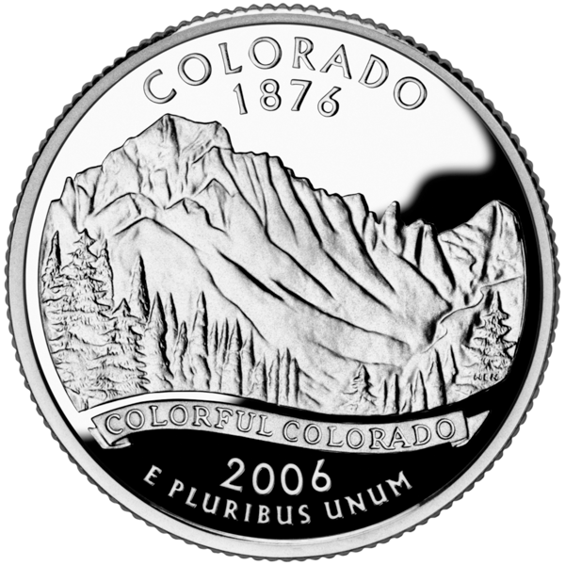
Idaho | Montana | Colorado | Utah

Slide 3
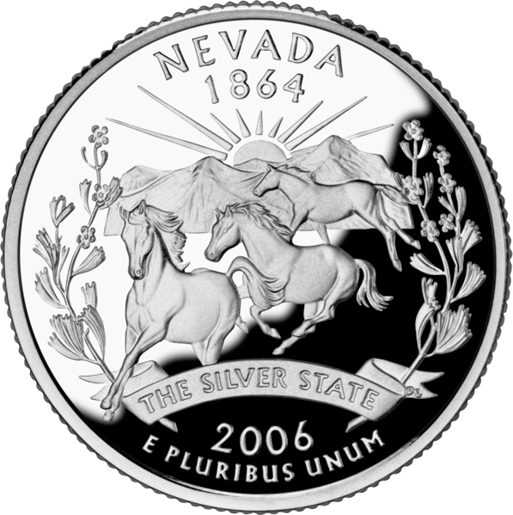
Colorado | California | Nevada | Oklahoma

Slide 4
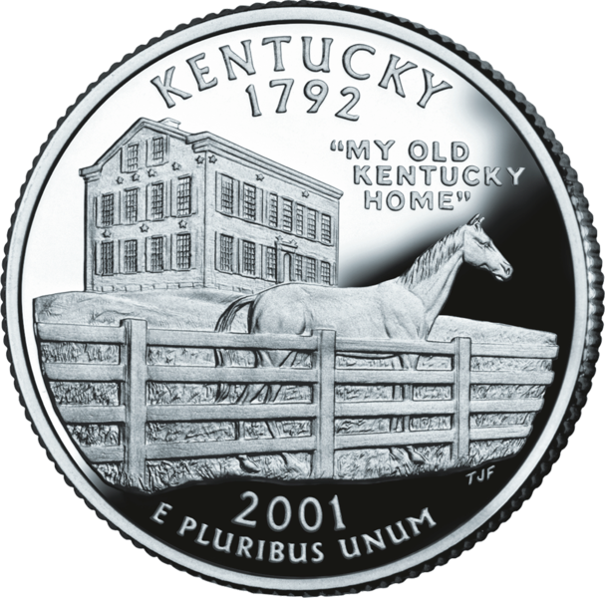
Ohio | Kentucky | Tennessee | Texas

Slide 5
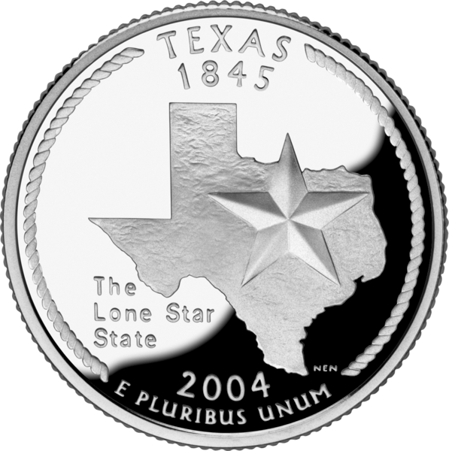
Arizona | Oklahoma | Texas | Louisiana

Slide 6
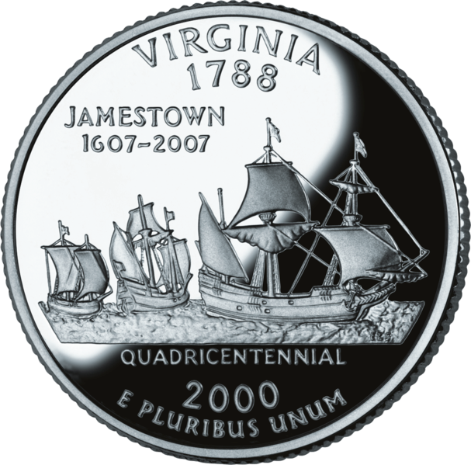
North Carolina | Maryland | Virginia | New York

Slide 7
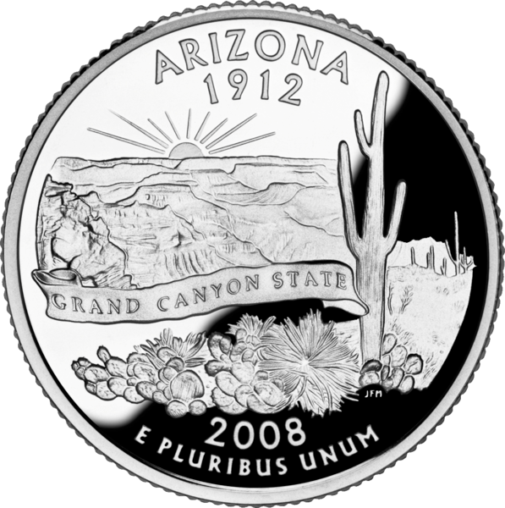
New Mexico | Utah | Arizona | Colorado

Slide 8
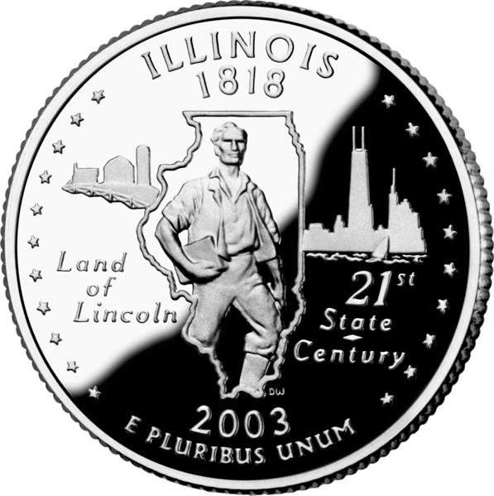
Michigan | Indiana | Illinois | Iowa

Slide 9
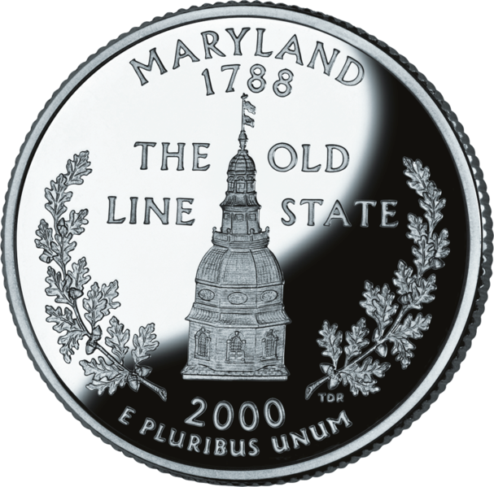
Ohio | Michigan | Maryland | Wisconsin

Slide 10
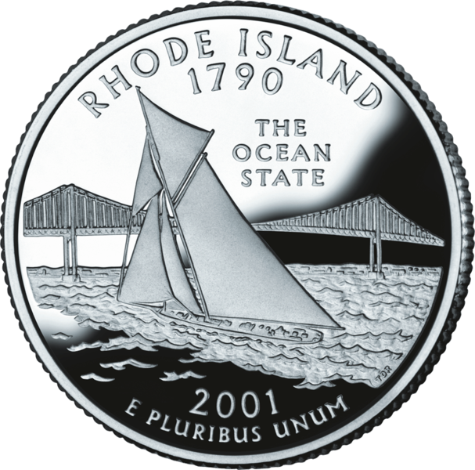
Connecticut | Rhode Island | Maine | Vermont

Slide 11
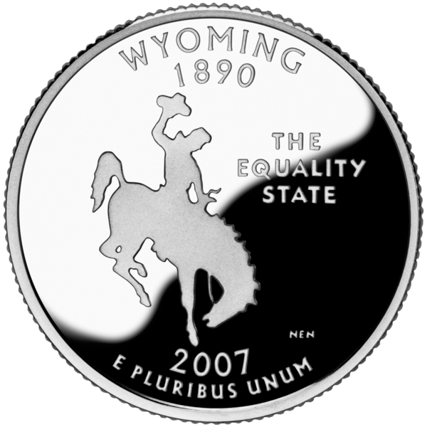
Wyoming | Texas | Arizona | Nebraska

Slide 12
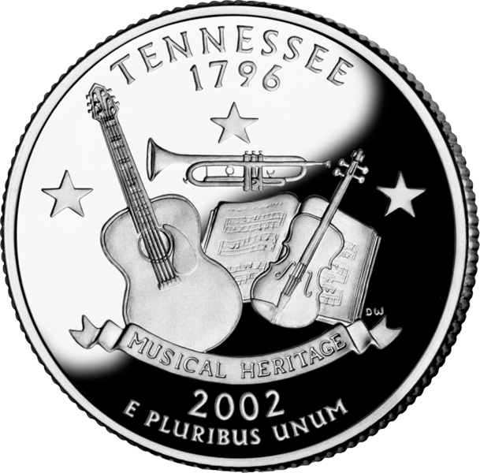
Kentucky | Alabama | Tennessee | Louisiana

Slide 13
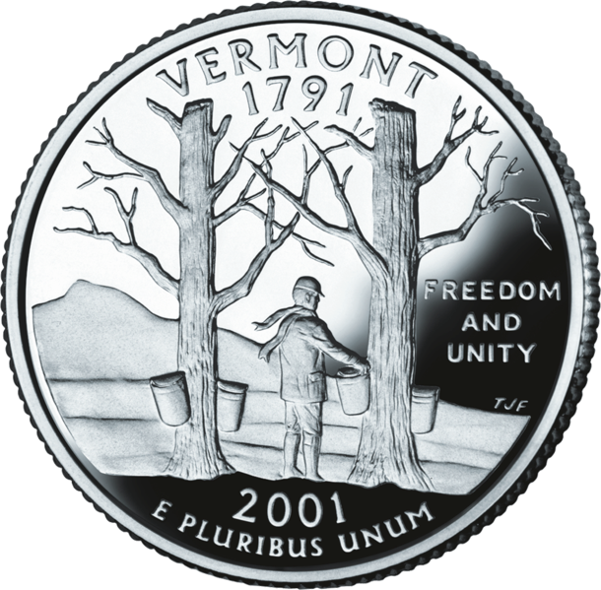
Vermont | Maine | New York | New Hampshire

Slide 14
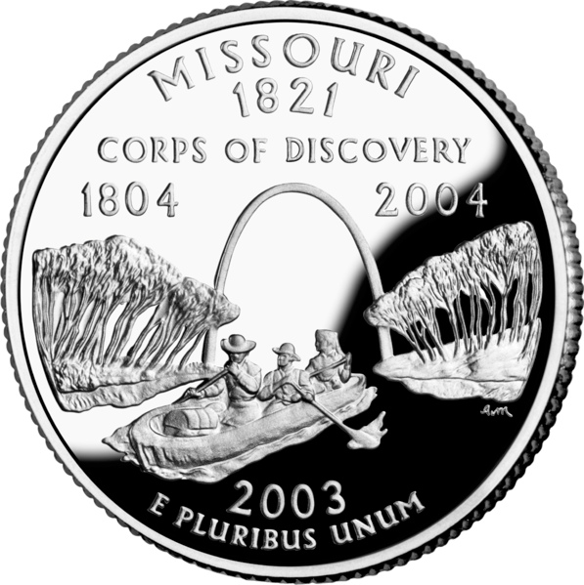
Louisiana | Arkansas | Missouri | Iowa

Slide 15
North Carolina | Ohio | Tennessee | Virginia

Slide 16
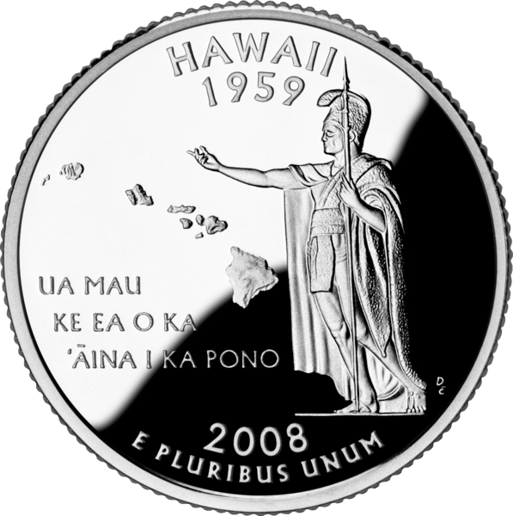
Oregon | Florida | Louisiana | Hawaii

Slide 17
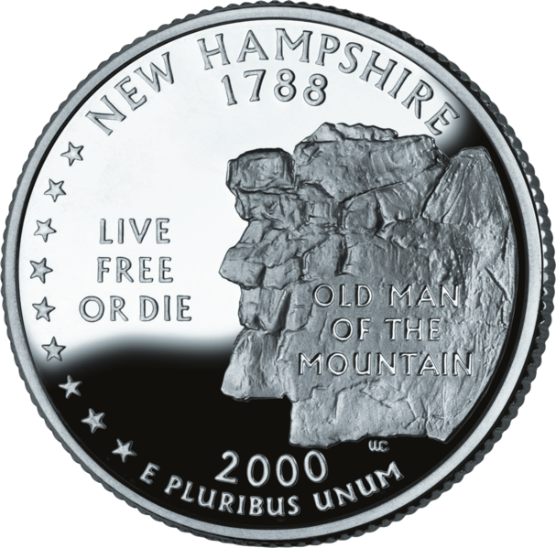
Vermont | New Hampshire | Maine | Massachusetts

Slide 18
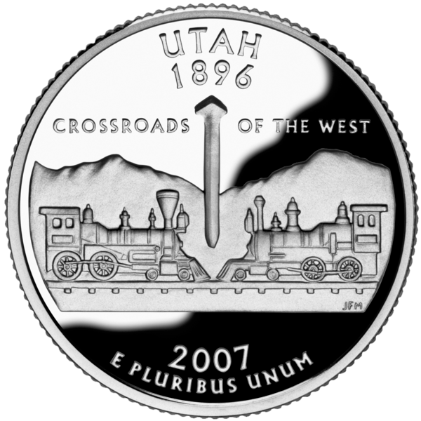
Nevada | Utah | Colorado | California

Slide 19
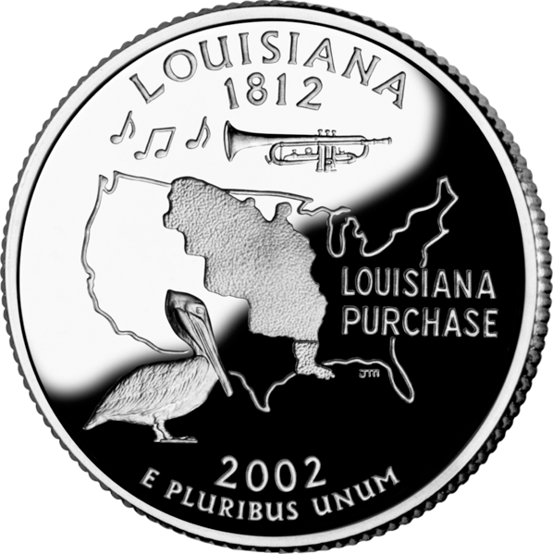
Arkansas | Texas | Oklahoma | Louisiana

Slide 20
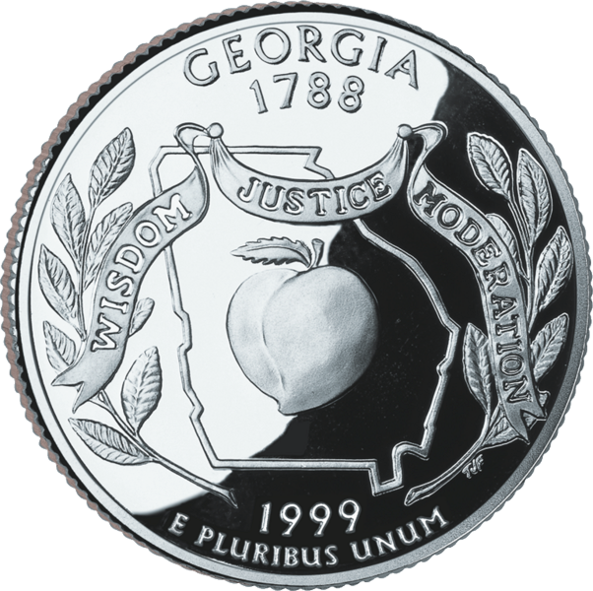
South Carolina | Georgia | North Carolina | Florida

Slide 21
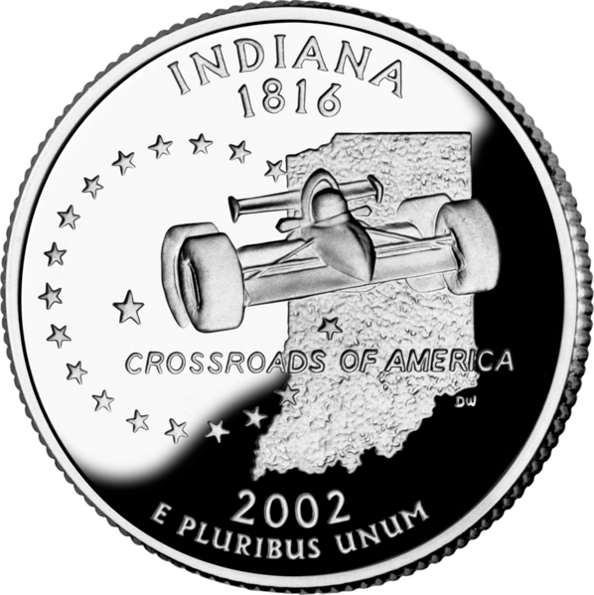
Ohio | Indiana | Illinois | Michigan

Slide 22
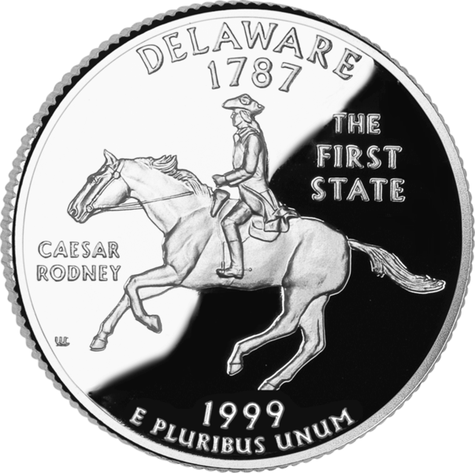
New Jersey | Delaware | Connecticut | Pennsylvania

Slide 23
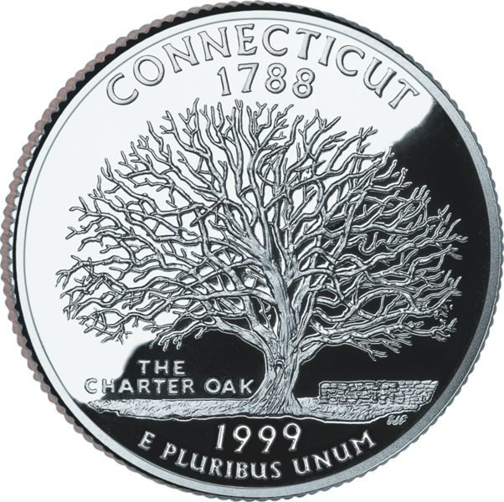
Connecticut | Nevada | California | Rhode Island

Slide 24
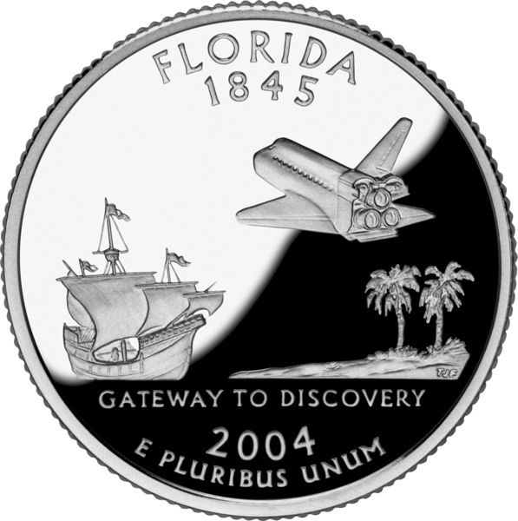
Texas | Louisiana | Florida | Virginia

Slide 25
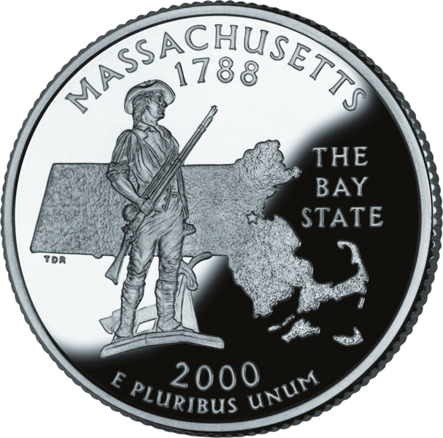
Massachusetts | Connecticut | New York | Virginia

Slide 26
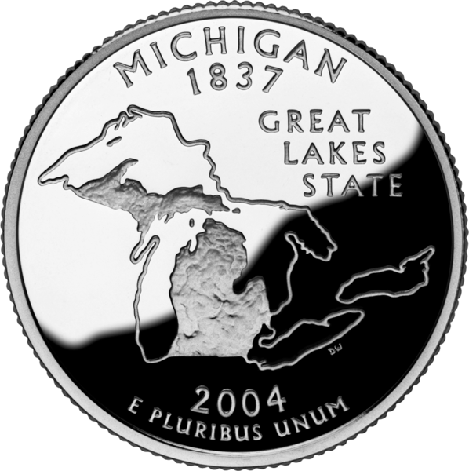
Wisconsin | Minnesota | Ohio | Michigan

Slide 27
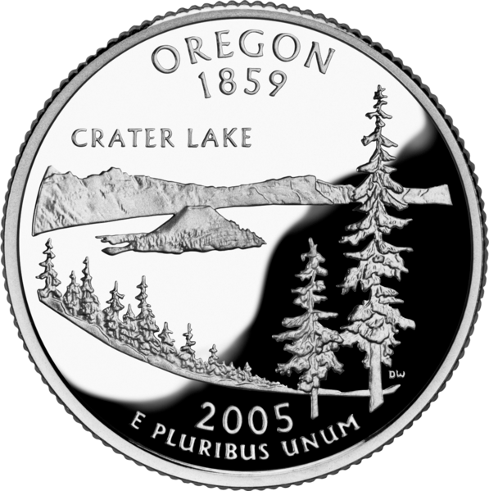
Wyoming | Oregon | Washington | Nevada

Slide 28
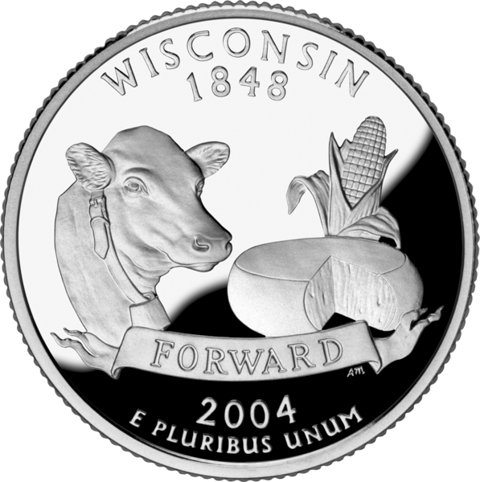
California | Wisconsin | Michigan | Minnesota

Slide 29
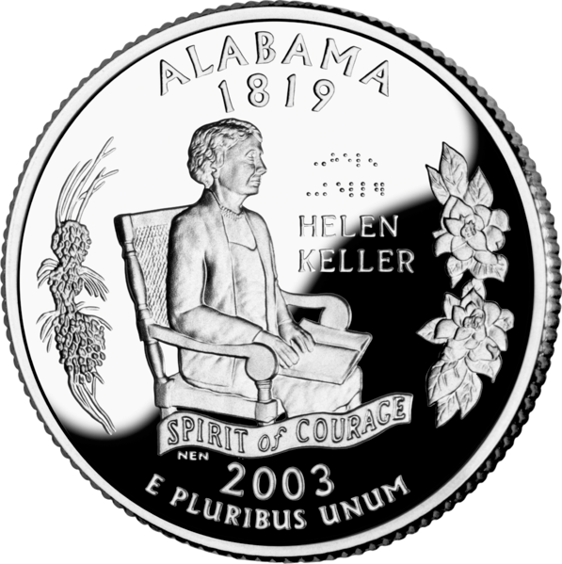
Mississippi | Arkansas | Alabama | Georgia

Slide 30
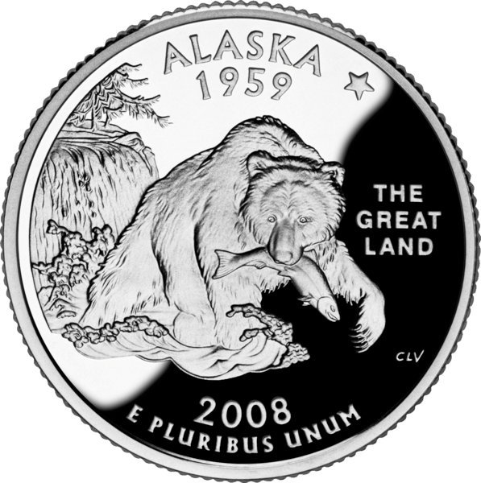
Alaska | Washington | Oregon | Montana

Slide 31
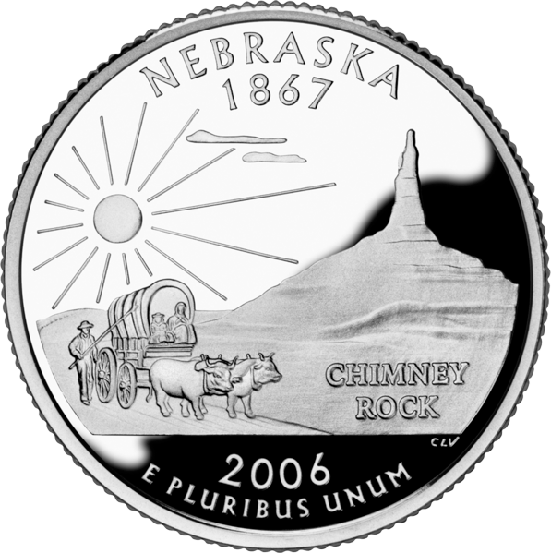
South Dakota | Nebraska | Wyoming | Montana

Slide 32
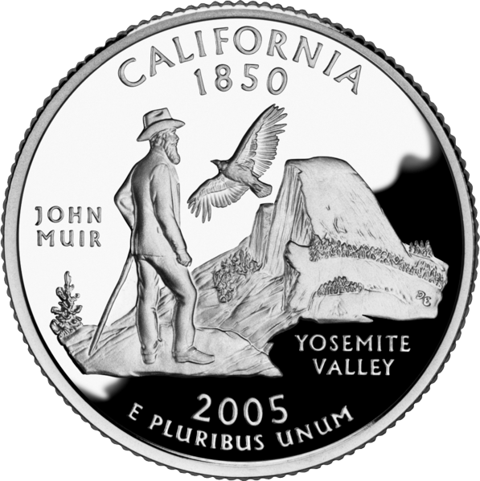
Nevada | California | Utah | Wyoming

Slide 33
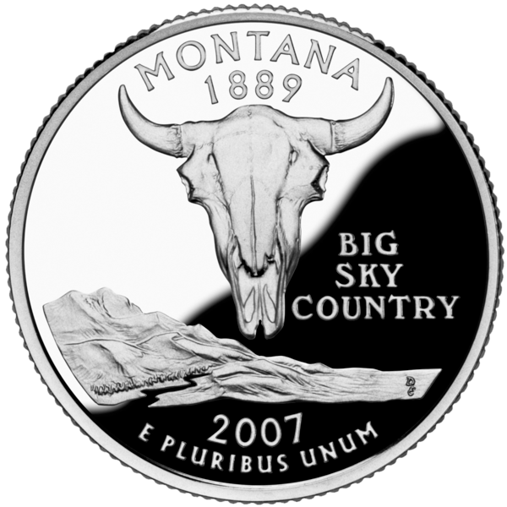
Wyoming | Colorado | Washington | Montana

Slide 34
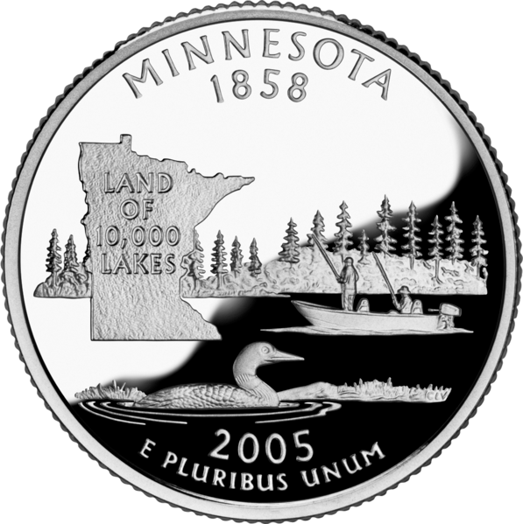
Wisconsin | South Dakota | Minnesota | Iowa

Slide 35
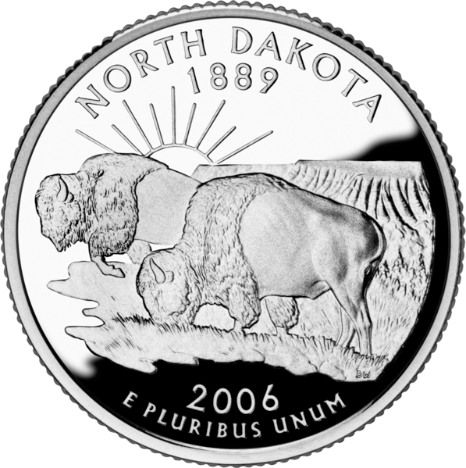
Montana | Wyoming | North Dakota | Idaho

Slide 36
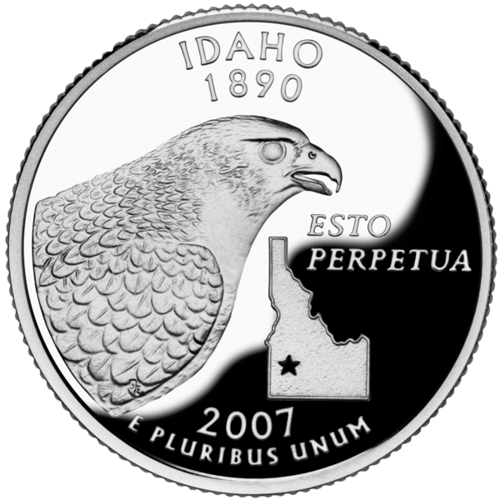
Alaska | Hawaii | Idaho | Maine

Slide 37
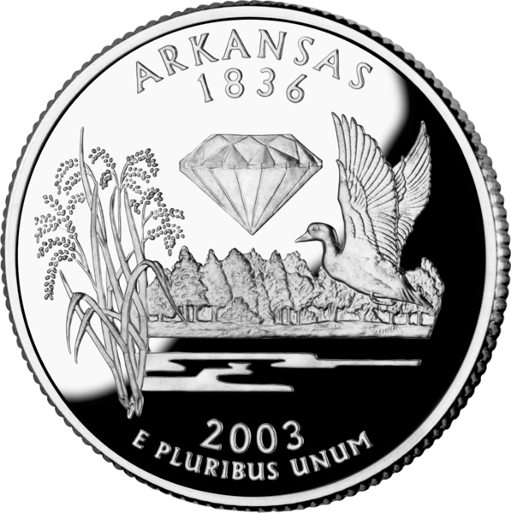
Missouri | Arkansas | Oklahoma | Kansas

Slide 38
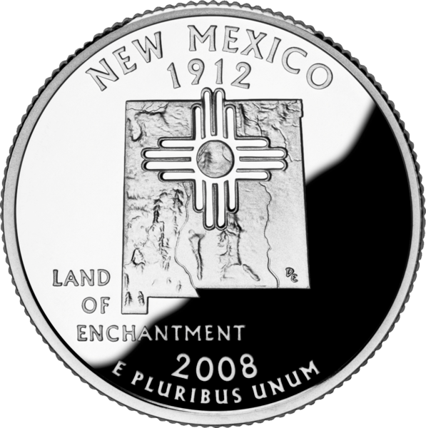
Arizona | New Mexico | Utah | Nevada

Slide 39
Pennsylvania | Ohio | New York | Connecticut

Slide 40
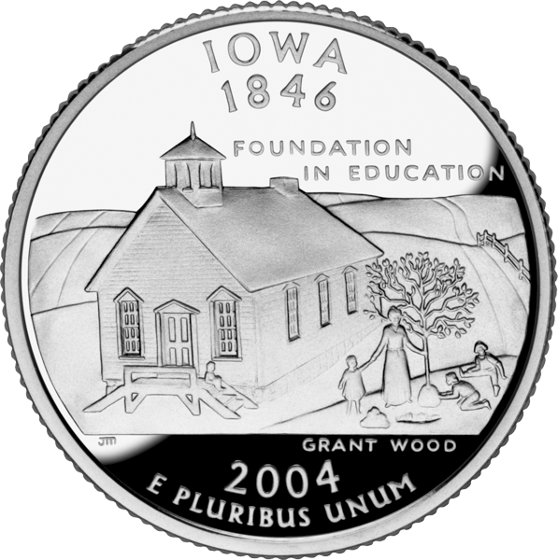
Minnesota | Iowa | North Dakota | New York

Slide 41
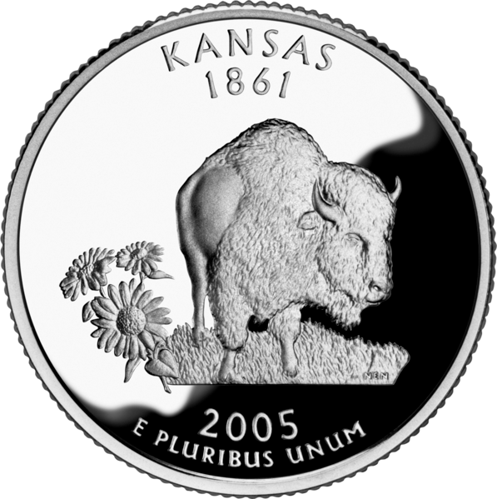
North Dakota | Texas | Kansas | Arizona

Slide 42
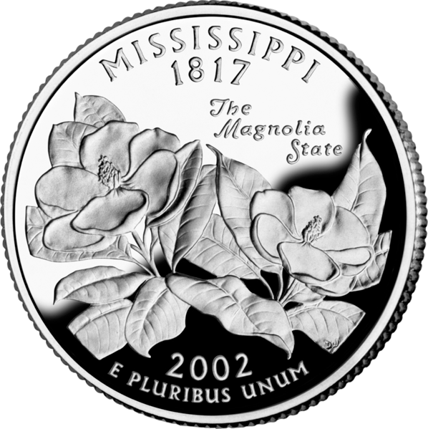
Arkansas | Mississippi | Alabama | Texas

Slide 43
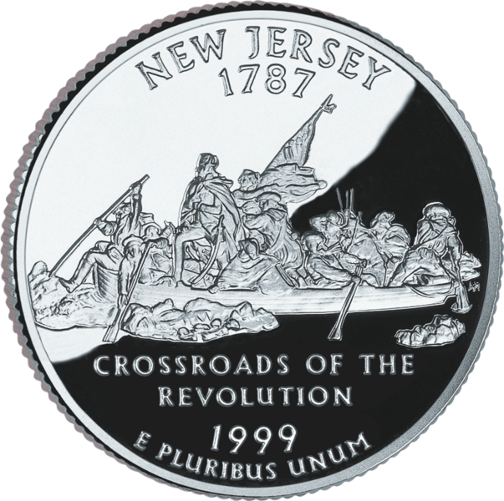
Pennsylvania | New York | Virginia | New Jersey

Slide 44
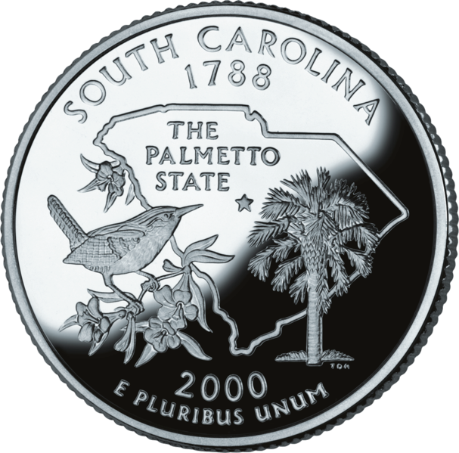
South Carolina | North Carolina | Virginia | Georgia

Slide 45
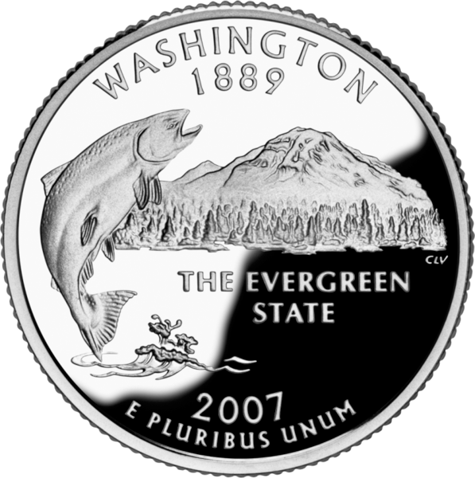
Oregon | California | Alaska | Washington

Slide 46
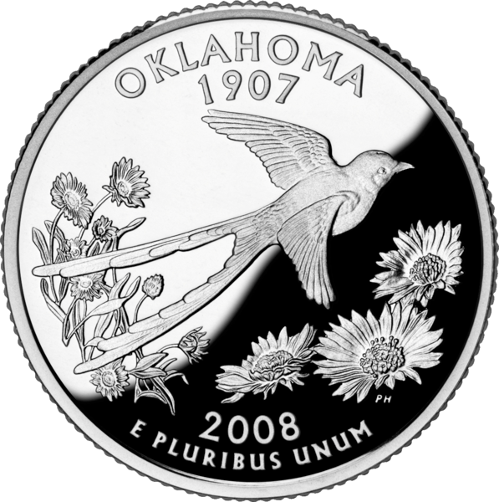
Texas | Colorado | Oklahoma | Nebraska

Slide 47
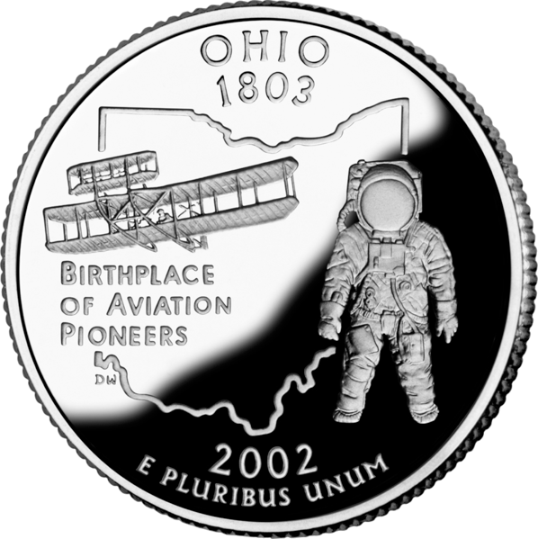
Indiana | Ohio | Illinois | Iowa

Slide 48
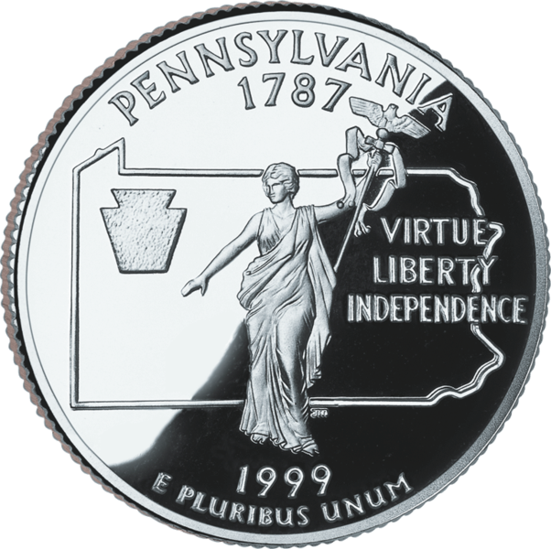
Maryland | Delaware | Pennsylvania | New Jersey

Slide 49
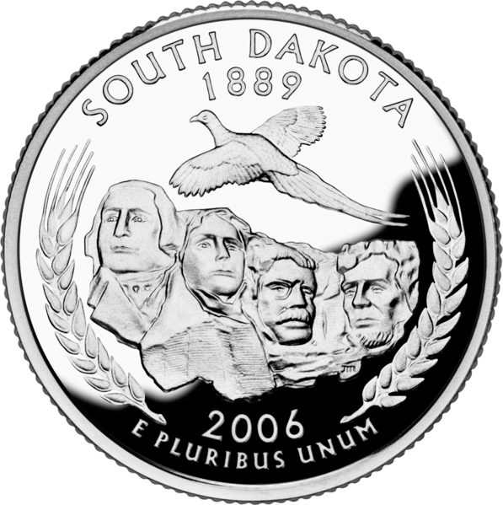
North Dakota | South Dakota | Wyoming | Colorado

Slide 50
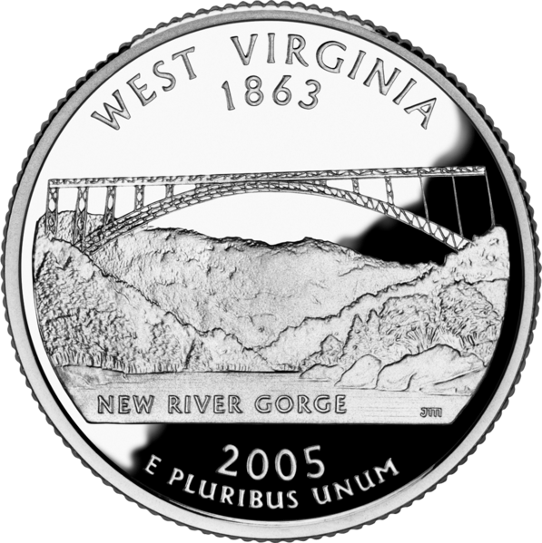
Kentucky | Pennsylvania | West Virginia | North Carolina

