Slide 1
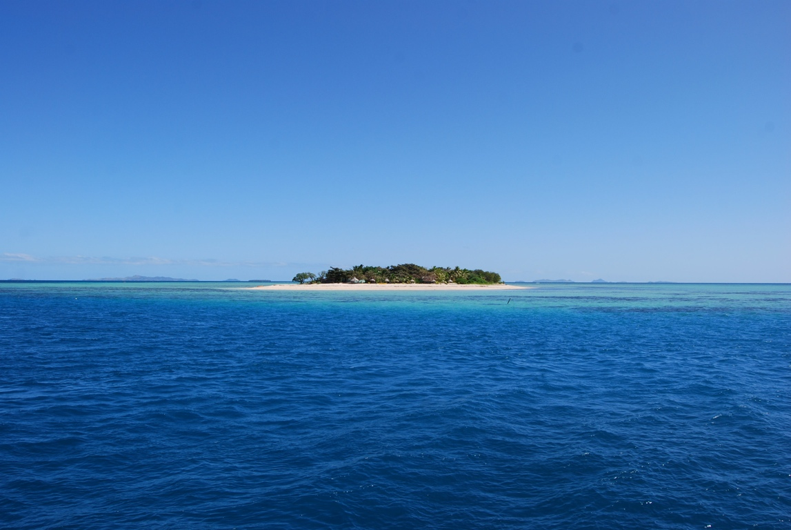
Vegetation Types

Slide 2
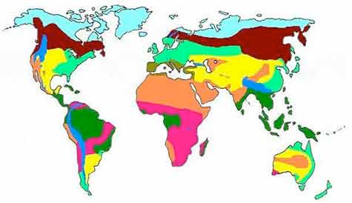

Slide 3
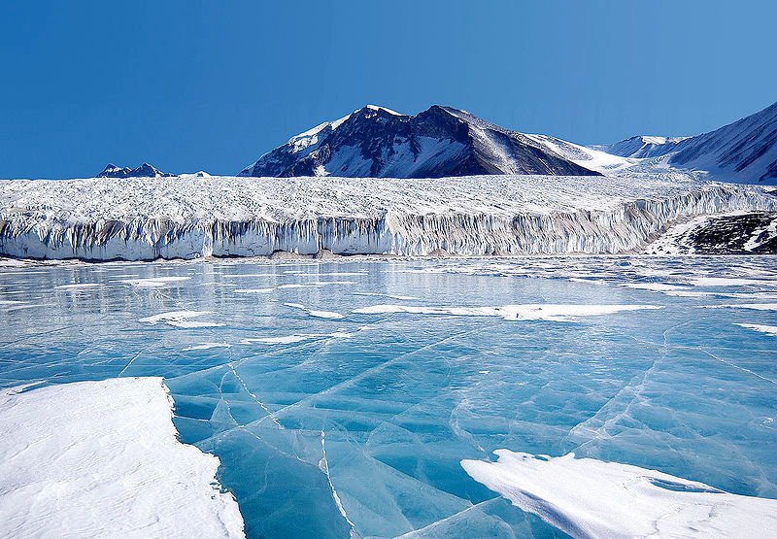
Alpine Tundra
Arctic Tundra
Boreal Forest
Chaparral
Desert
Icecap
Temperate Forest
Temperate Grassland
Tropical Rain Forest
Tropical Savanna
CHOICES
Alpine Tundra
Arctic Tundra
Boreal Forest
Chaparral
Desert
Icecap
Temperate Forest
Temperate Grassland
Tropical Rain Forest
Tropical Savanna

Slide 4
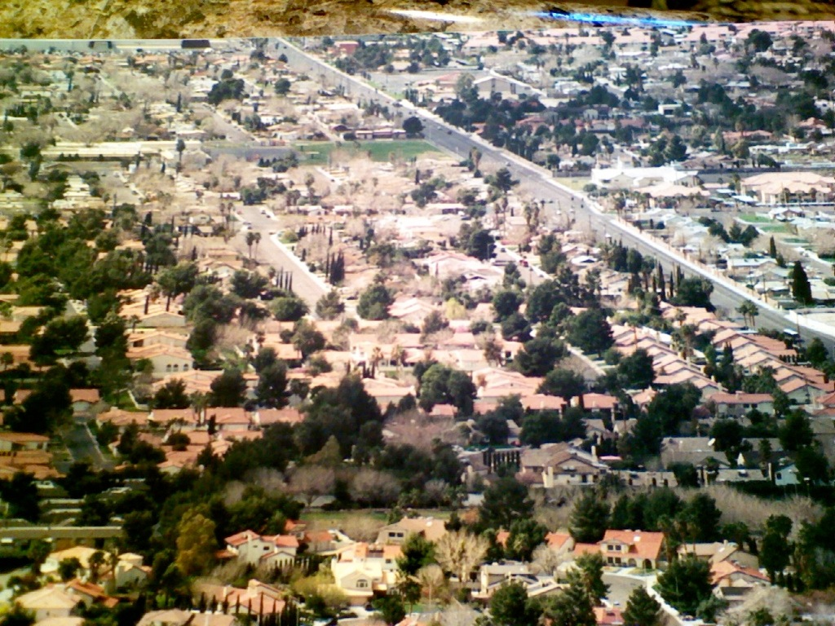
Alpine Tundra
Arctic Tundra
Boreal Forest
Chaparral
Desert
Icecap
Temperate Forest
Temperate Grassland
Tropical Rain Forest
Tropical Savanna
CHOICES
Alpine Tundra
Arctic Tundra
Boreal Forest
Chaparral
Desert
Icecap
Temperate Forest
Temperate Grassland
Tropical Rain Forest
Tropical Savanna

Slide 5
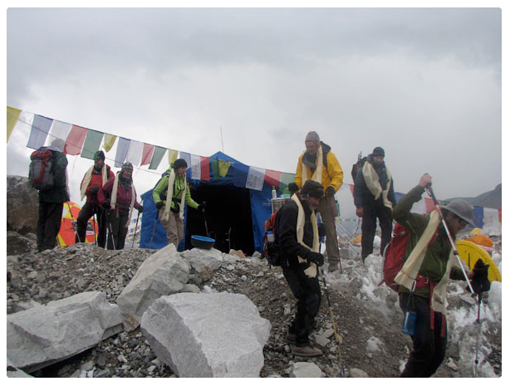
Alpine Tundra
Arctic Tundra
Boreal Forest
Chaparral
Desert
Icecap
Temperate Forest
Temperate Grassland
Tropical Rain Forest
Tropical Savanna
CHOICES
Alpine Tundra
Arctic Tundra
Boreal Forest
Chaparral
Desert
Icecap
Temperate Forest
Temperate Grassland
Tropical Rain Forest
Tropical Savanna

Slide 6
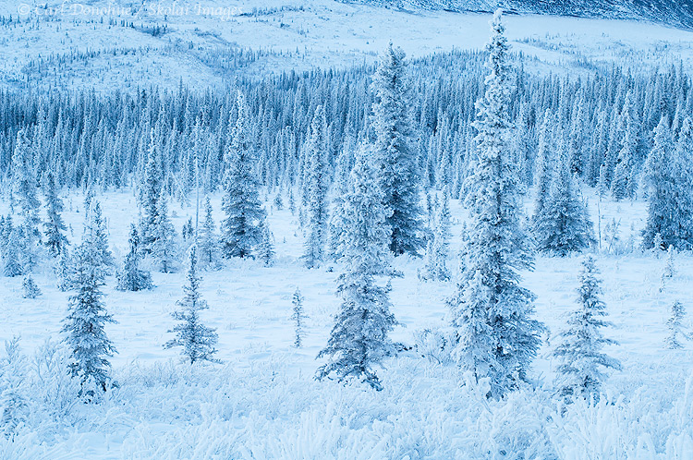
Alpine Tundra
Arctic Tundra
Boreal Forest
Chaparral
Desert
Icecap
Temperate Forest
Temperate Grassland
Tropical Rain Forest
Tropical Savanna
CHOICES
Alpine Tundra
Arctic Tundra
Boreal Forest
Chaparral
Desert
Icecap
Temperate Forest
Temperate Grassland
Tropical Rain Forest
Tropical Savanna

Slide 7
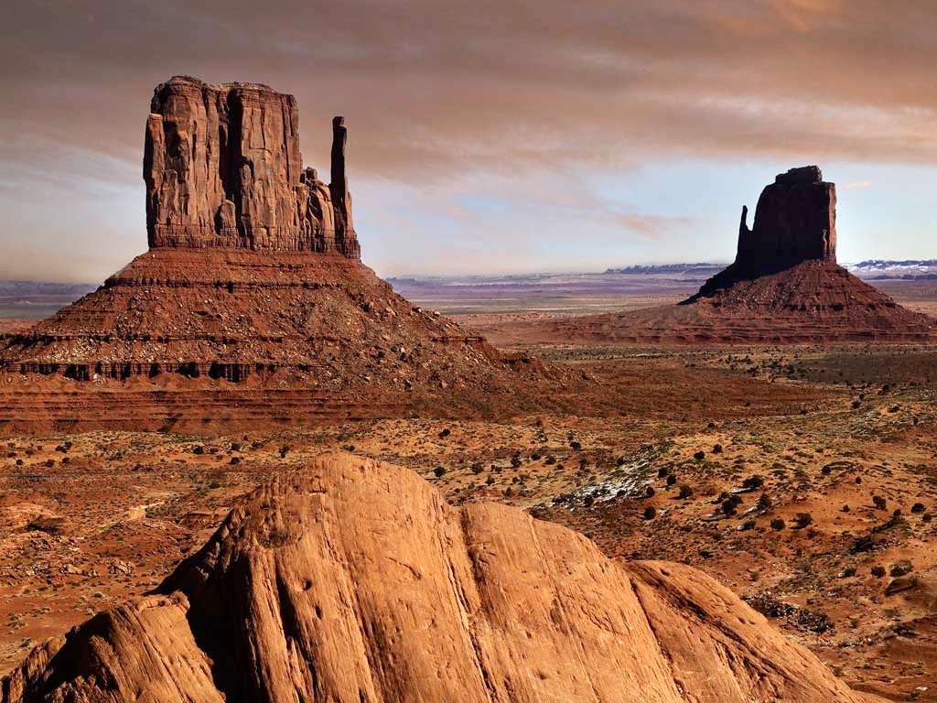
Alpine Tundra
Arctic Tundra
Boreal Forest
Chaparral
Desert
Icecap
Temperate Forest
Temperate Grassland
Tropical Rain Forest
Tropical Savanna
CHOICES
Alpine Tundra
Arctic Tundra
Boreal Forest
Chaparral
Desert
Icecap
Temperate Forest
Temperate Grassland
Tropical Rain Forest
Tropical Savanna

Slide 8
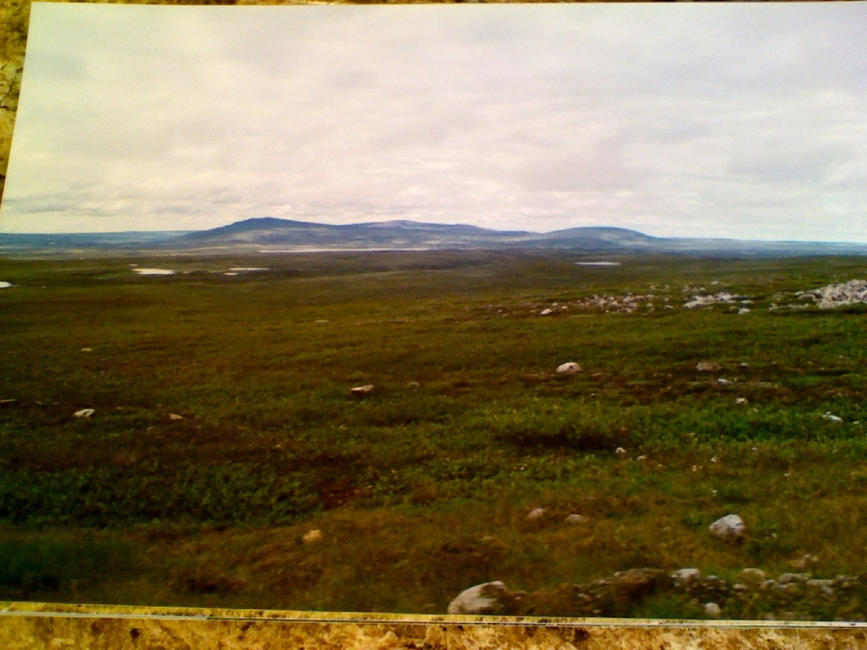
Alpine Tundra
Arctic Tundra
Boreal Forest
Chaparral
Desert
Icecap
Temperate Forest
Temperate Grassland
Tropical Rain Forest
Tropical Savanna
CHOICES
Alpine Tundra
Arctic Tundra
Boreal Forest
Chaparral
Desert
Icecap
Temperate Forest
Temperate Grassland
Tropical Rain Forest
Tropical Savanna

Slide 9
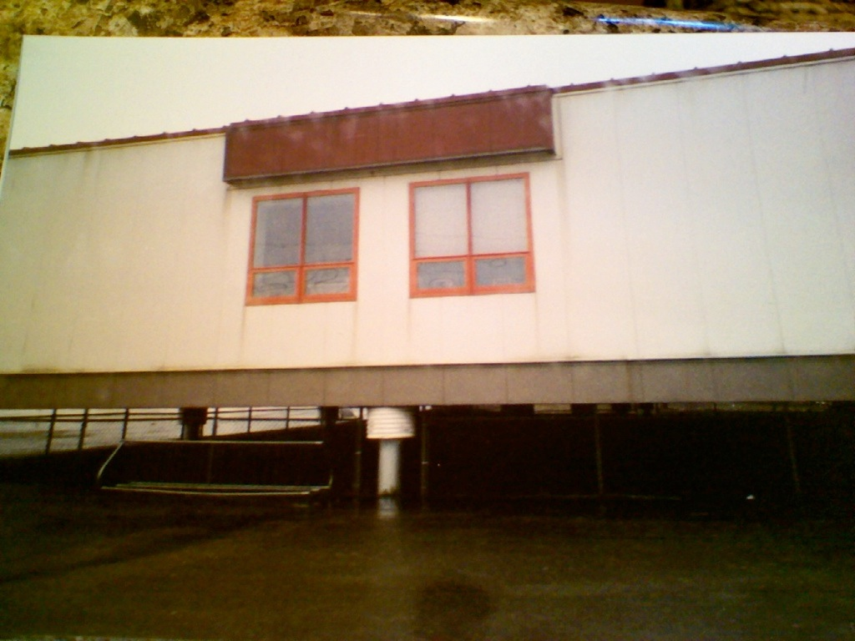
Alpine Tundra
Arctic Tundra
Boreal Forest
Chaparral
Desert
Icecap
Temperate Forest
Temperate Grassland
Tropical Rain Forest
Tropical Savanna
CHOICES
Alpine Tundra
Arctic Tundra
Boreal Forest
Chaparral
Desert
Icecap
Temperate Forest
Temperate Grassland
Tropical Rain Forest
Tropical Savanna

Slide 10
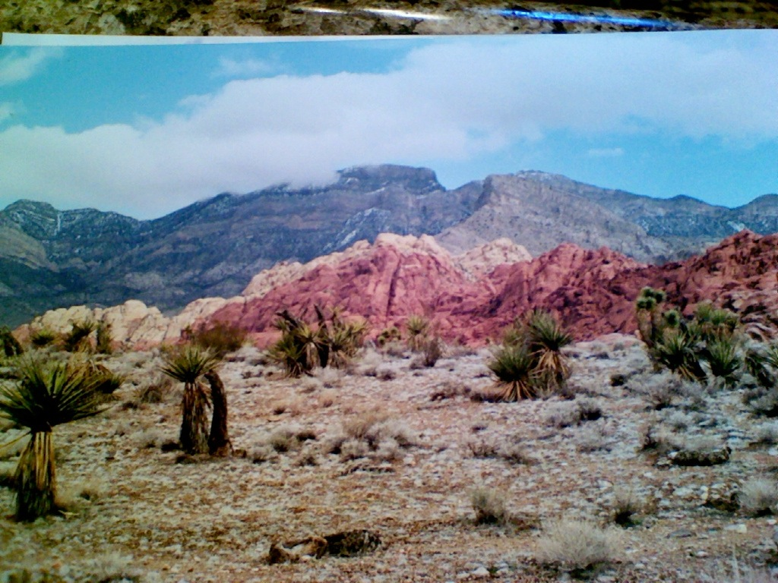
Alpine Tundra
Arctic Tundra
Boreal Forest
Chaparral
Desert
Icecap
Temperate Forest
Temperate Grassland
Tropical Rain Forest
Tropical Savanna
CHOICES
Alpine Tundra
Arctic Tundra
Boreal Forest
Chaparral
Desert
Icecap
Temperate Forest
Temperate Grassland
Tropical Rain Forest
Tropical Savanna

Slide 11
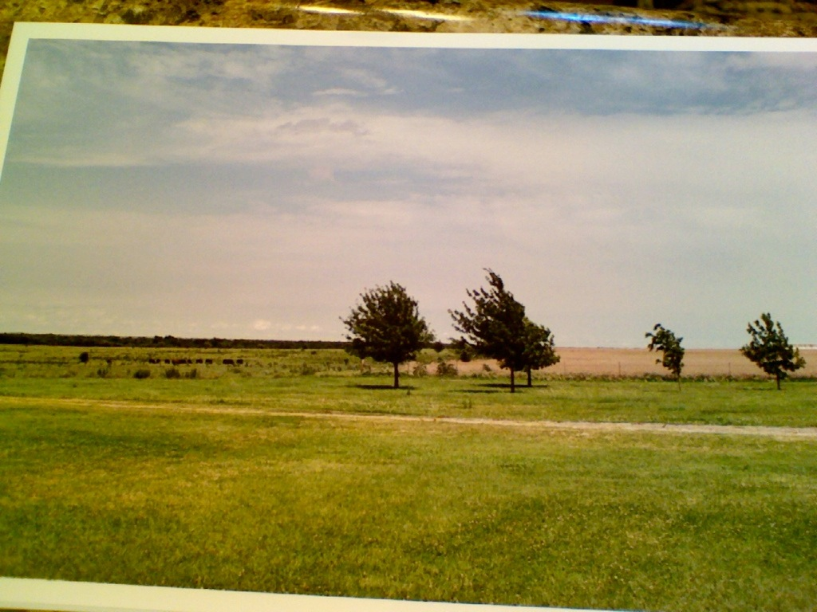
Alpine Tundra
Arctic Tundra
Boreal Forest
Chaparral
Desert
Icecap
Temperate Forest
Temperate Grassland
Tropical Rain Forest
Tropical Savanna
CHOICES
Alpine Tundra
Arctic Tundra
Boreal Forest
Chaparral
Desert
Icecap
Temperate Forest
Temperate Grassland
Tropical Rain Forest
Tropical Savanna

Slide 12
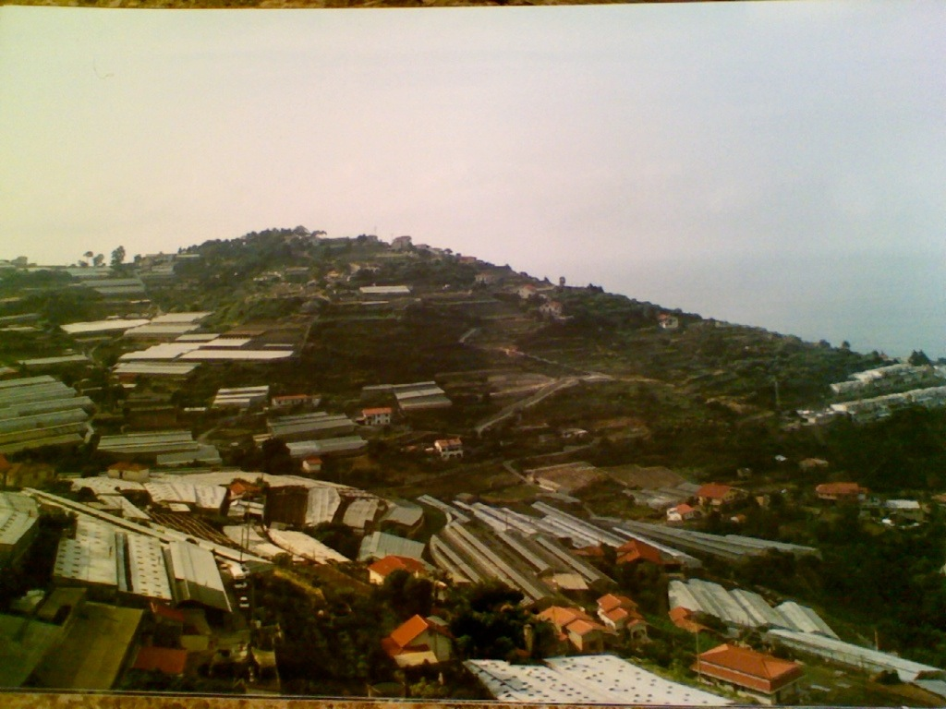
Alpine Tundra
Arctic Tundra
Boreal Forest
Chaparral
Desert
Icecap
Temperate Forest
Temperate Grassland
Tropical Rain Forest
Tropical Savanna
CHOICES
Alpine Tundra
Arctic Tundra
Boreal Forest
Chaparral
Desert
Icecap
Temperate Forest
Temperate Grassland
Tropical Rain Forest
Tropical Savanna

Slide 13
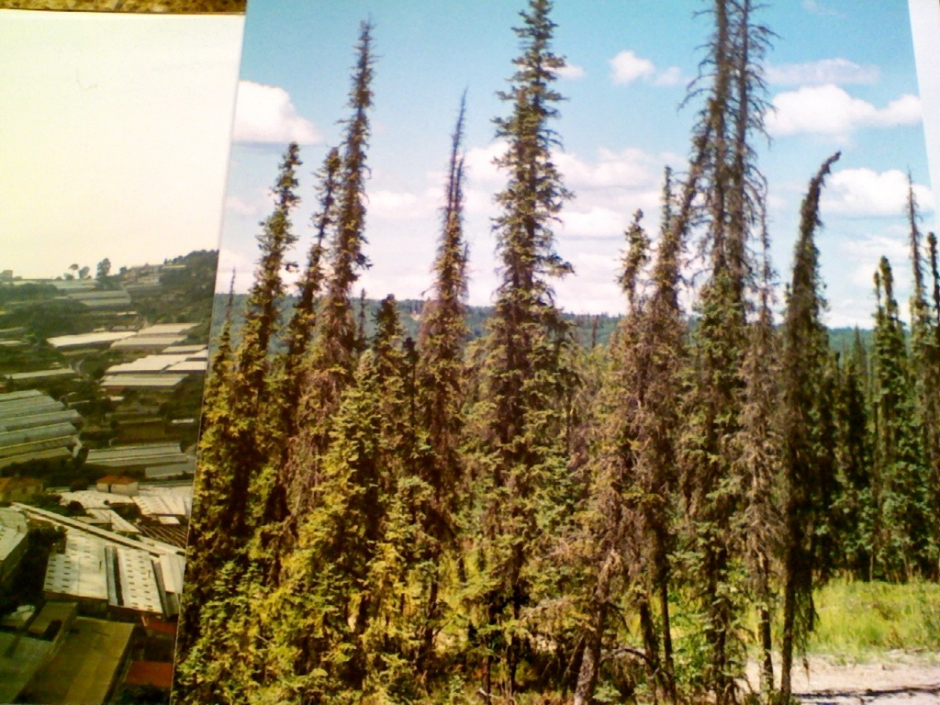
Alpine Tundra
Arctic Tundra
Boreal Forest
Chaparral
Desert
Icecap
Temperate Forest
Temperate Grassland
Tropical Rain Forest
Tropical Savanna
CHOICES
Alpine Tundra
Arctic Tundra
Boreal Forest
Chaparral
Desert
Icecap
Temperate Forest
Temperate Grassland
Tropical Rain Forest
Tropical Savanna

Slide 14
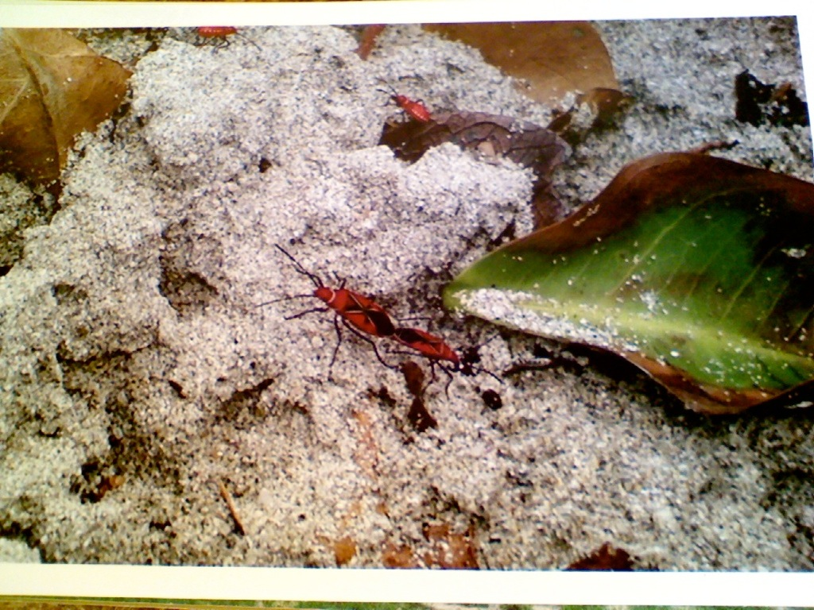
Alpine Tundra
Arctic Tundra
Boreal Forest
Chaparral
Desert
Icecap
Temperate Forest
Temperate Grassland
Tropical Rain Forest
Tropical Savanna
CHOICES
Alpine Tundra
Arctic Tundra
Boreal Forest
Chaparral
Desert
Icecap
Temperate Forest
Temperate Grassland
Tropical Rain Forest
Tropical Savanna

Slide 15
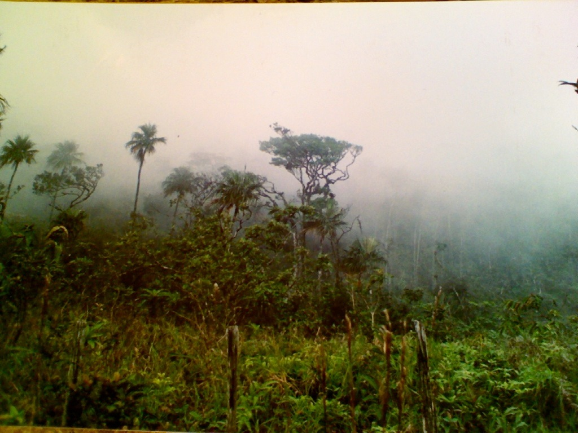
Alpine Tundra
Arctic Tundra
Boreal Forest
Chaparral
Desert
Icecap
Temperate Forest
Temperate Grassland
Tropical Rain Forest
Tropical Savanna
CHOICES
Alpine Tundra
Arctic Tundra
Boreal Forest
Chaparral
Desert
Icecap
Temperate Forest
Temperate Grassland
Tropical Rain Forest
Tropical Savanna

Slide 16
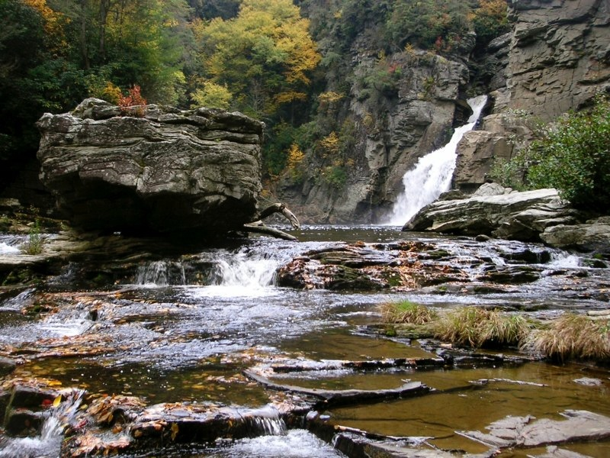
Alpine Tundra
Arctic Tundra
Boreal Forest
Chaparral
Desert
Icecap
Temperate Forest
Temperate Grassland
Tropical Rain Forest
Tropical Savanna
CHOICES
Alpine Tundra
Arctic Tundra
Boreal Forest
Chaparral
Desert
Icecap
Temperate Forest
Temperate Grassland
Tropical Rain Forest
Tropical Savanna

Slide 17
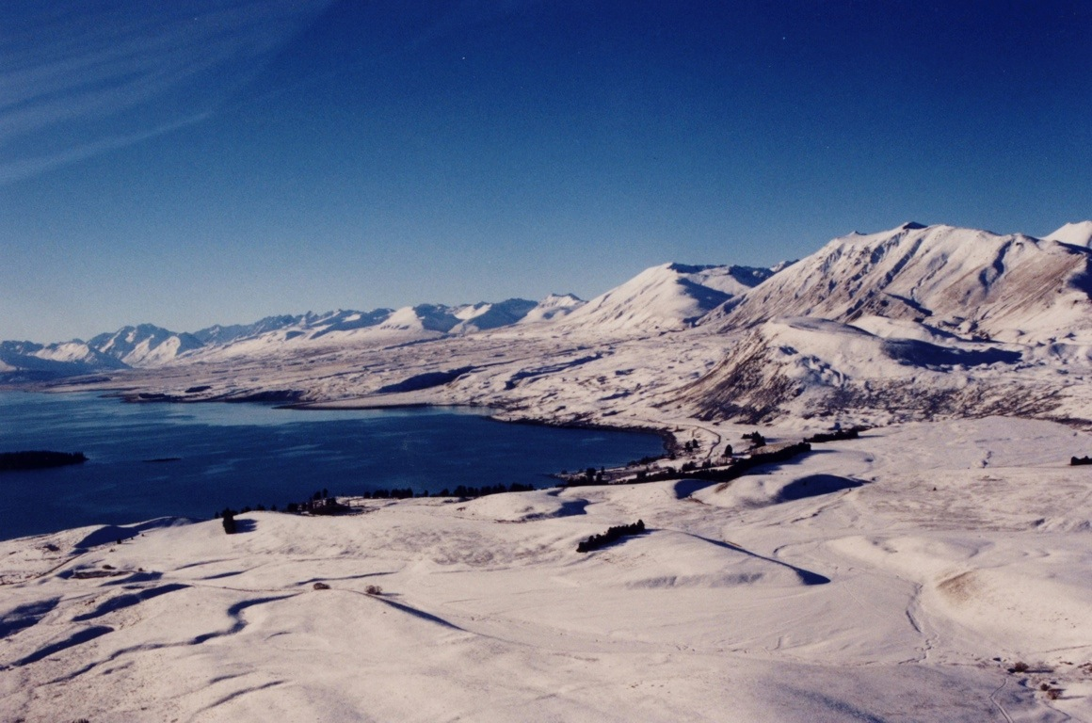
Alpine Tundra
Arctic Tundra
Boreal Forest
Chaparral
Desert
Icecap
Temperate Forest
Temperate Grassland
Tropical Rain Forest
Tropical Savanna
CHOICES
Alpine Tundra
Arctic Tundra
Boreal Forest
Chaparral
Desert
Icecap
Temperate Forest
Temperate Grassland
Tropical Rain Forest
Tropical Savanna

Slide 18
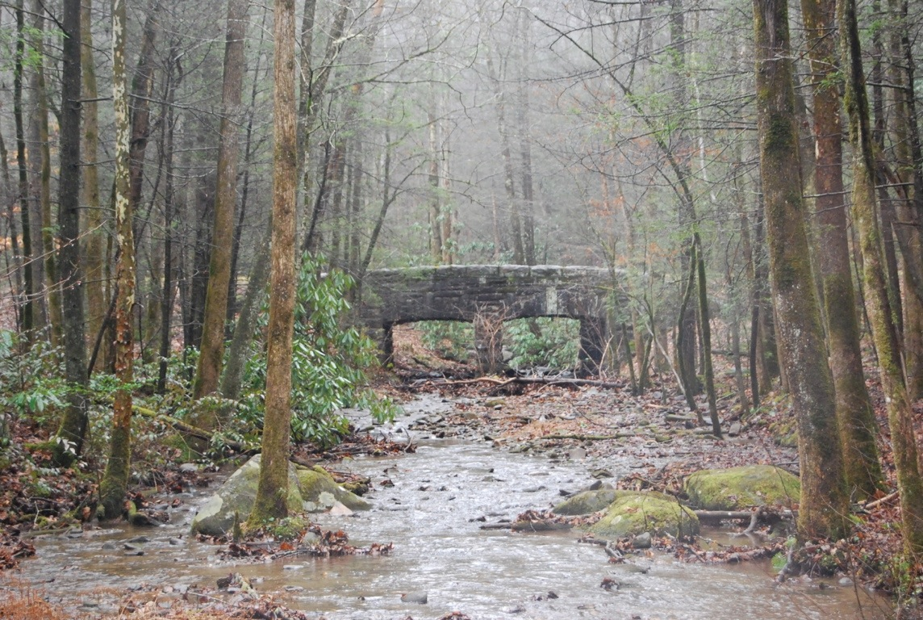
Alpine Tundra
Arctic Tundra
Boreal Forest
Chaparral
Desert
Icecap
Temperate Forest
Temperate Grassland
Tropical Rain Forest
Tropical Savanna
CHOICES
Alpine Tundra
Arctic Tundra
Boreal Forest
Chaparral
Desert
Icecap
Temperate Forest
Temperate Grassland
Tropical Rain Forest
Tropical Savanna

Slide 19
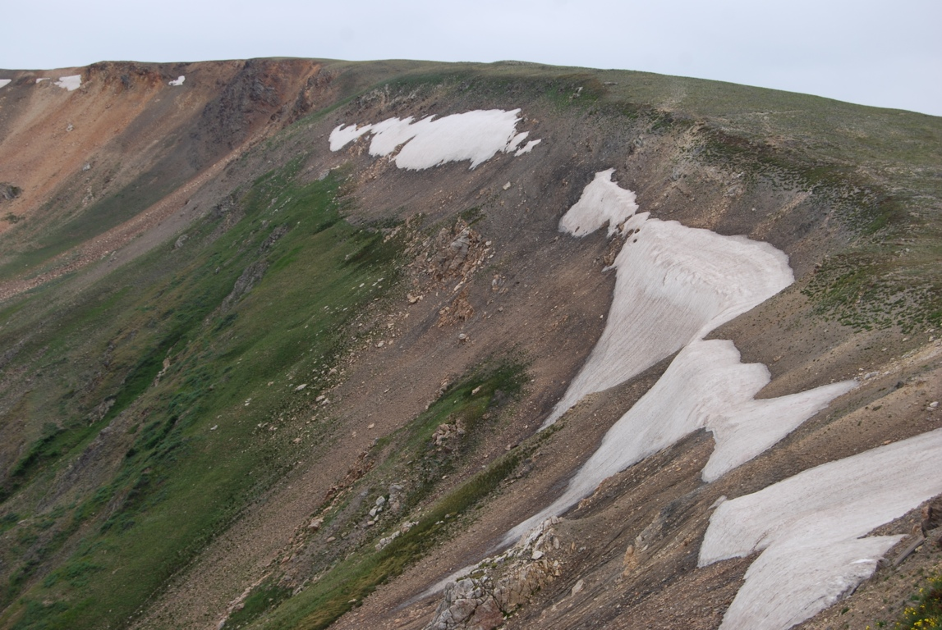
Alpine Tundra
Arctic Tundra
Boreal Forest
Chaparral
Desert
Icecap
Temperate Forest
Temperate Grassland
Tropical Rain Forest
Tropical Savanna
CHOICES
Alpine Tundra
Arctic Tundra
Boreal Forest
Chaparral
Desert
Icecap
Temperate Forest
Temperate Grassland
Tropical Rain Forest
Tropical Savanna

Slide 20
Alpine Tundra
Arctic Tundra
Boreal Forest
Chaparral
Desert
Icecap
Temperate Forest
Temperate Grassland
Tropical Rain Forest
Tropical Savanna
CHOICES
Alpine Tundra
Arctic Tundra
Boreal Forest
Chaparral
Desert
Icecap
Temperate Forest
Temperate Grassland
Tropical Rain Forest
Tropical Savanna

Slide 21
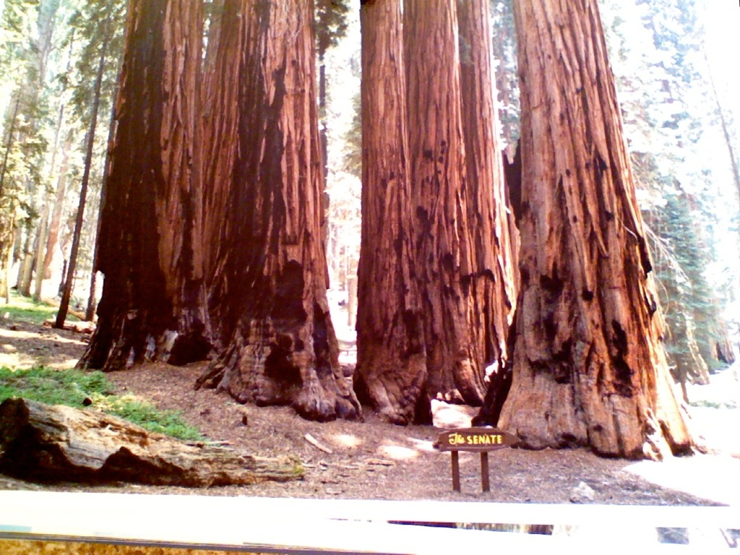
Alpine Tundra
Arctic Tundra
Boreal Forest
Chaparral
Desert
Icecap
Temperate Forest
Temperate Grassland
Tropical Rain Forest
Tropical Savanna
CHOICES
Alpine Tundra
Arctic Tundra
Boreal Forest
Chaparral
Desert
Icecap
Temperate Forest
Temperate Grassland
Tropical Rain Forest
Tropical Savanna

Slide 22
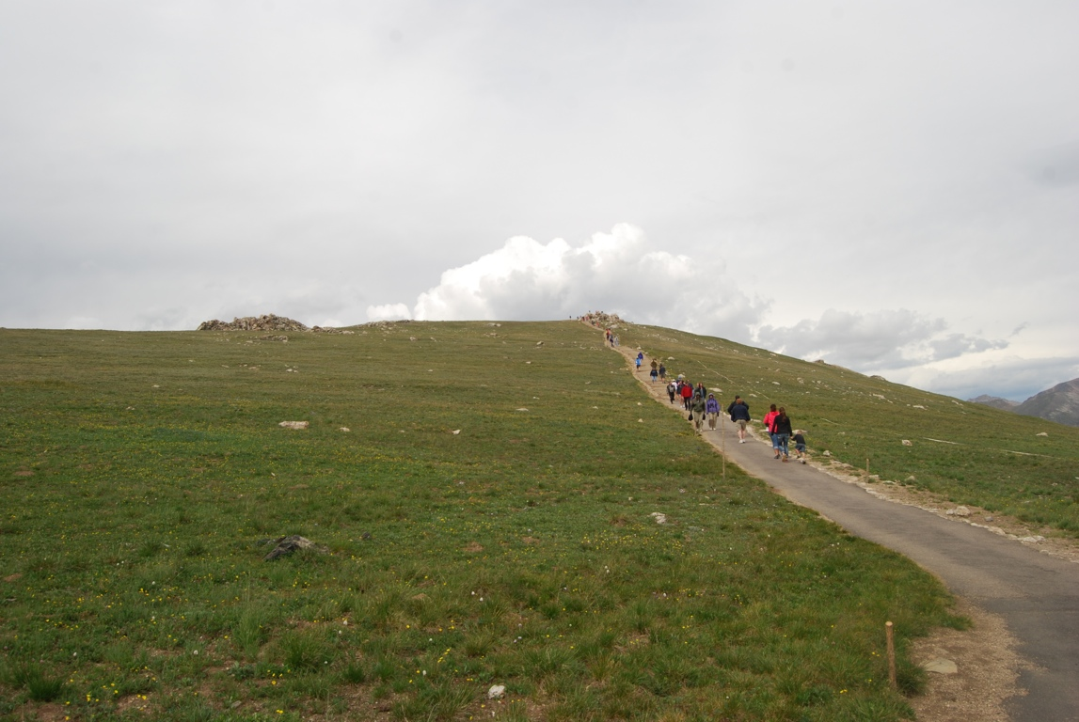
Alpine Tundra
Arctic Tundra
Boreal Forest
Chaparral
Desert
Icecap
Temperate Forest
Temperate Grassland
Tropical Rain Forest
Tropical Savanna
CHOICES
Alpine Tundra
Arctic Tundra
Boreal Forest
Chaparral
Desert
Icecap
Temperate Forest
Temperate Grassland
Tropical Rain Forest
Tropical Savanna

Slide 23
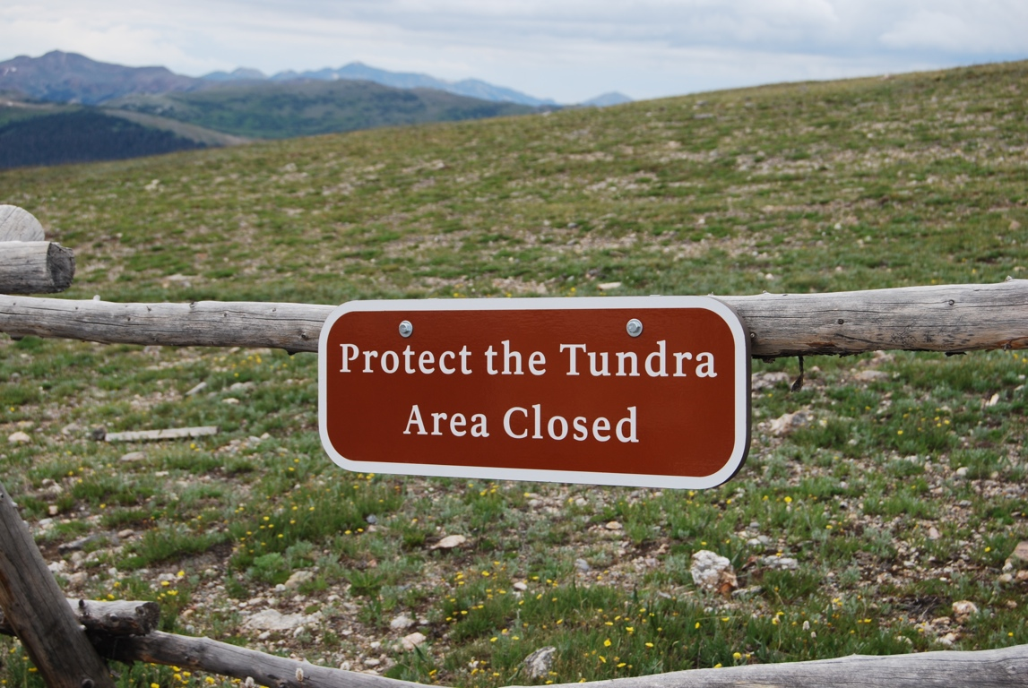

Slide 24
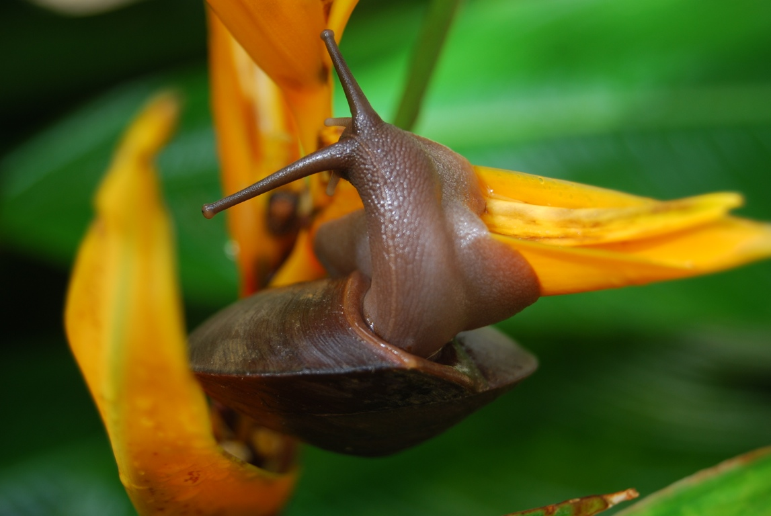
Alpine Tundra
Arctic Tundra
Boreal Forest
Chaparral
Desert
Icecap
Temperate Forest
Temperate Grassland
Tropical Rain Forest
Tropical Savanna
CHOICES
Alpine Tundra
Arctic Tundra
Boreal Forest
Chaparral
Desert
Icecap
Temperate Forest
Temperate Grassland
Tropical Rain Forest
Tropical Savanna

Slide 25
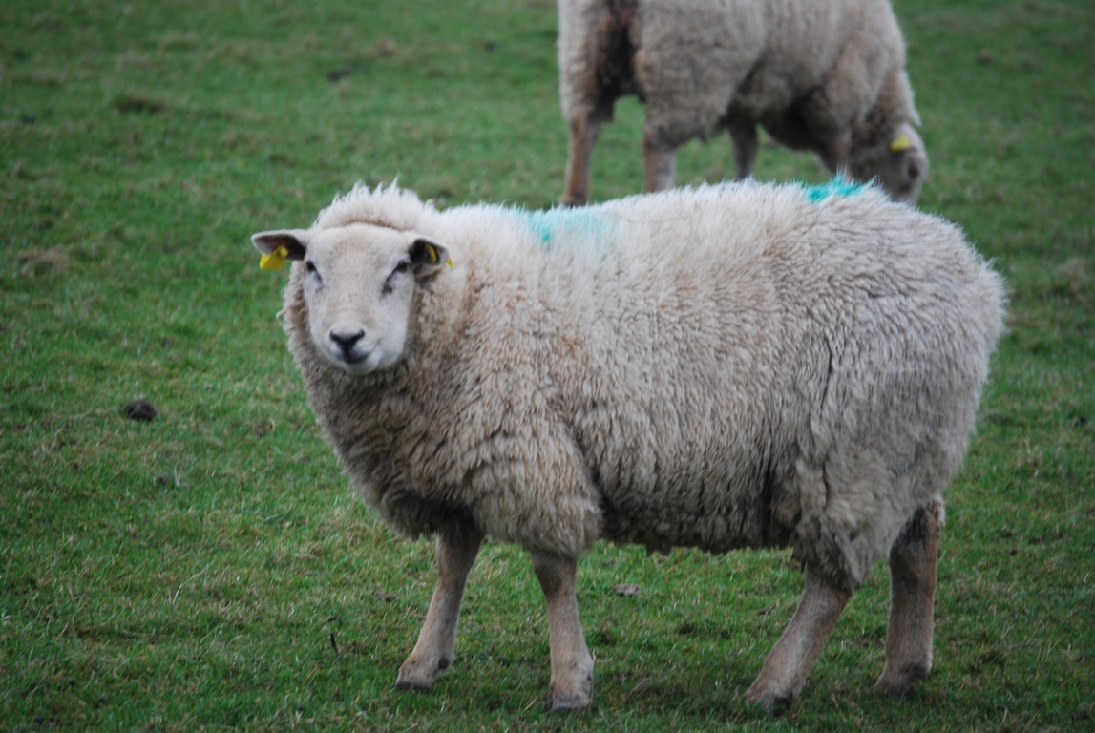
Alpine Tundra
Arctic Tundra
Boreal Forest
Chaparral
Desert
Icecap
Temperate Forest
Temperate Grassland
Tropical Rain Forest
Tropical Savanna
CHOICES
Alpine Tundra
Arctic Tundra
Boreal Forest
Chaparral
Desert
Icecap
Temperate Forest
Temperate Grassland
Tropical Rain Forest
Tropical Savanna

Slide 26
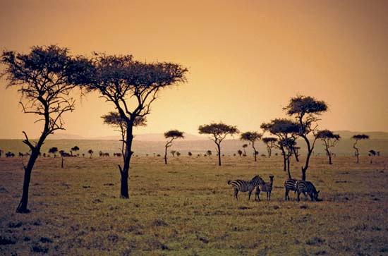
Alpine Tundra
Arctic Tundra
Boreal Forest
Chaparral
Desert
Icecap
Temperate Forest
Temperate Grassland
Tropical Rain Forest
Tropical Savanna
CHOICES
Alpine Tundra
Arctic Tundra
Boreal Forest
Chaparral
Desert
Icecap
Temperate Forest
Temperate Grassland
Tropical Rain Forest
Tropical Savanna

Slide 27
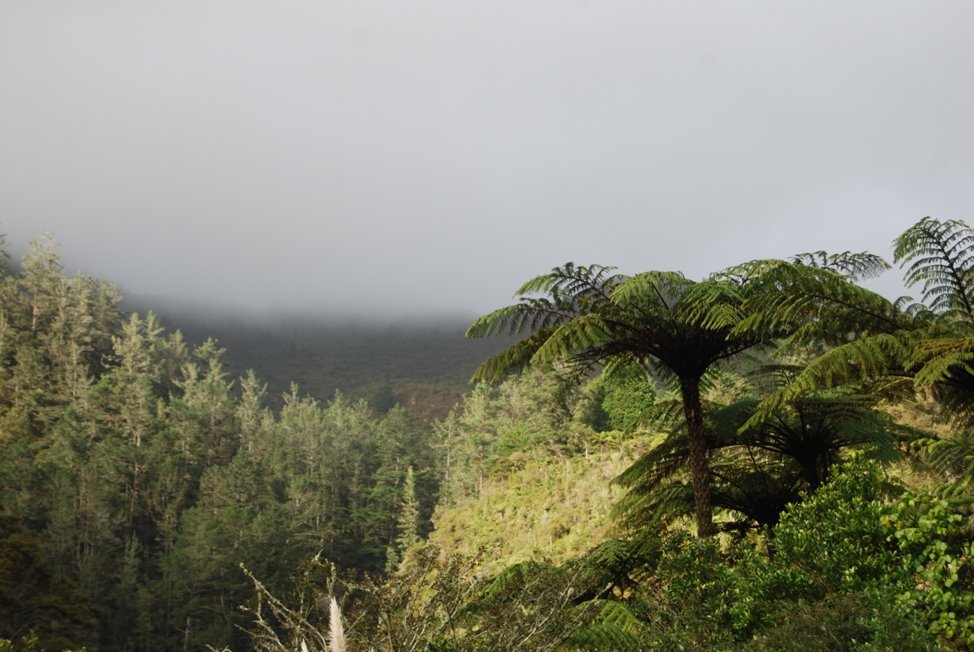
Alpine Tundra
Arctic Tundra
Boreal Forest
Chaparral
Desert
Icecap
Temperate Forest
Temperate Grassland
Tropical Rain Forest
Tropical Savanna
CHOICES
Alpine Tundra
Arctic Tundra
Boreal Forest
Chaparral
Desert
Icecap
Temperate Forest
Temperate Grassland
Tropical Rain Forest
Tropical Savanna

Slide 28
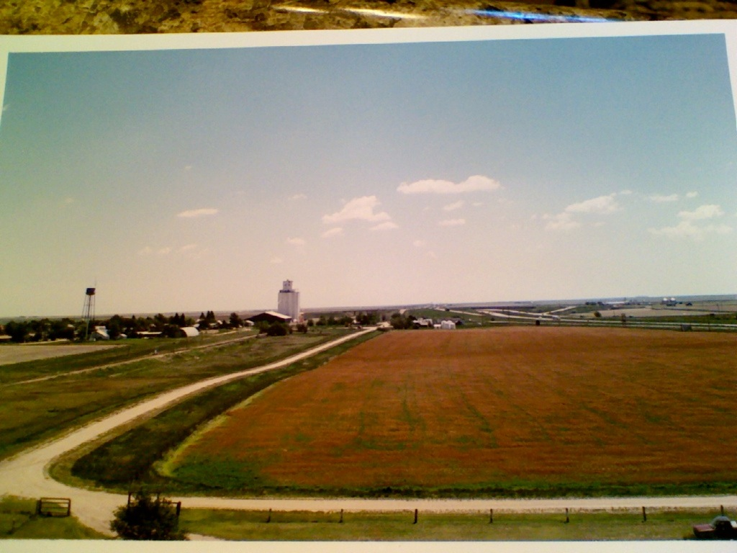
Alpine Tundra
Arctic Tundra
Boreal Forest
Chaparral
Desert
Icecap
Temperate Forest
Temperate Grassland
Tropical Rain Forest
Tropical Savanna
CHOICES
Alpine Tundra
Arctic Tundra
Boreal Forest
Chaparral
Desert
Icecap
Temperate Forest
Temperate Grassland
Tropical Rain Forest
Tropical Savanna

Slide 29
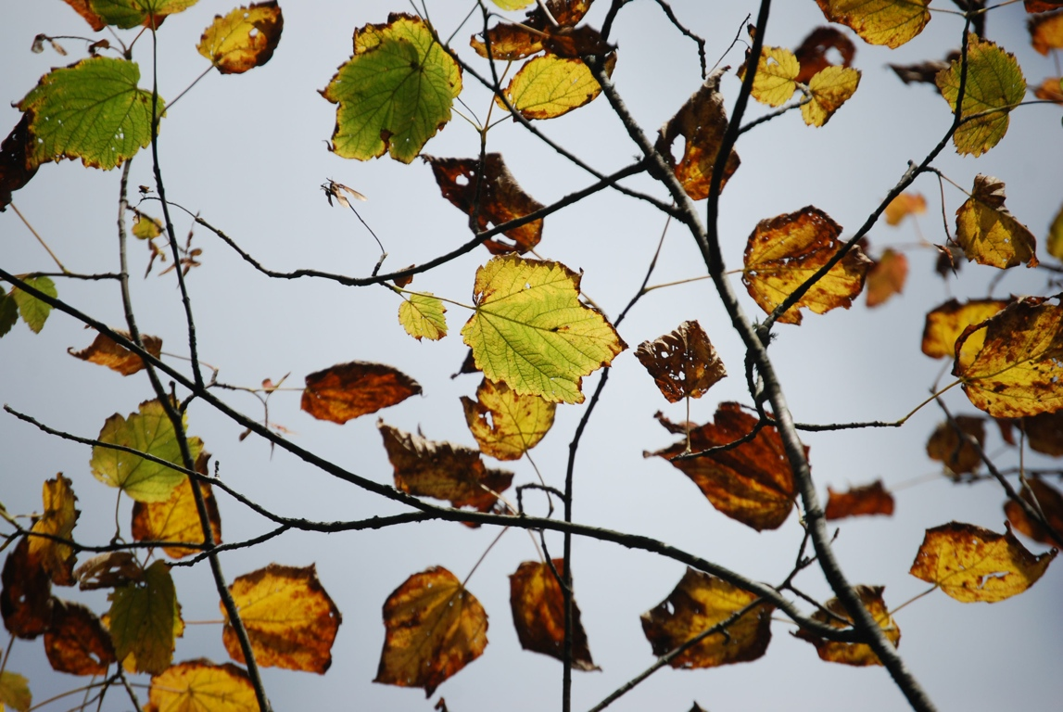
Alpine Tundra
Arctic Tundra
Boreal Forest
Chaparral
Desert
Icecap
Temperate Forest
Temperate Grassland
Tropical Rain Forest
Tropical Savanna
CHOICES
Alpine Tundra
Arctic Tundra
Boreal Forest
Chaparral
Desert
Icecap
Temperate Forest
Temperate Grassland
Tropical Rain Forest
Tropical Savanna

Slide 30
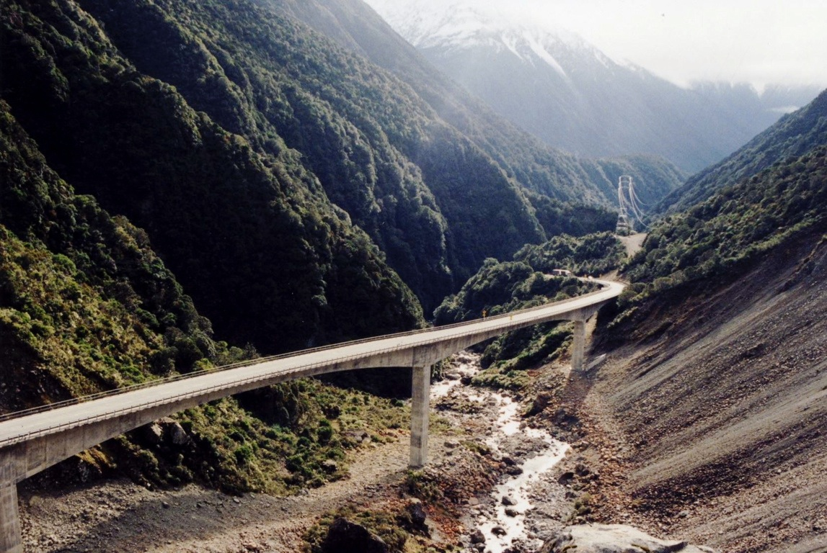
Alpine Tundra
Arctic Tundra
Boreal Forest
Chaparral
Desert
Icecap
Temperate Forest
Temperate Grassland
Tropical Rain Forest
Tropical Savanna
CHOICES
Alpine Tundra
Arctic Tundra
Boreal Forest
Chaparral
Desert
Icecap
Temperate Forest
Temperate Grassland
Tropical Rain Forest
Tropical Savanna

Slide 31
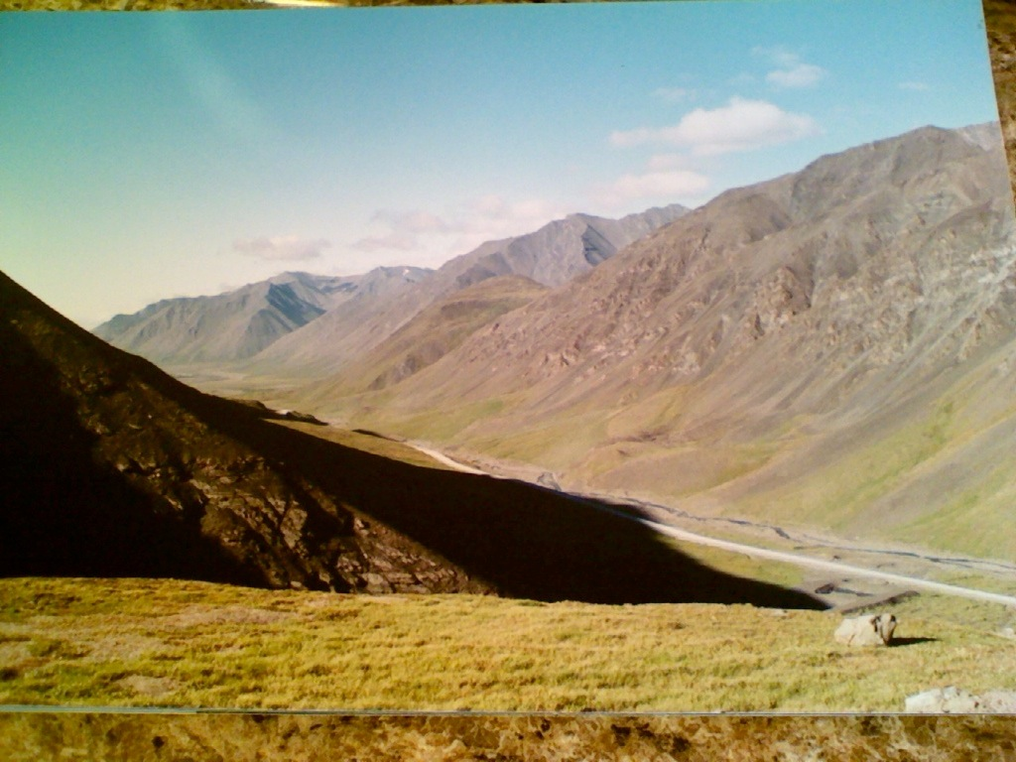
28
Alpine Tundra
Arctic Tundra
Boreal Forest
Chaparral
Desert
Icecap
Temperate Forest
Temperate Grassland
Tropical Rain Forest
Tropical Savanna
CHOICES
Alpine Tundra
Arctic Tundra
Boreal Forest
Chaparral
Desert
Icecap
Temperate Forest
Temperate Grassland
Tropical Rain Forest
Tropical Savanna

Slide 32
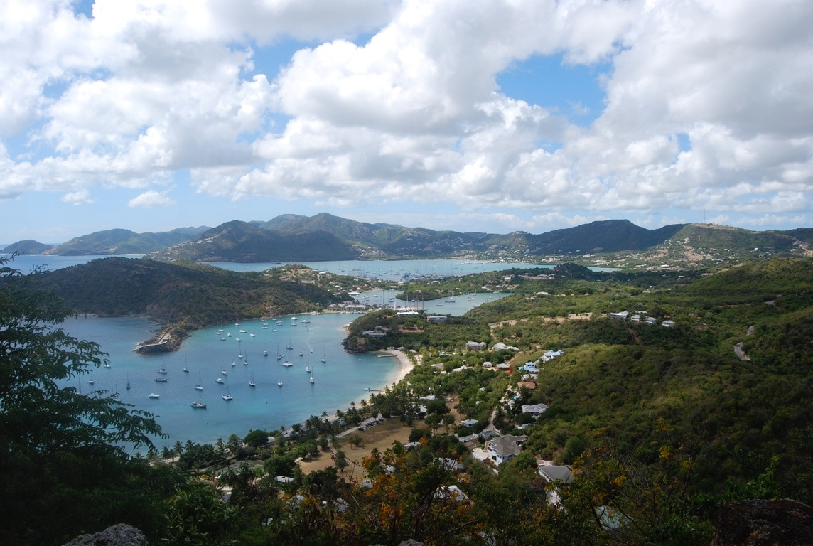
Alpine Tundra
Arctic Tundra
Boreal Forest
Chaparral
Desert
Icecap
Temperate Forest
Temperate Grassland
Tropical Rain Forest
Tropical Savanna
CHOICES
Alpine Tundra
Arctic Tundra
Boreal Forest
Chaparral
Desert
Icecap
Temperate Forest
Temperate Grassland
Tropical Rain Forest
Tropical Savanna

Slide 33
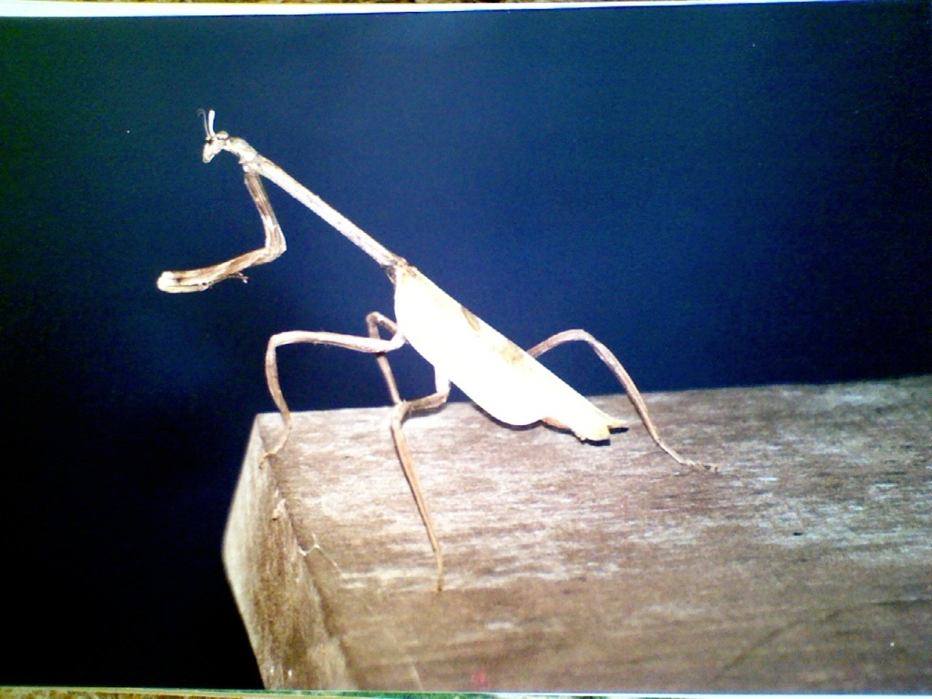
Alpine Tundra
Arctic Tundra
Boreal Forest
Chaparral
Desert
Icecap
Temperate Forest
Temperate Grassland
Tropical Rain Forest
Tropical Savanna
CHOICES
Alpine Tundra
Arctic Tundra
Boreal Forest
Chaparral
Desert
Icecap
Temperate Forest
Temperate Grassland
Tropical Rain Forest
Tropical Savanna

