Slide 1
World Currencies Activity

Slide 2
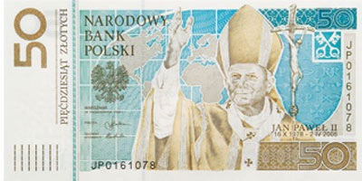
Italy
Poland
Russia
United kingdom

Slide 3
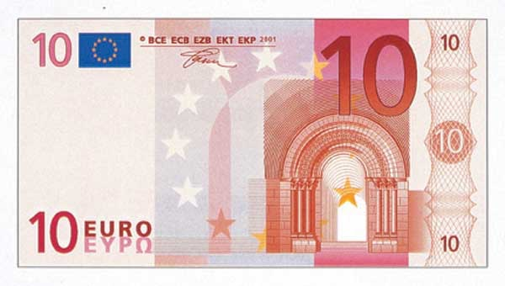
Some countries in Central America
Some countries in Asia
Some countries in Europe
Some countries in Africa

Slide 4
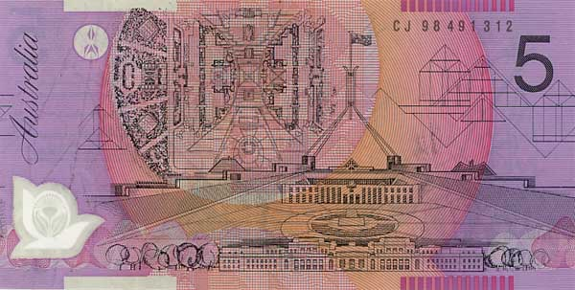
Australia
Canada
Brazil
Mexico

Slide 5
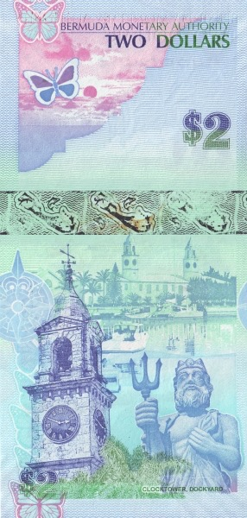
peru
Argentina
Iceland
Bermuda

Slide 6
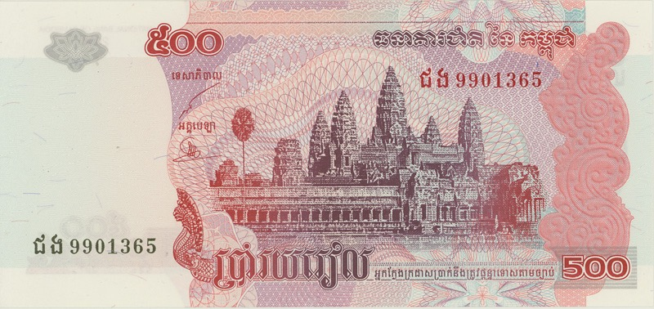
China
India
Cambodia
Saudi Arabia

Slide 7
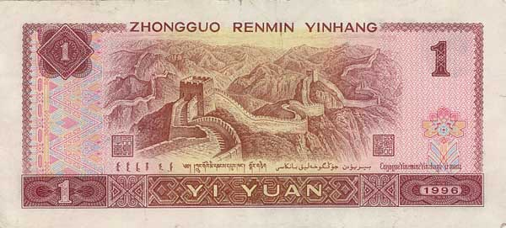
China
Taiwan
Thailand
Japan

Slide 8
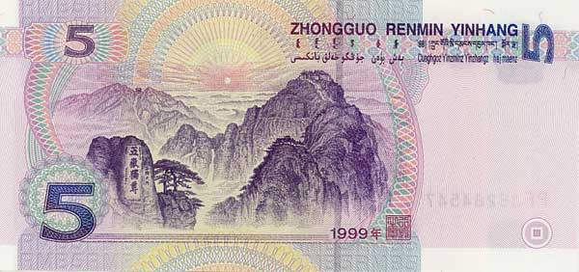
Nepal
Mongolia
India
China

Slide 9
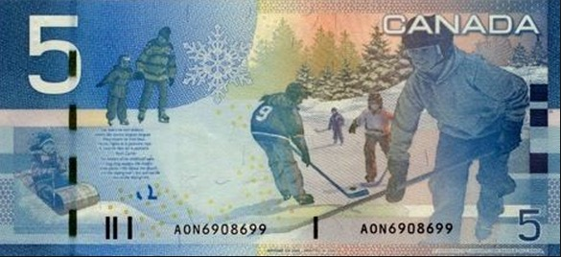
Canada
Germany
Norway
France

Slide 10
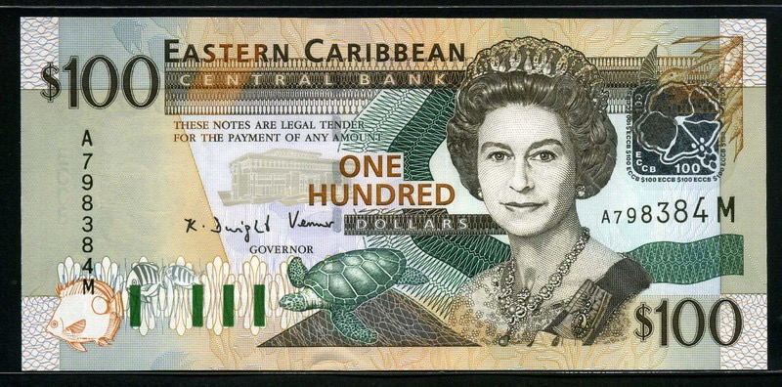
Northern Pacific island Nations
Australia
New Zealand
Eastern Caribbean

Slide 11
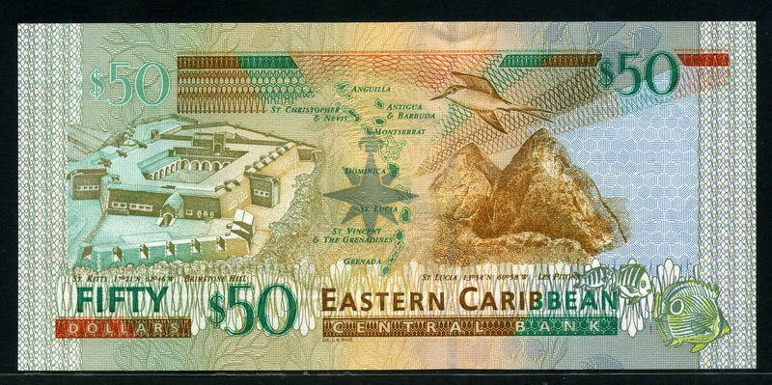
Eastern Caribbean
Belize
cuba
bahamas

Slide 12
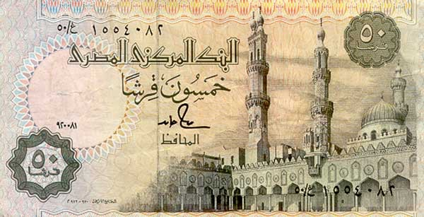
Israel
Egypt
Iran
Indonesia

Slide 13
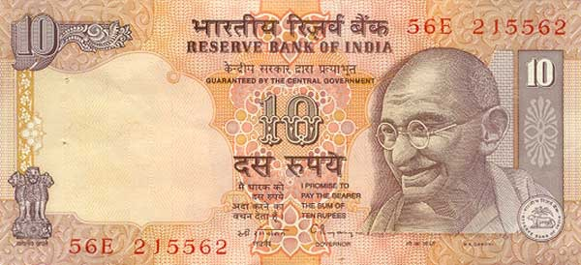
nepal
Sri Lanka
India
Thailand

Slide 14
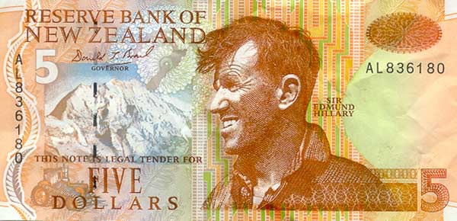
Bhutan
Australia
Nepal
New Zealand

Slide 15
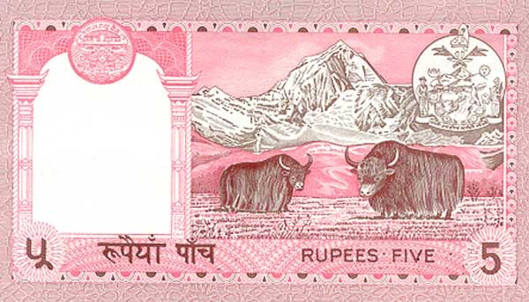
Nepal
India
Mongolia
Pakistan

Slide 16
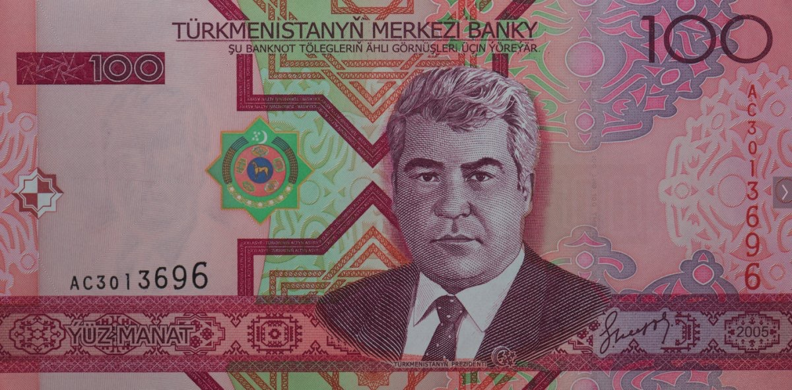
Ukraine
turkmenistan
Russia
China

Slide 17
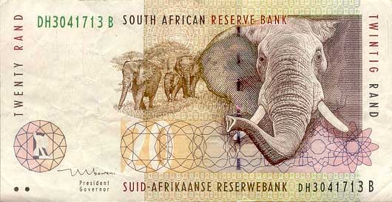
South Africa
India
Algeria
Nigeria

Slide 18
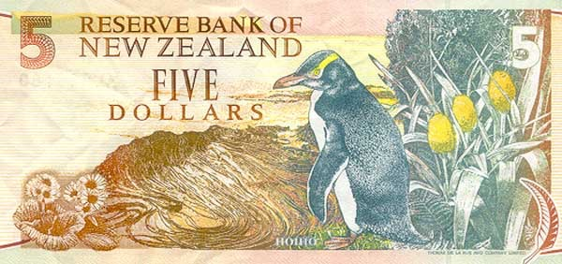
New Zealand
Argentina
Chile
South Africa

Slide 19
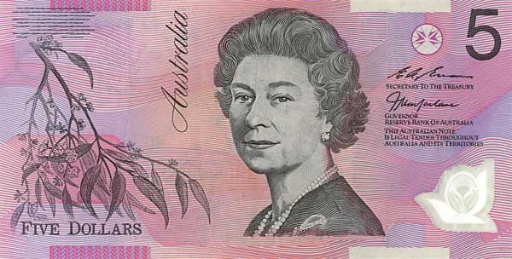
Australia
Canada
Indonesia
Falkland islands

Slide 20
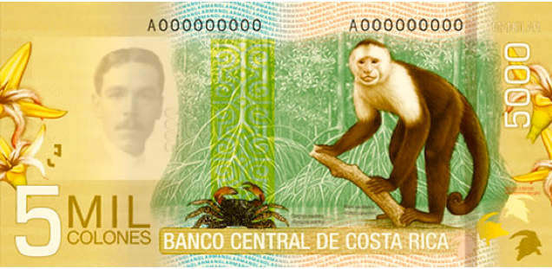
Mexico
Brazil
Costa Rica
Suriname

Slide 21
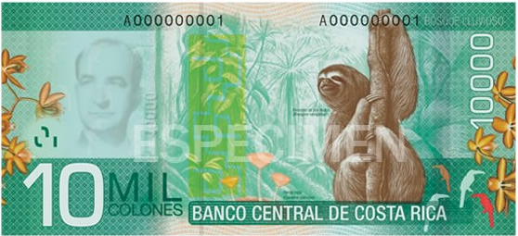
Peru
Ecuador
Costa Rica
Kenya

Slide 22
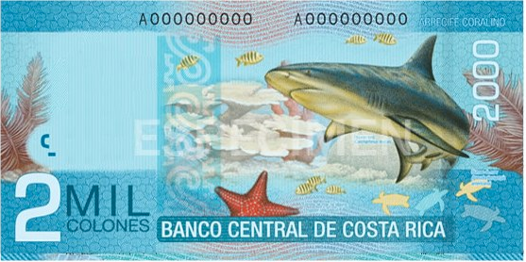
Costa Rica

Slide 23
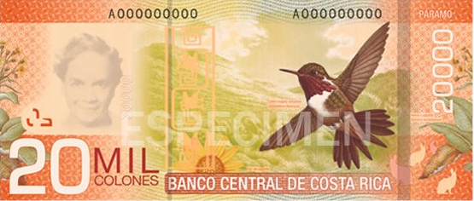
Costa Rica

Slide 24
Costa Rica

