Slide 1
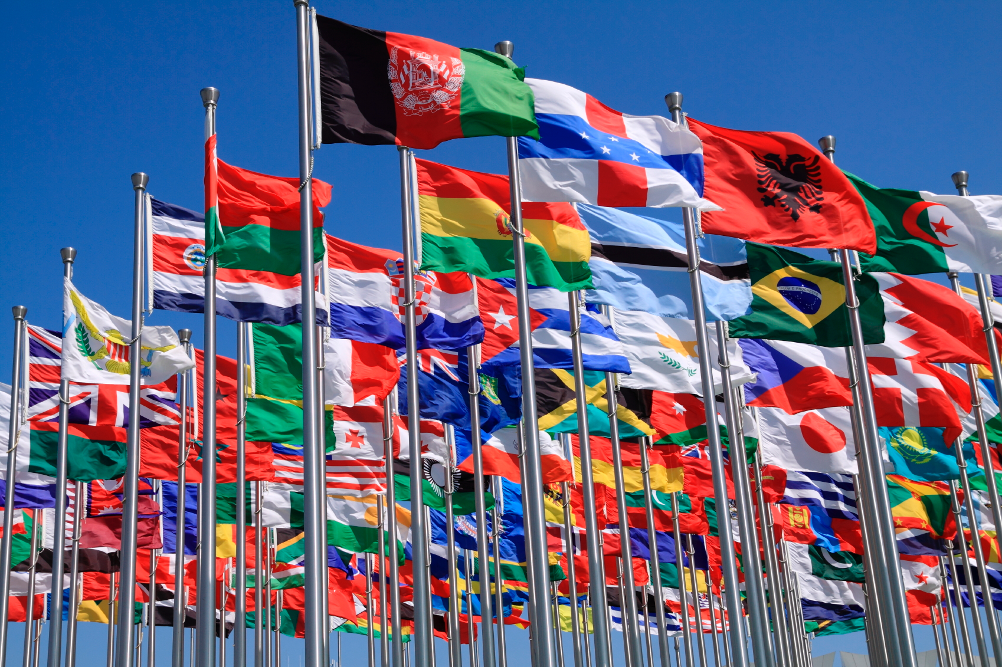
Name the world flag…
Bell Ringer Activity

Slide 2
Name the world flag…
Colombia | Argentina | Peru | Venezuela

Slide 3
Name the world flag…
Fiji | Indonesia | Guam | Australia

Slide 4
Name the world flag…
United Kingdom | England | Norway | Netherlands

Slide 5
Name the world flag…
Cuba | Brazil | Jamaica | Bahamas

Slide 6
Name the world flag…
Netherlands | France | Belgium | Germany

Slide 7
Name the world flag…
Vietnam | Cambodia | China | Thailand

Slide 8
Name the world flag…
Cuba | Jamaica | Puerto Rico | Antigua

Slide 9
Name the world flag…
Vietnam | China | Cambodia | Laos

Slide 10
Name the world flag…
Turkey | Lebanon | Cyprus | Crete

Slide 11
Name the world flag…
Denmark | Norway | Finland | Estonia

Slide 12
Name the world flag…
NATO | ASEAN | European Union | AU

Slide 13
Name the world flag…
Saudi Arabia | Egypt | U.A.E. | Qatar

Slide 14
Name the world flag…
Ireland | England | Wales | Scotland

Slide 15
Name the world flag…
Italy | Luxemburg | Ireland | Netherlands

Slide 16
Name the world flag…
France | Switzerland | Italy | Russia

Slide 17
Name the world flag…
New Zealand | Fiji | Australia | Tahiti

Slide 18
Name the world flag…
Austria | Poland | Germany | Czech Republic

Slide 19
Greenland | Faroe islands | Iceland | Denmark

Slide 20
Name the world flag…
Italy | Spain | Vatican City | Portugal

Slide 21
Name the world flag…
Macao | China | Singapore | Hong Kong

Slide 22
Name the world flag…
Pakistan | India | Bangladesh | Afghanistan

Slide 23
Name the world flag…
Indonesia | Malyasia | Myanmar | Thailand

Slide 24
Name the world flag…
Lebanon | Israel | Jordan | Palestine

Slide 25
Name the world flag…
Romania | Bulgaria | Italy | Serbia

Slide 26
Name the world flag…
Turkey | Libya | Algeria | Iraq

Slide 27
Name the world flag…
Japan | South Korea | North Korea | Guam

Slide 28
Name the world flag…
Cuba | Bahamas | Jamaica | Brazil

Slide 29
Name the world flag…
South Africa | Kenya | Rwanda | Tanzania

Slide 30
Name the world flag…
Macedonia | Montenegro | Kosovo | Croatia

Slide 31
Name the world flag…
Ukraine | Estonia | Kazakhstan | Belarus

Slide 32
Name the world flag…
Liberia | Senegal | Ghana | Togo

Slide 33
Name the world flag…
Peru | Panama | Costa Rica | Mexico

Slide 34
Name the world flag…
Marshall Islands | Guam | Fiji | Micronesia

Slide 35
Name the world flag…
Zimbabwe | Mozambique | Namibia | Angola

Slide 36
Name the world flag…
Ghana | Nigeria | Mali | Niger

Slide 37
Name the world flag…
South Korea | Vietnam | North Korea | Laos

Slide 38
Name the world flag…
Sweden | Finland | Estonia | Norway

Slide 39
Name the world flag…
OPEC | EU | AU | NATO

Slide 40
Name the world flag…
Afghanistan | Pakistan | Uzbekistan | Azerbaijan

Slide 41
Name the world flag…
Jordan | Iraq | Palestine | Iran

Slide 42
Name the world flag…
Belarus | Ukraine | France | Russia

Slide 43
Name the world flag…
Rwanda | Sudan | Tunisia | Madagascar

Slide 44
Name the world flag…
Greenland | Sami | Nunavut | Alaska

Slide 45
Name the world flag…
Botswana | Congo (DRC) | South Africa | Maldives

Slide 46
Name the world flag…
North Korea | Japan | Taiwan | South Korea

Slide 47
Name the world flag…
South Sudan | Somolia | Tanzania | Egypt

Slide 48
Name the world flag…
Qatar | Saudi Arabia | Oman | Yemen

Slide 49
Name the world flag…
Portugal | Monoco | Spain | italy

Slide 50
Name the world flag…
Denmark | Belgium | Switzerland | Norway

Slide 51
Name the world flag…
Indonesia | Malaysia | Maldives | Singapore

Slide 52
Name the world flag…
Syria | Iran | Afghanistan | Turkmenistan

Slide 53
Name the world flag…
Hong Kong | Taiwan | Macao | Laos

Slide 54
Name the world flag…
Greece | South Sudan | Tunisia | Ghana

Slide 55
Name the world flag…
Ukraine | Armenia | Cyprus | Turkey

Slide 56
Name the world flag…
Tibet | Nepal | Bhutan | Mongolia

Slide 57
Name the world flag…
Romania | Ukraine | Poland | Lithuania

Slide 58
Name the world flag…
Zimbabwe | Kenya | Uganda | Cameroon

Slide 59
Name the world flag…
China | Laos | Philippines | Vietnam

Slide 60
Name the world flag…
Venezuela | Peru | Chile | Suriname

Slide 61
Name the world flag…
Scotland | Wales | Northern Ireland | Faroe Islands

Slide 62
Name the world flag…
Slovenia | Russia | Serbia | France

Slide 63
Name the world flag…
South Africa | Botswana | Angola | Zimbabwe

