Slide 1
3
2
4
1

Slide 2
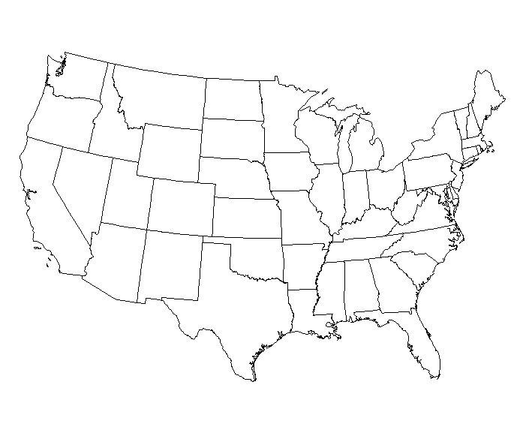
1
2
4
3

Slide 3
1
3
2
4

Slide 4
1
3
4
2

Slide 5
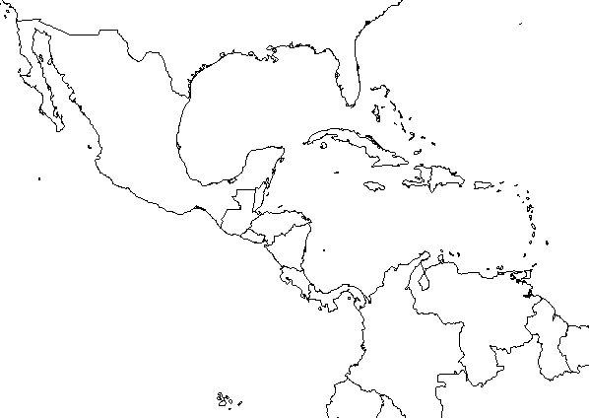
1
2
3
4

Slide 6
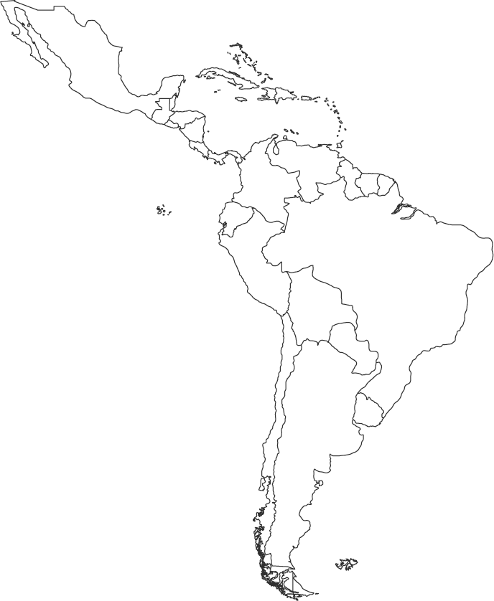
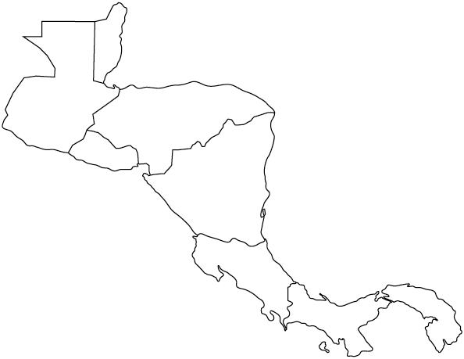
4
1
3
Central
America
2
South
America

Slide 7
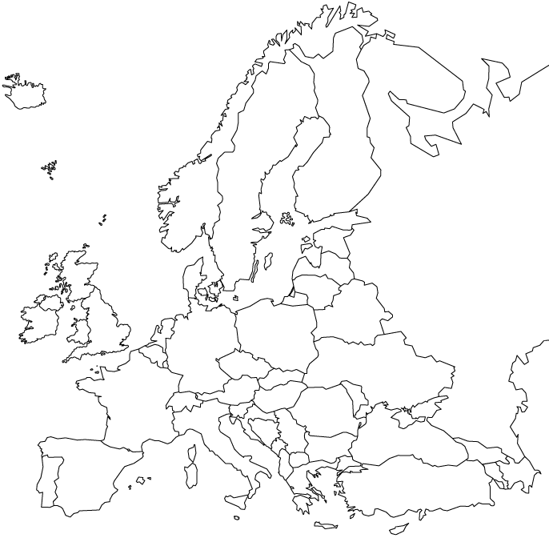
2
1
3
4

Slide 8
4
2
3
1

Slide 9
1
4
2
3

Slide 10
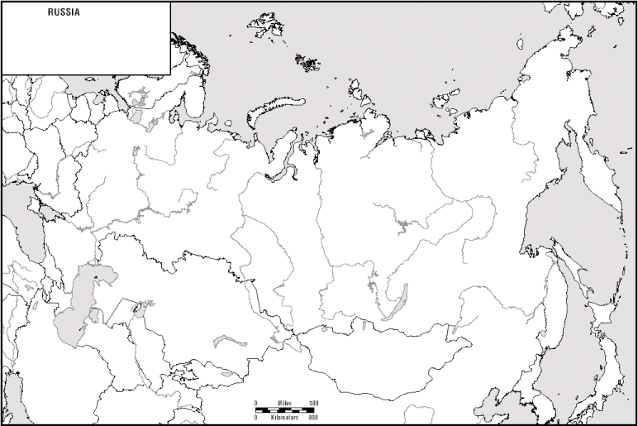
4
1
3
2

Slide 11
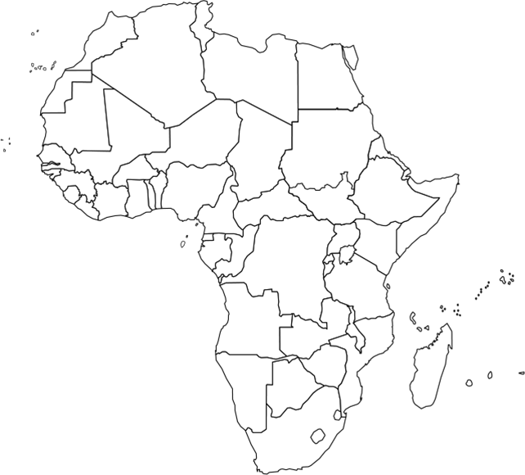
1
2
4
3

Slide 12
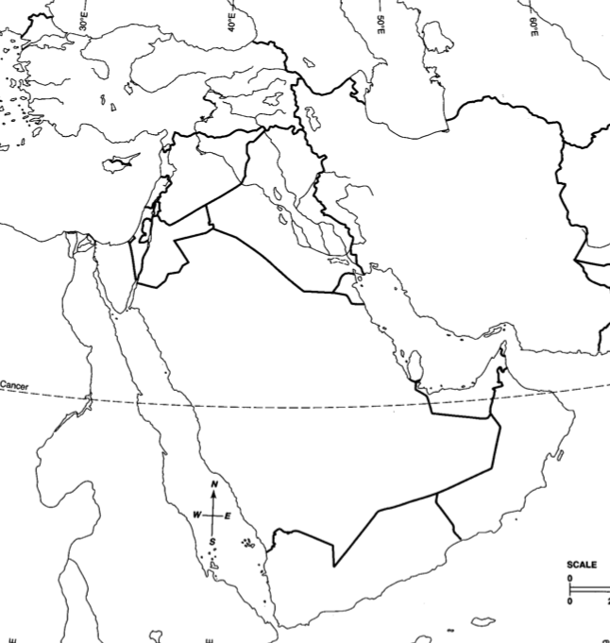
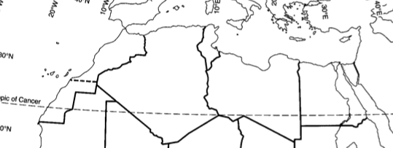
4
3
2
1

Slide 13
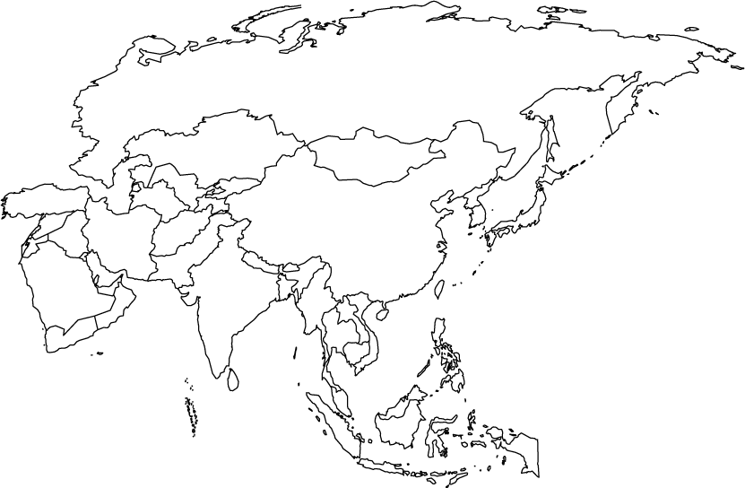
1
3
2
4

Slide 14
2
1
4
3

Slide 15
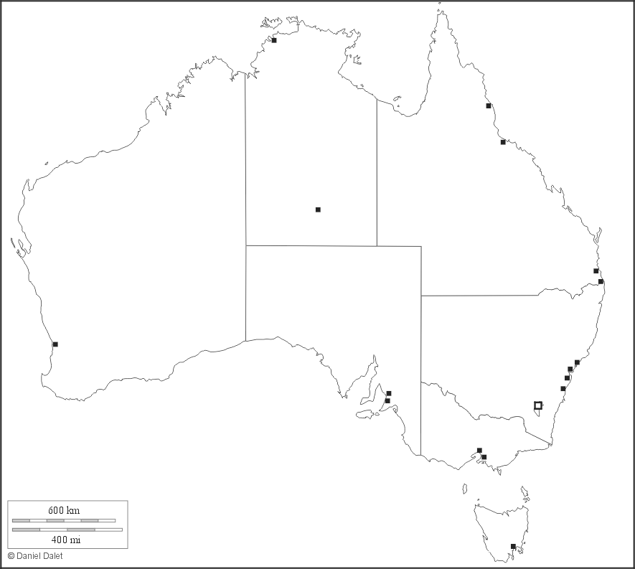
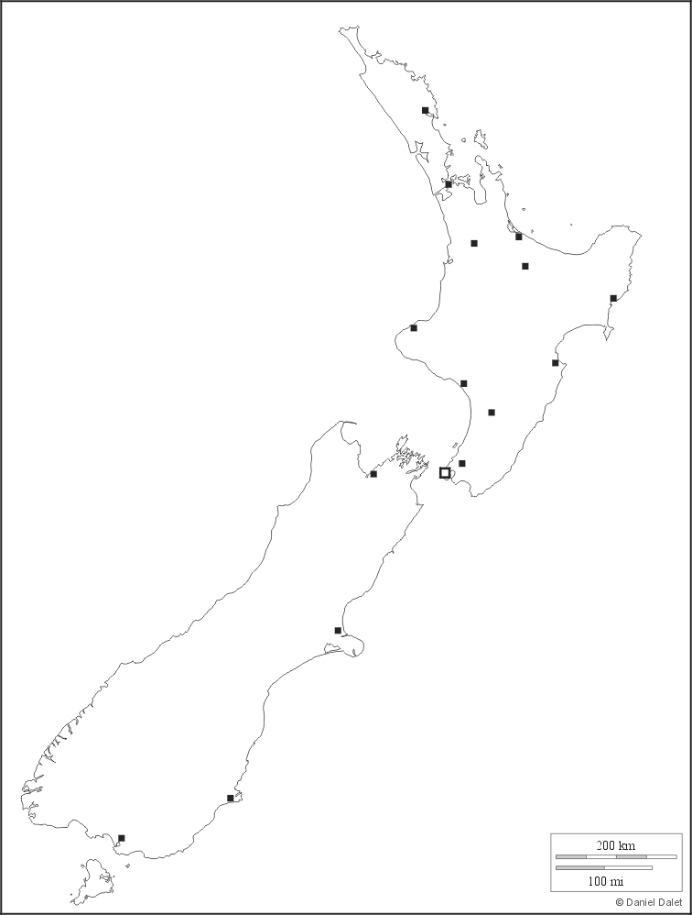
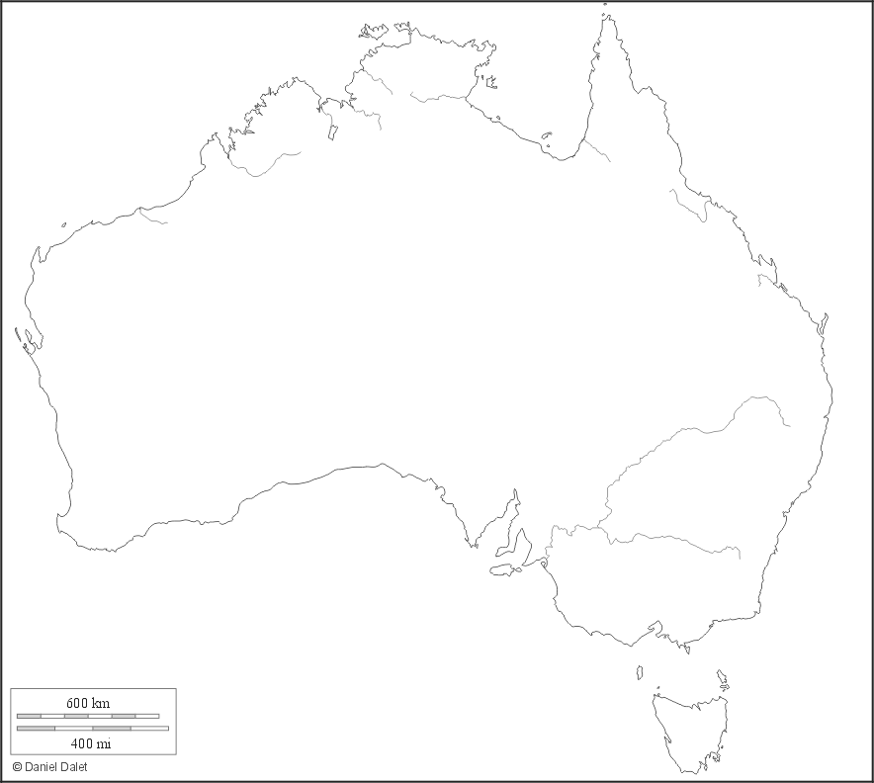
1
2
4
3

